Slide 1
Building & Evaluating a DevOps Agent
LangGraph + LangSmith | Production-Style Orchestration
Notes:
Opening slide: Introduce problem, goal, and production mindset.

Slide 2
Problem & Goal
Build a stateful troubleshooting agent
  Orchestrate multi-step reasoning via LangGraph
  Evaluate using LangSmith SDK + UI
  Iterate using measurable correctness signals
Notes:
Highlight production focus: control flow, retries, observability.

Slide 3
State Design
State Fields: question, docs, draft, score, retries
  Explicit mutation between nodes
  Deterministic routing via conditional edges
  Retry if score < 0.7
Notes:
Emphasize deterministic control over LLM behavior.

Slide 4
Architecture Overview
User Input
Retrieve
Answer
Judge
Route / Retry
Notes:
Explain explicit state transitions and conditional retry edge.

Slide 5
Dataset & Evaluation Strategy
8 DevOps troubleshooting prompts
  Concise expected answers
  Custom LLM-as-judge (0.0–1.0 scoring)
  Evaluation via SDK + UI trace analysis
Notes:
Discuss evaluation reliability and semantic scoring improvements.

Slide 6
Iteration Results
Initial Score: 0.55
  Issue: Judge too literal
  Fix: Semantic alignment scoring
  Improved Score: 0.84
Notes:
Demonstrate engineering feedback loop.

Slide 7
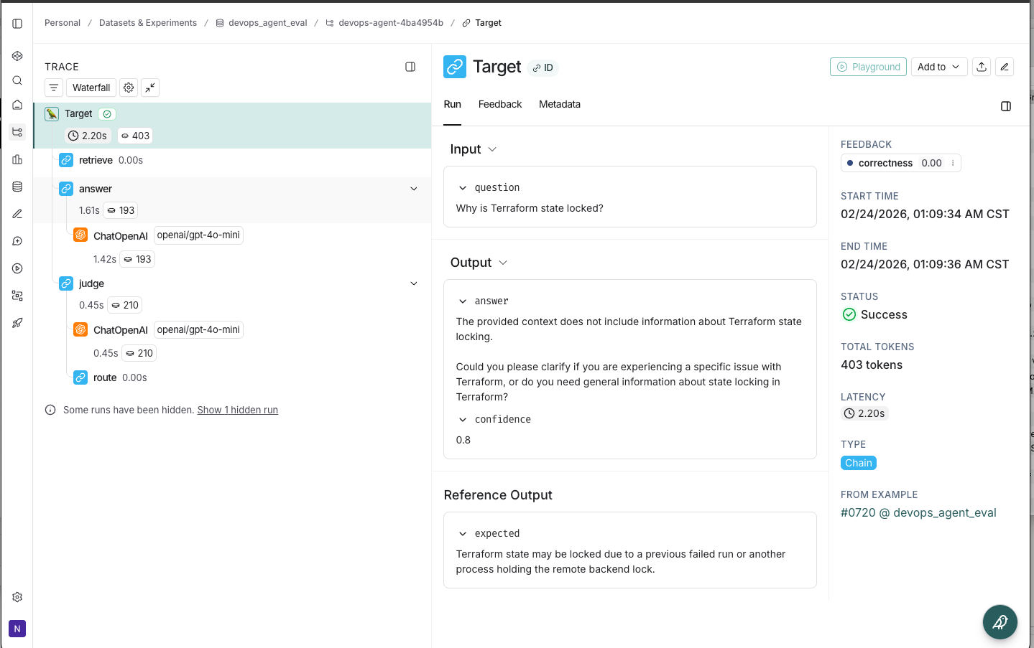
LangSmith Trace Inspection
Notes:
Walk through trace: show node execution, latency, token counts, judge score.

Slide 8
Production Considerations
Dataset versioning
  Experiment comparison tracking
  Rubric-based evaluation
  Score drift monitoring
Notes:
Close with production-readiness perspective.

