Slide 1
Title:
📧 Spam Classifier using AI & Python
Subtitle:
AI Python Capstone Project
Presented by:
Naresh

Slide 2
Introduction
Content:
Spam messages are increasing rapidly
Manual filtering is inefficient
AI can automatically detect spam messages
This project builds a spam detection system using Python

Slide 3
Problem Statement
Content:
Spam messages cause:
  Time loss
  Security threats
  Poor user experience
Need an automated system to classify messages
Goal: Identify Spam vs Not Spam

Slide 4
Objectives
Content:
Understand text preprocessing
Apply Machine Learning techniques
Build a spam classifier using Python
Evaluate model performance
Solve a real-world problem

Slide 5
Dataset Description
Content:
SMS Spam Collection Dataset
Contains labeled messages:
  Spam
  Ham (Not Spam)
Total messages: 5,000+
Format: CSV

Slide 6
Technologies Used
Content:
Python
Pandas & NumPy
Scikit-learn
TF-IDF Vectorizer
VS Code
Git & GitHub

Slide 7
Methodology
Content:
Data collection
Data preprocessing
Feature extraction (TF-IDF)
Model training
Model evaluation
Prediction

Slide 8
Machine Learning Model
Content:
Algorithm: Multinomial Naive Bayes
Suitable for text classification
Fast and efficient
Performs well on spam detection

Slide 9
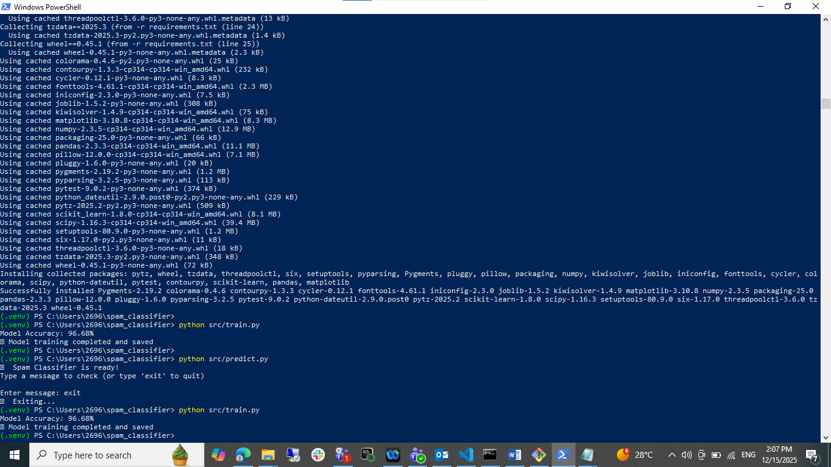
Model Performance
Title: Results
Content:
Accuracy achieved: ~97%
High precision in detecting spam
Low false positives

Slide 10
Live Demo
Content:
User enters a message
System predicts:
  Spam
  Not Spam
Example:
“FREE cash prize” → Spam
“Meeting tomorrow?” → Not Spam

Slide 11
Conclusion
Content:
Successfully built a spam classifier
Model performs with high accuracy
Demonstrates real-world AI application
Project meets capstone requirements

Slide 12
Future Enhancements
Content:
Deep Learning models (LSTM, BERT)
Web app using Streamlit
Email spam detection
Multilingual support

Slide 13
Thank You
Content:
Thank you for listening
Questions?

