Slide 1
BINDER

Slide 2
Agenda
  What is Binder?
  Why Binder?
  Types of Binder Available
  Binder Architecture
  Binder Packet Format
  Context/Service Manager Registration
  Service Registration with Service Manager
  Client using Service
  Binder logging and tracing

Slide 3
What is Binder?
An IPC system for developing object oriented OS services
Comes from OpenBinder
Ported to android
It can be used for making remote procedure calls across process boundaries
Focused on scalability & easy programming model
Consists of user space and kernel space component

Slide 4
Why Binder?
Android apps and system services run in separate processes for security, stability
and memory management reasons but they need to communicate and share data
Security: each process is sandboxed and run under a distinct system identity
Stability: if a process misbehaves (e.g. crashes), it does not affect any other processes
Memory management: processes are removed to free memory for new ones
Binder advantages
Its built-in reference-counting of "object" references plus death-notification mechanism make
it suitable for hostile environments (where lowmemorykiller roams)
Automatic management of thread-pools
Methods on remote objects can be invoked as if they were local - the thread appears to
jump to the other process
Ability to send file descriptors across process boundaries
Built-in support for marshalling/demarshalling
Simplified transaction invocation model via auto-generated proxies and stubs (Java-only)

Slide 5
Type of Binder Available
/dev/binder : IPC between framework / app processes (system.img) with AIDL interfaces
/dev/hwbinder : IPC between framework / vendor processes ( system.img & vendor.img) with HIDL interfaces
/dev/vndbinder : IPC between vendor / vendor processes (vendor.img) with AIDL Interfaces

Slide 6
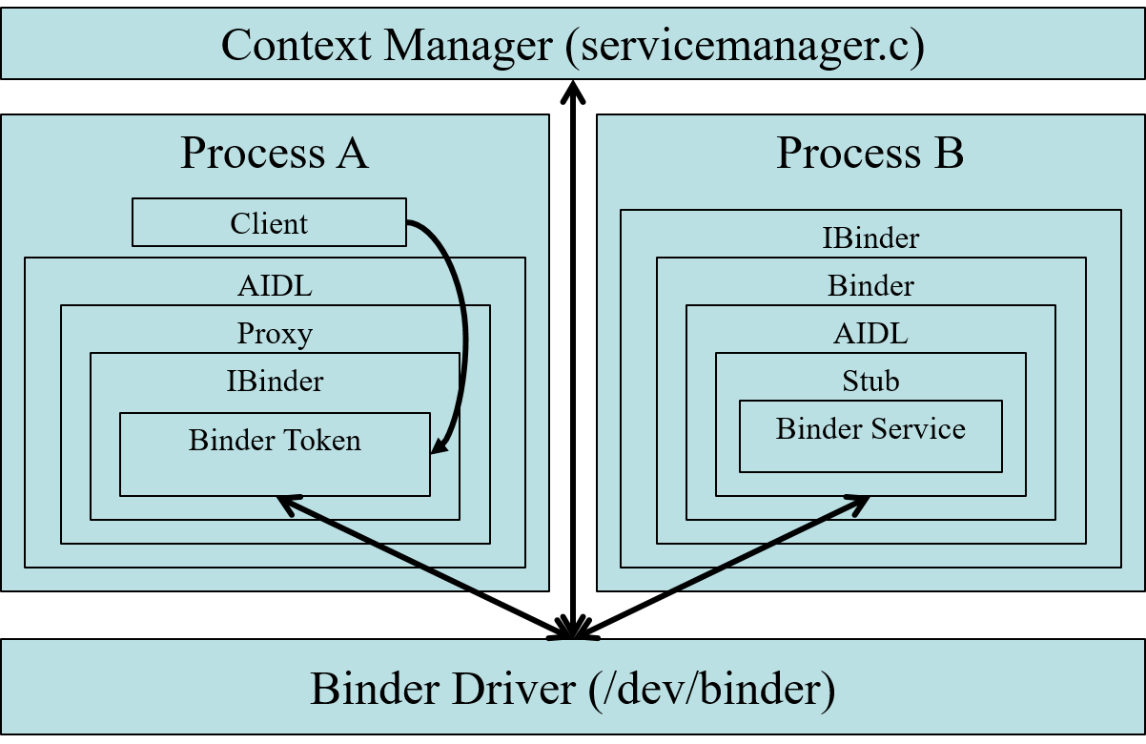
Binder Architecture

Slide 7
Binder Packet Format
BINDER_WRITE_READ
BINDER_SET_MAX_THREADS
BINDER_SET_CONTEXT_MGR
BINDER_THREAD_EXIT
BINDER_VERSION
Ioctl cmd
struct binder_write_read {
binder_size_t write_size; /* bytes to write */
binder_size_t write_consumed; /* bytes consumed by driver */
binder_uintptr_t write_buffer;
binder_size_t read_size; /* bytes to read */
binder_size_t read_consumed; /* bytes consumed by driver */
binder_uintptr_t read_buffer;
};
Binder Packet

Slide 8
Binder Packet Format Cntd.
BC_ACQUIRE
BC_RELEASE
BC_TRANSACTION
BC_REPLY
BC_ENTER_LOOPER
BC_EXIT_LOOPER
cmd
Write Buffer
handle
Associated Txn data
struct binder_transaction_data

Slide 9
Process 1
Process 2
userspace
Copy from user buffer of
process 1 into target_proc
ie. Process 2 buffer
Copy to user pointer
user_va_p2
kernel
user_va_p2 = kernel_va_p2 +
user_va_offset_p2
Copy from user buffer of
Process 2 into target_proc
ie. Process 1 buffer
Mmap buffer for Process 1
Mmap buffer for Process 2

Slide 10
Context/Service Manager Registration
A special Binder Object with a known handle (registered as handle 0) that is used as a registry/lookup service for other Binder Objects (name → handle mapping)
Service Manager
Binder Driver
Open /dev/binder
Mmap on fd
BINDER_SET_CONTEXT_MGR
BC_ENTER_LOOPER
BINDER_WRITE_READ

Slide 11
Service Registration with Service Manager
Service
Binder Driver
Service Manager
BC_TRANSACTION for pinging service manager
BR_TRANSACTION for pinging service manager
BC_REPLY
BR_REPLY
BC_INCREF for service manager
BC_TRANSACTION with add service command
BR_TRANSACTION with add service command
Add service into
service manager
database
BC_INCREF for newly added service
BC_REQUEST_DEATH_NOTIFICATION for newly added service
BR_REPLY
BC_REPLY
BC_ ENTERLOOPER for service thread
BC_TRANSACTION blocking service thread for reading

Slide 12
Client using Service
Client/UI
Binder Driver
Service Mgr
BC_TRANSACTION for pinging service manager
BR_TRANSACTION for pinging service manager
BC_REPLY
BR_REPLY
BC_INCREF for service manager
BC_TRANSACTION with get service command
BR_TRANSACTION with get service command
BC_REPLY including handle for service
BR_REPLY including handle for service
Service
BC_TRANSACTION for using operations exposed
BR_TRANSACTION for using operations exposed
BC_REPLY
BR_REPLY

Slide 13
Logging & Tracing
Debugfs Entries
/sys/kernel/debug/binder/state
/sys/kernel/debug/binder/stats
/sys/kernel/debug/binder/transactions
/sys/kernel/debug/binder/transaction_log
/sys/kernel/debug/binder/failed_transaction_log
Ftrace
/sys/kernel/debug/tracing/events/binder/enable
Changing log level
/sys/module/binder/parameters/debug_mask

