Slide 1
ION
Usage & Debug

Slide 2
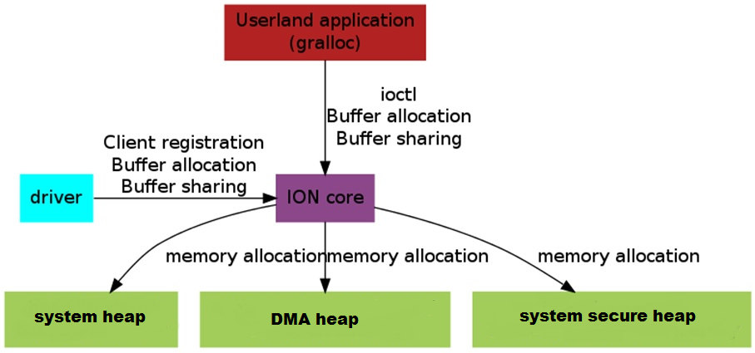

Slide 3
ION Heap Types

Slide 4
ION_HEAP_TYPE_SYSTEM
Allocate from kernel buddy layer via alloc_pages
The pages that are allocated can be scattered and not physically contiguous
IOMMU clients are most frequent users of such heap
ION_HEAP_TYPE_SYSTEM_CONTIG
Support for this heap is deprecated
ION_HEAP_TYPE_CARVEOUT
Allocated from a pre-reserved carveout region and is physically contiguous
ION_HEAP_TYPE_DMA
Allocated using DMA APIs
It can provide large physical contiguous buffers (CMA supported systems)
ION_HEAP_TYPE_SECURE_DMA
Allocate secure buffers on a target supporting slave side (xpu/mpu base) protection
The buffers are expected to be physically contiguous and 2MB aligned
ION_HEAP_TYPE_SYSTEM_SECURE
Secure buffer use cases for system supporting hypervisor.
Buffers need not be physically contiguous.
ION_HEAP_TYPE_HYP_CMA
Use cases on hypervisor based system may still need physically contiguous buffers protected through hypervisor.

Slide 5
ION Heap Configuration

Slide 6
arch/arm64/boot/dts/qcom/sdm845-ion.dtsi qcom,ion { compatible = "qcom,msm-ion"; #address-cells = <1>; #size-cells = <0>; system_heap: qcom,ion-heap@25 { reg = <25>; qcom,ion-heap-type = "SYSTEM"; }; qcom,ion-heap@22 { /* ADSP HEAP */ reg = <22>; memory-region = <&adsp_mem>; qcom,ion-heap-type = "DMA"; }; qcom,ion-heap@27 { /* QSEECOM HEAP */ reg = <27>; memory-region = <&qseecom_mem>; qcom,ion-heap-type = "DMA"; }; qcom,ion-heap@13 { /* SPSS HEAP */ reg = <13>; memory-region = <&sp_mem>; qcom,ion-heap-type = "DMA"; }; qcom,ion-heap@10 { /* SECURE DISPLAY HEAP */ reg = <10>; memory-region = <&secure_display_memory>; qcom,ion-heap-type = "HYP_CMA"; }; qcom,ion-heap@9 { reg = <9>; qcom,ion-heap-type = "SYSTEM_SECURE"; }; };

Slide 7
arch/arm64/boot/dts/qcom/sdm845.dtsi reserved-memory { #address-cells = <2>; #size-cells = <2>; ranges; adsp_mem: adsp_region { compatible = "shared-dma-pool"; alloc-ranges = <0 0x00000000 0 0xffffffff>; reusable; alignment = <0 0x400000>; size = <0 0xc00000>; }; qseecom_mem: qseecom_region { compatible = "shared-dma-pool"; alloc-ranges = <0 0x00000000 0 0xffffffff>; reusable; alignment = <0 0x400000>; size = <0 0x1400000>; }; sp_mem: sp_region { /* SPSS-HLOS ION shared mem */ compatible = "shared-dma-pool"; alloc-ranges = <0 0x00000000 0 0xffffffff>; /* 32-bit */ reusable; alignment = <0 0x400000>; size = <0 0x800000>; }; secure_display_memory: secure_display_region { compatible = "shared-dma-pool"; alloc-ranges = <0 0x00000000 0 0xffffffff>; reusable; alignment = <0 0x400000>; size = <0 0x5c00000>; }; };

Slide 8
ION User APIs

Slide 9
open and close

Slide 10
int ion_open()
{
int fd = open("/dev/ion", O_RDONLY | O_CLOEXEC);
if (fd < 0)
ALOGE("open /dev/ion failed!\n");
return fd;
}
int ion_close(int fd)
{
int ret = close(fd);
if (ret < 0)
return -errno;
return ret;
}

Slide 11
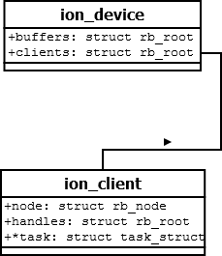

Slide 12
alloc and free

Slide 13
int ion_alloc(int fd, size_t len, size_t align, unsigned int heap_mask, unsigned int flags, ion_user_handle_t *handle) { int ret; struct ion_allocation_data data = { .len = len, .align = align, .heap_id_mask = heap_mask, .flags = flags, };
if (handle == NULL) return -EINVAL;
ret = ion_ioctl(fd, ION_IOC_ALLOC, &data); if (ret < 0) return ret;
*handle = data.handle; return ret;
}
int ion_free(int fd, ion_user_handle_t handle) { struct ion_handle_data data = { .handle = handle, }; return ion_ioctl(fd, ION_IOC_FREE, &data); }

Slide 14
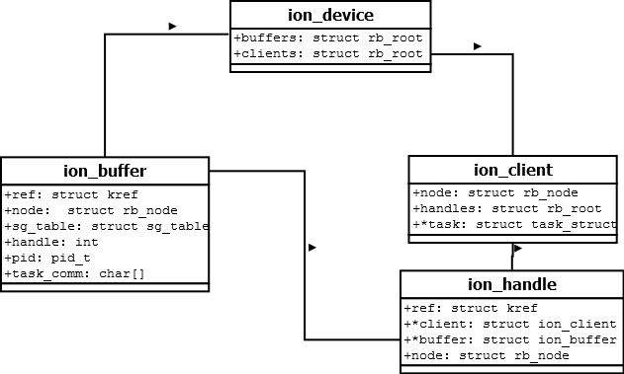

Slide 15
map and use ion buffer

Slide 16
int ion_map(int fd, ion_user_handle_t handle, size_t length, int prot, int flags, off_t offset, unsigned char **ptr, int *map_fd)
{
int ret;
unsigned char *tmp_ptr;
struct ion_fd_data data = {
.handle = handle,
};
ret = ion_ioctl(fd, ION_IOC_MAP, &data);
if (ret < 0)
return ret;
tmp_ptr = mmap(NULL, length, prot, flags, data.fd, offset);
if (tmp_ptr == MAP_FAILED)
return -errno;
*map_fd = data.fd;
*ptr = tmp_ptr;
return ret;
}

Slide 17
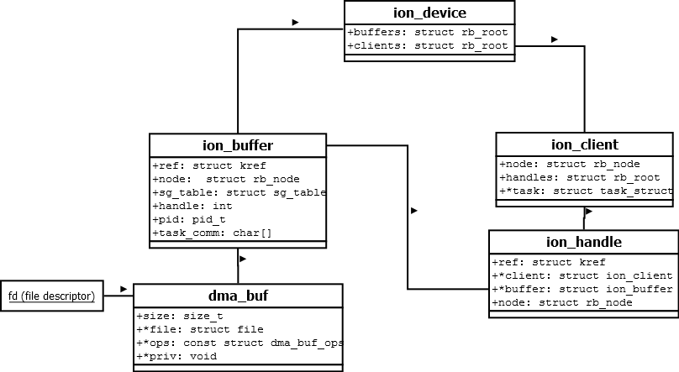
mmap

Slide 18
share ion buffer

Slide 19
int ion_share(int fd, ion_user_handle_t handle, int *share_fd)
{
int ret; struct ion_fd_data data = {
.handle = handle,
};
if (share_fd == NULL)
return -EINVAL;
ret = ion_ioctl(fd, ION_IOC_SHARE, &data);
if (ret < 0)
return ret;
if (data.fd < 0)
return -EINVAL;
*share_fd = data.fd;
return ret;
}

Slide 21
alloc, share and free Is this a valid use case ?

Slide 22
int ion_alloc_fd(int fd, size_t len, size_t align, unsigned int heap_mask, unsigned int flags, int *handle_fd)
{
ion_user_handle_t handle;
int ret;
ret = ion_alloc(fd, len, align, heap_mask,
flags, &handle);
if (ret < 0)
return ret;
ret = ion_share(fd, handle, handle_fd);
ion_free(fd, handle);
return ret;
}
Results in Orphan Buffer

Slide 23
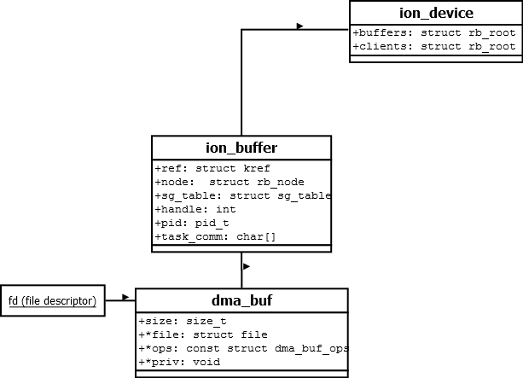
Orphan Buffer

Slide 24
Orphan Ion Buffers
ION Buffers with no handle associated are orphan buffer
Orphan ion buffers may not be necessarily leaks
ion_buffer->pid is updated to context it is being removed from
They could be imported and used by ion clients
As soon as an ion handle is associated with an ion buffer, it is no more orphan buffer
Persistent, growing orphan ion buffers however indicate leak

Slide 25
import ion buffer

Slide 26
int ion_import(int fd, int share_fd, ion_user_handle_t *handle)
{
int ret;
struct ion_fd_data data = {
.fd = share_fd,
};
if (handle == NULL)
return -EINVAL;
ret = ion_ioctl(fd, ION_IOC_IMPORT, &data);
if (ret < 0)
return ret;
*handle = data.handle;
return ret;
}

Slide 27
int ion_import_and_map(int fd, int shared_fd)
{
int ret;
unsigned char *ptr;
struct ion_fd_data data = {
.fd = share_fd,
};
ret = ion_ioctl(fd, ION_IOC_IMPORT, &data);
if (ret < 0)
return ret;
ptr = mmap(NULL, length, prot, flags, data.fd, offset);
if (ptr == MAP_FAILED)
return -errno;
/* use ptr */
close(data.fd);
ion_ioctl(fd, ION_IOC_FREE, data.handle);
return 0
}

Slide 28
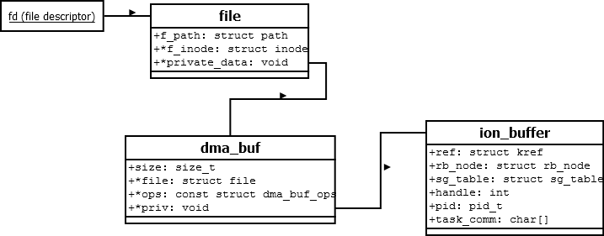

Slide 29
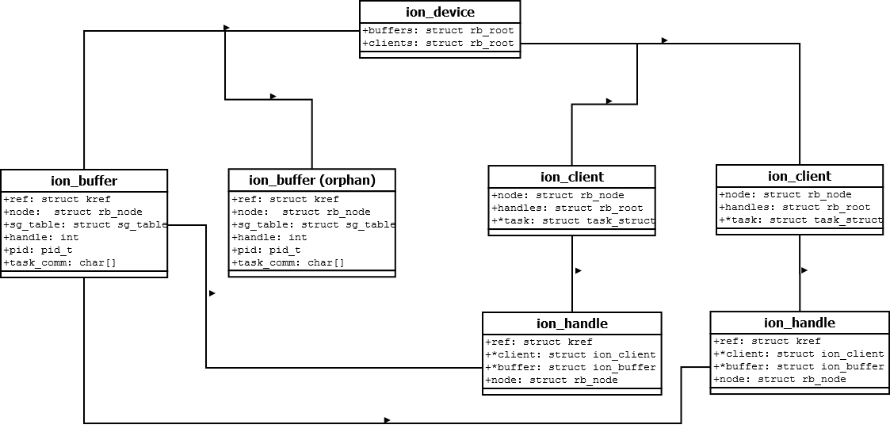

Slide 30
ion debug

Slide 31
Live Target
# cat /sys/kernel/debug/ion/clients/qseecom-kernel-0
heap_name: size_in_bytes : handle refcount : buffer
qsecom: b000 : 1 : ffffffc05f5bce00
qsecom: b000 : 1 : ffffffc0620fee00
qsecom: 32000 : 1 : ffffffc063727200
qsecom: 2000 : 1 : ffffffc06deaea00
qsecom: 1000 : 1 : ffffffc06e5b1c00
qsecom: 5000 : 1 : ffffffc06e624d00
qsecom: 5000 : 1 : ffffffc070108700
qsecom: 5000 : 1 : ffffffc070108f00
qsecom: 7000 : 1 : ffffffc07010ac00
qsecom: 1000 : 1 : ffffffc07010ce00
qsecom: 7e000 : 1 : ffffffc070751100
qsecom: 5000 : 1 : ffffffc070f11500
# cat /sys/kernel/debug/ion/clients/673-0
heap_name: size_in_bytes : handle refcount : buffer
system: 1000 : 1 : ffffffc05b0f8600
system: 1000 : 1 : ffffffc05b0f8900
system: 1000 : 1 : ffffffc05b0f8d00
system: 1000 : 1 : ffffffc05b0f9300
system: 1000 : 1 : ffffffc05b0fe400
system: 1000 : 1 : ffffffc05b0fe800
system: 1000 : 1 : ffffffc05b0feb00
system: 1000 : 1 : ffffffc05b0fee00
system: 2000 : 1 : ffffffc05b0fef00
system: 1000 : 1 : ffffffc05b0ff100
system: f000 : 1 : ffffffc05f4ae000
system: 3c000 : 1 : ffffffc05f4af400
system: f000 : 1 : ffffffc05f4af700
system: 1000 : 1 : ffffffc05f76c100
system: 1000 : 1 : ffffffc05f76c800
system: 1000 : 1 : ffffffc05f7bf500
system: 1000 : 1 : ffffffc062309300
system: 4000 : 1 : ffffffc063440800
system: 1000 : 1 : ffffffc063761000

Slide 32
Live Target
# cat /sys/kernel/debugfs/heaps/system
client pid size
----------------------------------------------------
hbtp_daemon 2151 5242880
audioserver 673 4096
audioserver 673 4096
audioserver 673 4096
audioserver 673 4096
audioserver 673 4096
audioserver 673 16384
. . .
audioserver 673 4096
DTS_EAGLE 80 131072
voip_client 80 8192
voip_client 80 4096
voc_cal 80 4096
adsprpc-smd 1 5242880
----------------------------------------------------
orphaned allocations (info is from last known client):
surfaceflinger 500 4096 0 1
surfaceflinger 500 8417280 0 1
surfaceflinger 500 8417280 0 1
surfaceflinger 500 4096 0 1
surfaceflinger 500 4096 0 1
surfaceflinger 500 8355840 0 1
----------------------------------------------------
total orphaned 107061248
total 112922624
deferred free 0
----------------------------------------------------
--------------------------------------------
uncached pool = 3141632 cached pool = 25243648 secure pool = 0
pool total (uncached + cached + secure) = 28385280
--------------------------------------------

Slide 33
Live Target
# cat /sys/kernel/debugfs/heaps/qsecom
client pid size
----------------------------------------------------
keystore 678 45056
gatekeeperd 699 45056
mdtpd 698 204800
qseecomd 535 8192
qseecomd 535 4096
qseecomd 535 20480
qseecomd 535 20480
qseecomd 535 28672
qseecomd 535 4096
qseecomd 535 20480
qseecomd 535 516096
qseecomd 535 20480
qsee_log 1 32768
qseecom-kernel 1 937984
----------------------------------------------------
orphaned allocations (info is from last known client):
----------------------------------------------------
total orphaned 0
total 970752
----------------------------------------------------
Memory Map
client start address end address size
qsee_log 0x0x00000000f8000000 0x0x00000000f8007fff 32768 (0x8000)
qseecom-kernel 0x0x00000000f8008000 0x0x00000000f800efff 28672 (0x7000)
535 0x0x00000000f8008000 0x0x00000000f800efff 28672 (0x7000)
qseecom-kernel 0x0x00000000f800f000 0x0x00000000f800ffff 4096 (0x1000)
535 0x0x00000000f800f000 0x0x00000000f800ffff 4096 (0x1000)
qseecom-kernel 0x0x00000000f8010000 0x0x00000000f8014fff 20480 (0x5000)
535 0x0x00000000f8010000 0x0x00000000f8014fff 20480 (0x5000)
qseecom-kernel 0x0x00000000f8015000 0x0x00000000f8015fff 4096 (0x1000)
535 0x0x00000000f8015000 0x0x00000000f8015fff 4096 (0x1000)
qseecom-kernel 0x0x00000000f8016000 0x0x00000000f8017fff 8192 (0x2000)
535 0x0x00000000f8016000 0x0x00000000f8017fff 8192 (0x2000)

Slide 34
Live Target
msm8937_64:/d/ion # ls -l /proc/673/fdinfo
ls -l /proc/673/fd
total 0
lrwx------ 1 audioserver audio 64 1970-01-01 00:26 0 -> /dev/null
lrwx------ 1 audioserver audio 64 1970-01-01 00:26 1 -> /dev/null
lrwx------ 1 audioserver audio 64 1970-01-01 00:17 10 -> /dev/msm_audio_cal
lrwx------ 1 audioserver audio 64 1970-01-01 00:17 11 -> /dev/msm_rtac
lr-x------ 1 audioserver audio 64 1970-01-01 00:17 12 -> /system/etc/aanc_tuning_mixer.txt
lr-x------ 1 audioserver audio 64 1970-01-01 00:17 13 -> /dev/ion
lrwx------ 1 audioserver audio 64 1970-01-01 00:17 14 -> anon_inode:dmabuf
lrwx------ 1 audioserver audio 64 1970-01-01 00:17 15 -> anon_inode:dmabuf
lrwx------ 1 audioserver audio 64 1970-01-01 00:17 16 -> anon_inode:dmabuf
lrwx------ 1 audioserver audio 64 1970-01-01 00:17 17 -> anon_inode:dmabuf
lrwx------ 1 audioserver audio 64 1970-01-01 00:17 18 -> anon_inode:dmabuf
lrwx------ 1 audioserver audio 64 1970-01-01 00:17 19 -> anon_inode:dmabuf
lrwx------ 1 audioserver audio 64 1970-01-01 00:26 2 -> /dev/null
lrwx------ 1 audioserver audio 64 1970-01-01 00:17 20 -> anon_inode:dmabuf
lrwx------ 1 audioserver audio 64 1970-01-01 00:17 21 -> anon_inode:dmabuf
lrwx------ 1 audioserver audio 64 1970-01-01 00:17 22 -> anon_inode:dmabuf
lrwx------ 1 audioserver audio 64 1970-01-01 00:17 23 -> anon_inode:dmabuf
lrwx------ 1 audioserver audio 64 1970-01-01 00:17 4 -> /dev/binder
l-wx------ 1 audioserver audio 64 1970-01-01 00:17 40 -> /sys/kernel/debug/tracing/trace_marker
lrwx------ 1 audioserver audio 64 1970-01-01 00:17 41 -> /dev/ashmem
lrwx------ 1 audioserver audio 64 1970-01-01 00:17 42 -> /dev/snd/controlC0
lrwx------ 1 audioserver audio 64 1970-01-01 00:17 43 -> /dev/snd/controlC0
l-wx------ 1 audioserver audio 64 1970-01-01 00:17 44 -> /dev/snd/hwC0D1000
lrwx------ 1 audioserver audio 64 1970-01-01 00:17 45 -> /dev/ashmem
lrwx------ 1 audioserver audio 64 1970-01-01 00:17 46 -> /dev/ashmem
lrwx------ 1 audioserver audio 64 1970-01-01 00:17 47 -> /dev/ashmem
lrwx------ 1 audioserver audio 64 1970-01-01 00:17 5 -> /dev/snd/controlC0
l-wx------ 1 audioserver audio 64 1970-01-01 00:17 6 -> /dev/cpuctl/tasks
l-wx------ 1 audioserver audio 64 1970-01-01 00:17 7 -> /dev/cpuctl/bg_non_interactive/tasks
lrwx------ 1 audioserver audio 64 1970-01-01 00:17 8 -> /dev/snd/controlC0
lrwx------ 1 audioserver audio 64 1970-01-01 00:17 9 -> /dev/diag

Slide 35
Clara (go/clara): Memory -> ION
Number of heaps:5 parsing 1 of 5 heap Heap: 0xffffffe9aa270c00
*********************************************
Heap ID : 25 Heap Type: 0 Heap Name : system
Total allocated : 2015372 KB
Total Handles : 2015368 KB
Orphan : 4 KB
*********************************************
CLIENT: (struct ion_client *)0xffffffe8492ad900 , task : ndroid.systemui / ion_client : 10429-1 / PID: 10429 / Size : 18648 KB ion_buffer: 0xffffffe8ded6f300 size: 836 KB Handle Count: 3
ion_buffer: 0xffffffe8ded6f600 size: 4 KB Handle Count: 3 ion_buffer: 0xffffffe8f2246200 size: 464 KB Handle Count: 3
ion_buffer: 0xffffffe8f2247500 size: 4 KB Handle Count: 3 ion_buffer: 0xffffffe910b77b00 size: 4 KB Handle Count: 3
ion_buffer: 0xffffffe910b77c00 size: 14720 KB Handle Count: 3
. . .
CLIENT: (struct ion_client *)0xffffffe9a817bf00 , ion_client : adsprpc-smd-0 / PID: 1 / Size : 13312 KB
ion_buffer: 0xffffffe8e8db3500 size: 3072 KB Handle Count: 2
ion_buffer: 0xffffffe940951900 size: 1024 KB Handle Count: 2
ion_buffer: 0xffffffe940951e00 size: 2048 KB Handle Count: 2
ion_buffer: 0xffffffe95483a600 size: 1024 KB Handle Count: 2
Total number of clients: 38
----------------------------------
orphaned allocations (info is from last known client):
buffer: 0xffffffe93918f400, Buffer size: 4 KB comm: rot_fenceq_0_0 PID: 9179 kmap count: 0 ref_count : 1
----------------------------------
total orphan size: 4 KB
total buffer size: 2015372 KB
----------------------------------

Slide 36
Clara (go/clara): Files -> Open File List
TASK : 0xFFFFFFE9A4D10E80 PID : 679 TASK_NAME : provider@2.4-se
[0] file : 0xFFFFFFE9A693BB80 \\vmlinux\mem\null_fops null
[1] file : 0xFFFFFFE9A693BB80 \\vmlinux\mem\null_fops null
[2] file : 0xFFFFFFE9A693BB80 \\vmlinux\mem\null_fops null
**[MSM_IPC] (struct sock)0xFFFFFFE9A3CABA80
[48] file : 0xFFFFFFE8A9870780 \\vmlinux\ion\ion_fops ion client : 0xFFFFFFE98E1D9200
[73] file : 0xFFFFFFE92F0DE3C0 \\vmlinux\ion\ion_fops ion client : 0xFFFFFFE95D11E300
[74] file : 0xFFFFFFE92F0DF7C0 \\vmlinux\adsprpc\fops adsprpc-smd
[75] file : 0xFFFFFFE875A21A40 \\vmlinux\eventfd\eventfd_fops [eventfd]
[76] file : 0xFFFFFFE875A212C0 \\vmlinux\inotify_user\inotify_fops inotify
[77] file : 0xFFFFFFE875A21E00 \\vmlinux\dma-buf\dma_buf_fops dmabuf
[78] file : 0xFFFFFFE875A20140 \\vmlinux\eventfd\eventfd_fops [eventfd]
[79] file : 0xFFFFFFE8CA1457C0 \\vmlinux\dma-buf\dma_buf_fops dmabuf
[81] file : 0xFFFFFFE976B10B40 \\vmlinux\dma-buf\dma_buf_fops dmabuf
[86] file : 0xFFFFFFE96178C640 \\vmlinux\ion\ion_fops ion client : 0xFFFFFFE961316100
[110] file : 0xFFFFFFE8A7441B80 \\vmlinux\dma-buf\dma_buf_fops dmabuf
[111] file : 0xFFFFFFE8C0331540 \\vmlinux\dma-buf\dma_buf_fops dmabuf
[112] file : 0xFFFFFFE934890500 \\vmlinux\dma-buf\dma_buf_fops dmabuf
[113] file : 0xFFFFFFE8E92F6C80 \\vmlinux\dma-buf\dma_buf_fops dmabuf
[118] file : 0xFFFFFFE8804F0780 \\vmlinux\dma-buf\dma_buf_fops dmabuf
[119] file : 0xFFFFFFE8804F1E00 \\vmlinux\dma-buf\dma_buf_fops dmabuf
[120] file : 0xFFFFFFE8E92F7680 \\vmlinux\dma-buf\dma_buf_fops dmabuf
[121] file : 0xFFFFFFE8E92F7040 \\vmlinux\dma-buf\dma_buf_fops dmabuf
[123] file : 0xFFFFFFE9294DEB40 \\vmlinux\dma-buf\dma_buf_fops dmabuf
[124] file : 0xFFFFFFE9294DF040 \\vmlinux\dma-buf\dma_buf_fops dmabuf
[128] file : 0xFFFFFFE8E4642640 \\vmlinux\dma-buf\dma_buf_fops dmabuf
[129] file : 0xFFFFFFE8E4642DC0 \\vmlinux\dma-buf\dma_buf_fops dmabuf
[130] file : 0xFFFFFFE872532640 \\vmlinux\dma-buf\dma_buf_fops dmabuf
[131] file : 0xFFFFFFE87298BE00 \\vmlinux\dma-buf\dma_buf_fops dmabuf
[133] file : 0xFFFFFFE90B0C2A00 \\vmlinux\dma-buf\dma_buf_fops dmabuf
[134] file : 0xFFFFFFE90B0C28C0 \\vmlinux\dma-buf\dma_buf_fops dmabuf
[137] file : 0xFFFFFFE87298B2C0 \\vmlinux\dma-buf\dma_buf_fops dmabuf
[138] file : 0xFFFFFFE87298AB40 \\vmlinux\dma-buf\dma_buf_fops dmabuf
[142] file : 0xFFFFFFE86F6C8B40 \\vmlinux\dma-buf\dma_buf_fops dmabuf
[143] file : 0xFFFFFFE873BA2C80 \\vmlinux\dma-buf\dma_buf_fops dmabuf

Slide 37
ion performance

Slide 38
Ion Allocation Latency
ION Allocation latency depend on heap type
ION_HEAP_TYPE_SYSTEM faces lot of questions around this
ION_HEAP_TYPE_SYSTEM allocation flow
Try allocate from ion page pools
Try allocate highest order from buddy in this sequence (order 9, 8, 4)
High order allocations are with (GFP_HIGHUSER | __GFP_NOWARN __GFP_NORETRY) & ~__GFP_RECLAIM)
Falling to order 0 allocations is costliest and would depend on system memory fragmentation
Allocations can also be preempted

Slide 39
ION Allocation Latency
memory_prof test results
ION: system heap without page pooling: Cached.
=> 44049290 ION_IOC_ALLOC ION_SYSTEM_HEAP_ID ION_FLAG_CACHED|ION_FLAG_POOL_FORCE_ALLOC 2MB average: 1.21 std_dev: 0.39 reps: 50
=> 44049290 mmap ION_SYSTEM_HEAP_ID ION_FLAG_CACHED|ION_FLAG_POOL_FORCE_ALLOC 2MB average: 0.12 std_dev: 0.00 reps: 50
=> 44049290 ION_IOC_FREE ION_SYSTEM_HEAP_ID ION_FLAG_CACHED|ION_FLAG_POOL_FORCE_ALLOC 2MB average: 0.01 std_dev: 0.00 reps: 50
=> 44049415 ION_IOC_ALLOC ION_SYSTEM_HEAP_ID ION_FLAG_CACHED|ION_FLAG_POOL_FORCE_ALLOC 4MB average: 2.15 std_dev: 0.03 reps: 50
=> 44049415 mmap ION_SYSTEM_HEAP_ID ION_FLAG_CACHED|ION_FLAG_POOL_FORCE_ALLOC 4MB average: 0.22 std_dev: 0.00 reps: 50
=> 44049415 ION_IOC_FREE ION_SYSTEM_HEAP_ID ION_FLAG_CACHED|ION_FLAG_POOL_FORCE_ALLOC 4MB average: 0.01 std_dev: 0.00 reps: 50
=> 44049598 ION_IOC_ALLOC ION_SYSTEM_HEAP_ID ION_FLAG_CACHED|ION_FLAG_POOL_FORCE_ALLOC 6MB average: 3.20 std_dev: 0.02 reps: 50
=> 44049598 mmap ION_SYSTEM_HEAP_ID ION_FLAG_CACHED|ION_FLAG_POOL_FORCE_ALLOC 6MB average: 0.34 std_dev: 0.01 reps: 50
=> 44049598 ION_IOC_FREE ION_SYSTEM_HEAP_ID ION_FLAG_CACHED|ION_FLAG_POOL_FORCE_ALLOC 6MB average: 0.01 std_dev: 0.00 reps: 50
=> 44049840 ION_IOC_ALLOC ION_SYSTEM_HEAP_ID ION_FLAG_CACHED|ION_FLAG_POOL_FORCE_ALLOC 8MB average: 4.22 std_dev: 0.02 reps: 50
=> 44049840 mmap ION_SYSTEM_HEAP_ID ION_FLAG_CACHED|ION_FLAG_POOL_FORCE_ALLOC 8MB average: 0.45 std_dev: 0.01 reps: 50
=> 44049840 ION_IOC_FREE ION_SYSTEM_HEAP_ID ION_FLAG_CACHED|ION_FLAG_POOL_FORCE_ALLOC 8MB average: 0.01 std_dev: 0.00 reps: 50
=> 44050140 ION_IOC_ALLOC ION_SYSTEM_HEAP_ID ION_FLAG_CACHED|ION_FLAG_POOL_FORCE_ALLOC 10MB average: 5.24 std_dev: 0.02 reps: 50
=> 44050140 mmap ION_SYSTEM_HEAP_ID ION_FLAG_CACHED|ION_FLAG_POOL_FORCE_ALLOC 10MB average: 0.56 std_dev: 0.00 reps: 50
=> 44050140 ION_IOC_FREE ION_SYSTEM_HEAP_ID ION_FLAG_CACHED|ION_FLAG_POOL_FORCE_ALLOC 10MB average: 0.02 std_dev: 0.00 reps: 50

Slide 40
Ion Allocation Latency
ION Allocation trace events
ion_alloc_buffer_start
ion_alloc_buffer_end
kmem:mm_page_alloc

Slide 41
ION Allocation Latency
699.182943: ion_alloc_buffer_start: client_name=6435 heap_name=system len=10485760 mask=0x2000000
. . .
. . .
699.182976: mm_page_alloc: page=ffffffbdc2060000 pfn=530432 order=9 migratetype=0
699.183137: mm_page_alloc: page=ffffffbdc2068000 pfn=530944 order=9 migratetype=0
699.183305: mm_page_alloc: page=ffffffbdc2070000 pfn=531456 order=9 migratetype=0
699.183459: mm_page_alloc: page=ffffffbdc2078000 pfn=531968 order=9 migratetype=0
699.183600: mm_page_alloc: page= (null) pfn=0 order=9 migratetype=0
699.183610: mm_page_alloc: page= (null) pfn=0 order=8 migratetype=0
699.183643: mm_page_alloc: page=ffffffbdc2cc82c0 pfn=733707 order=0 migratetype=0
. . .
. . .
699.186248: ion_alloc_buffer_end: client_name=6435 heap_name=system len=10485760 mask=0x2000000

Slide 42
Backup

Slide 43
ion alloc

Slide 44
static long ion_ioctl(struct file *filp, unsigned int cmd, unsigned long arg)
{
. . .
. . .
case ION_IOC_ALLOC:
{
struct ion_handle *handle;
handle = __ion_alloc(client, data.allocation.len, data.allocation.align, data.allocation.heap_id_mask, data.allocation.flags, true);
if (IS_ERR(handle))
return PTR_ERR(handle);
data.allocation.handle = handle->id;
break;
}
. . .
}

Slide 45
static struct ion_handle *__ion_alloc( struct ion_client *client, size_t len, size_t align, unsigned int heap_id_mask, unsigned int flags, bool grab_handle) {
struct ion_buffer *buffer; struct ion_handle *handle;
buffer = ion_buffer_create(heap, dev, len, align, flags);
handle = ion_handle_create(client, buffer);
ion_handle_add(client, handle);
return handle; }

Slide 46
ion free

Slide 47
static long ion_ioctl(struct file *filp, unsigned int cmd, unsigned long arg)
{
. . .
. . .
case ION_IOC_FREE:
{
struct ion_handle *handle;
handle = ion_handle_get_by_id_nolock(client, data.handle.handle);
if (IS_ERR(handle))
return PTR_ERR(handle);
ion_free_nolock(client, handle);
ion_handle_put_nolock(handle);
break;
}
. . .
}

Slide 48
static void ion_free_nolock(struct ion_client *client,
struct ion_handle *handle)
{
ion_handle_put_nolock(handle);
}

Slide 49
ion buffer share

Slide 50
static long ion_ioctl(struct file *filp, unsigned int cmd, unsigned long arg)
{
. . .
. . .
case ION_IOC_SHARE:
case ION_IOC_MAP:
{
struct ion_handle *handle;
handle = ion_handle_get_by_id(client, data.handle.handle);
if (IS_ERR(handle))
return PTR_ERR(handle);
data.fd.fd = ion_share_dma_buf_fd(client, handle);
ion_handle_put(handle);
if (data.fd.fd < 0)
ret = data.fd.fd;
break;
. . .
}

Slide 51
int ion_share_dma_buf_fd(struct ion_client *client, struct ion_handle *handle)
{
struct dma_buf *dmabuf;
int fd;
dmabuf = ion_share_dma_buf(client, handle);
if (IS_ERR(dmabuf))
return PTR_ERR(dmabuf);
fd = dma_buf_fd(dmabuf, O_CLOEXEC);
if (fd < 0)
dma_buf_put(dmabuf);
return fd;
}

Slide 52
ion buffer import

Slide 53
static long ion_ioctl(struct file *filp, unsigned int cmd, unsigned long arg)
{
. . .
. . .
case ION_IOC_IMPORT:
{
struct ion_handle *handle;
handle = ion_import_dma_buf_fd(client, data.fd.fd);
if (IS_ERR(handle))
ret = PTR_ERR(handle);
else
data.handle.handle = handle->id;
break;
}
. . .
}

Slide 54
struct ion_handle *ion_import_dma_buf_fd(struct ion_client *client, int fd)
{
struct dma_buf *dmabuf;
struct ion_handle *handle;
dmabuf = dma_buf_get(fd);
if (IS_ERR(dmabuf))
return ERR_CAST(dmabuf);
handle = ion_import_dma_buf(client, dmabuf); dma_buf_put(dmabuf);
return handle;
}

Slide 57
struct ion_device {
struct rb_root buffers; struct rb_root clients; . . .
};
ion_device
ion_client
ion_client
struct ion_client{
struct rb_node node;
struct ion_device *dev;
struct rb_root handles;
. . .
};
ion_handle
ion_handle
ion_handle
ion_buffer
ion_buffer
ion_buffer
struct ion_buffer{
struct kref ref;
struct sg_table *sg_table; struct page **pages; struct list_head vmas; int handle_count;
char task_comm[TASK_COMM_LEN]; pid_t pid;
. . .
};
struct ion_handle {
struct kref ref;
struct ion_client *client; struct ion_buffer *buffer; struct rb_node node; . . .
};

Slide 58
ion buffer and handle ref-counting

Slide 59
open /dev/ion
create ion_client
close /dev/ion
destroy ion_handles associated with client
ion_buffer->count-- for all held ion buffers
destroy ion_client
ION_IOC_ALLOC
create and set ion_buffer->count = 1
create and set ion_handle->count = 1
ion-buffer->handle_count = 1
ION_IOC_FREE
ion_handle->count--
If ion_handle->count goes to 0
ion-buffer->handle_count--, ion_buffer->count-- and free ion_handle
If ion_buffer->count goes to 0 then free ion_buffer

Slide 60
ION_IOC_SHARE/ION_IOC_MAP
ion_buffer->count++
create and export dma_buf object
ION_IOC_IMPORT
import dma_buf object
create ion_handle, associate with ion_buffer,
Ion_handle->count = 1
ion_buffer->count++
ion_buffer->handle_count++
close(dma_buf_fd)
ion_buffer->count--

