Slide 1
(L)ittle (K)ernel Overview

Slide 2
(L)ittle (K)ernel background
LK (Little Kernel) is a tiny embedded operating system.
Suited for
  small embedded devices,
  bootloaders, and
  other environments where OS primitives (threads, mutexes, and timers)
Small/light weight applications.
Who is using LK?
LK is the Android bootloader (aka Android apps processor bootloader or appsbl)
Android Trusted Execution Environment
Magenta, Fuchsia Operating System’s microkernel.

Slide 3
Agenda
PART - A
Introduction
  Apps Bootloader – Software requirements
  Boot flow e.g. 8909
LK Code Organization
  LK Code Organization: Overview
  Concept: LK Code Build System
  LK code organization depth
  LK Call flow: Overview
Other Features
  Fastboot/Recovery
PART - B
Security issues/concerns in LK
Reference Slides
  Sync and build LK Code

Slide 4
Introduction

Slide 5
LK as Apps bootloader
  Booting kernel
      Maintains ROT (root of trust) / Authentication.
      Device authentication (locked/unlocked) and selection.
      Few terms.
        Boot state – Green, Yellow, Orange, Red
        Device state – Unlocked/Locked
        OEM Key – Tamper protected keys, to verify boot image.
      Kernel command line.
      dtb selection.
  Update device: OTA/Flashing.
      Fastboot protocol.
      Recovery mode selection.
  Common Initializations:
      Hardware initialization
      Setting up vector table
      MMU, cache (internal use)
      Initialize peripherals, storage, USB, crypto, vibrator, display(Splash screen) etc.
      Off mode charging/ battery status update.

Slide 6
Ref: Boot Flow MSM8909
APPS
RPM
Power
ON
1
APPS PBL
ROM
2b
ROM
AARM32
RPM CodeRAM
2a
L2 TCM
SBL1 Exec
Reg#1
SBL1
Exec Reg#2
RPM_FW
RPM CodeRAM/
DataRAM
IMEM
3a
3b
3c
3d
QSEE
QHEE
5
4
APPSBL
DDR
6
7
Image load only
HLOS
Image load/auth/exec
Image load and auth but no exec
Bring processor out of reset
Signaled to transfer execution
Signaled to auth before transfer execution

Slide 7
LK Code Organization

Slide 8
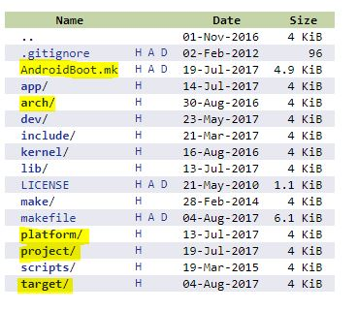
LK Code organization : Overview
  lib : Open libraries, like openssl, zlib_inflate etc.
  arch : Architecture specific code.
  kernel : primitives like mutex, thread, timers etc.
  dev: drivers for drivers, like usb, pmic etc.
  make : rules for building LK.
  project, platform, target, arch: will take up later.

Slide 9
Concept: LK Code & Build system
Projects are what you ask make to build.
    Include modules (typically apps and libraries)
    Projects are built for a Target
LK build system thinks of the world in four layers
      PROJECTS
      TARGETS
      PLATFORM
      ARCH
Targets are typically a specific PCB/Products.
    Project select a target with TARGET := <name>
    Select PROJECT := <name>
    Belongs to a Platform
Platform are Systems-on-Chip (either individual or related families).
  Platform are select with PLATFORM := <name>
  Belongs to an Architecture
Architectures are a specific CPU or CPU family
    ARM Cortex M3, Intel IA32, etc.

Slide 10
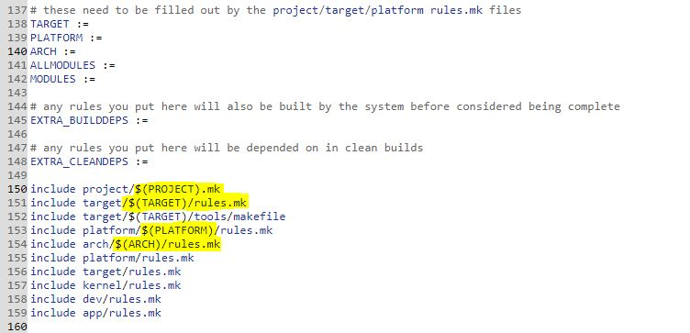
LK Code Organization in depth
LK code: Platform, Target, Arch, Independent code…..
Distinction might be blurred in some cases.
LK Code located in source <src_start_dir>/bootable/bootloader/lk
Code walk through with example:
Target Specific Code
          Continuous Splash Screen
          Fastboot initialization
          What PMIC target uses ?
          defines Platform
Platform Specific Code
          Defines Arch
          GPIO Status/Config

Slide 11
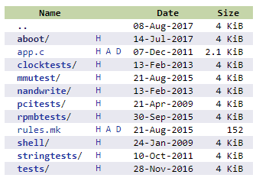
LK Code Organization in depth (cont.)
Independent code
    Apps in LK
aboot app
    Aboot Init
This leads to Overall Code Flow…

Slide 12
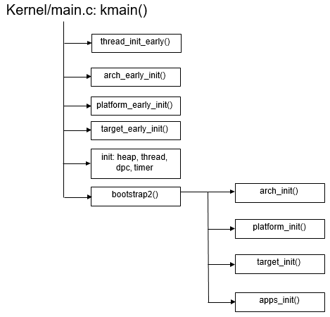
LK Call flow: Overview
ARCH Initialization
Platform Initialization
Target Initialization
Run a app (aboot)
Fastboot thread is one of possibility of aboot thread.
Aboot loads the kernel post authentication.

Slide 13
Fastboot/Recovery

Slide 14
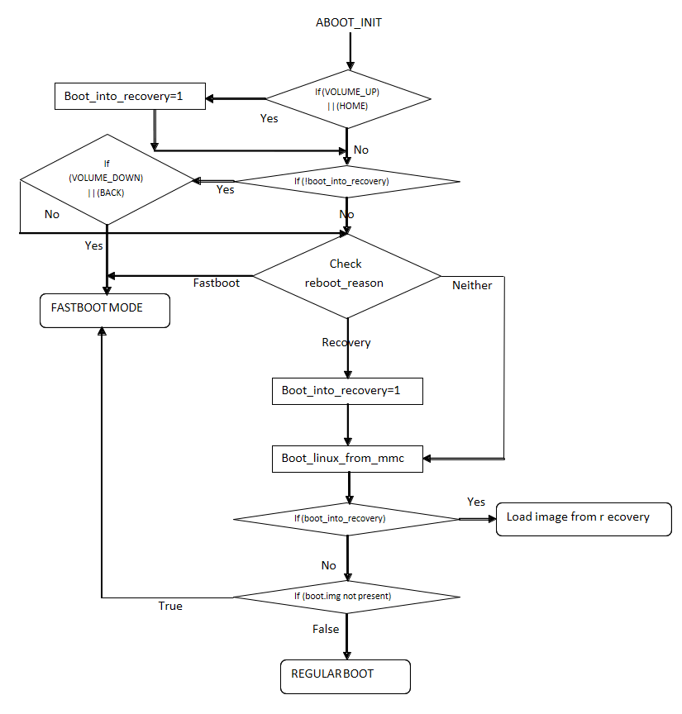
Fastboot/Recovery Mode
ABOOT thread/app
Load boot image to scratch region.
Unzip if required/Authenticate if required kernel image.
Load kernel to KERNEL_ADDR
Extract, Update and Load device tree to TAGS_ADDR
Start kernel execution.
Conditions for fastboot
Key Combination (Volume down key/ GPIO)
Reboot Reason set explicitly
Invalid boot image.
Other reason of boot failure
Commands registration :
fastboot_init() : start of fastboot mode.

Slide 15
PART- B
LK Security concerns/issues

Slide 16
Security Issues
Some of the recent security issues reported due to :
  Buffer/Integer Overflows.
      Information leak by flashing of uninitialized data to flash/mmc
  Time-of-check Time-of-use (TOCTOU) race conditions.
  Reading special crafted images
      Possible out of bounds access when processing UBI image
  Elevation of privilege vulnerability.
  Failed to generate random numbers.
Notes:
External researcher reported/Customer reported/Internally testd.

Slide 17
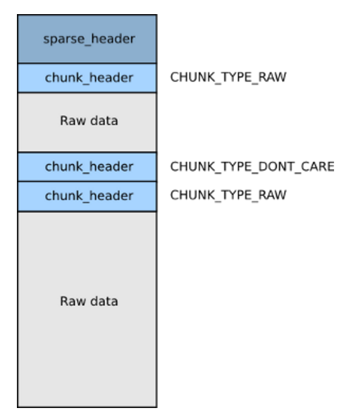
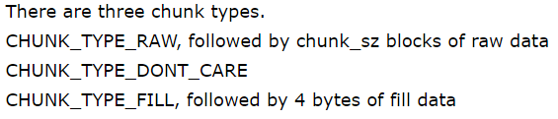
Security Issues : Buffer Overflow
  ISSUE # 01 Information Leak.
      CR: 2078272
      Due to improper integer overflow.
      Fix Gerrit, External researcher
  Buggy Code
Notes:
Fill data will be written to MMC if blk_sz is very large. And fill_value is also supplied by user.
We are writing all data in RAM/Heap on mmc, which can be read by user.

Slide 18
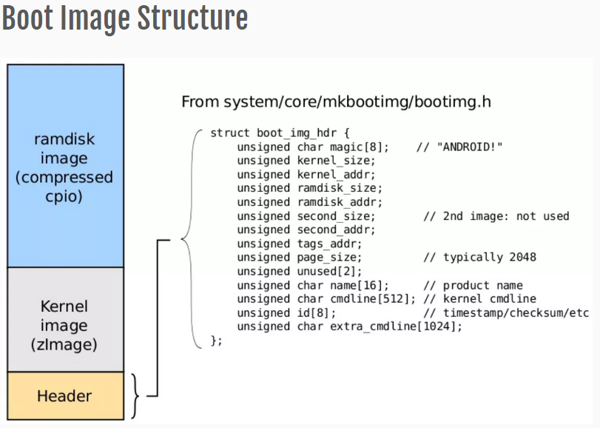
Security Issues : TOCTOU
  ISSUE # 02 Time-of-check Time-of-use (TOCTOU) race conditions.
      CR: 2034087
      TOCTOU : different headers can be used
      Reported by google, may require hardware modification.
  Time-of-Check
  Time-of-Use
  Fix read the header first and than read only image.
Notes:
Kernel_addr : can be used maliciously.

Slide 19
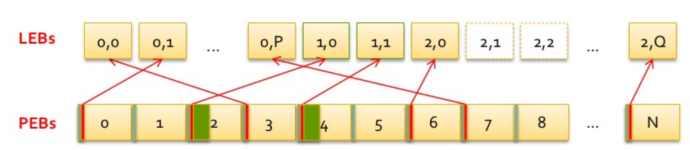
Security Issues : Specially crafted images
  ISSUE # 03 Corrupt memory via a specially crafted UBI image
      CR: 2055629
      Possible to corrupt memory via a specially crafted UBI image
      UBI volume is a set of consecutive logical eraseblocks (LEBs). Each logical eraseblock may be mapped to any physical eraseblock (PEB).
      Reported by external researcher.
Notes:
physical eraseblock (PEB); logical eraseblocks (LEBs)
UBI volume is a set of consecutive

Slide 20
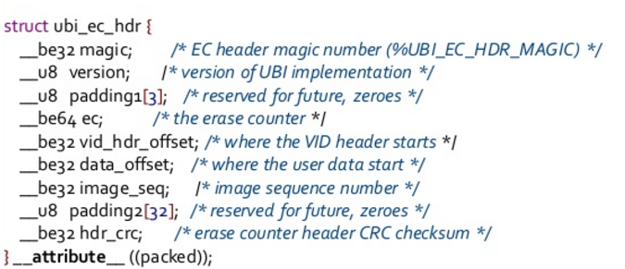
Security Issues : Specially crafted images (cont)
Readin img_peb
Possible out of bounds access when processing UBI image.
Notes:
physical eraseblock (PEB); logical eraseblocks (LEBs)
UBI volume is a set of consecutive

Slide 21
Security Issues : Random number generation failure
  ISSUE # 04 Possible MDTP verification bypass due to failure in generating random number
      CR: 1000546
      Mobile Device Theft Prevention - a system designed to prevent or deter theft of mobile devices
      Due to inconsistent cache reads.
      Fix was to invalidate the buffer before SCM call is made in the function to obtain random number into that buffer.
      Fix Gerrit
      Reported : White box penetration testing while verifying another issue.
Notes:
physical eraseblock (PEB); logical eraseblocks (LEBs)
UBI volume is a set of consecutive

Slide 22
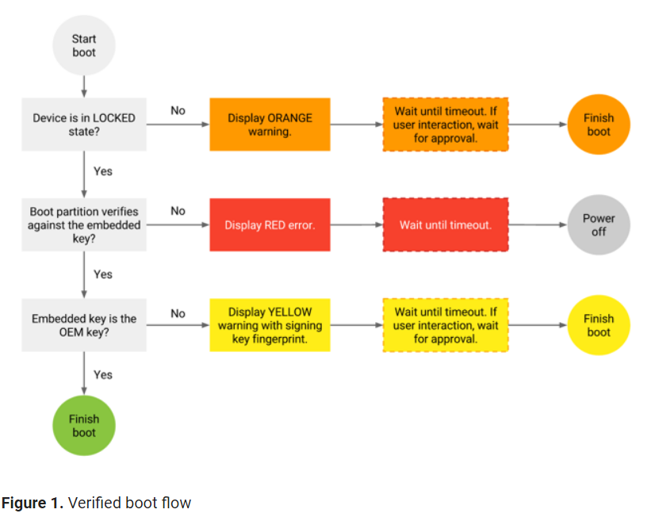
Security Issues : Verified boot authentication bypassed.
  ISSUE # 05 Verified boot authentication is bypassed in some boot images
      CR: 1094105
      As per CR description
          customer has found some hackers use this bug to flash their devices.
          The steps is as simple as that they created a boot.img, and change the "length" field in signature and then the device will boot.
          Product: MSM8996.LA.1.0.1.c2
      2017-05-01 : security bulletin : QC-CR#1094105
      Code Reference
Notes:
Very interesting.

Slide 23
Reference Slides

Slide 24
Sync & Build LK
Cloning the LK tip
  repo init -u git://git.quicinc.com/platform/manifest.git -b lk.lnx.1.0-dev.1.0
  repo sync bootable/bootloader/lk (if only want LK code)
Building LK:
  source build/envsetup.sh
  Lunch
  <select target to build from combo>
  make aboot

Slide 25
Quick References
  Go/aboot
  Go/bootflow
  http://opengrok.qualcomm.com/source/xref/LE.UM.0.0
  Go/agile : 80-ND928-80_E
  https://source.android.com/security/

