Slide 1
Linux Timers
Srinivas Ramana

Slide 2



Timer…timer…time…err..!
timer
Clock monotonic
Clock Source
Deferrable timer
Time keeping
Clock realtime
arch timer
Timer interrupt
memtimer
Sched_clock
Jiffies
Clock event
hrtimer
Clock boottime
delay
Counter
Tick..tick
Pinned timer
sleep
Broadcast timer
tick-nohz
Timer cascading
Timer softirq
Timer event
Timer migration

Slide 3
What do we need?
Keep up with the time
Real time
monotonic time line where the events could be placed
Generate events when required on a given time line
Ability to manage the events (set/clear)
Periodic or onetime events
Events on monotonic timeline
Events on a real time
Timers and timeouts
Timing for scheduling
Keep up the time when in suspend
Manage the events across CPU PC

Slide 4
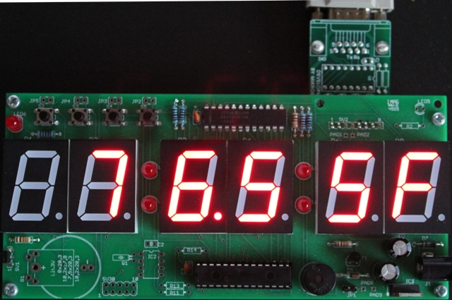
What’s in the HW
Counter
A system counter of ‘x’ bits which would run monotonically from an always ON power domain.
On APPS
Per CPU CP15 or arch timers accessible from that CPU on which its present
One memory mapped timer accessible to all CPUs.
Other HW subsystems may have their timers driven from the system counter similar to APPS.
All the timer counters deriving the count from system counter would run in sync.
CP15 timer
Accessible to the CPU(one timer per cpu) via system registers. Uses system instructions MRS, MSR to read/write.
Loses power when cpu enters power collapse.
Mem timer
Accessible to the CPU via memory mapped registers. Can use normal load/store instructions.
Does not lose power when cpu enters power collapse.

Slide 5
Linux timer stack
sched-timer
ktime_get
Sched-clock
hrtimers
timers
mono
boot
Real
tick-device (oneshot / periodic)
tick-broadcast
time keeping
clock events
clock source
Mem timer
CP15 timer
Mem timer counter
CP15 timer counter
Counter

Slide 6
Linux arch timer
Arch timer
One per cpu
Uses PPI
Mem timer
one global
Uses SPI
Uses mrs, msr instructions to access
Provides memory mapped access
asm volatile("mrs %0, cntvct_el0" : "=r" (cval));
readl_relaxed_no_log(arch_counter_base + CNTVCT_HI)
Event count
Counter
Down counter
Counter/time source
Event
Handle timer sources with dynamic CPU start and stop, with CPU_STARTING and CPU_DYING notifications.
arch_timer_start/stop(this_cpu_ptr(arch_timer_evt));
Register with clock events layer of Linux
/* struct clock_event_device *clk */
clockevents_config_and_register(clk, arch_timer_rate, 0xf, 0x7fffffff);

Slide 7
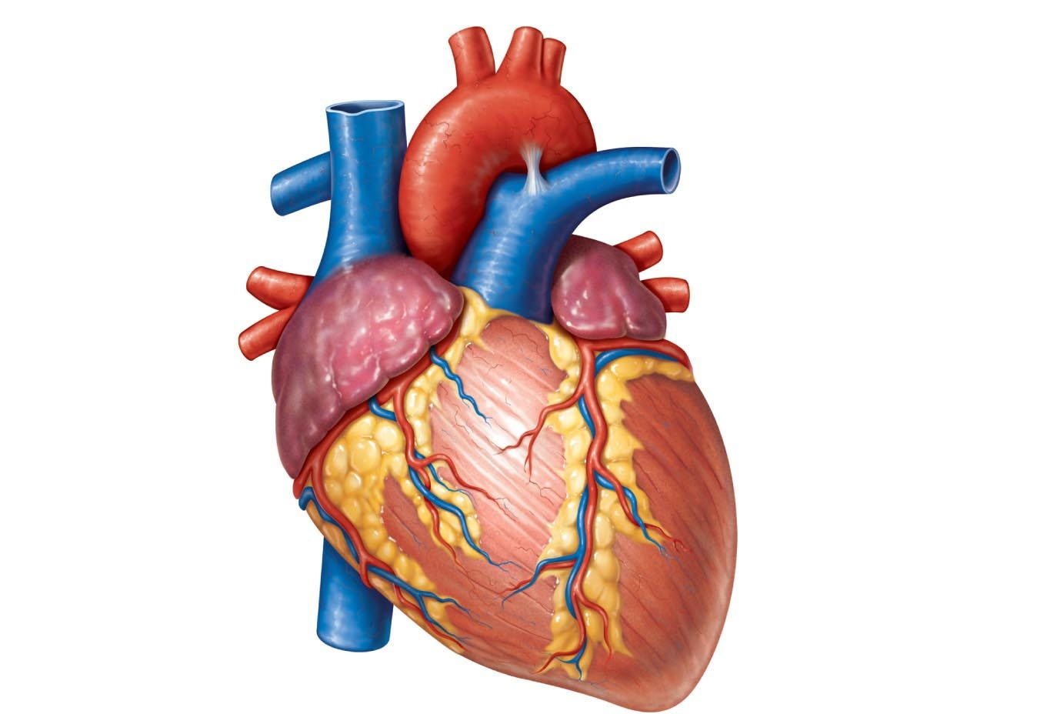
Clock source
The purpose of the clock source is to provide a time-line for the system that tells you where you are in time.
Eg: ‘date’ command uses clocksource
Typically the clock source is a monotonic, atomic counter which will provide n bits which count from 0 to 2^(n-1) and then wraps around to 0 and start over. It will ideally NEVER stop ticking as long as the system is running. It may stop during system suspend.
To achieve better wall-clock accuracy with clocksource it may be synchronizing the user-visible time to RTC clocks in the system or against networked time servers using NTP.
The clock source kernel infrastructure provides a means to translate the provided counter into a nanosecond value as an unsigned long long (unsigned 64 bit) number. This is done in an efficient way using multiply and shift operations. So in clocksource_cyc2ns() you find:
ns ~= (clocksource * mult) >> shift

Slide 8
Clock source…cntd
Register the clock counters available to the clocksource framework. This happens from the timer driver for the timer counter as clocksource.
arch_timer_common_init(void) -> arch_counter_register(arch_timers_present);
static struct clocksource clocksource_counter = {
.name = "arch_sys_counter",
.rating = 400,
.read = arch_counter_read, // points to arch_counter_get_cntvct
.mask = CLOCKSOURCE_MASK(56),
.flags = CLOCK_SOURCE_IS_CONTINUOUS | CLOCK_SOURCE_SUSPEND_NONSTOP,
};
While converting the clocksources to ns, the mult and shift values used are calculated after limiting the maximum sleep time to 10 min in order to achieve good conversion precision. Taking the maximum adjustment that can happen because of NTP and considering 50% of actual maximum,
[ 0.000000] clocksource: arch_sys_counter: mask: 0xffffffffffffff max_cycles: 0x46d987e47, max_idle_ns: 440795202767 ns
The function evaluates the shift/mult pair for the scaled math operations of clocksources and clockevents.
Void clocks_calc_mult_shift(u32 *mult, u32 *shift, u32 from, u32 to, u32 maxsec)
@to and @from are frequency values in HZ. For clock sources @to is NSEC_PER_SEC == 1GHz and @from is the counter frequency. For clock event @to is the counter frequency and @from is NSEC_PER_SEC. The @maxsec conversion range argument controls the time frame in seconds which must be covered by the runtime conversion with the calculated mult and shift factors.

Slide 9

Clock event device
Clock event devices are used to schedule the next event interrupt(s) on the system timeline, while clock sources provide read access to the monotonically increasing time value. Clock events take a desired time specification value and calculate the values to poke into hardware timer registers. They can generate periodic or oneshot events.
Features and capabilities of clock_event_device
clk->features = CLOCK_EVT_FEAT_ONESHOT;
clk->features |= CLOCK_EVT_FEAT_C3STOP; <- for CP15 timers
clk->name = "arch_sys_timer";
clk->rating = 450;
clk->cpumask = cpumask_of(smp_processor_id());
clk->irq = arch_timer_ppi[VIRT_PPI];
clk->set_state_shutdown = arch_timer_shutdown_virt;
clk->set_next_event = arch_timer_set_next_event_virt;
While calculating mult/shift factors for scaled math of clocks (from nsec_per_sec to timer freq), limit the minimum and maximum ticks that can be programmed in oneshot.
min_delta_ticks = 0xf
max_delta_ticks = 0x7fffffff
All the new clock event devices are added to clockevent_devices list and registered with tick_device layer.
list_add(&dev->list, &clockevent_devices);
tick_check_new_device(dev);

Slide 10

tick device
The tick device layer exposes an interface to OS to program timer events to the timer. It also provides an interface for a seamless transition to a broadcast event device in case the cpu chooses to enter into idle.
DEFINE_PER_CPU(struct tick_device, tick_cpu_device);
struct tick_device tick_broadcast_device; struct tick_device {
struct clock_event_device *evtdev;
enum tick_device_mode mode;
};
tick layer also helps in integrating no-hz/tickless functionality into the idle enter/exit paths.
The common tick device which can be used across cpus to handle ticks when local tick device is not available/dummy is called broadcast tick device.
Once it’s switched to oneshot, it setups up the event handler
td->mode = TICKDEV_MODE_ONESHOT;
tick_setup_oneshot(newdev, handler, next_event);
newdev->event_handler = handler; // handler = hrtimer_interrupt for local tick device

Slide 11

tick broadcast
broadcast tick device would be switched to oneshot once the lock device switches to oneshot, but it may continue to have the next event set to tick_period until all the cpus boots up and start using local tick devices.
tick_broadcast_device->event_handler = tick_handle_oneshot_broadcast
broadcast enter
When cpu enters lpm state, it will switch from local tick device to broadcast tick device. The broadcast tick device is programmed with the first pending timer across all cpus using the underlying memtimer.
tick_broadcast_oneshot_control(TICK_BROADCAST_ENTER)
cpumask_test_and_set_cpu(cpu, tick_broadcast_oneshot_mask)
if local event is earlier than current bc event, program the CED under the tick_bc device and also set the bc irq affinity to this cpu.
broadcast exit and handle
Once the broadcast timer expires, interrupt wakes up the cpu and calls tick_handle_oneshot_broadcast(). For all the cpus present in tick_broadcast_pending_mask and tick_broadcast_force_mask,
smp_cross_call_common(mask, IPI_TIMER); // send the ipi, IPI_TIMER
Call the event handler for the local cpu. This will call hrtimer_interrupt for that cpu and execute expired timers. cpus that would receive the IPI call the event_handler from the local tick device in the IPI (interrupt) context.

Slide 12
timekeeping
Timekeeper and different bases it supports provide access to the timeline in the required format.
CLOCK_MONOTONIC - Monotonically increasing time base
CLOCK_MONOTONIC_RAW - Monotonically increasing time base without any adjustments
CLOCK_REALTIME - Human readable wall clock time, can be set
CLOCK_BOOTTIME - real time/wall time of system boot
CLOCK_TAI - International atomic time
Initialize the clocksource for timekeeping and common timekeeping values
tk_setup_internals(tk, clock); // the timekeeper mono base is updated with the clocksource.
Realtime and other bases are maintained as offsets from monotonic time. Update the Initial time from RTC in hctosys init call.
Set wall to monotonic from xtime. Wall-to-monotonic is the offset of monotonic time from wall time.
static void tk_set_wall_to_mono(struct timekeeper *tk, struct timespec64 wtm)
tk->wall_to_monotonic = wtm;
Real time
monotonic
(-)Wall-to-monotonic

Slide 13
timekeeping – Few interface functions
int __getnstimeofday64(struct timespec64 *ts) - Returns the time of day in a timespec64
Get the seconds from real-time base. Get the delta nsec from mono base, use the mult and shift and the fractional nsec to compute the total nsec. Return the sec and nsec value in timespec64 format.
ktime_t ktime_get(void)
Get mono base, get the delta nsec, add it to base and return in ktime_t format.
void do_gettimeofday(struct timeval *tv)
Similar to __getnstimeofday but returns sec and usec.
int do_settimeofday64(const struct timespec64 *ts) - Sets the time of day
Forward the timekeeper so that the bases are updated with latest time. Get the delta between the time to be set and the real time. make sure we don’t set time to epoch + system-up-time. Correct existing wall_to_monotonic by subtracting delta time. correct the real and tai offsets. Set the xtime with new time.
int timekeeping_inject_offset(struct timespec *ts)
void getboottime64(struct timespec64 *ts)

Slide 14
Timers
This implementation is changed to handle the timers more efficiently avoiding cascading. So, skipping the implementation part as of now.
Essentially there are timer_bases for each of the CPU and the new timers gets added to the list in these bases. The timers are arranged such that the time taken to get to the given timer is very minimal and would just need to calculate the index to get into the array. There is also a single global timer_base for all the deferrable timers.
Timers gets migrated to other cpus (via notifiers) when the cpu on which they are queued is going down.
timer_cpu_notify()
case CPU_DEAD:
case CPU_DEAD_FROZEN:
migrate_timers((long)hcpu);
How and when are the timers handled?
During initialization we create a timer softirq to handle the expired timers.
open_softirq(TIMER_SOFTIRQ, run_timer_softirq);
timers gets handled in the softirq, bottom half context.
static void run_timer_softirq(struct softirq_action *h)
struct tvec_base *base = this_cpu_ptr(&tvec_bases);
__run_deferrable_timers();
if (time_after_eq(jiffies, base->timer_jiffies))
__run_timers(base);
tick resolution

Slide 15
Timers…cntd
The softirq for timer would be raised when the tick is hit by tick-sched timer
tick_sched_timer() -> tick_sched_handle() -> update_process_times(user_mode(regs)) -> run_local_timers() -> r aise_softirq(TIMER_SOFTIRQ)
When do these softirqs get to execute?
irq_exit() -> invoke_softirq() -> __do_softirq() -> call softirq_action for each pending type. If there are more softirqs pending after this it would wakeup ksoftirqd using wakeup_softirqd()
run_ksoftirqd() -> __do_softirq()
__local_bh_enable_ip() -> do_softirq() -> do_softirq_own_stack() -> __do_softirq()
__run_timers() runs all expired timers (if any) on that cpu.
In Older kernels (4.4 and below) this function cascades all vectors and executes all expired timer vectors.
Deferrable timer
A deferrable timer will work normally when the system is busy, but will not cause a CPU to come out of idle just to service it; instead, the timer will be serviced when the CPU eventually wakes up with a subsequent non-deferrable timer.

Slide 16
sleep API
hrtimer_init_on_stack(&t.timer, clock, mode);
hrtimer_set_expires_range_ns(&t.timer, *expires, delta);
t.timer.function = hrtimer_wakeup;
hrtimer_start_expires(&t.timer, mode);
schedule();
hrtimer_cancel(&t.timer);
usleep_range
TASK_UNINTERRUPTIBLE
schedule_hrtimeout_range
hrtimer expires
hrtimer_wakeup
wake_up_process((struct task_struct *)__data);
schedule_timeout(signed long timeout)
expire = timeout + jiffies;
setup_timer_on_stack(&timer, process_timeout, (unsigned long)current);
__mod_timer(&timer, expire, false, TIMER_NOT_PINNED);
schedule();
del_singleshot_timer_sync(&timer);
msleep_interruptible
TASK_INTERRUPTIBLE
schedule_timeout
msleep
TASK_UNINTERRUPTIBLE
schedule_timeout
timer expires
process_timeout
wake_up_process((struct task_struct *)__data);

Slide 17
Few timer API
1. unsigned long round_jiffies(unsigned long j)
rounds an absolute time in the future (in jiffies) up or down to (approximately) full seconds. This is useful for timers for which the exact time they fire does not matter too much, as long as they fire approximately every X seconds. By rounding these timers to whole seconds, all such timers will fire at the same time, rather than at various times spread out. The goal of this is to have the CPU wake up less, which saves power.
2. void set_timer_slack(struct timer_list *timer, int slack_hz)
Set the amount of time, in jiffies, that a certain timer has in terms of slack. So the timer will expire somewhere between expires and expires + slack.
3. void init_timer_on_stack_key(struct timer_list *timer, unsigned int flags, const char *name, struct lock_class_key *key)
void init_timer_key(struct timer_list *timer, unsigned int flags, const char *name, struct lock_class_key *key)
Initialize the timer.
timer->entry.pprev = NULL;
timer->flags = flags | raw_smp_processor_id();
timer->slack = -1;
4. int mod_timer_pending(struct timer_list *timer, unsigned long expires)
mod_timer_pending() is the same for pending timers as mod_timer(), but will not re-activate and modify already deleted timers.

Slide 18
Few timer API
5. int mod_timer(struct timer_list *timer, unsigned long expires)
mod_timer() is a more efficient way to update the expire field of an active timer (if the timer is inactive it will be activated)
mod_timer(timer, expires) ~ del_timer(timer); timer->expires = expires; add_timer(timer);
6. int mod_timer_pinned(struct timer_list *timer, unsigned long expires)
same as mod_timer() and ensure that the timer is scheduled on the current CPU.
7. void add_timer(struct timer_list *timer) - start a timer. The kernel will do a ->function(->data) callback from the timer interrupt at the ->expires point in the future. The current time is 'jiffies’.
8. void add_timer_on(struct timer_list *timer, int cpu) –
Start a timer on a particular CPU. timer->flags |= TIMER_PINNED_ON_CPU;
9. int del_timer(struct timer_list *timer)
del_timer() deactivates a timer - this works on both active and inactive timers.
10. int try_to_del_timer_sync(struct timer_list *timer) - This function tries to deactivate a timer.
11. int del_timer_sync(struct timer_list *timer)
deactivate a timer and wait for the handler to finish.
for (;;)
int ret = try_to_del_timer_sync(timer);

Slide 19
hrtimer
Timers with higher resolution which means users can request much precise time events.
The unpredictable [O(N)] overhead of cascading leads to delays which necessitate a more complex handling of high resolution timers. The timer wheel data structure is too rigid for high-res timers.
The timer wheel code is most optimal for use cases which can be identified as "timeouts". Such timeouts are usually set up to cover error conditions in various I/O paths, such as networking and block I/O. The vast majority of those timers never expire.
High resolution capability
The primary users of precision timers are user-space applications that utilize nanosleep, posix-timers and itimer interfaces. Also, in-kernel users like drivers and subsystems which require precise timed events (e.g. multimedia)
The rbtree used for hrtimers helps in time sorted enqueuing(ordering), which helps to decide whether the event device has to be reprogrammed when a timer is added. Every time value, absolute or relative, is in a special nanosecond-resolution type: ktime_t.

Slide 20
hrtimer
There are per cpu hrtimer bases to hold and manage the hrtimers queued on that cpu.
DEFINE_PER_CPU(struct hrtimer_cpu_base, hrtimer_bases)
Each base has 4 types of clock bases into which the timers can be queued.
hrtimers can also get migrated when the cpu is hotplugged out
case CPU_DEAD:
case CPU_DEAD_FROZEN:
migrate_hrtimers(scpu);
clockid= CLOCK_MONOTONIC
get_time = &ktime_get
clockid = CLOCK_REALTIME
get_time = &ktime_get_real
clockid = CLOCK_BOOTTIME
get_time = &ktime_get_boottime
clockid = CLOCK_TAI
get_time = &ktime_get_clocktai

Slide 21
hrtimer
The high resolution timer interrupt called with interrupts disabled. clock_event_device will have the event handler set to hrtimer_interrupt. event_handler gets called from arch_timer_handler_virt in arm_arch timer.
void hrtimer_interrupt(struct clock_event_device *dev)
Each timer is removed from the timer base and its function is run. Since we are running in the hardirq, users of hrtimer should be aware that they are in interrupt context.
Once all the pending timers are executed, the next event will be programmed into the clock event device.

Slide 22
Few hrtimer API
1. void hrtimer_init(struct hrtimer *timer, clockid_t clock_id, enum hrtimer_mode mode)
Initialize a timer to the given clock base (mono, realtime).
2. u64 hrtimer_forward(struct hrtimer *timer, ktime_t now, ktime_t interval)
Forward the timer expiry so it will expire in the future. Can be safely called from the callback function of @timer. If called from other contexts @timer must neither be enqueued nor running the callback and the caller needs to take care of serialization. This only updates the timer expiry value and does not requeue the timer.
3. void hrtimer_start_range_ns(struct hrtimer *timer, ktime_t tim, u64 delta_ns, const enum hrtimer_mode mode) - (re)start an hrtimer on the current CPU.
Remove the timer if actve, update the _softexpires(expiry) and node->expires (expiry+slack), set pinned if flag is passed (queued to the current CPU doing start), enqueue into rb tree.
Reprogram if the new node is left most.
tick_program_event(expires, 1);
clockevents_program_event(dev, expires, force);
dev->set_next_event((unsigned long) clc, dev);
arch_timer_set_next_event_virt(unsigned long evt, struct clock_event_device *clk)
arch_timer_reg_write(access, ARCH_TIMER_REG_TVAL, evt, clk);
arch_timer_reg_write(access, ARCH_TIMER_REG_CTRL, ctrl, clk)

Slide 23
Few hrtimer API…cntd
4. int hrtimer_try_to_cancel(struct hrtimer *timer) - try to deactivate a timer.
If not active (neither enqueued nor running the callback)-> return
enqueued but not running the callback -> remove it, reprogram CED if required.
5. int hrtimer_cancel(struct hrtimer *timer)
cancel a timer. If the callback is running wait for the handler to finish and then cancel.
6. ktime_t __hrtimer_get_remaining(const struct hrtimer *timer, bool adjust)
get remaining time for the timer. ktime_sub(timer->node.expires, timer->base->get_time())
7. bool hrtimer_active(const struct hrtimer *timer)
A timer is active, when it is enqueued into the rbtree or the callback function is running or it's in the state of being migrated to another cpu.
8. void hrtimer_init_sleeper(struct hrtimer_sleeper *sl, struct task_struct *task)
sl->timer.function = hrtimer_wakeup; // it does wake_up_process(task);
sl->task = task;

Slide 24
Few hrtimer API…cntd
9. int __sched schedule_hrtimeout_range(ktime_t *expires, u64 delta, const enum hrtimer_mode mode)
Make the current task sleep until the given expiry time has elapsed.
The @delta argument gives the kernel the freedom to schedule the actual wakeup to a time that is both power and performance friendly. The kernel give the normal best effort behavior for "@expires+@delta", but may decide to fire the timer earlier, but no earlier than @expires.
10. int __sched schedule_hrtimeout(ktime_t *expires, const enum hrtimer_mode mode)
schedule_hrtimeout_range with 0 slack.

Slide 25
sched_clock
This function shall return the number of nanoseconds since the system was started. As the name suggests, sched_clock() is used for scheduling timings in the system. For example, determining the absolute timeslice for a certain process in the CFS scheduler. It is also used for printk timestamps.
Sched_clock() should be very fast and should be monotonic. The sched_clock() function may wrap only on unsigned long long boundaries, i.e. after 64 bits. Since this is a nanosecond value this will mean it wraps after circa 585 years.
The clock driving sched_clock() may stop or reset to zero during system suspend/sleep. This does not matter to the function it serves of scheduling events on the system. However it may result in interesting timestamps in printk().
The sched_clock() function should be callable in any context, IRQ- and NMI-safe and return a sane value in any context.
Register sched clock with a read API, number of bits in the counter and frequency of the counter. This time it uses the maxsec to be 3600, so the maxcycles would be a lot more compared to timekeeping.
>> clocks_calc_mult_shift(&new_mult, &new_shift, rate, NSEC_PER_SEC, 3600);
>> sched_clock_register: new_mult: 109226667 new_shift: 21, rate: 19200000
>> sched_clock: 56 bits at 19MHz, resolution 52ns, wraps every 4398046511078ns

Slide 26
tick-sched
Once a system has switched to high resolution mode, the periodic tick is switched off.
The periodic tick functionality is provided by a per-cpu hrtimer. The callback function is executed in the next event interrupt context and updates jiffies and calls update_process_times and profiling. The implementation of the hrtimer based periodic tick is designed to be extended with dynamic tick functionality. This allows to use a single clock event device to schedule high resolution timer and periodic events (jiffies tick, profiling, process accounting).
static DEFINE_PER_CPU(struct tick_sched, tick_cpu_sched);
ts->sched_timer.function = tick_sched_timer;
Dynaticks
Dynamic ticks are the logical consequence of the hrtimer based periodic tick replacement (sched_tick). The functionality of the sched_tick hrtimer is extended by three functions:
- tick_nohz_stop_sched_tick() called from tick_nohz_idle_enter()
- tick_nohz_restart() called from tick_nohz_idle_exit()
- tick_do_update_jiffies64 while exiting from idle
tick_nohz_stop_sched_tick() is called when a CPU goes into idle state. The code evaluates the next scheduled timer event (from both hrtimers and the timer wheel) and in case that the next event is further away than the next tick it reprograms the sched_tick to this future event, to allow longer idle sleeps without worthless interruption by the periodic tick.
tick_nohz_restart() is called when the CPU leaves the idle state.

Slide 27
nanosleep - userspace
nanosleep() suspends the execution of the calling thread until either at least the time specified in *rqtp has elapsed, or the delivery of a signal that triggers the invocation of a handler in the calling thread or that terminates the process. If the call is interrupted by a signal handler, nanosleep() returns -1, sets errno to EINTR, and writes the remaining time into the structure pointed to by rmtp unless rmtp is NULL. The value of *rmtp can then be used to call nanosleep() again and complete the specified pause.
SYSCALL_DEFINE2(nanosleep, struct timespec __user *, rqtp, struct timespec __user *, rmtp)
hrtimer_nanosleep(&tu, rmtp, HRTIMER_MODE_REL, CLOCK_MONOTONIC)
long hrtimer_nanosleep(struct timespec *rqtp, struct timespec __user *rmtp, const enum hrtimer_mode mode, const clockid_t clockid)
slack = current->timer_slack_ns;
initialize a local hrtimer and set the expires with slack.
do_nanosleep(&t, mode)
initialize sleeper with hrtimer_wakeup(), set task state to TASK_INTERRUPTIBLE and start the hrtimer.
freezable_schedule();
cancel the hrtimer, set mode to ABS and set task state to TASK_RUNNING
restart = &current->restart_block;
restart->fn = hrtimer_nanosleep_restart;
fill other parameters of restart block including clockid, rmtp and expires.
ret = -ERESTART_RESTARTBLOCK;

Slide 28
Need delay? - Which API?
Atomic context:
Awlays use *delay() variants
ndelay(unsigned long nsecs)
udelay(unsigned long usecs)
mdelay(unsigned long msecs)
Non-atomic context:
You should use the *sleep[_range] family of functions.
SLEEPING FOR "A FEW" USECS ( < ~10us? ): udelay()
SLEEPING FOR ~USECS OR SMALL MSECS ( 10us - 20ms): usleep_range()
SLEEPING FOR LARGER MSECS ( 10ms+ ): msleep() or msleep_interruptible()

Slide 29
Linux timer stack
sched-timer
ktime_get
Sched-clock
hrtimers
timers
mono
boot
Real
tick-device (oneshot / periodic)
tick-broadcast
time keeping
clock events
clock source
Mem timer
CP15 timer
Mem timer counter
CP15 timer counter
Counter

Slide 30
References and Resources
Source code
kernel Documentation
https://git.kernel.org/pub/scm/linux/kernel/git/torvalds/linux.git/tree/Documentation/timers?h=v4.15-rc2
Git history
Hrtimers
1. https://lwn.net/Articles/152436/
2. https://lwn.net/Articles/152363/
3. https://lwn.net/Articles/167315/
delays
1. https://lkml.org/lkml/2007/8/3/250
Sboyds presentation at ELC
https://www.youtube.com/watch?v=Puv4mW55bF8
Wiki that I have created
http://qwiki.qualcomm.com/quic/Kernel/qipl_baseport/baseport_team_charter/timers

Slide 31


Slide 32




Slide 33


Slide 34
Backup

Slide 35
Backup – Old timer wheel & cascading
The array (tv1) contains a set of 256 linked lists of upcoming timer events. This array is indexed directly by the bottom bits of a jiffies value to find the next set of events to execute.
When the kernel has, over the course of 256 jiffies, cycled through the entire tv1 array, it gets replenished with the next 256 jiffies worth of events from the array tv2 which can be indexed using next set of jiffies bits. This is called 'cascading'.
When tv2 is exhausted, it is replenished from tv3 in the same way. This process continues up to tv5. The final entry in tv5 is special, in that it holds all of the far-future events which do not otherwise fit into this hierarchy.
It can retrieve all of the events to execute with a simple array lookup. Insertion and removal of events is cheap, since their location in the structure is easy to calculate.
On the other hand, this data structure is firmly tied to jiffies values, and cannot easily cope with timers with sub-jiffies resolution.
The cascade process, which moves events from the higher arrays to the lower ones, can be expensive if there are a lot of events to work with. Events which are removed prior to expiration will often not have to be cascaded at all.
If the clock interrupt frequency is raised (to get better timer resolution), these cascades will happen more often, and the cost of the data structure operations goes up.

Slide 36
Backup - ARM Generic Timer

