Slide 1
PIL

Slide 2
Agenda
What is it?
Source code.
Driver Architecture.
Relocatable, non-relocatable images
Understanding Image structure
Request_firmware variants
How subsystems communicates?
Proxy voting of clocks and regulators.
Subsystem boot/shutdown

Slide 3
Definition
Loads peripheral images into memory and interfaces with the Peripheral authentication service(MBA/TZ) to authenticate and bring peripherals out of reset (or) bring them down.

Slide 4
Files
Well structured driver
peripheral_loader.c
subsystem_restart.c
Modem: pil-q6v5-mss.c/pil-q6v5.c/pil-msa.c
Other SS: subsys-pil-tz.c
sysmon-glink.c, sysmon-qmi.c

Slide 5
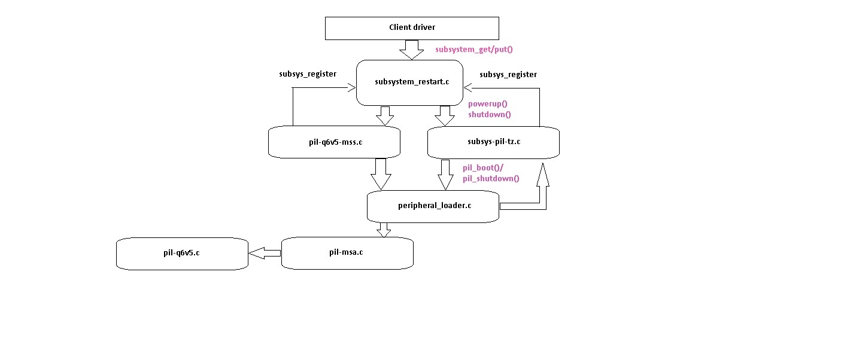
Architecture

Slide 6
Relocatable
Venus, WCNSS and LPASS – relocatable images
Modem – relocatable image

Slide 7
Understanding image structure
Memory descriptor table
<subsystem-name>.mdt
e.g. modem.mdt, venus.mdt
Blobs or real binaries,
e.g. Modem.b00, modem.b01 …. Modem.b20
Modem Boot Authenticator
Mba.mbn

Slide 8
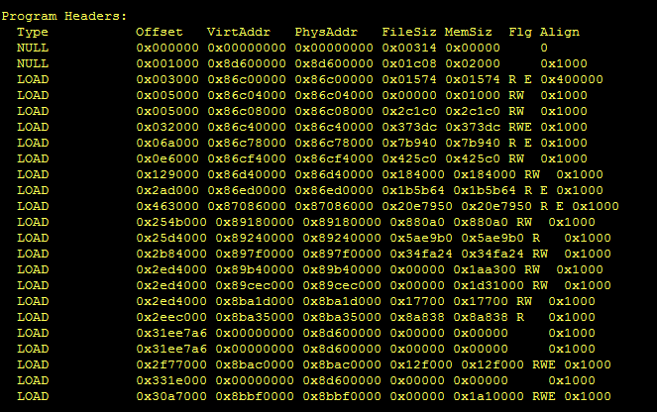
Using readelf utility
#readelf -a modem.mdt

Slide 9
Image Location
/firmware/image
- File system Non-HLOS.bin partition
- contains modem, LPASS and WCNSS images

Slide 10
request_firmware variants
Request_firmware
used to read a file from file system, copy to memory.
Virtually continuous in memory.
used to get mba.mbn, *.mdt files
Request_firmware_direct
used to read a file from FS, copy to memory specified by driver.
used to read blobs.

Slide 11
How subsystems communicate?
SYSMON interface
- uses qmi interface on latest hardware and smd on older ones
SMP2P interface
- uses smp2p driver
Watch dog IRQs
- each subsystem has a hard irq line routed to APPS processor.
Notes:
•Example use case for sysmon: When the modem crashes, the LPASS/ADSP subsystem driver informs the ADSP that the modem has crashed via the sysmon API.

Slide 12
Proxy voting for clocks and voltages
Subsystems need certain clocks and regulators to be ON to come out of reset and to be functional.
PIL driver votes for clocks and voltage – proxy voting
Once subsystem is up and running – proxy votes are withdrawn and subsystems vote for themselves.
Subsystems communicate with PIL driver though SMP2P interrupts for proxy unvoting.

Slide 13
Subsystem boot/shutdown
pil_boot()
request_firmware()
Reads the firmware metadata *.mdt from the file system.
pil_init_mmap(desc, mdt)
Allocate memory for firmware loading
Memory for firmware loading is allocated with dma_alloc_attrs() with the below attributes:
DMA_ATTR_SKIP_ZEROING -> Do not allow dma to zero out the memory as this could be locked.
DMA_ATTR_NO_KERNEL_MAPPING -> This attribute is done to avoid dma giving a virtual address for the memory range allocated.
Read every segment address and size and populate the segment list.
pil_proxy_vote()
Enable the required regulators and clocks.

Slide 14
Continued…
init_image(desc, fw->data, fw->size)
Modem: Load MBA, Authenticate modem.mdt
dma_alloc_attrs() with attribute DMA_ATTR_STRONGLY_ORDERED is allocated for mba and modem.mdt loading to avoid any un-aligned access or prefetching.
Pronto/adsp/venus: Allocate dma memory and copy metadata. Make an scm call (PAS_INIT_IMAGE_CMD) to TZ with the metadata address.
mem_setup()
Modem: NA
Pronto/adsp/venus: Sends an scm_call (PAS_MEM_SETUP_CMD) to TZ with the start_addr and size of the firmware image, for TZ to initialize & keep track of the region for each subsystem.
Notes:
Note:
mba.mbn: MBA: Modem Boot Authenticator -> This is dynamically loaded to memory and this takes care of authenticating the modem images.
modem.mdt -> Metadata file containing the information about the modem blobs.

Slide 15
Continued…
pil_load_seg()
request_firmware_direct()
Reads each firmware.bXX blob from the file system.
dma_remap, loads the image in the subsystem memory and does a dma_unremap.
verify_blob()
Modem: Verifies each blob by blob and authenticates.
Pronto/adsp/venus: NA
auth_and_reset()
Modem: authentication blob once again and bring SS out of reset.
Pronto/adsp/venus: Sends an scm call (PAS_AUTH_AND_RESET_CMD) to TZ to authenticate the loaded firmware image.

Slide 16
Continued…
pil_proxy_unvote()
Disables proxy clocks and regulators.
pil_shutdown()
Modem: Halts the axi ports & restart_reg = 1.
Pronto/adsp/venus: Sends an scm call (PAS_SHUTDOWN_CMD) to TZ with shutdown command to shutdown the subsystem.

