Slide 1
Perf (Performance monitoring and Tracing tool)

Slide 2
Perf
Perf is a event-oriented observability tool which helps in solving advance performance and troubleshooting problem.
It gives flexibility to understand CPU usage quickly and completely.
Count events, sample events, bpf program on events.

Slide 3
Perf prerequisites
Symbols User space: Incase of user space, –dbgsym package need to be installed Or Compile the package without striping the symbols. Kernel space: Running kernel should be compiled with CONFIG_KALLSYMS=y.
Stack Traces User space: Compile the package with –fno-omit-frame-pointer. Kernel space: CONFIG_FRAME_POINTER=y

Slide 4
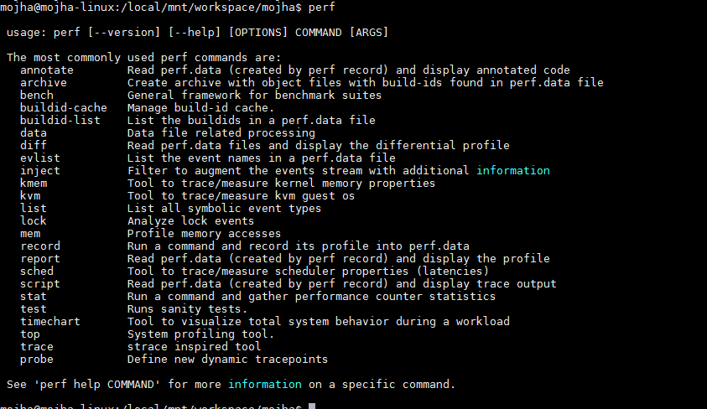
Usage:

Slide 5
Perf events
Hardware events.
Software events.
Kernel tracepoint events.
Statically defined tracing. (compile with –with-dtrace option)
Dynamic tracing.(Kprobe, Uprobe)
Timed profiling.

Slide 6
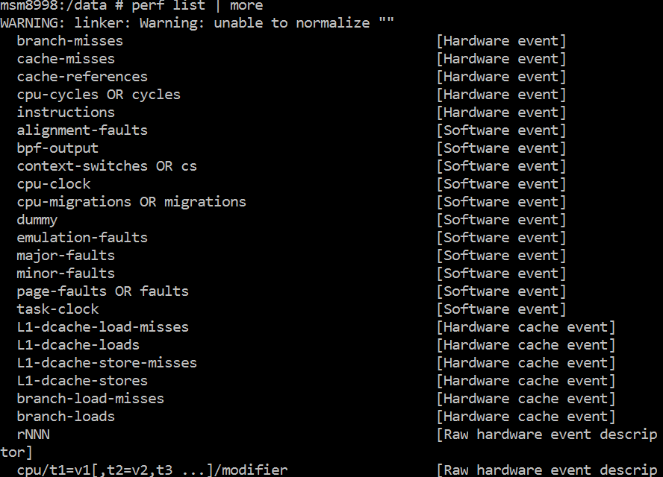

Slide 7
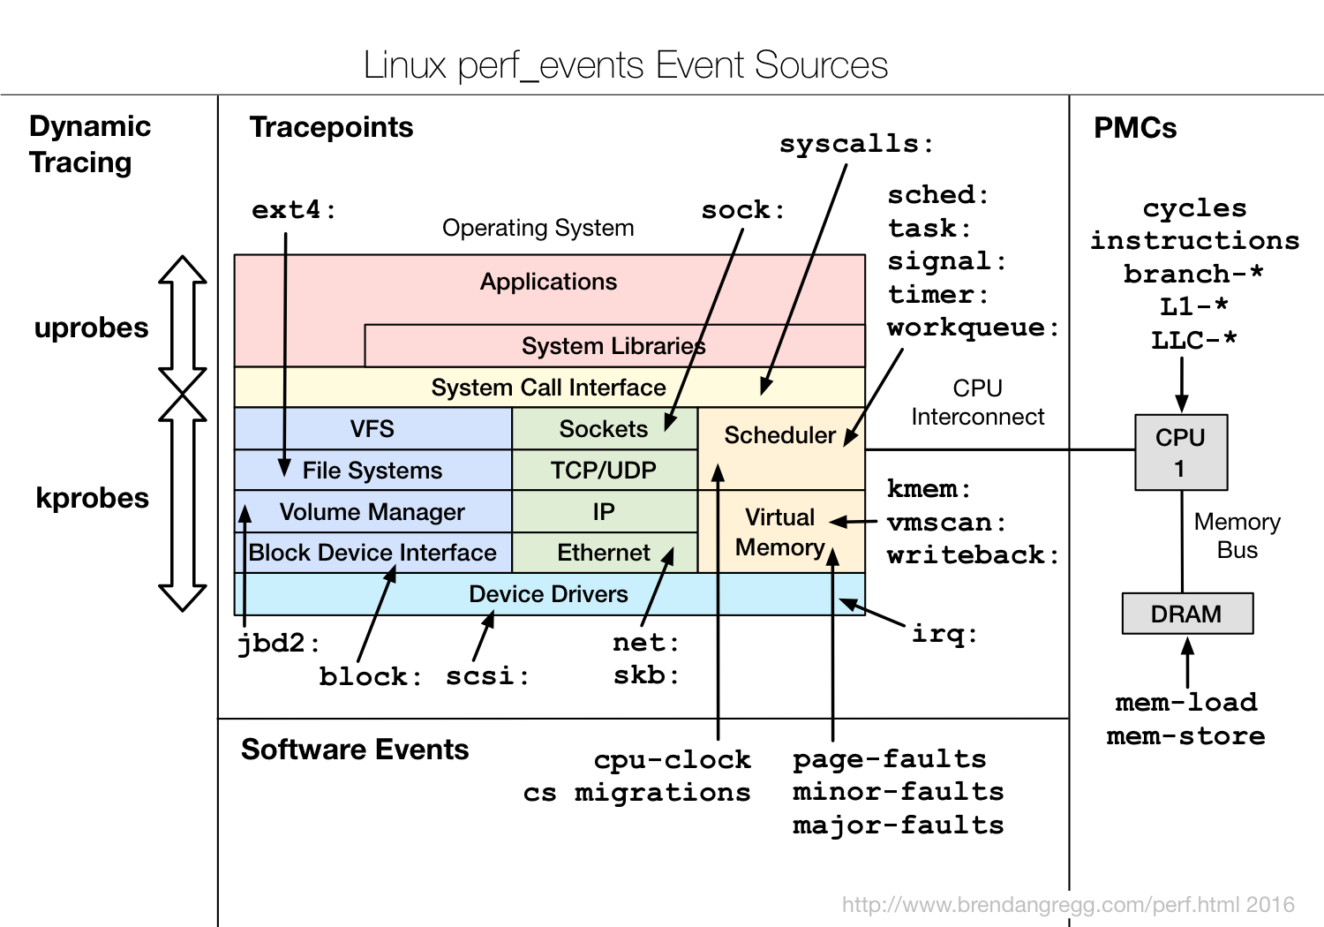
Event source

Slide 8
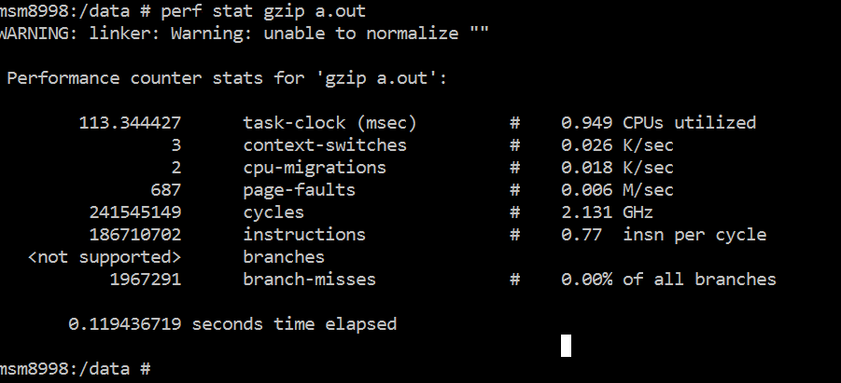

Slide 9
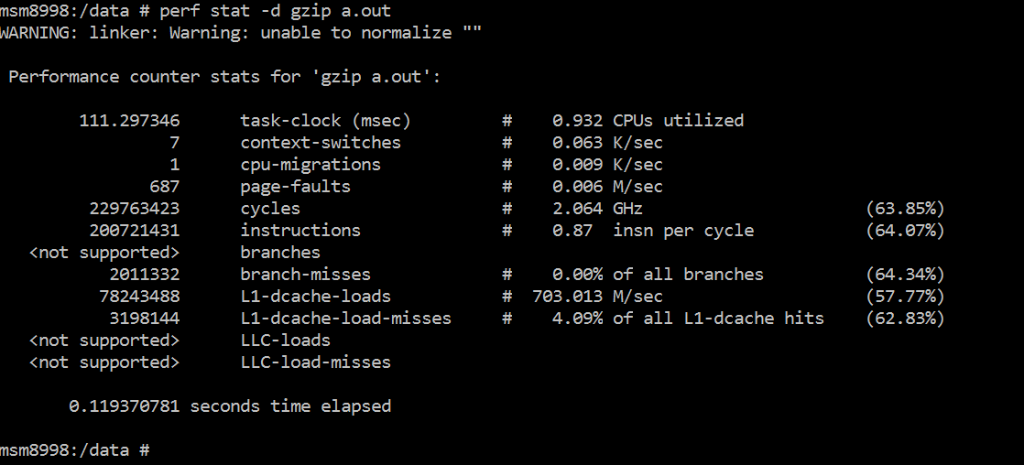
CPU profiling

Slide 10
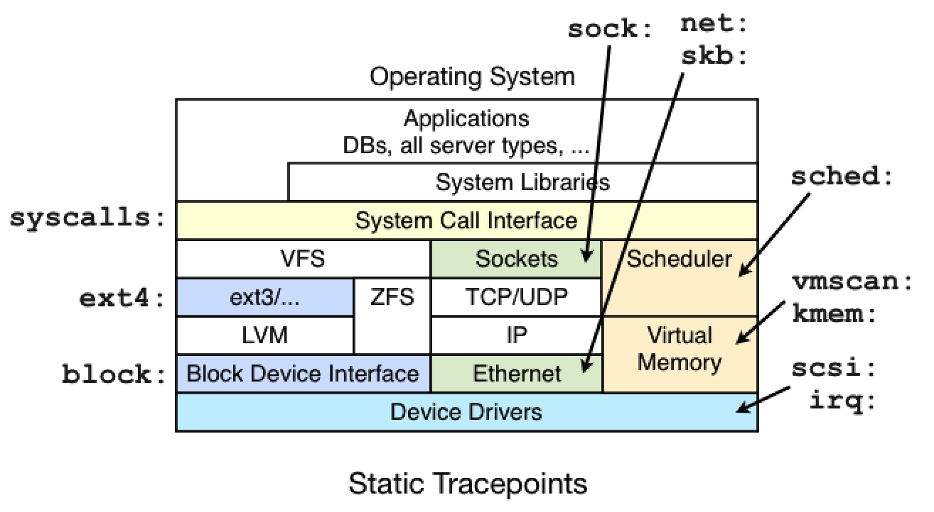
Kernel Tracepoints

Slide 11
Kernel Tracepoints
These tracepoints are hardcoded at interesting and logical location in the kernel so that higher level behavior can easily be traced.
Block: for block device I/O
Ext: file system operations
kmem: kernel memory allocation events
random: kernel random number generator events
sched: CPU scheduler events
syscalls: system call enter and exits
task: task events

Slide 12
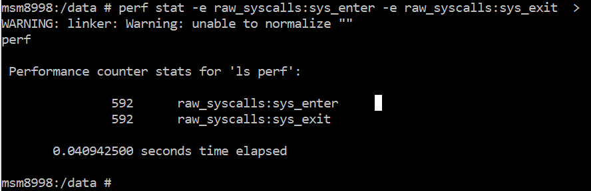
Kernel Tracepoints

Slide 13
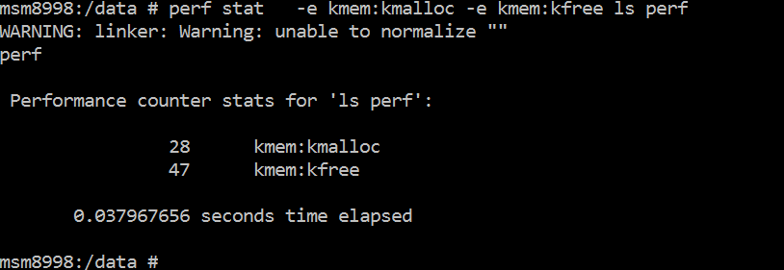

Slide 14
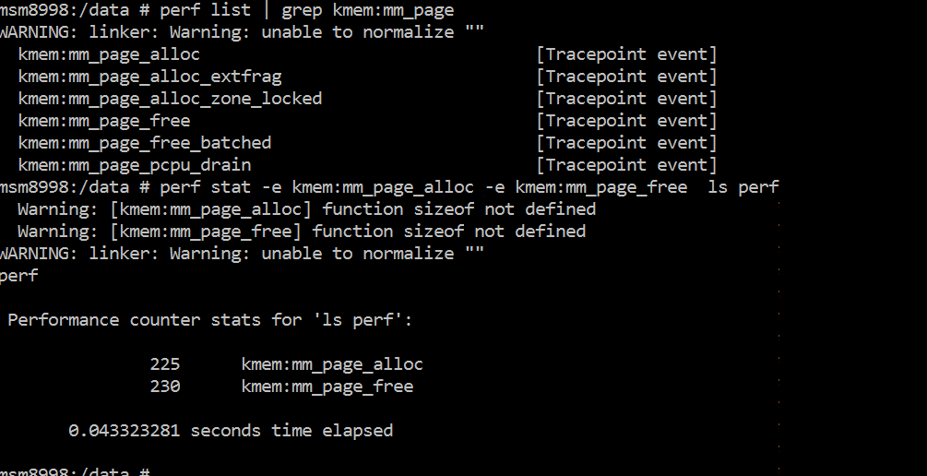
Kernel Tracepoints

Slide 15
Some one liners example of static tracing
# Trace new processes, until Ctrl-C: perf record -e sched:sched_process_exec -a # Trace all context-switches, until Ctrl-C: perf record -e context-switches -a # Trace context-switches via sched tracepoint, until Ctrl-C: perf record -e sched:sched_switch -a
# Trace all context-switches with stack traces, until Ctrl-C: perf record -e context-switches –ag # Trace all context-switches with stack traces, for 10 seconds: perf record -e context-switches -ag -- sleep 10 # Trace all CS, stack traces, and with timestamps (< Linux 3.17, -T now default): perf record -e context-switches -ag -T

Slide 16
# Trace CPU migrations, for 10 seconds: perf record -e migrations -a -- sleep 10 # Trace all connect()s with stack traces (outbound connections), until Ctrl-C: perf record -e syscalls:sys_enter_connect –ag # Trace all accepts()s with stack traces (inbound connections), until Ctrl-C: perf record -e syscalls:sys_enter_accept* -ag # Trace all block device (disk I/O) requests with stack traces, until Ctrl-C: perf record -e block:block_rq_insert -ag # Trace all block device issues and completions (has timestamps), until Ctrl-C: perf record -e block:block_rq_issue -e block:block_rq_complete –a # Trace all block completions, of size at least 100 Kbytes, until Ctrl-C: perf record -e block:block_rq_complete --filter 'nr_sector > 200’

Slide 17
# Trace all block completions, synchronous writes only, until Ctrl-C: perf record -e block:block_rq_complete --filter 'rwbs == "WS“’ # Trace all block completions, all types of writes, until Ctrl-C: perf record -e block:block_rq_complete --filter 'rwbs ~ "*W*“’
# Trace all minor faults (RSS growth) with stack traces, until Ctrl-C: perf record -e minor-faults –ag
# Trace all page faults with stack traces, until Ctrl-C: perf record -e page-faults -ag # Trace all ext4 calls, and write to a non-ext4 location, until Ctrl-C: perf record -e 'ext4:*' -o /tmp/perf.data -a # Trace kswapd wakeup events, until Ctrl-C: perf record -e vmscan:mm_vmscan_wakeup_kswapd -ag

Slide 18
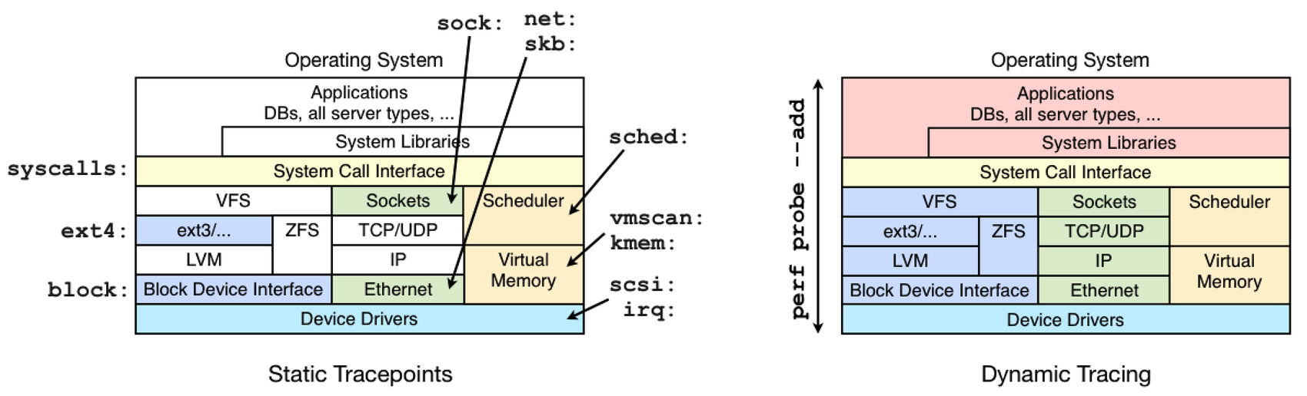
Dynamic tracing

Slide 19
Dynamic tracing
This can be enabled on the live system without restarting anything.
Patches instruction in memory to add instrumentation.
No overhead until dynamic tracing is in use. Only overhead is extra instruction execution and It is relative to the frequency of instrumented events X work done on each instruction.
To enable kernel dynamic tracing CONFIG_KPROBES=y and CONFIG_KPROBE_EVENTS=y
To enable user level dynamic tracing CONFIG_UPROBES=y and CONFIG_UPROBE_EVENTS=y
Note: For ARM User level dynamic tracing is not there.

Slide 20
How to add a dynamic tracepoint
$ perf probe --add 'do_unlinkat pathname:string’
Adds probe on ‘do_unlinkat’.
$perf record -e probe:do_unlinkat –aR rm 1.txt Record the activity.
$perf script
Shows the result

Slide 21
Adding a probe on a line.
To show the line in a kernel function.
$ perf probe -L do_unlinkat | grep 32 32 inode = dentry->d_inode;
To put probe on a line a kernel function.
$ perf probe -a 'do_unlinkat:32 dentry->d_iname:string’ To record the activity on a probe point. $perf record -e probe:do_unlinkat -aR rm /tmp/test
To show the recorded activity in organized way.
$perf script

Slide 22
Probing a external module
$perf probe -F -m /lib/modules/4.6.0/kernel/drivers/block/sampleblk.ko
$ perf probe -m /lib/modules/4.6.0/kernel/drivers/block/sampleblk.ko -a sampleblk_request
$ perf record -e probe:sampleblk_request -aRg sleep 1
$ perf report

Slide 23
perf probe
# Add a tracepoint for the kernel tcp_sendmsg() function entry ("--add" is optional):
perf probe --add tcp_sendmsg
# Remove the tcp_sendmsg() tracepoint (or use "--del"):
perf probe -d tcp_sendmsg
# Add a tracepoint for the kernel tcp_sendmsg() function return:
perf probe 'tcp_sendmsg%return’ # Add a tracepoint for tcp_sendmsg() return, and capture the return value: perf probe 'tcp_sendmsg%return $retval’ # Show available variables for the kernel tcp_sendmsg() function (needs debuginfo): perf probe -V tcp_sendmsg # Show available variables for the kernel tcp_sendmsg() function, plus external vars (needs debuginfo): perf probe -V tcp_sendmsg --externs

Slide 24
perf probe
# Show available line probes for tcp_sendmsg() (needs debuginfo):
perf probe -L tcp_sendmsg # Show available variables for tcp_sendmsg() at line number 81 (needs debuginfo): perf probe -V tcp_sendmsg:81 # Add a tracepoint for tcp_sendmsg(), with three entry argument registers (platform specific): perf probe 'tcp_sendmsg %x1 %x2 %x3’ # Add a tracepoint for tcp_sendmsg(), with an alias ("bytes") for the %x1 register (platform specific): perf probe 'tcp_sendmsg bytes=%x1’ # Trace previously created probe when the bytes (alias) variable is greater than 100: perf record -e probe:tcp_sendmsg --filter 'bytes > 100’

Slide 25
perf probe
# Add a tracepoint for tcp_sendmsg(), and "size" entry argument (reliable, but needs debuginfo): perf probe 'tcp_sendmsg size’ # Add a tracepoint for tcp_sendmsg(), with size and socket state (needs debuginfo): perf probe 'tcp_sendmsg size sk->__sk_common.skc_state’ # Tell me how on Earth you would do this, but don't actually do it (needs debuginfo): perf probe -nv 'tcp_sendmsg size sk->__sk_common.skc_state’ # Trace previous probe when size is non-zero, and state is not TCP_ESTABLISHED(1) (needs debuginfo): perf record -e probe:tcp_sendmsg --filter 'size > 0 && skc_state != 1’ –a
# Add a tracepoint for tcp_sendmsg() line 81 with local variable seglen (needs debuginfo): perf probe 'tcp_sendmsg:81 seglen’

Slide 26
perf probe
# Add a tracepoint for do_sys_open() with the filename as a string (needs debuginfo):
perf probe 'do_sys_open filename:string’ # Add a tracepoint for myfunc() return, and include the retval as a string: perf probe 'myfunc%return +0($retval):string’ # Add a tracepoint for the user-level malloc() function from libc: perf probe -x /lib64/libc.so.6 malloc # List currently available dynamic probes: perf probe -l

Slide 27
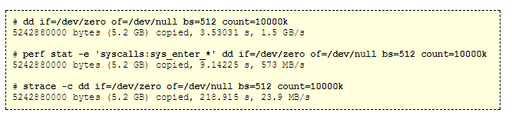
perf vs strace
With perf program ran 2.5 slower but with strace it ran 62x slower although the difference will not be much if the syscalls are not so frequent.

Slide 28
References:
http://www.brendangregg.com/perf.html#SCALE13x
http://oliveryang.net/2016/07/linux-perf-tools-tips/

