Slide 1
Napali SW DCVS

Slide 2
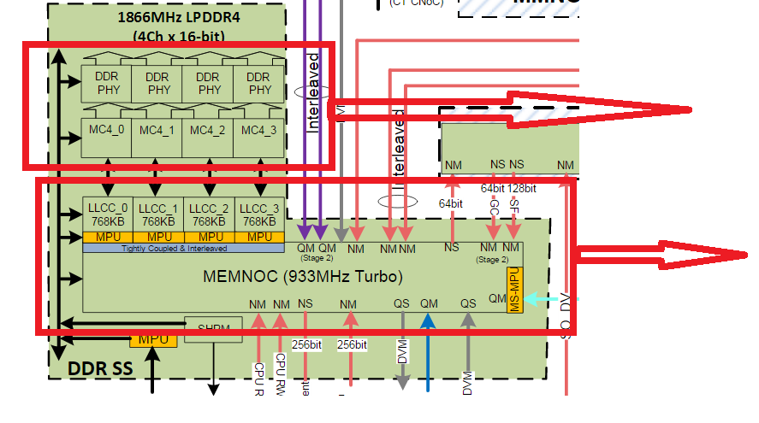
Building blocks
Same Clock domain MC4 (new BIMC) and DDR phy
Same Clock domain MEMNOC and LLCC
Memnoc and LLLC are handled with the same clock domain
MC4 and DDR PHY HW will be handled in the same clock domain.
MC4 is enhanced version of the BIMC used in the legacy target.

Slide 3
Possibilities
DCVS | L3 Scaling L2 -> L3 traffic | LLCC scaling L3->LLCC traffic | DDR Scaling LLCC-> DDR Traffic
Memlat | L2 miss counts from PMU (Legacy memlat governor) | L3 miss count, For testing purpose reuse the CPU PMU counters used for L2 miss counter. 3) Need confirmation on availability of PMU counters. Note: Possibility of optimization in PMU framework to reuse the common events from the same counters. 3) Rohit uploaded the gerrits. | No Per CPU LLCC miss stats available Project based on L3 miss count, and bwmon2 cpuss traffic which discussed more in point 3 3) Get L3 miss from 1st row 2nd column driver and cpuss total traffic from the bwmone counters filtering traffic from CPUSS () No change in governor, add all projections related code in LLCC counter drivers which reads both L3 miss counts and BWMON2 counters (which is LLCC misses of all traffic from CPUSS) (channel 0, instance 1. Get counters and multiply by 4 to get total traffic from CPUSS. Don’t read for all the channels. Same is being done for avg bw voting.). Set up big sample window to minimize interrupts compared to avg BW voting. Note: BWMON1 counters are not present in Napali.
Average BW voting | 1) Based on the cache hit + miss counts 2) We need confirmation from the Corinth document to get the details of L3 cache Bwmon counters – AI Santosh 3) Counters in L3 that counts all the traffic from L2 (i.e L2 misses) check if any PMU counters in L3 module. | Memnoc BWMON2 counters to measure traffic from L3 to LLCC (measures traffic only from CPUSS) | 1) LLCC BWMON2 counts the traffic between LLCC -> DDR 2) Channel 0, instance 0 (Get counters and multiply by 4 to get total traffic from CPUSS. Not reading for all the channels) 3) This is verified Rohit has updated the gerrits.
QIPL team will be handling this.

Slide 4
SW Block diagram
DEVFREQ
Governor_memlat.c
Arm-mem-lat.c
Llcc-memlat.c
New modules to be written.

Slide 5
LLCC scaling L3->LLCC traffic (memlat)
CPUSS L3 miss counter details
Anaken and pramethous have per core L3 PMU counters
Setup the L3 PMU counters
Read at fixed interval
Get per core L3 miss counter contribution in terms of percentage
The Ananke TRM lists the events (page 530+):
Event#, Event name, description
0x0029 [33] L3D_CACHE_ALLOCATE Attributable Level 3 unified cache allocation without refill
0x002A [34] L3D_CACHE_REFILL Attributable Level 3 unified cache refill -> tested to be working
0x002B [35] L3D_CACHE Attributable Level 3 unified cache access
0x00A0 - L3D_CACHE_RD Attributable Level 3 unified cache access, read
0x00A2 - L3D_CACHE_REFILL_RD Attributable Level 3 unified cache refill, read -> not working.
0x00C0 - L3D_CACHE_REFILL_PREFETCH Level 3 cache refill due to prefetch
The Prometheus TRM lists the events (page 539+):
Event#, Event name - description
0x29 L3D_CACHE_ALLOCATE - Attributable Level 3 data or unified cache allocation without refill.
0x2A L3D_CACHE_REFILL - Attributable Level 3 data or unified cache refil. -> tested to be working
0x2B L3D_CACHE - Attributable Level 3 data or unified cache access.
0xA0 L3D_CACHE_RD - Attributable Level 3 data or unified cache access, read.
0xA2 L3D_CACHE_REFILL_RD - Attributable Level 3 data or unified cache refill, read.

Slide 6
DDR Scaling LLCC-> DDR Traffic (memlat)
We cannot have the legacy memlat governor implemented based on L3 miss counts because of LLCC coming in between L3 and DDR.
L3 miss from the per CPU can be read with the PMU in anaken and promethus cores
Read the LLCC BWMON counters which are filtered with the CPUSS ID and this counts will give total traffic generated from LLCC to DDR from CPUSS
Project the traffic to DDR from CPUSS based on 1 & 2 counters as describe below.
With the total BWMON2 count and L3 Miss counters we need to interpolate the total count in terms of the L3 CPU miss percentage and interpolate the
Cpu contribution into DDR traffic.
For example consider
Read per CPU L3 counters
Calculate per CPU L3 miss percentage of total miss counts. Eg: CPU0: 10%, CPU1: 30%, CPU2: 20% & CPU3: 40%
Reat the LLCC BWMON2 count and interpolate in terms of the same percentage mentioned above
Consider the BWMON COUNT is X and interpolation of per CPU LLCC misses as below
a. CPU0 is 10% of X
b. CPU1 is 30% of X
c. CPU2 is 20% of X
d. CPU3 is 40% of X
This gives the per cpu LLCC miss count and which can help on voting the DDR IB using memlat governor.

Slide 7
L3 Scaling L2 -> L3 traffic (memlat)
Anaken and pramethous have per core L3 PMU counters
Setup the L2 PMU counters
Read at fixed interval
Get per core L2 miss counter contribution and apply the legacy mem lat and scale L3 accordingly.
Event number PMUEVENT bit position Event mnemonic Description
0x0016 [20] L2D_CACHE Level 2 cache access
0x0017 [21] L2D_CACHE_REFILL Level 2 cache refill
0x0018 [22] L2D_CACHE_WB Level 2 cache write-back

Slide 8
L3 Scaling L2 -> L3 traffic (Average BW voting)
Pending Activity.
Refer Corinth document for availability of L3 cache BWMON counters (Counters in L3 that counts all the traffic from L2 (i.e L2 misses))

Slide 9
LLCC scaling L3->LLCC traffic (Average BW voting)
DDR bwmon2 (sitting on MEMNOC before LLCC) taking account traffic between L3 and LLCC: bus vote Apps->LLCC
will be taken based on the bwmon counters on the memnoc.
Legacy BWMON is verified on Napali RUMI.
Note: Mail with the subject “status BWMON2 verification on napali RUMI” have details of this verification
Reference for the address of this bw mon counters.
http://ipcatalog.qualcomm.com/swi/chip/99/version/1768/module/1053759?show_ar=null

Slide 10
DDR Scaling LLCC-> DDR Traffic (Average BW voting)
No Per CPU LLCC miss stats available
Project based on L3 miss count,
and bwmon2 cpuss traffic which discussed more in point 3
3) Get L3 miss from 1st row 2nd column driver and cpuss total traffic from the bwmone counters filtering traffic from CPUSS ()
No change in governor, add all projections related code in LLCC counter drivers which reads both L3 miss counts and BWMON2 counters (which is LLCC misses of all traffic from CPUSS) (channel 0, instance 1. Get counters and multiply by 4 to get total traffic from CPUSS. Don’t read for all the channels. Same is being done for avg bw voting.).
Set up big sample window to minimize interrupts compared to avg BW voting.
Note: BWMON1 counters are not present in Napali.

Slide 11
Questions
Can the system handle both the bwmon2 on Memnoc and other on LLCC will there be no impact on power and performance as we will be getting more interrupts.
Answer – yes system can handle
Is the LLCC scaling handled like DDR in RPM where all the clients give vote to RPM and RPM decides the max of AB/IB?
In the legacy target the voting to RPM from the CPUSS was taken care by bus driver. What will be the center entity for this?
Answer – yes Bus Driver voting takes care of LLCC, port need details needs to be passed.

Slide 12
Unit tests - TBD
Details of test setup
Unit Test cases and results

Slide 13
Testing and Evaluation by Power/Perf - TBD
Capture all the measurements results and graphs from the power/perf evaluation.
Details of test setup

Slide 15
DDR Scaling LLCC-> DDR Traffic (memlat) – DELETE SLIDE
LLCC MISS counters
LLCC module have the counters to count how many LLCC miss has happened
Set up the LLCC counters to read the LLCC miss
Read the counter at the same interval when the L3 miss is calculated
Possible counters in BEAC module of LLCC
In TRP module of the LLCC
LLCC is a global counter which counts all the reads to LLCC from different master in the target.
According to the arch team they have informed there is no way to filter out the events from the different master.
References for the address are here
http://ipcatalog.qualcomm.com/swi/chip/99/version/1768/module/1053589?show_ar=null#LLCC0_LLCC_PERFMON_DEBUG_CTRL
No. | Event | Description | Obs. Point | Filter | Scaled
0 | RD_TX | Read command sent to MC | BEAC2MC | Yes | No
1 | WR_TX | Write command sent to MC | BEAC2MC | Yes | No
4 | RD_HIT | Read access hits in system cache | PS3 | Yes | No
5 | WR_HIT | Write access hits in system cache | PS3 | Yes | No
6 | RD_MISS | Read access misses in system cache | PS3 | Yes | No
7 | WR_MISS | Write access misses in system cache | PS3 | Yes | No

