Slide 1
ARMv8 Memory Model
Shiraz Hashim

Slide 2
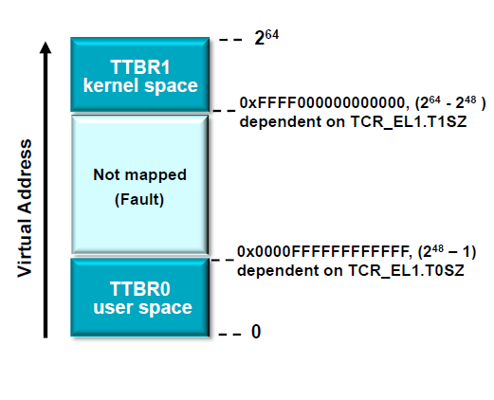
ARMv8 Memory Model
Address Space
Separate TTBR register for user and kernel
Selection based on higher bits of the virtual address
Maximum 48-bit virtual address for each TTBR
IPA supports 48 bits on same basis
Maximum 48-bit physical address
Upper 8 bits of the address can be configured for Tagged Pointers

Slide 3
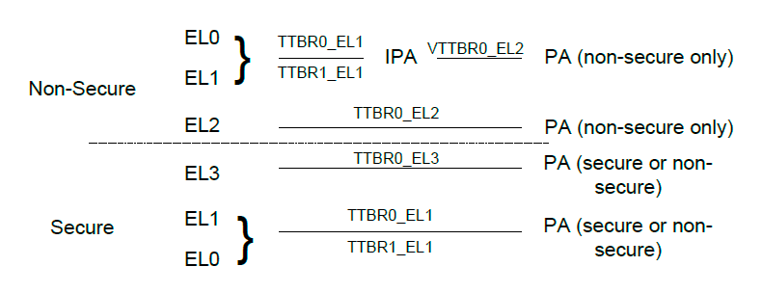
ARMv8 Memory Model
Address Space
Exception levels above EL0 manage their own translation context, Translation base address, control registers, exception syndrome etc
EL0 translation managed by EL1
EL2 manages an additional stage2 of translation for EL1/EL0 in the Non-secure state only

Slide 4
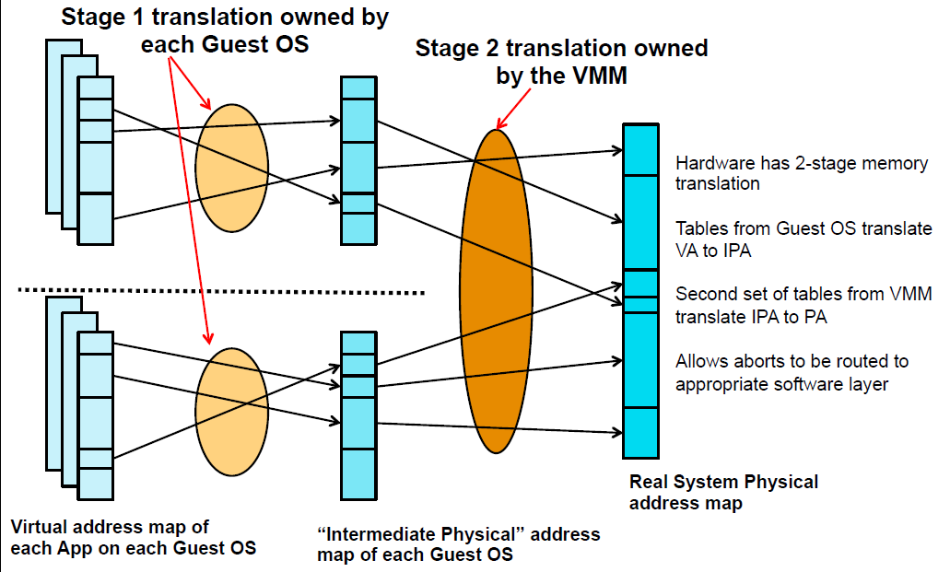
ARMv8 Memory Model
Address Space

Slide 5
ARMv8 Memory Model
Address Space
Input address size
TCR.TxSZ fields specify the input address size
IPA address size
TCR.IPS fields specify the Intermediate Physical Address Size
Physical address size
The ID_AA64MMFR0_EL1.PARange field indicates the implemented physical address size

Slide 6
ARMv8 Memory Model
Address Space
Address calculations are done using 64bit registers
supervisory software can configure the top eight address bits for use as a tag
If this is done, address bits[63:56]
Are not considered when determining whether the address is valid
Are never propagated to the program counter

Slide 7
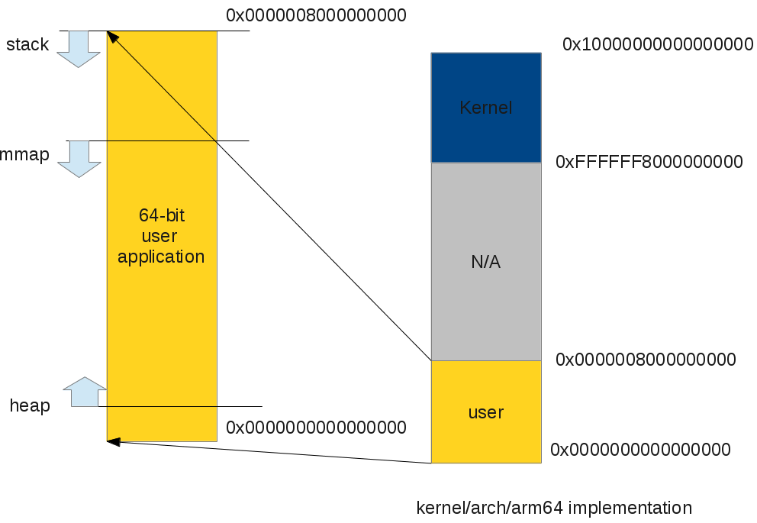
ARMv8 Memory Model
Linux Address Space
0x0000007FFFFFFFFF
0xFFFFFFFFFFFFFFFF
0xFFFFFF8000000000
0x0000007FFFFFFFFF
0x0000000000000000
0x0000000000000000

Slide 8
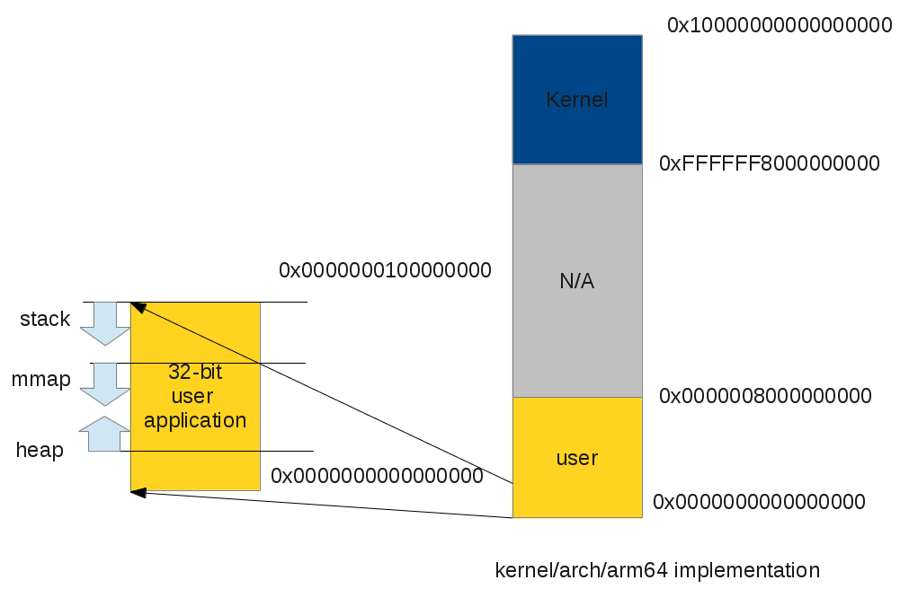
ARMv8 Memory Model
Linux Address Space
0x0000007FFFFFFFFF
0xFFFFFF8000000000
0x00000000FFFFFFFF
0x0000007FFFFFFFFF
0x0000000000000000
0x0000000000000000

Slide 9
ARMv8 Memory Model
Linux Address Space
39-bit virtual address for both user and kernel
0000000000000000-0000007fffffffff (512GB) : user
[architectural gap]
ffffff8000000000-ffffffbbfffeffff (~240GB) : vmalloc
ffffffbbffff0000-ffffffbcffffffff (64KB) : [guard]
ffffffbc00000000-ffffffbdffffffff (8GB) : vmemmap
ffffffbe00000000-ffffffbffbffffff (~8GB) : [guard]
ffffffbffc000000-ffffffbfffffffff (64MB) : modules
ffffffc000000000-ffffffffffffffff (256GB) : mapped RAM

Slide 10
ARMv8 Memory Model
Linux Address Space
arch/arm64/include/memory.h
#ifdef CONFIG_ARM64_64K_PAGES
#define VA_BITS (42)
#else
#define VA_BITS (39)
#endif
#define PAGE_OFFSET (UL(0xffffffffffffffff) << (VA_BITS - 1))
#define MODULES_END (PAGE_OFFSET)
#define MODULES_VADDR (MODULES_END - SZ_64M)
#define FIXADDR_TOP (MODULES_VADDR - SZ_2M - PAGE_SIZE)
#define TASK_SIZE_64 (UL(1) << VA_BITS)
#ifdef CONFIG_COMPAT
#define TASK_SIZE_32 UL(0x100000000)
#define TASK_SIZE (test_thread_flag(TIF_32BIT) ? \
TASK_SIZE_32 : TASK_SIZE_64)
#else
#define TASK_SIZE TASK_SIZE_64
#endif /* CONFIG_COMPAT */

Slide 11
ARMv8 Memory Model
MMU Support
Two different translation granules: 4KB and 64KB
Number of translation tables and maximum VA range:
4KB and 4 levels => 48-bit VA
64KB and 3 levels => 48-bit VA (top table partially populated)
4KB and 3 levels => 39-bit VA (currently used by AArch64 Linux)
64KB and 2 levels => 42-bit VA
Large page (block) mapping supported
2MB and 1GB with 4KB page configuration
512MB with 64KB page configuration

Slide 12
ARMv8 Memory Model
MMU Support
4-level lookup, 4KB translation granule, 48-bit address
9 address bits per level
2-level lookup, 64KB page/page table size, 42-bit address
13 address bits per level
3 levels for 48 bits of VA –top level table is a partial table
64-bit Translation table entry format

Slide 13
ARMv8 Memory Model
Linux MMU Support
4KB page configuration
3 levels of page tables
Linear mapping using 4KB, 2MB or 1GB blocks
64KB page configuration
2 levels of page tables
Linear mapping using 64KB or 512MB blocks
AArch32 (compat) not supported because the 32-bit ABI assumes 4KB pages
SPARSEMEM support
SPARSEMEM_VMEMMAP optimization for virtual mapping of the struct page array (mem_map)

Slide 14
ARMv8 Memory Model
Memory Types
Normal
Bulk memory operations, R/W, R/O
Device
Speculative reads forbidden
Additional attributes
Non-Gathering (nG)
Prevents aggregation of R/W
Non-Reordering (nR)
Preserves access order and synchronization requirements
Non-Early write acknowledgement (nE)
Write can be acknowledged at the end point

Slide 15
ARMv8 Memory Model
Memory Types
Shareability
Non-shareable, inner shareable, outer shareable
Cacheability
Non-cacheable, write-through cacheable, write-back cacheable

Slide 16
ARMv8 Memory Model
Memory Types
arch/arm64/include/memory.h
/*
* Memory types available.
*/
#define MT_DEVICE_nGnRnE 0
#define MT_DEVICE_nGnRE 1
#define MT_DEVICE_GRE 2
#define MT_NORMAL_NC 3
#define MT_NORMAL 4

Slide 17
ARMv8 Memory Model
Mismatched Attributes
Physical memory locations are accessed with mismatched attributes if all accesses to the location do not use a common definition of all of the following attributes of that location:
Memory type, Device or Normal.
Shareability.
Cacheability, for the same level of the inner or outer cache
Collectively these are referred to as memory attributes.
ARM strongly recommends not to use mismatched attributes for aliases of the same location. An implementation might not optimize the performance of a system that uses mismatched aliases.

Slide 18
ARMv8 Memory Model
Cache Maintenance
Higher Exception level can enable EL0 access to the following:
data cache maintenance instructions (DC CVAU, DC CVAC, and DC CIVAC)
instruction cache maintenance instruction, (IC IVAU)
cache type register (CTR_EL0)
data cache zero instruction, (DC ZVA)

Slide 19
ARMv8 Memory Model
Memory Ordering
ISB
flushes the pipeline in the PE
DMB
data memory barrier
Takes required shareability domain and required access types as arguments
DSB
synchronizes the execution stream with memory accesses
Takes required shareability domain and required access types as arguments

Slide 20
ARMv8 Memory Model
Memory Ordering (DSB/DMB)
Shareability Domain Argument
Full system
Outer Shareable
Inner Shareable
Non-shareable
Access Type Argument
Read and write accesses in Group A and Group B.
Write accesses only in Group A and Group B.
Read access only in Group A.

Slide 21
ARMv8 Memory Model
Memory Ordering (DSB/DMB)
arch/arm64/include/asm/barrier.h
#define isb() asm volatile("isb" : : : "memory")
#define dmb(opt) asm volatile("dmb " #opt : : : "memory")
#define dsb(opt) asm volatile("dsb " #opt : : : "memory")
#define mb() dsb(sy)
#define rmb() dsb(ld)
#define wmb() dsb(st)

