Slide 1

CAPSTONE PROJECT Project name :- Android google play store applications analysis Name:-Naresh Kumar Student ID: - 0767830 Name of Supervisor: - Dr. Savita Seharawat Date of Submission: - 31st January

Slide 2

Basic information about project (Abstract)
My project name is Android Google Play applications analysis, moreover, known as the Google Play Store, and in which I used androiddataset.csv dataset in which 1048575 records and 24 attributes. With the help of android google play store we will download or purchase millions of apps, diversions, and other media onto your Android gadget. You'll be able discover programs for a wide cluster of interfaces. You'll be able download apps or recreations by exploring to the app or amusement page inside the Play Store and tapping Introduce. Numerous apps will be free, a few will have in-app promotions, a few will fetch cash, whereas others may offer in-app buys, or a combination of any of these things. For those who are interested, there's the Google Play Pass, which allows you to download hundreds of apps and recreations for complimentary, without advertisements or in-app buys.so in this data we have some important attributes and value that help us to understand all functions of this dataset. Its a stage. It’s Google’s stage for advertising different advanced substance to its customers. Opposite to what a few individuals may think, the Google Play Store isn't fair an app store, not at all. You'll discover all sorts of substance accessible here. The Google Play Store is domestic to music, motion pictures, books, and recreations

Slide 3
RESEARCH QUESTIONS
Question 1)- find how many applications are free, ad supported using pie chart?
Solution:- 99.4 % applications are free of cost for the customers , also same percentage is noticed in applications that supported ads that is 99.4% and 0.6% applications are paid and also not supported ads.
Question – 2) Which category of content rating show highest numbers that shows rating corresponding to application.
Solution: - from all categories of content rating I find that people those are 18+ , they give more rating to the applications.

Slide 4
Question 3) find accuracy of this project(dataset) by using different methods and also compare each other model to check which one is best as compared to the others? Solution: - I used four models to find accuracy of this project That is Logistic regression , KNN model , Naïve bayes model and random forest classifier model . Logistic regression accuracy is 59.33 KNN model accuracy is 54.91 Naïve bayes model accuracy is 59.09 Random forest classifier accuracy is 56.88 So accuracy that we find with the help of logistic regression is best for our model that is 59.33

Slide 5
Methodology:
Data preprocessing
Experimental Design
Model implementation and value
Conclusion

Slide 6
Numerical attributes
contain summary of dataset it is showing the numeric attributes of count, mean or average, is calculated by adding up the scores and dividing the total by the number of scores, standard deviation is a measure of dispersion of data values from the mean.
Attributes Name | count | mean | std | min | 25% | 50% | 75% | max
Rating | 1038265 | 2 | 2 | 0 | 0 | 3 | 4 | 5
Rating_Count | 1038265 | 2937 | 255967 | 0 | 0 | 6 | 42 | 1.39E+08
Minimum_Installs | 1048529 | 176200 | 13259642 | 0 | 50 | 500 | 5000 | 5E+09
Maximum_Installs | 1048575 | 304457 | 20466334 | 0 | 84 | 695 | 7361 | 9.77E+09
Price | 1048575 | 0 | 3 | 0 | 0 | 0 | 0 | 400

Slide 7
Missing values
Missing values are the null values in a dataset. When there is no value stored for any variable in an observation then that condition is treated as null/missing or N/A value. If there is an availability of null values in any dataset, then our result will never be accurate
Developer_Website | 100692
Privacy_Policy | 55600
Released | 9349
Rating | 3033
Rating_Count | 3033

Slide 8

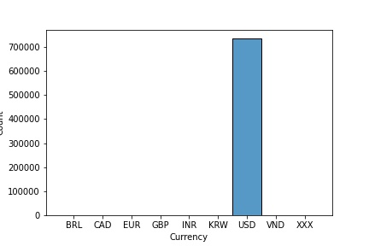
Data visualization
(Count vs Currency) :-
This bar graph represents the information between currency and counts. We can see that from this graph that the counts of USD currency has highest as compared to others. It is nearly 700000.

Slide 9
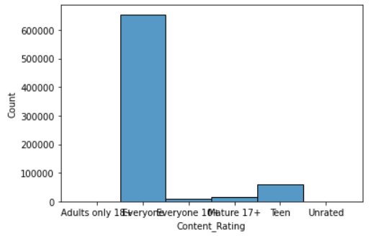
Show highest content rating category
We can noticed that people who are 18+ that people give highest rating to the content of all application as compare to the other categories( adults only , everyone , mature , 17+ , Teen , Unrated) like more then as a 60,00,00 counts number

Slide 10
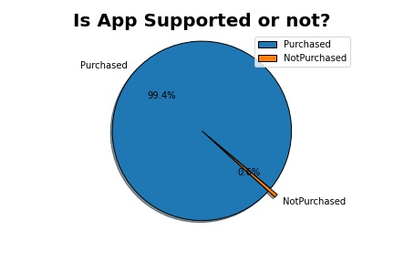
Show how many applications are supported purchased feature.:-
In this pie chart the blue colour represent the percentage of apps which are purchased that is 99.4% and the yellow colour represents the apps which are not purchased that are 0.6%.

Slide 11
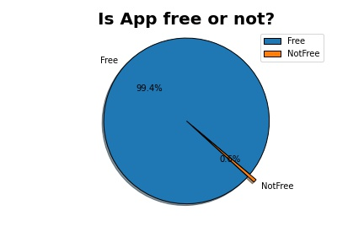
Show how many applications are free of cost to the customer:-
The pie chart is showing the percentage of apps that are free or not free. There are 99.4% apps that are free of cost. And the rest are not free.

Slide 12

Model implementation
K-nearest neighbour
Logistic regression
Naïve bayes
Random forest classifier
Cross validation

Slide 13
Knn : - The KNN stands for “K-Nearest Neighbour”. It is a supervised machine learning algorithm. The algorithm can be used to solve both classification and regression problem statement.
Logistic regression :- This model is supervised learning classification algorithm. It is used to predict the value of target variable.
naïve bayes : - Naive Bayes is a classification technique based on Bayes' Theorem with an assumption of independence among predictors

Slide 14
Random Forest CLASSIFIER: It is a Supervised Machine Learning Algorithm that is used widely in Classification and Regression problems. It builds decision trees on different samples and takes their majority vote for classification and average in case of regression.
Cross Validation:- It is a resampling method that uses different portions of the data to test and train a model on different iterations.

Slide 15
Models result
Model | train_test_split
0 | Logistic Regression | 59.334262
1 | knn | 54.917170
2 | Naive Bayes | 59.098932
3 | Random Forest | 56.880322
After implementation of models we can see logistic regression model is the best model to find accuracy of the project that is 59.33 that is best accuracy of the different models.

Slide 16
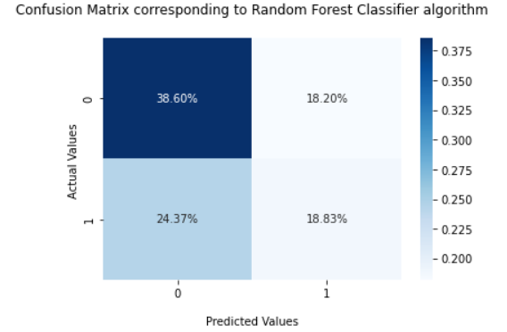
Confusion matrix
Well, it is a performance measurement for machine learning classification problem where output can be two or more classes. It is a table with 4 different combinations of predicted and actual values.and it a tabular summary of the number of correct and incorrect predictions made by a classifier

Slide 17
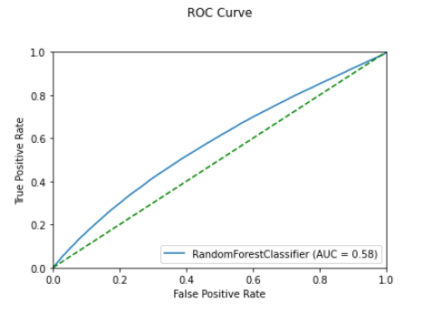
ROC CURVE (RECEIVER OPERATING CHARACTERISTIC)
Roc curves are widely used in binary classification to study the output of a classifier . ROC curve, is a graphical plot that illustrates the diagnostic ability of a binary classifier system as its discrimination threshold is varied. The method was originally developed for operators of military radar receivers starting in 1941, which led to its name.

