Slide 1
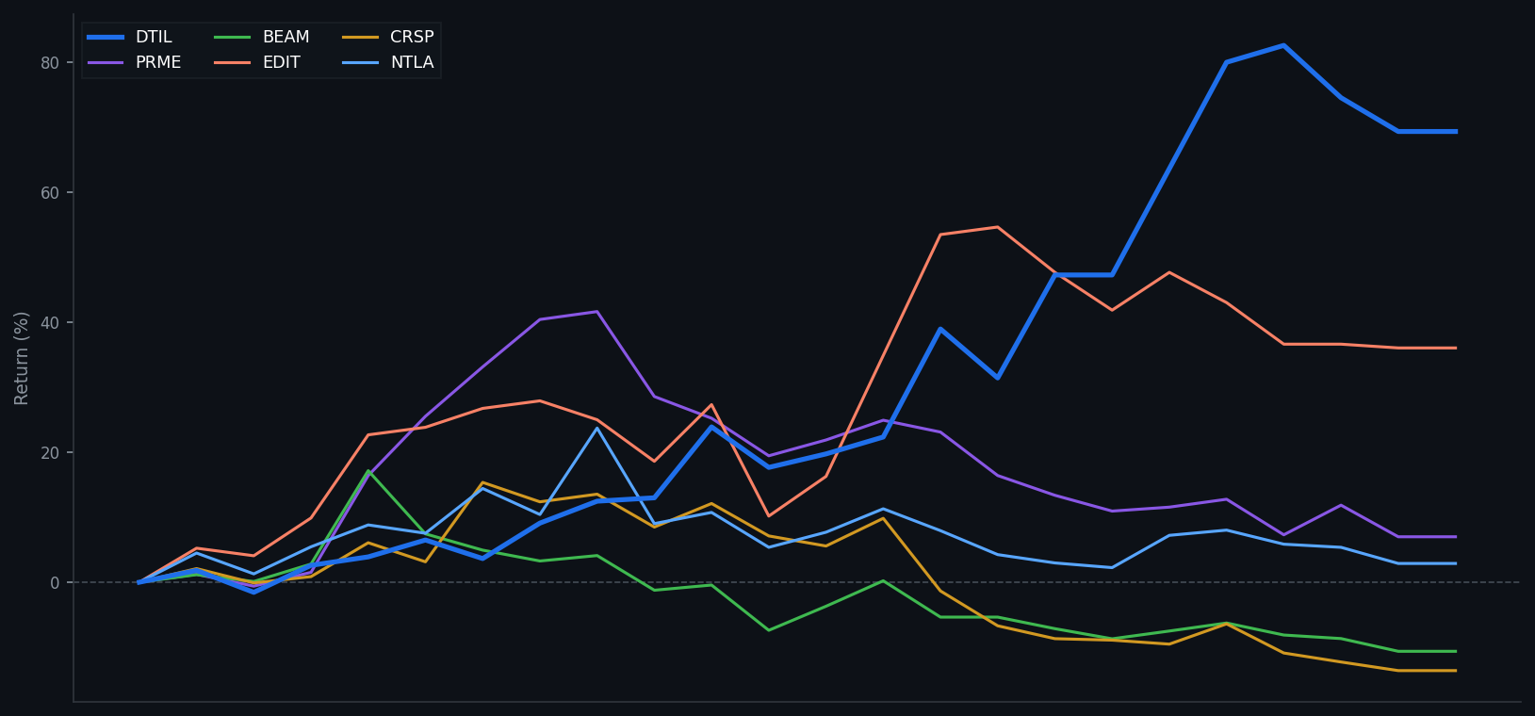
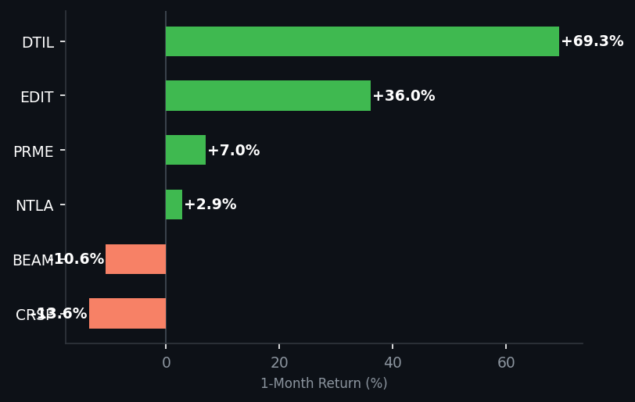
Biotech Portfolio — 1-Month Performance
Feb 20 – Mar 22, 2026 | DTIL · PRME · BEAM · EDIT · CRSP · NTLA
DTIL
PRME
BEAM
EDIT
CRSP
NTLA
+69.35%
+6.99%
-10.63%
+36.05%
-13.60%
+2.88%
$6.52
$3.52
$24.63
$2.34
$46.24
$12.84
Source: Yahoo Finance | For internal use only — not for distribution

