Slide 1


WELCOME! TO CAMPUS CHAM

Slide 2
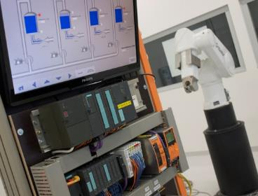
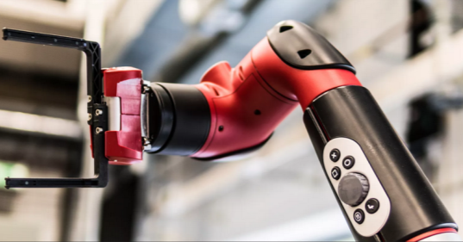

CAMPUS CHAM
Energy Optimization of e-VTOL systems using Simulation-Based Analysis
Author: Team Fire
Cham

Slide 3

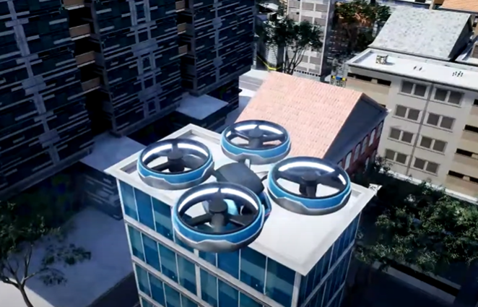
Introduction
System Inefficiencies
Non-Optimized System Weight
Unnecessary Energy Consumption
Flight Time
More Expensive Battery Pack

Slide 4

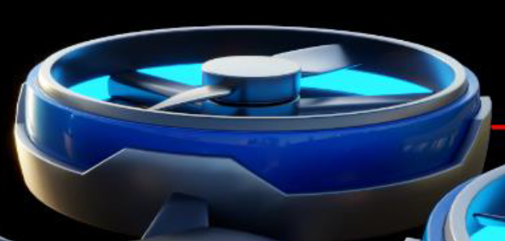
Aim & Objectives
What Do We Plan to Achieve?
Lower budget motor-battery package
Less energy for the same distance
More efficient e-vtol systems
Lighter e-vtol systems

Slide 5
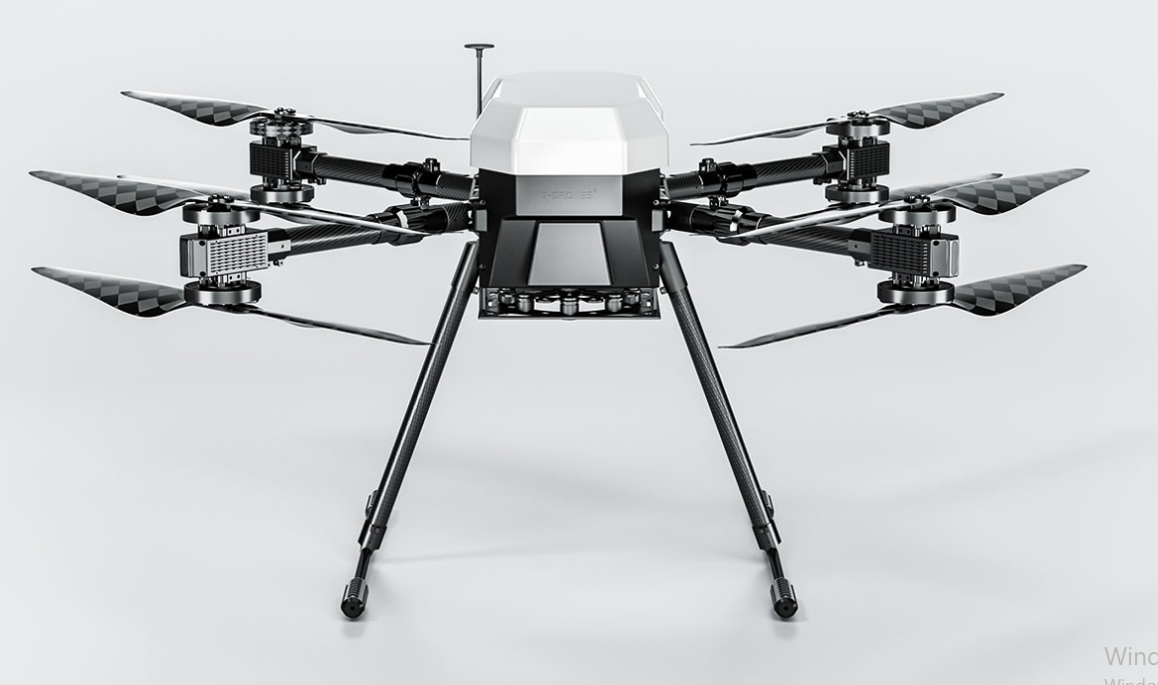
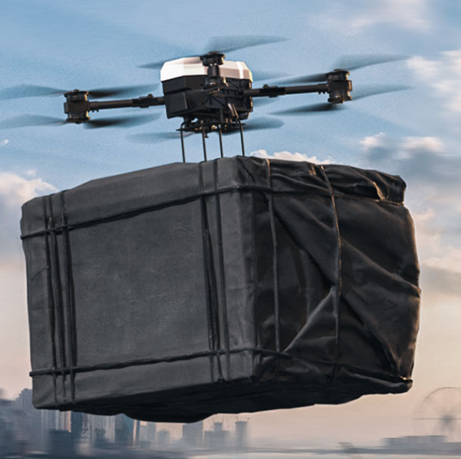
System Description
MX860 Vertical Take-Off and Landing

Slide 6
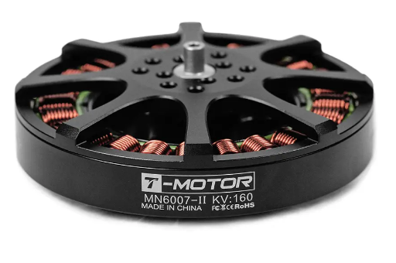
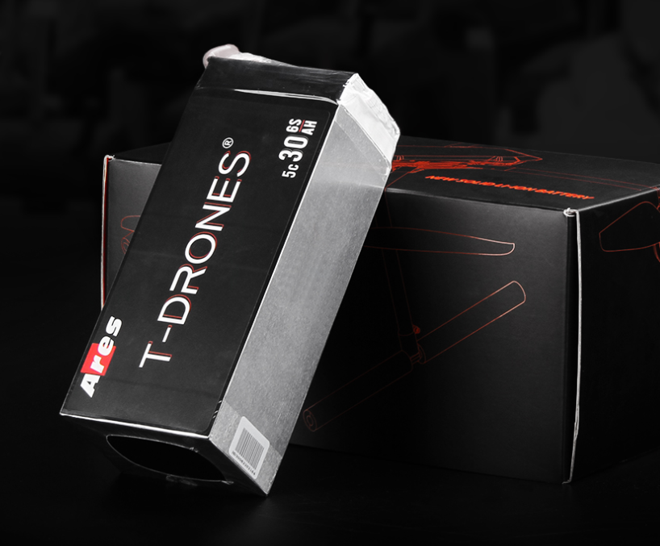
System Specifications
Specification | Value
Max Take-off Weight | 19.96 kg
Weight (with Battery) | 9.96 kg
Battery | 2 × 6S 30Ah 22.2 V (Total: 60Ah, 5.2 kg)
Hover Time ( 9 kg) | 24 minutes
Motor Configuration | 8 × T-MOTOR MN6007 KV320

Slide 7
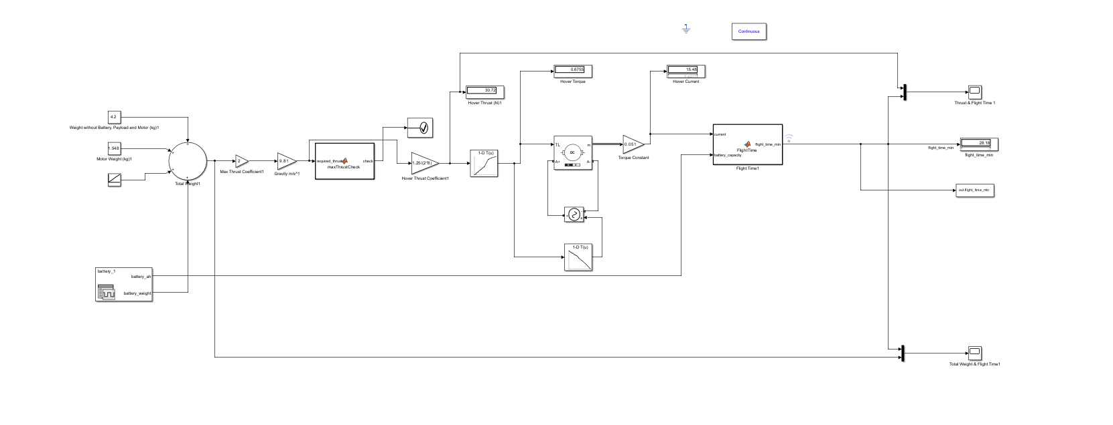
Simulink Model Architecture

Slide 8
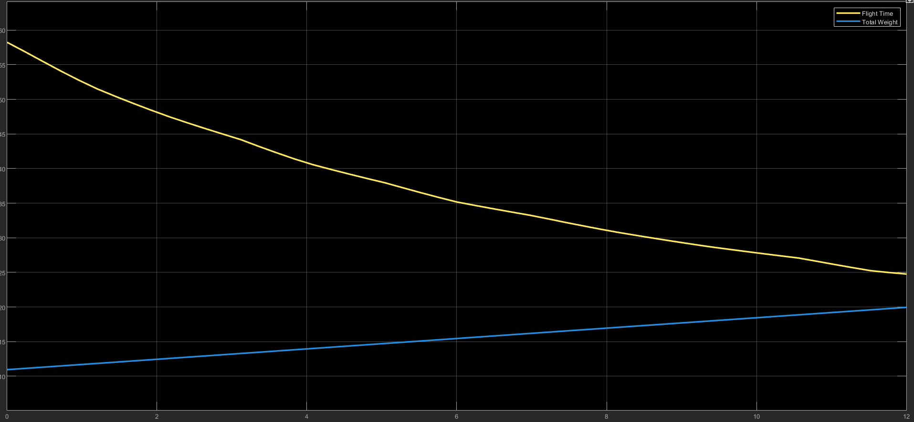
Simulation Outputs Flight Time vs Total Weight (Ares)

Slide 9
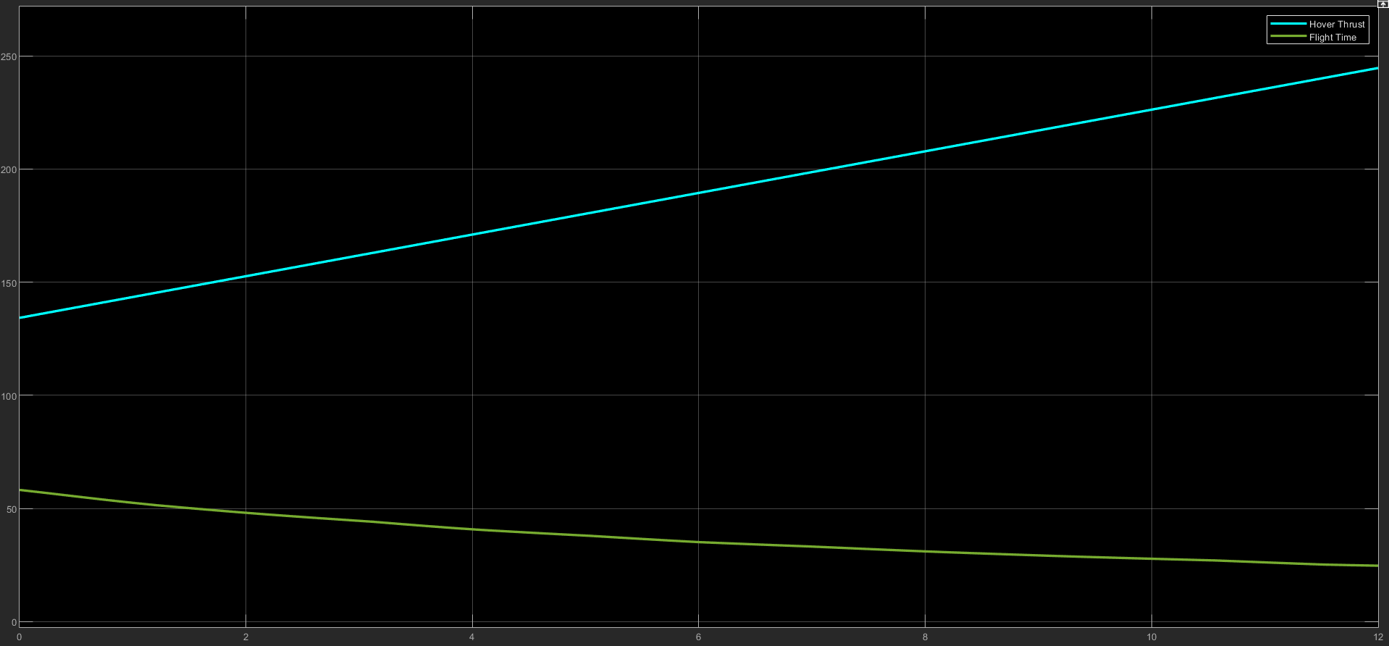
Simulation Outputs Flight Time vs Hover Thrust (Ares)

Slide 10
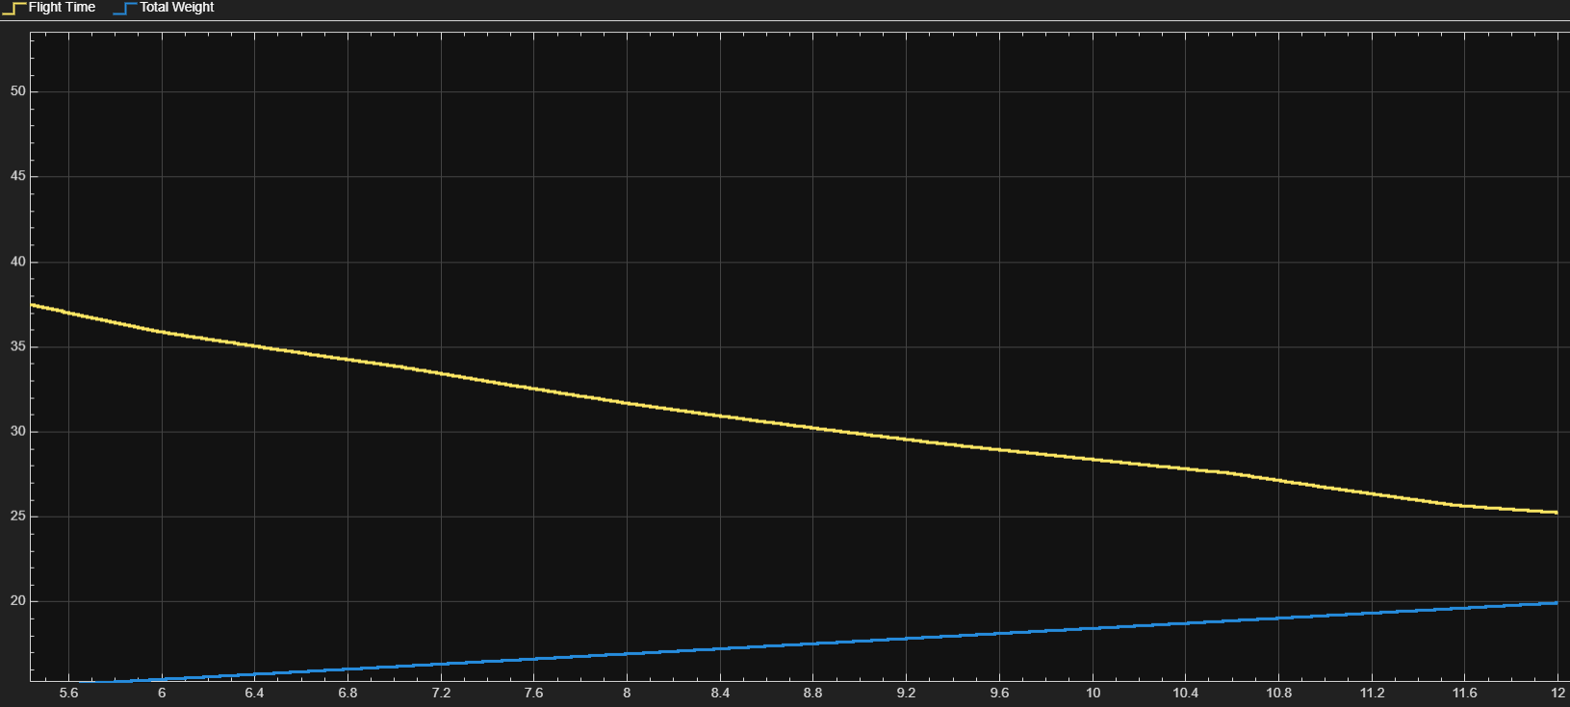
Simulation Outputs Flight Time vs Total Weight (XTAR)

Slide 11
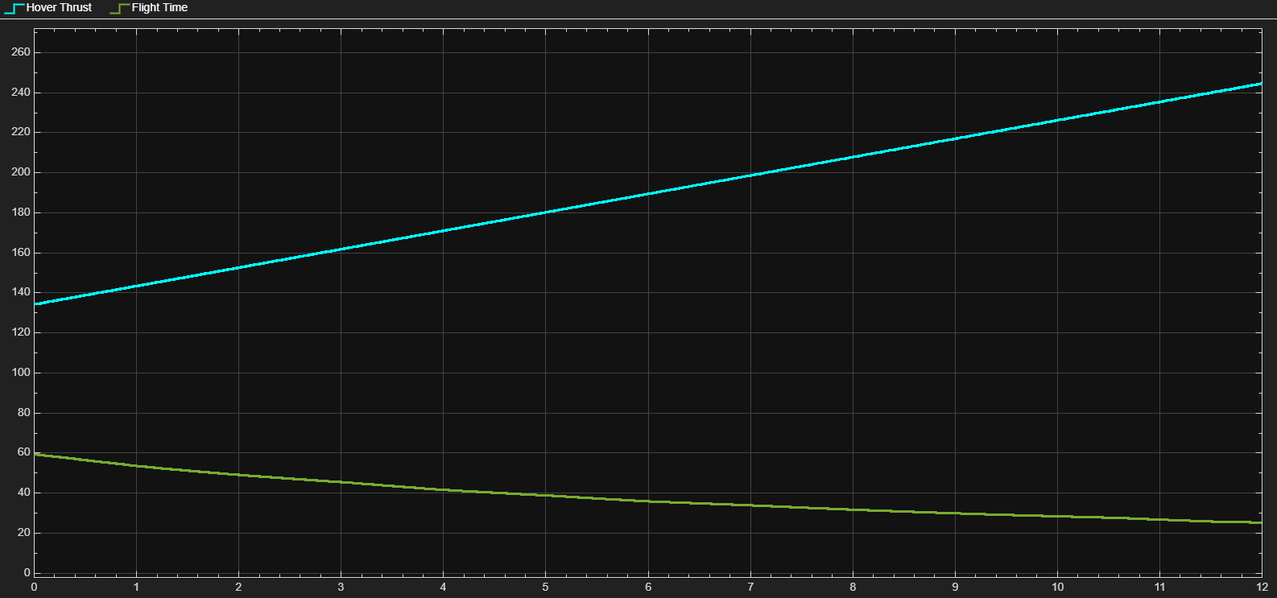
Simulation Outputs Flight Time vs Hover Thrust (XTAR)

Slide 12
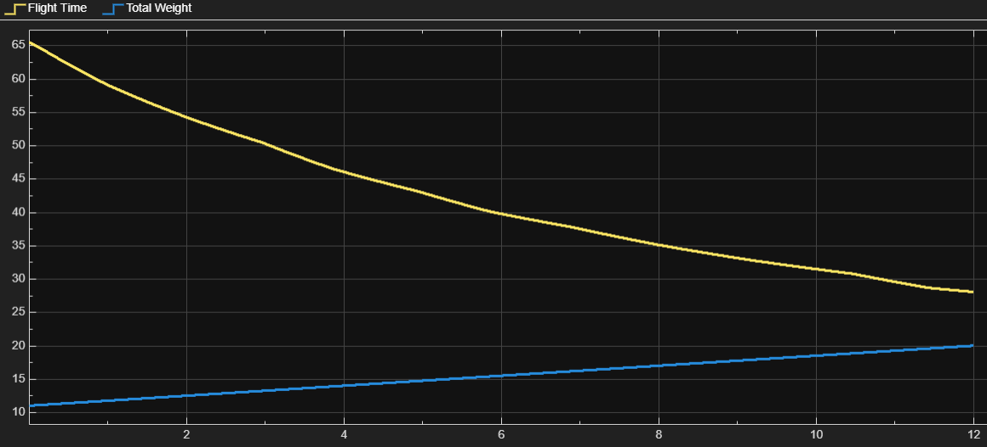
Simulation Outputs Flight Time vs Total Weight (Keeppower)

Slide 13
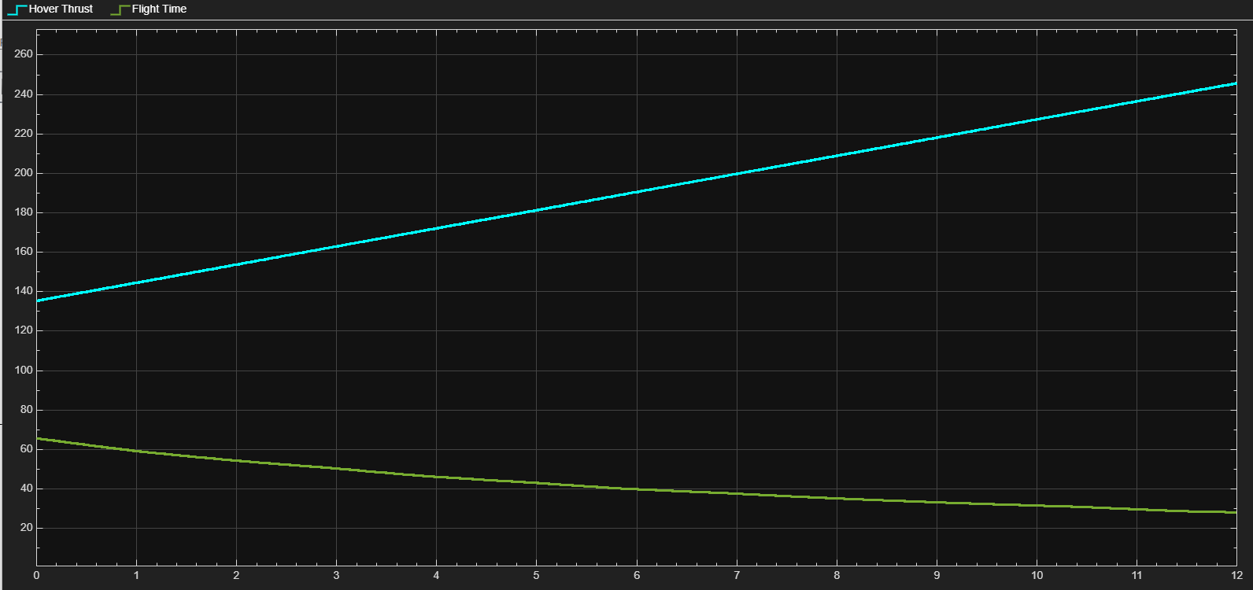
Simulation Outputs Flight Time vs Hover Thrust (Keeppower)

Slide 14
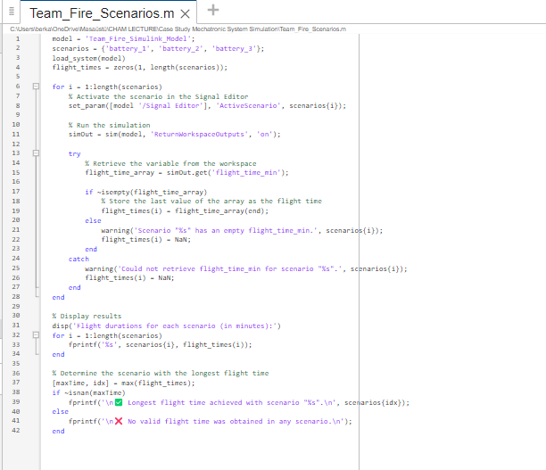

The Algorithm of Optimization
Output

Slide 15
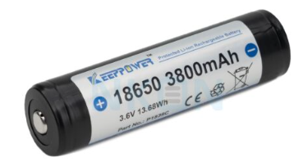
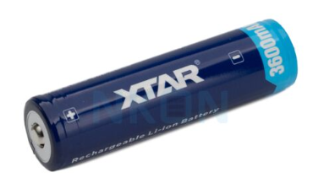
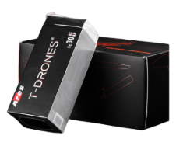
System Specifications
Specif. | Value
Battery Name | Keeppower | XTAR | Ares Base Model
Battery Weight | 49x6x18= 5292 gr | 51x6x17= 5202 gr | 2600x2= 5200 gr
Battery Capacity | 68.4 Ah | 61.2 Ah | 60.0 Ah
Battery | 18 x 6S 22.2 V | 17 x 6S 22.2 V | 2 × 6S 22.2 V

Slide 16
Analysis of energy inefficiencies
Specif. | Value
Battery Name | Keeppower | XTAR | Ares Base Model
Hover Time ( 9 kg) | 28.1 | 25.2 | 24.7
Flight Time is for the same battery weight
Flight Time Improvement Percentage | 13.77% | 2.02% | 24.7
Or energy use is for the same flight duration
Energy Utilization | 1181 Wh 11.3% | 1278 Wh 4.05% | 1332 Wh

Slide 17
Future Scope
Batteries with higher energy capacity
Current battery energy density averages around 250–300 Wh/kg, with expectations to reach 400 Wh/kg in 5 years and up to 500–600 Wh/kg in 10 years through advancements.
Advanced AI support
With advanced AI algorithms, more efficient and adaptive flight profiles can be generated based on real-time payload, mission type, and battery status.
Next-Gen Power Technologies
Future integration of alternative energy sources such as hydrogen fuel cells and nuclear batteries could significantly extend flight endurance and reduce reliance on conventional lithium-based systems.
Modular Power Systems
Designing swappable battery/motor modules to adapt the aircraft for different missions and payloads.

Slide 18
Project Plan
📅 30.04.2025 ➔ Concept Presntation (TASK 1)
📅 01.05.2025 – 10.05.2025
➔ Component Library Creation (Weight, Energy Capacity, Power Consumption, Price)
📅 11.05.2025 – 20.05.2025 ➔ Simulation of Example System (Motor Selection, Battery Matching, Energy Consumption Calculation, Visualization)
📅 21.05.2025 ➔ System Simulation Presentation (TASK 2)

Slide 19
Project Plan
📅 22.05.2025 – 10.06.2025
➔ Optimization Model Development
📅 11.06.2025 – 17.06.2025
➔ Final Simulation and Comparison
📅 18.06.2025
➔ Final Presentation (TASK 4)
📅 01.06.2025 – 01.07.2025
➔ Report Writing (IEEE Format)

Slide 20
References
Data Source: T-MOTOR Official Website – MN6007 KV320 Datasheet and Ares Battary
Data Source: Keeppower 18650 3800mAh Specification Sheet
Data Source: XTAR 18650 3600mAh Specification Sheet
H. Taghbalout, L. A. Doustmohammadi, M. Shahbakhti, "Energy Management of an eVTOL Aircraft with Optimization-Based Powertrain Control," 2024 IEEE Transactions on Transportation Electrification, 2024.
P. Chatterjee, A. Ray, and S. Kar, “Electric Vehicle Modeling in MATLAB and Simulink with SoC SoE Estimation of a Lithium-ion Battery,” IOP Conf. Series: Journal of Physics: Conf. Series, vol. 2385, no. 1, 2022.

Slide 21
THANK YOU

