Slide 1
A Study of Interoperability in Electronic Health Record Software
Prashant Anantharaman, bx Shapiro,
Vishnupriya Varadharaju, Michael E. Locasto
Narf Industries
@ HealthSec ’24 14th Oct 2024
Work performed as part of ARPA-H-DIGIHEALS program. Contract No. SP4701-23-C-0089

Slide 2




Alice
Bob
Complex medical history
PCP using
EPIC software

Slide 3

Alice
Bob
Eva
Complex medical history
PCP using
EPIC software
Gastroenterologist
using VistA software

Slide 4


Transfer Alice’s EHR
Bob
Eva
PCP using
EPIC software
Gastroenterologist
using VistA software

Slide 5
Incomplete EHR of Alice
Missing Alice’s history of gastrointestinal surgeries and autoimmune disorders
Alice
Eva
Complex medical history
Gastroenterologist
using VistA software

Slide 6



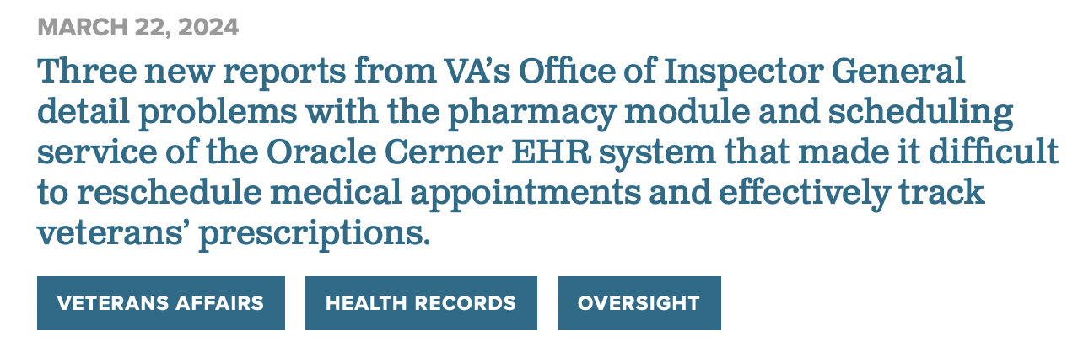
Incomplete EHR of Alice
Misdiagnose or Inappropriate treatment
Missing Alice’s history of gastrointestinal surgeries and autoimmune disorders
Alice
Eva
Complex medical history
Gastroenterologist
using VistA software
https://www.informationweek.com/data-management/electronic-health-record-errors-are-a-serious-problem
https://www.nextgov.com/modernization/2024/03/issues-vas-new-ehr-have-contributed-patient-harms-and-one-death-watchdog-says/395174/

Slide 7
Interoperability Standards
openEHR
Focuses on long-term, structured storage of clinical data through archetypes and templates
Health Level 7 (HL7)
Focuses on quick and easy data exchange between systems or organizations

Slide 8
Interoperability Standards
Health Level 7 (HL7)
Version 1
Version 2
Version 3
CDA
C-CDA
FHIR

Slide 9
Interoperability Standards
Health Level 7 (HL7)
FHIR
Fast health Interoperability Resource
Open-Source
Blaze
Proprietary
Google FHIR
IBM FHIR
HAPI FHIR
VistA
EPIC
Cerner
Microsoft FHIR

Slide 10



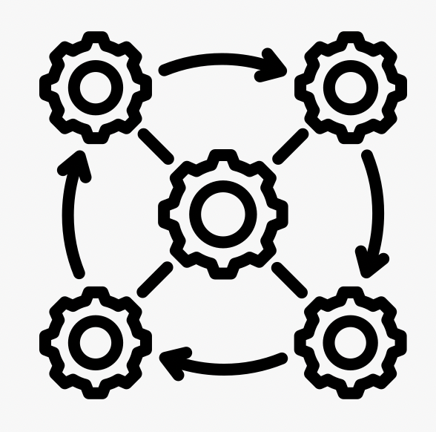




Why is the FHIR standard important?
RESTful services; easy modular access to patient data
Simple interoperability standard
Popular among tech companies
FHIR
Mandates use of FHIR R4
https://www.mymipsscore.com/mips-blog/how-microsoft-google-apple-and-amazon-are-leveraging-fhir

Slide 11
Research Focus
Misinterpretations between the XML and JSON implementations of the various FHIR servers and their exploitations
Differential parsing identification
FHIR standard adoption by Open-Source providers

Slide 12

Bottom Line Up Front (BLUF): Our Research
Identified 59 parser differentials in FHIR implementations
Exploited vulnerability found in VistA, that can change patient records during transfer
Identified few vulnerabilities and deficiencies in openEMR
Most open-source EHR providers haven’t entirely implemented all specifications from FHIR, affecting interoperability
SMART-on-FHIR not implemented by many open-source EHR, exposing patient data for public access
Created FHIR Garden – testbench to study interoperability between FHIR servers

Slide 13
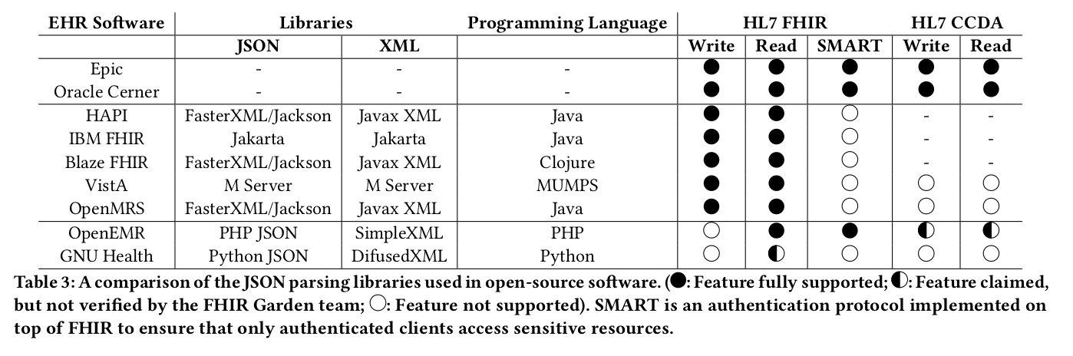
FHIR Servers in our testbed

Slide 14
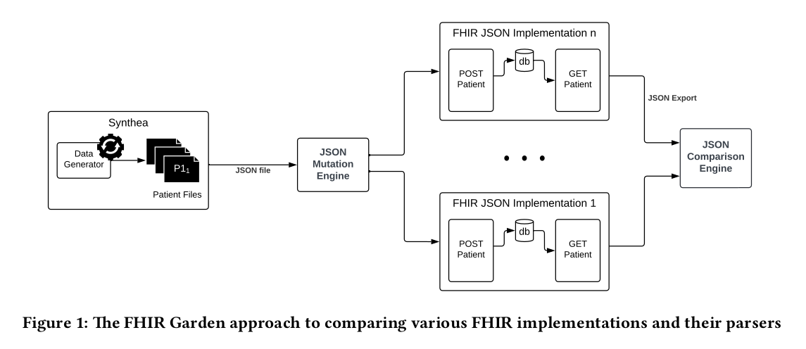
FHIR Garden Design

Slide 15
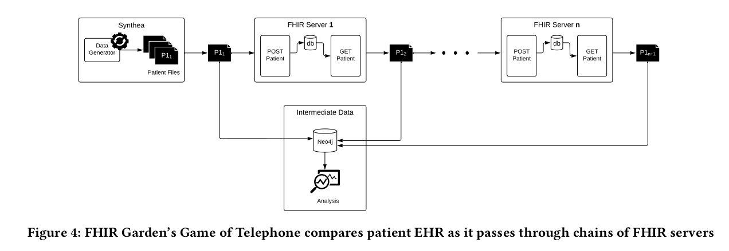
Game of Telephone (GoT)
Primary Care Provider
Healthcare Specialist

Slide 16
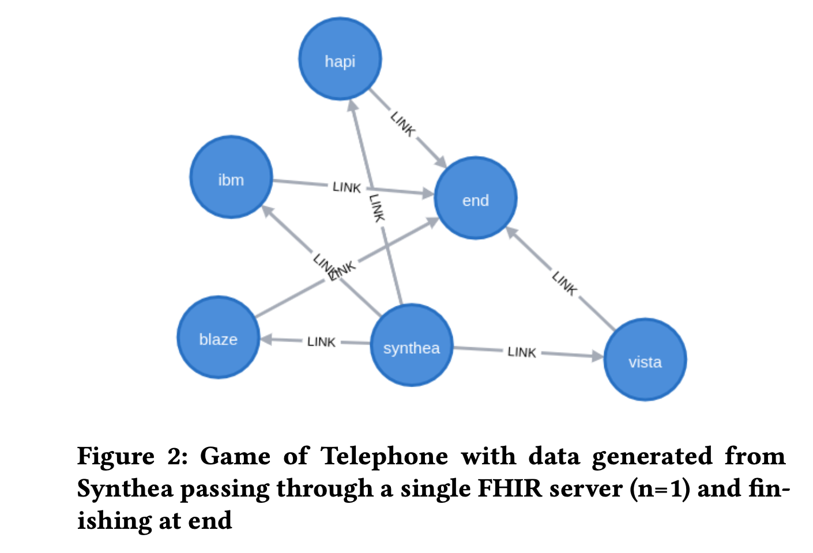
Game of Telephone (GoT)

Slide 17
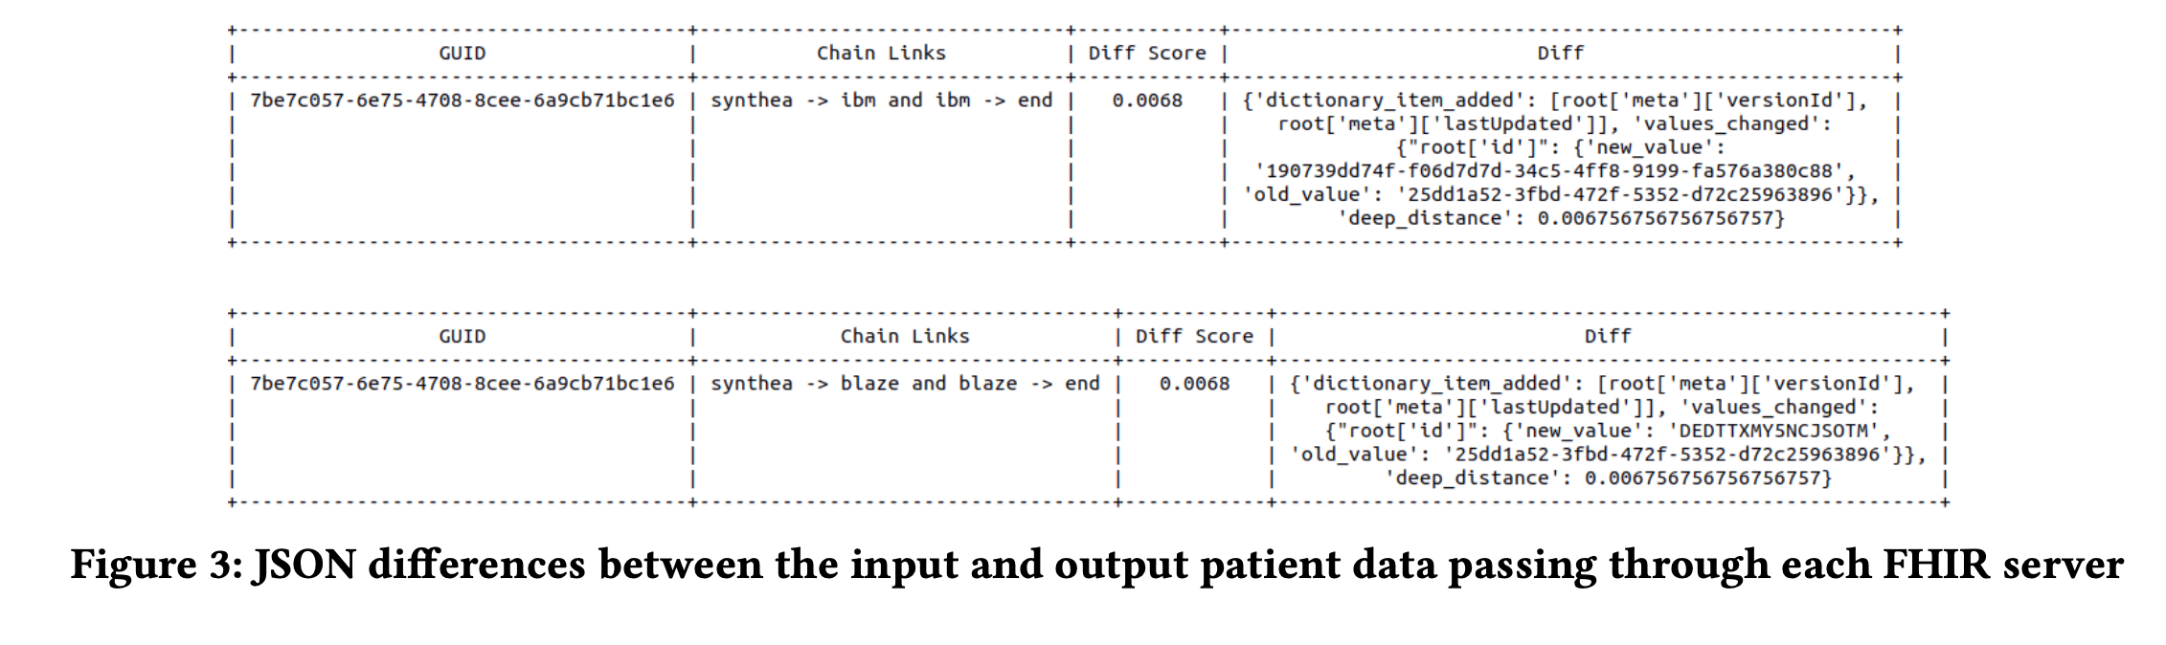
JSON Differences

Slide 18
Findings
1
OpenEMR did not fully support Consolidated CDA format

Slide 19
OpenEMR related findings
Does not fully support C-CDA format
Data Integrity not entirely maintained while parsing EHR
Does not implement import of FHIR data
Supports import/export of CCDA data only
Could not import a CCDA file that it exported previously
Subtle differences observed between imported and exported EHR
Changes in time stamp information and vaccine descriptions

Slide 20
Findings
1
OpenEMR did not fully support Consolidated CDA format
FHIR server adds some additional rules to the JSON format, but these constraints are often ignored
2

Slide 21
Fuzzing Results
Syntactic Errors
Malformed Array
[1, 2 3, 4, 5]

Slide 22
Fuzzing Results
Syntactic Errors
Blaze | HAPI | IBM FHIR | VistA | OpenEMR | OpenMRS | gnuhealth
error | error | error | [1,2,4,5] | error | error | error
Malformed Array
[1, 2 3, 4, 5]

Slide 23
{
"resourceType": "Bundle",
"type": "collection",
"entry": [
{
"resource": {
"resourceType": "Patient",
"..."
}
},
{
"resource": {
"resourceType": "Observation",
"..."
}
}
{
"resource": {
"resourceType": ”Procedure",
"..."
}
},
{
"resource": {
"resourceType": "Condition",
"..."
}
}
]
}
{
"resourceType": "Bundle",
"type": "collection",
"entry": [
{
"resource": {
"resourceType": "Patient",
"..."
}
},
{
"resource": {
"resourceType": "Observation",
"..."
}
},
{
"resource": {
"resourceType": "Condition",
"..."
}
}
]
}
{
"resourceType": "Bundle",
"type": "collection",
"entry": [
{
"resource": {
"resourceType": "Patient",
"..."
}
},
{
"resource": {
"resourceType": "Observation",
"..."
}
},
{
"resource": {
"resourceType": "Condition",
"..."
}
}
]
}
To VistA
To HAPI
Missing comma

Slide 24
Fuzzing Results
Syntactic Errors
Blaze | HAPI | IBM FHIR | VistA | OpenEMR | OpenMRS | gnuhealth
error | error | error | [1,2,4,5] | error | error | error
Malformed Array
[1, 2 3, 4, 5]
Object with missing key
{“a”:1, :2, “c”:3}

Slide 25
Fuzzing Results
Syntactic Errors
Blaze | HAPI | IBM FHIR | VistA | OpenEMR | OpenMRS | gnuhealth
error | error | error | [1,2,4,5] | error | error | error
Malformed Array
[1, 2 3, 4, 5]
Object with missing key
error | error | error | {“a”:1, “c”:3} | error | error | error
{“a”:1, :2, “c”:3}

Slide 26
Fuzzing Results
Decimal Value Precision
Blaze | HAPI | IBM FHIR | VistA | OpenEMR | OpenMRS | gnuhealth
NC | NC | NC | NC | 100 | 100.0 | 100.0
1e+2
1e+1000
NC | NC | NC | parse error | “” | “Infinity” | Infinity
NC - “No Change”

Slide 27
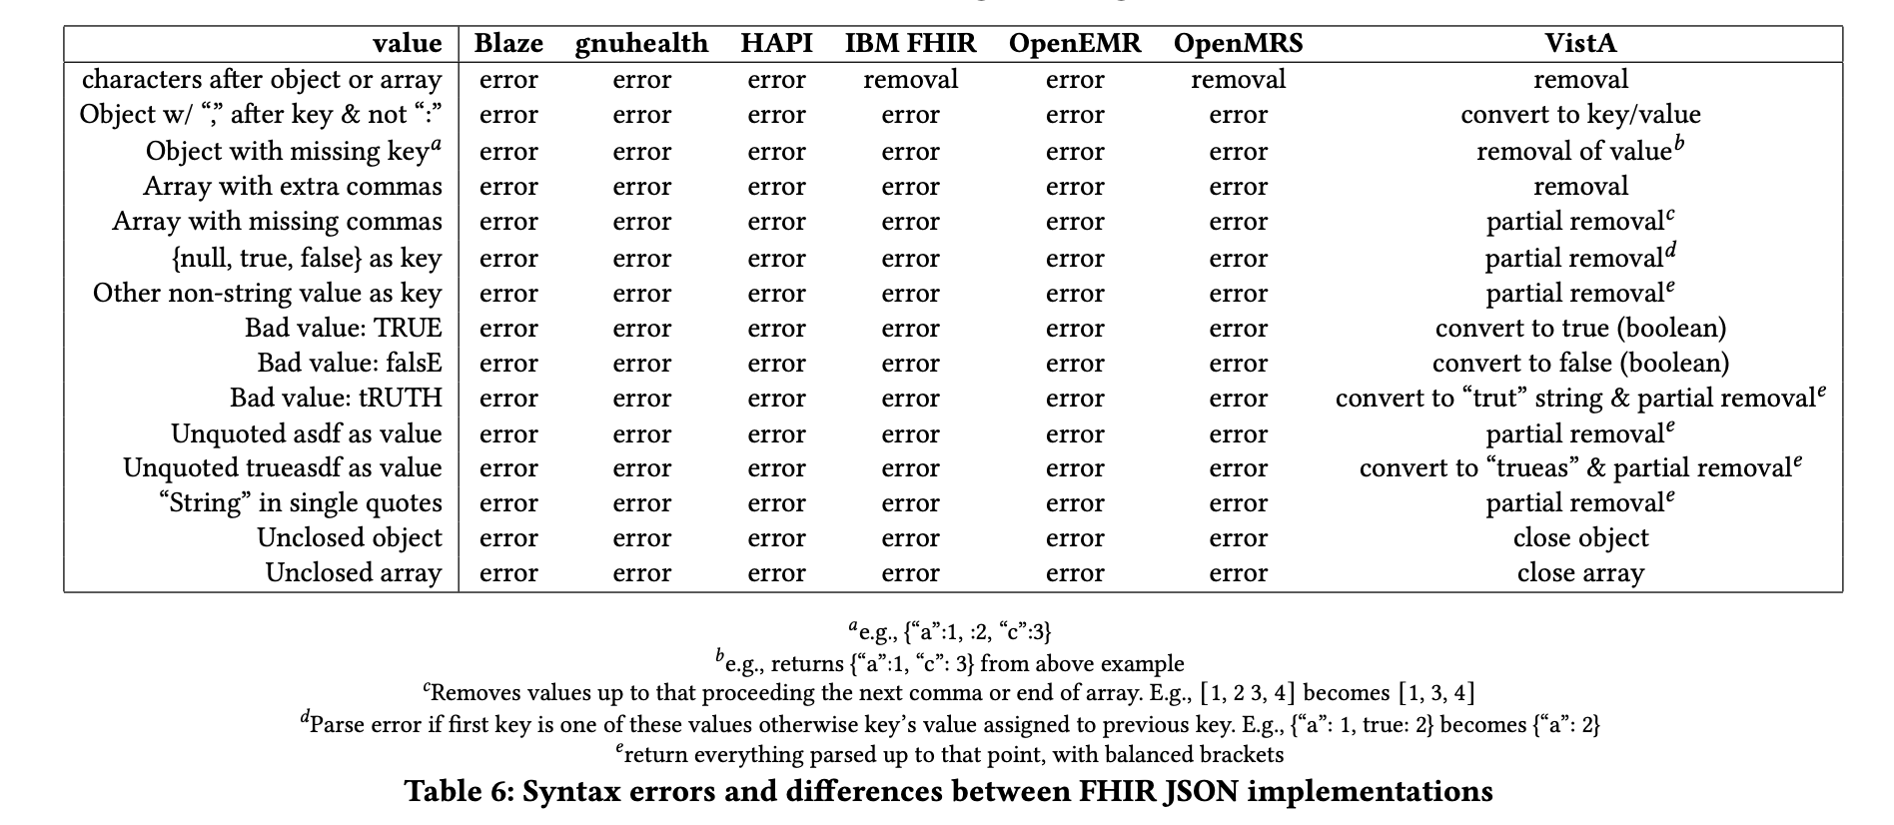
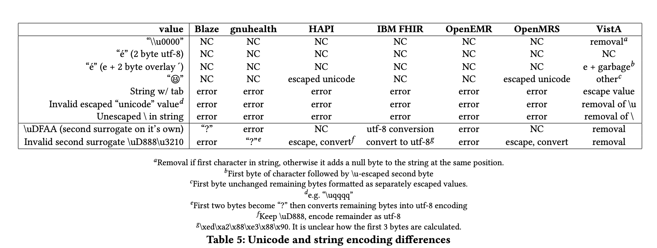
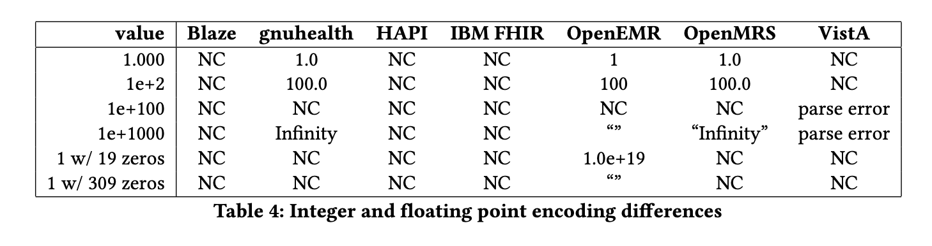

Slide 28
Findings
1
OpenEMR did not fully support Consolidated CDA format
FHIR server adds some additional rules to the JSON format, but these constraints are often ignored
2
3
Presence of many unauthenticated FHIR servers on the internet

Slide 29
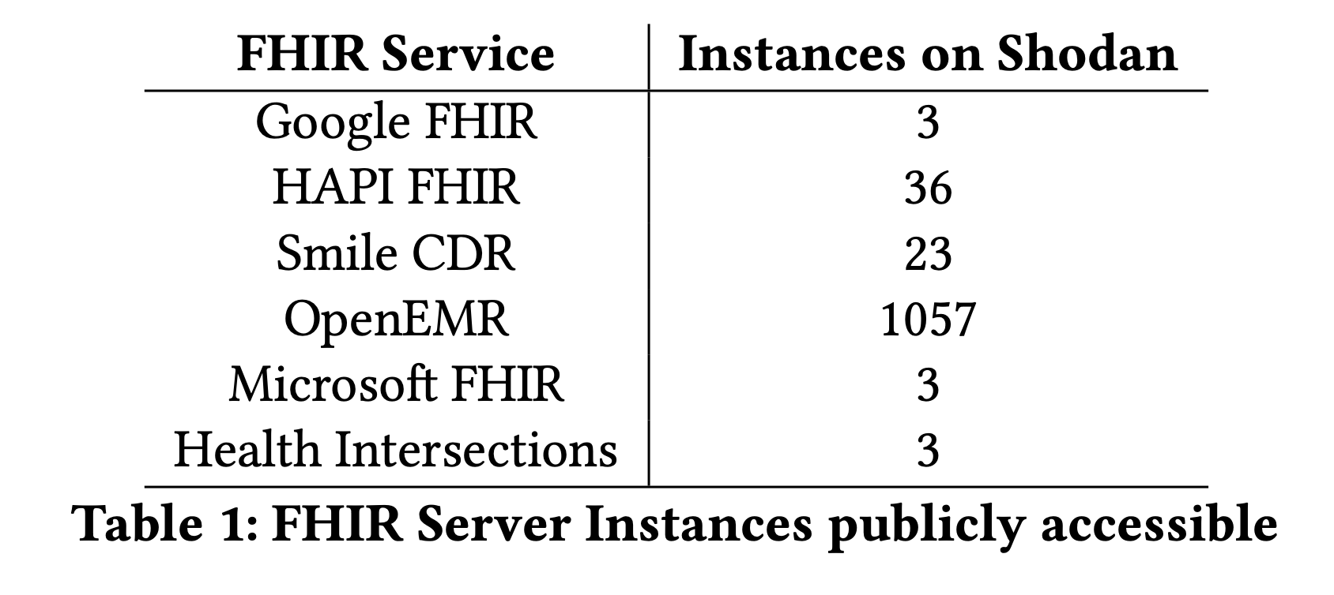
Unauthenticated FHIR Servers
Searched on SHODAN using queries like “FHIR,” “OpenEMR,” “HAPI FHIR,” and “SmileCDR”
Difficulty in differentiating between honeypots, test data from Synthea, and accidentally exposed legitimate patient data
Many open-source servers do not enforce SMART-on-FHIR authentication by default, exposing all data to public requests

Slide 30
Ongoing and Future Work
Support for all Resources as a Bundle resourcetype
Support for XML patient records in our FHIR Garden tool
Expand testbed to include more FHIR servers
Coverage guided fuzzing to find deeper vulnerabilities and differences

Slide 31


Thank You Questions ?
vishnu@narfindustries.com
Link to Project

