Slide 1
Goldenberry
Speaker: Nestor Rodriguez
Advisor: Sergio A. Rojas, PhD.
Notes:
Goldenberry is the product of the development of my thesis.

Slide 2
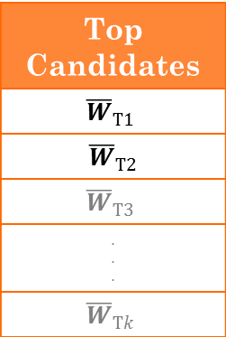
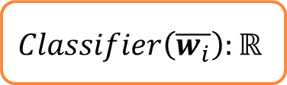

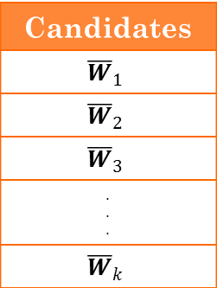
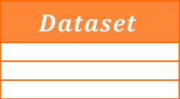

Motivation
Selection Mechanism
Candidates
$${\overline{W}}_{1}$$
$${\overline{W}}_{2}$$
$${\overline{W}}_{3}$$
. . .
$${\overline{W}}_{k}$$
Top Candidates
$${\overline{W}}_{T1}$$
$${ \overline{W}}_{T2}$$
$${\overline{W}}_{T3}$$
. . .
$${\overline{W}}_{Tk}$$
$$Dataset$$
$$Dataset∈ℝ^{mxn}$$
$$Classifier\left(\overline{w_{i}}\right):ℝ$$
$$\overline{W}∈{\left\{0,1\right\}}^{n}$$
Notes:
Thesis about Feature Selection.
Feature selection is a technique to reduce the variables amount.
Supose you want to classify a dataset.
We will INCORPORATE a search mechanizm to obtain the most relevant variables.
SELECT, SUBSET and COMBINATION
Take data to classify and you need to select the most relevant variables.
We will INCORPORATE a SELECTION mechamism to assign relevance to the variables.
SELECTION MECHANIZM is a
Classifier SCORES how GOOD this CONVINATION
The most RELEVANT candidates WILL HELP to GENERATE better and better candidates.
CLASSIFICATION = MACHINE LEARNING -> ORANGE !! LACK of OPTIMIZATION

Slide 3
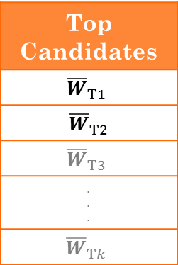


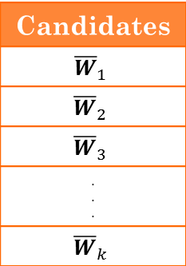
Motivation
Bivariate EDA
Candidates
$${\overline{W}}_{1}$$
$${\overline{W}}_{2}$$
$${\overline{W}}_{3}$$
. . .
$${\overline{W}}_{k}$$
Top Candidates
$${\overline{W}}_{T1}$$
$${ \overline{W}}_{T2}$$
$${\overline{W}}_{T3}$$
. . .
$${\overline{W}}_{Tk}$$
$$Dataset$$
$$Dataset∈ℝ^{mxn}$$
$$\overline{W}∈{\left\{0,1\right\}}^{n}$$
$$Learner\left(\overline{w_{i}}\right):ℝ$$
Notes:
Thesis about Feature Selection.
Feature selection is a technique to reduce the variables amount.
Supose you want to classify a dataset.
We will INCORPORATE a search mechanizm to obtain the most relevant variables.
SELECT, SUBSET and COMBINATION
Take data to classify and you need to select the most relevant variables.
We will INCORPORATE a SELECTION mechamism to assign relevance to the variables.
SELECTION MECHANIZM is a
Classifier SCORES how GOOD this CONVINATION
The most RELEVANT candidates WILL HELP to GENERATE better and better candidates.
CLASSIFICATION = MACHINE LEARNING -> ORANGE !! LACK of OPTIMIZATION

Slide 4
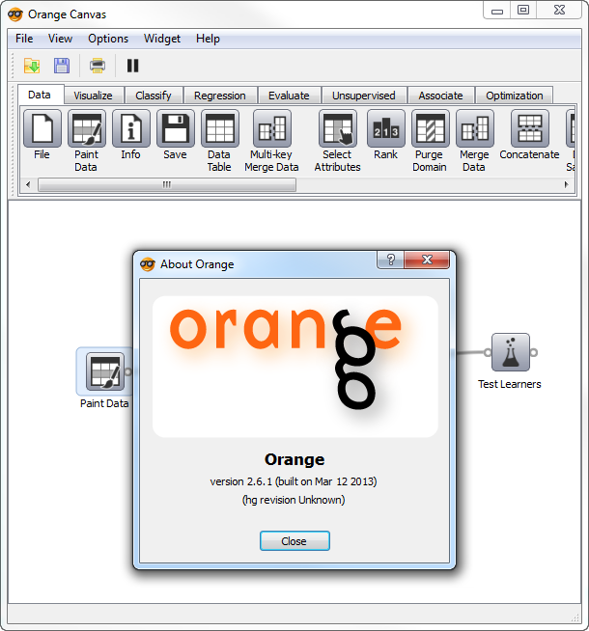
What is Orange?
Notes:
Visual environment for Data Mining
Set of graphical components to do a Visual Analysis
Components: Visualization, classify
It is an Open source data visualization and analysis software for Data mining through visual programming or Python scripting. Provides a set of drag-and-drop components for machine learning, bioinformatics, text mining.
UNFORTUNATELLY ORANGE does not include OPTIMIZATION ALgorithms

Slide 5
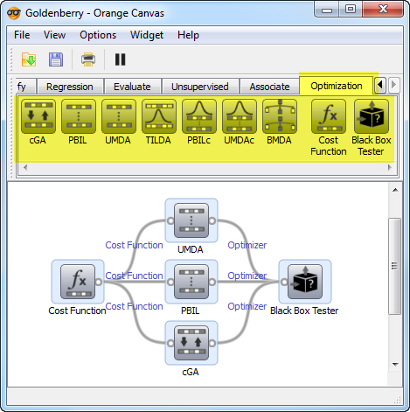
Goldenberry
Notes:
a supplementary machine learning and evolutionary computation suite for Orange.
To this day, Orange does not include a set of tools available to model explicit optimization problems within the context of machine learning analysis
First release comprises a set of EDA components like cGA,… and utilities for testing and comparing.
Next release it will contain additional Blackbox optimization techniques and some other machine learning algorithms and feature selection.

Slide 6
Context Diagram
Notes:
Numpy for Mathematical calculations.

Slide 7
Modules
Notes:
Hierarchy of SubModules

Slide 8
Decomposition View
Notes:
BaseOptimizer: Abstraction of a Optimizer, You have the search method and it returns a Solution.
Solution: Contains the parameters and cost of an arbitrary solution for a given problem.
CostFunction: Estimates the cost of a given solution and execution statistics. It is very flexible, you are free to set any cost function using python-like syntax.
BaseDistribution: Holds the distribution parameters and samples solutions.
EDA: Find a solution by refining a probability model
EXTEND abstraction to create the CONCRETE EDAs
MENTION the EXTENSIBILITY

Slide 9
Live Demo…

Slide 10

Live Demo – One Max
$$\overline{x}∈{\left\{0,1\right\}}^{n} \\ \sum_{i}^{n}{x_{i}}$$
Notes:
Simple optimization binary problem.
Find a VECTOR (bit string) of size N which maximize this function.
Function is the SUM of the vector components.
The best solution is where all the components of X = 1

Slide 11

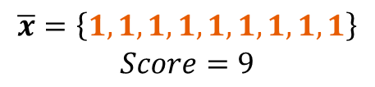
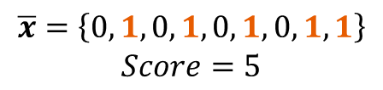
Live Demo – One Max
$n=9$
$$\overline{x}=\left\{0,1,0,1,0,1,0,1,1\right\}$$
$$Score=5$$
$$\overline{x}=\left\{1,1,1,1,1,1,1,1,1\right\}$$
$$Score=9$$

Slide 12
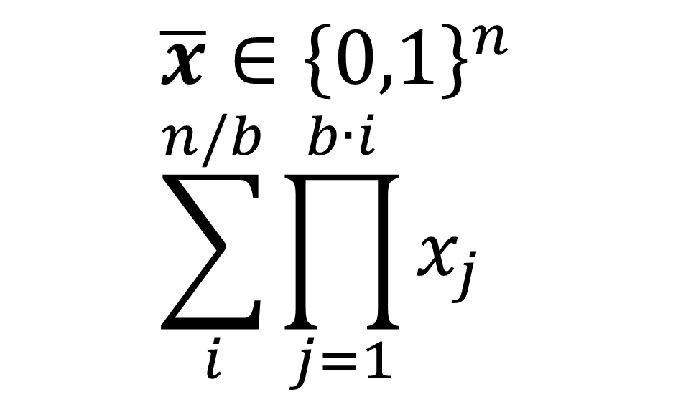
Live Demo – Leading Ones Block
$$\overline{x}∈{\left\{0,1\right\}}^{n} \\ \sum_{i}^{n/b}{\prod_{j=1}^{b∙i}{x_{j}}}$$
Notes:
More complex optimization binary problem.
Find a vector which miximized this function.
This function counts the number of blocks of ones of size B
Function is the SUM of the vector components.
The best solution is where all the components of X = 1

Slide 13

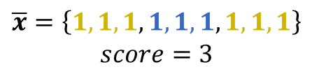
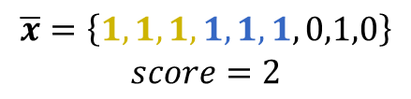
Live Demo – Leading Ones Block
$$n=9∧b=3$$
$$\overline{x}=\left\{1,1,1,1,1,1,0,1,0\right\}$$
$$score=2$$
$$\overline{x}=\left\{1,1,1,1,1,1,1,1,1\right\}$$
$$score=3$$

Slide 14

Goldenberry in GECCO 2013

Slide 15
Questions ?
GOLDENBERRY.CODEPLEX.COM

