Slide 1

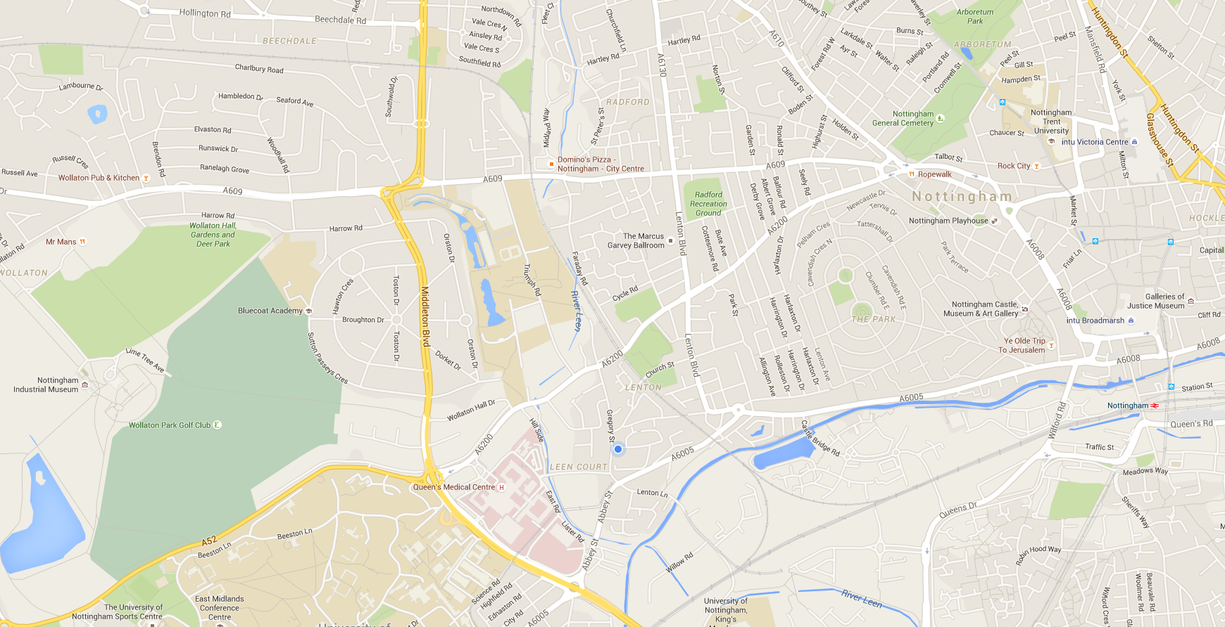


Landing Page/Route Discovery - 1
Welcome, Craig!
Want to be more specific?

Slide 2





Landing Page/Route Discovery - 2
Search

Slide 3
Landing Page/Route Discovery - 3
Why not add some filters?
Next
Search

Slide 4
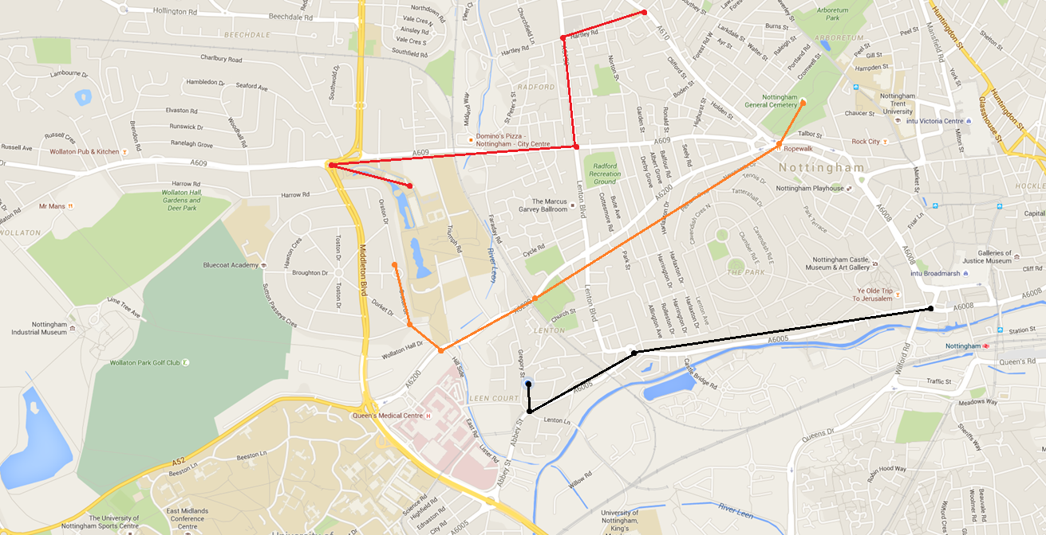

Route Listing Page - 1
1. Name
Point A – Point B
£10 in Petrol, 10KM travelled
2. Name
Point A – Point B
£10 in Petrol, 10KM travelled
3. Name
Point A – Point B
£10 in Petrol, 10KM travelled

Slide 5
Route Listing Page - 2
Showing results for
Start: Point A
End: Point B
Cost: < £10

Slide 6
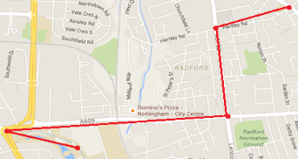
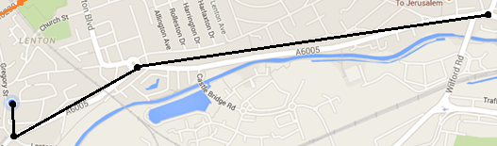
Route Listing Page - 3
Search Again
1. Name
Point A – Point B
£10 in Petrol, 10KM travelled
1. Name
Point A – Point B
£10 in Petrol, 10KM travelled

Slide 7

Route Detail Page - 1
Name
Fork this route
By username
Route Details
Point A to Point B
Estimated Petrol Cost: £10
10KM travelled (direct route is 7KM)
User description of route
Open in Gmaps
Download
Go to A
Go to B
Go to C
Go along D
Comments on NAME
Username (1 days ago)
So pretty

Slide 8
Route Detail Page - 2
Fork this route
Name
By username
Route Details
Point A to Point B
Open in Gmaps
Download
Estimated Petrol Cost: £10
10KM travelled (direct route is 7KM)
User description of route
Route Steps
Go to A
Go to B
Go to C
Go along D
Comments on NAME
Username (1 days ago)
So pretty

Slide 9
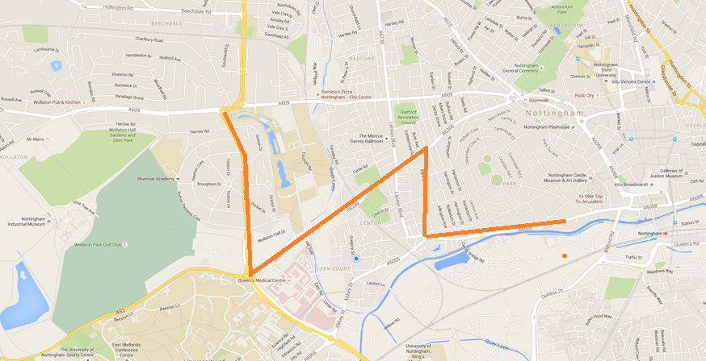
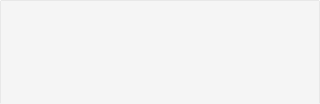


Route Detail Page - 3
Name
By username
See Route Details
Point C (0:10)
Brief description
See Comments
Fork this route

Slide 10
Route Creation Page
Your Route
Welcome to the route creation tool! To get started, click on the map to add a point!
1. (-64, 11) x
2. (-65, 11) x
3. (-66, 11) x
Got it, thanks!
4. (-67, 11) x
Submit Route

Slide 11
Route Creation Page
Your Route
Welcome to the route creation tool! To get started, click on the map to add a point!
1. (-64, 11)
2. (-65, 11)
Save your route
3. (-66, 11)
Got it, thanks!
Enter route name
4. (-67, 11)
Describe your route
Submit Route
Select route privacy
Public
Keep Editing
Save

Slide 12
Landing Page

Slide 13
Route
Listing Page
Route
Detail Page
Account Creation Page
Landing Page
(route discovery)
My Profile Page
Login Page
Admin
Page
Route Creator

Slide 14
Login Page
Log in to Niceway.to
User name
Password
Sign Up
FR 4
Login
FR 9

Slide 15



Account Details Page – My Routes
Logout
My Routes
My Details
Ability to filter and search?
Add New
Name
Start
End
Privacy [?]
Manage
Route 1
Town D
City D
Public
Route 2
Town A
City A
Public
Route 3
Town C
City C
Public
Route 4
Town B
City B
Private
FR 9.2, 2, 2.1, 2.2, 6
Add New

Slide 16
Account Details Page – My Details
Logout
My Routes
My Details
Personal Details
<Username – cannot change>
Enter your name
Enter your email address
Update Details
Enter your location
Update Password
Enter current password
FR 9.1, 4
Enter new password
Update Password
Enter new password again

Slide 17
Administration Page
Logout
New tab only for admins
My Routes
My Details
Admin
Manage users
Type a username or user id
Search
Search results
1. cxk01u
Craig Knott
#routes/comments
Ban?/sban?/
Create User
FR 5, 5.1, 5.1.1, 5.1.2, 5.1.3, 5.4, 5.5, 5.6, 5.7
Username
Password
Create
Post Announcement
Your message
Email too?
Post
Server Management
Make a backup
De authorize all active sessions
Lock the site

Slide 18
Account Creation Page
Sign up for Niceway.to
Username
Enter your name
Enter your email address
Enter your location
FR 4
Create Account

