Slide 1
Statistical Database Security
Notes:
1
The slides for this text are organized into chapters. This lecture covers Chapter 21, and discusses database security, including SQL support for access control, and issues in allowing access to databases over a network.
The material on Mandatory Access Control and later slides can be omitted at the instructor’s discretion in an introductory course.

Slide 2
Statistical Database (SDB)
Statistical DB: Contains information about individuals, but allows only aggregate queries (e.g., average age, rather than Joe’s age).
•The SDB is usually in relational form. (And sometimes in Cube form)
• Let N is the number of tuples and M is the # of attributes of the SDB schema.
• Xij denotes the value of the j-th attribute Aj for the i-th record in the SDB…
• Each attribute Aj has |Aj| possible values.

Slide 3
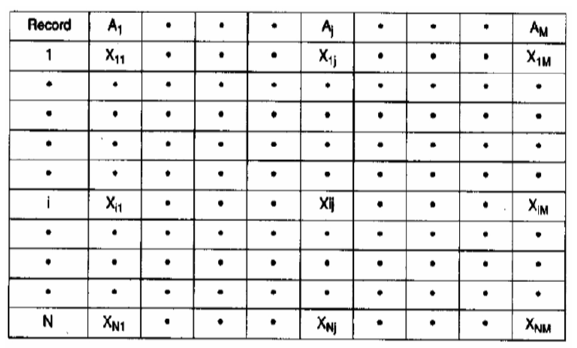

Relational SDB model

Slide 4
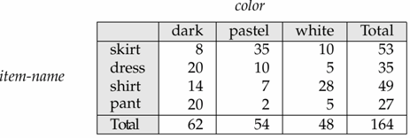
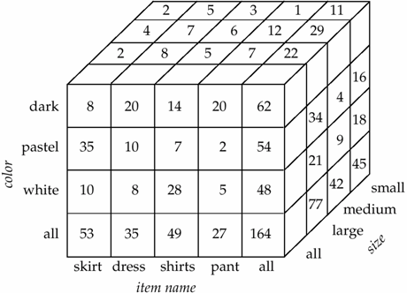
Multi-dimensional (Cube) SDB model

Slide 5
Statistic queries
• Special-purpose SDBs, such as survey DBs, release statistics in the form of a table (called macro-statistics),
• Statistics queries can be issued through either keys or characteristics formulas.
• A key-based statistics is the form of Sum (C, Salary), with
C= (John, Mary, Tom).
• Characteristic formula (indicated by A, B, …) is a logical
formula of attributed combined by Boolean operators OR,
AND, NOT.
Example:
A= (Sex=F) ᴧ ((Dept-Code=Dept1) ᵥ (Dept_code=Dept2)) ᴧ(Birth-Year<1965)

Slide 6
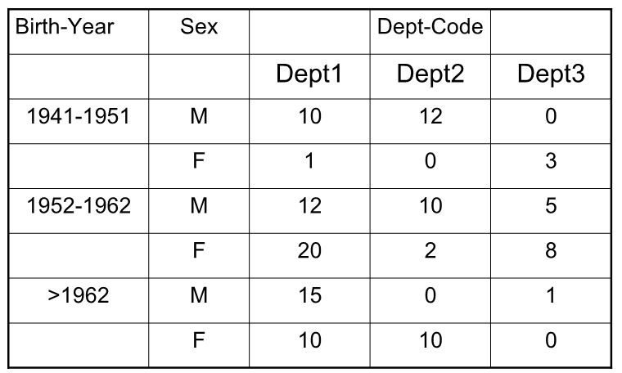
Example:

Slide 7
Statistical DB Security
New problem: It may be possible to infer some secret information!
  E.g., If I know Joe is the oldest sailor, I can ask “How many sailors are older than X?” for different values of X until I get the answer 1; this allows me to infer Joe’s age.
Idea: Insist that each query must involve at least N rows, for some N. Will this work? (No!)

Slide 8
Why Minimum N is Not Enough
By asking “How many sailors older than X?” until the system rejects the query, can identify a set of N sailors, including Joe, that are older than X; let X=55 at this point.
Next, ask “What is the sum of ages of sailors older than X?” Let result be S1.
Next, ask “What is sum of ages of sailors other than Joe who are older than X, plus my age?” Let result be S2.
S1-S2 – my age is Joe’s age!

Slide 9
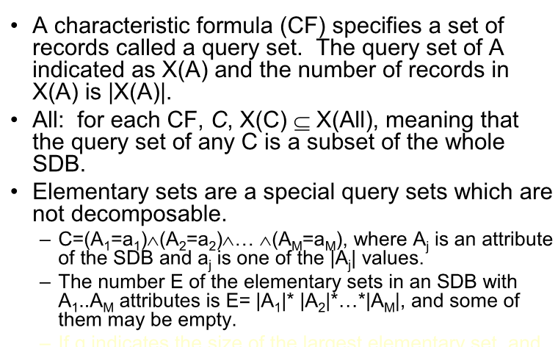
CFs and Elementary sets

Slide 10
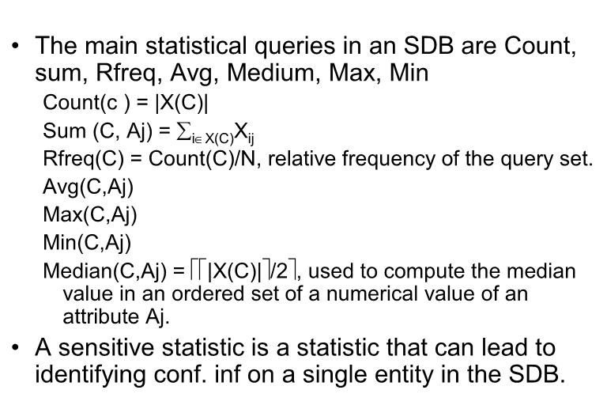
Statistical operations

Slide 11
Inference Protection techniques
•Aims at preventing users from inferring confidential info about
Tuples existing in SDBs, causing SDB to be compromised.
• Let Ai be a non-numerical conf. attr. or a numerical attr. and Xj describing a tuple in SDB:
• Exact compromise: occurs if a user through some statistical
query, can state for Ai the the exact value for a record j in SDB.
• Partial compromise: occurs if a user through some
statistical query, can obtain an estimator of the actual value such that its variance < k2, where k is defined by DBA.

Slide 12
Prevention techniques
•Conceptual techniques: Address the inference problem at a conceptual level, dealing with a conceptual data model of the SDB.
• Restriction-based techniques: Provide inference protection by restricting some statistical queries; queries containing a very small/very large number of records. Should take care of usability of SDB due to the large number of false denials on queries.
• Perturbation-based, provide inference protection through introducing modification of info used to answer statistical queries. The modification can be on either the stored data in SDB, or the computed results, before releasing to the user.
Crucial problems:
– The bias introduced in the responses which should be as small as
possible to assure inference protection and also accuracy of
responses.
– Modifications must guarantee the consistency of the released results.

Slide 13
Restriction based techniques
•The techniques protect against inference by restricting (not releasing) the statistical sensitive queries. Includes:
Query- set size control: controls the size of the query set associated with a statistical query. A statistic q(C) is permitted only if its query set X(C) satisfies:
k ≤ |X(C)| ≤ N-k
where N is the number of SDB records and k≥0 is a fixed
parameter. K is good to be around N/2 in order not to
release q(All), where q(All) = A(C) + Q(¬C)
This prevents simple attacks based on very small and very
large.
• If a user knows a certain individual satisfies characteristic C, if the q1=Count(C) returns 1, then …

Slide 14
•If q2 = Count (C ᴧ C’) also returns 1, then the
intruder understand that the entity has C’. If q2
returns 0, then the entity does not have C’
characteristic.
• Large query sets [e.g. q(C)] are also restricted, as
q(¬C) is small and may be abused.
• More complex attacks, tracker.
• A tracker is a set of characteristic formulas can be
used to pad out small-size query sets with
additional records in the allowed range [k, N-k].

Slide 15
Example:
C=(Dept-Code=Dept ᴧ Sex=F ᴧ Birth-Year=1951)
specifies an employee Mary.
• The query-size control has parameter k=3 _x0001_ the
query is not permitted!
• A tracker is obtained by defining
A=(Sex=F) and B= (Dept-Code=Dept ᴧ Birth-Year=1951) and
T= (A ᴧ¬ B))
Now, Count(C) = Count(A) – Count(T)
• Moreover it is possible to infer additional info:
Count(C ᴧ Salary ≥20) = Count (T ᵥ A ᴧ Salary ≥ 20) – Count(T)

Slide 16
Expand query-size control
• A solution is to expand the # of query sets to be
controlled to decide if info is released.
• i.e. given a characteristic formula C, we can define
implied query set, query sets identified by
characteristics directly derived from C. These
query sets must also be controlled.
• Given an m-order statistics of the form:
q(A1=a1 ᴧ A2=a2 ᴧ …. ᴧ Am=am),
• There exist 2^{m} implied query sets corresponding to the following statistics

Slide 17
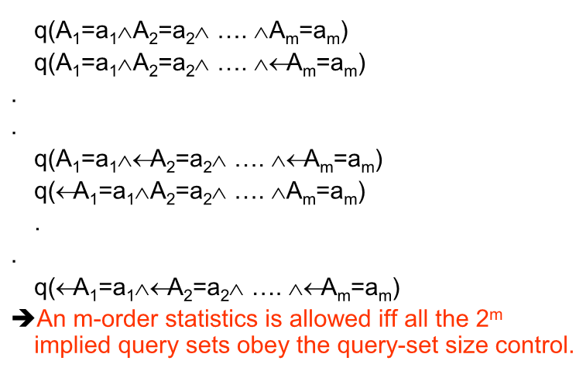

Slide 18
Query set overlap control
•Another way to improve query-size control is
to act on the number of common records.
• Precisely, the Query-Set Overlap Control
technique permits a requested statistic q(C)
only if
|X(C) ᴧ X(D)| ≤ a , a > 0;
a is called the overlap threshold.

Slide 19
Conceptual techniques
•The main conceptual techniques called the lattice
model and the partitioning of the SDB entities into
populations.
• The lattice model provides a conceptual
representation of the records stored in an SDB,
based on the lattice structure of m-dimensional
tables.
• Next slide shows a m-table for the count statistic
computed on Birth-year, Sex, and Dept-Code, also called macrostatistics form

Slide 20
Example:

Slide 21
•An m-dimentional table represents a collection of correlated statistics of m order on m SDB attributes A1, A2,…,Am.
• If each Ai has |Ai| values, the total number of table elements: Sm = |A1|x|A2|x…x|Am|
• The possible statistics can be derived from
the table is 2 ^{Sm} -1
• The m-table related to a given statistic corresponds to a lattice structure

Slide 22
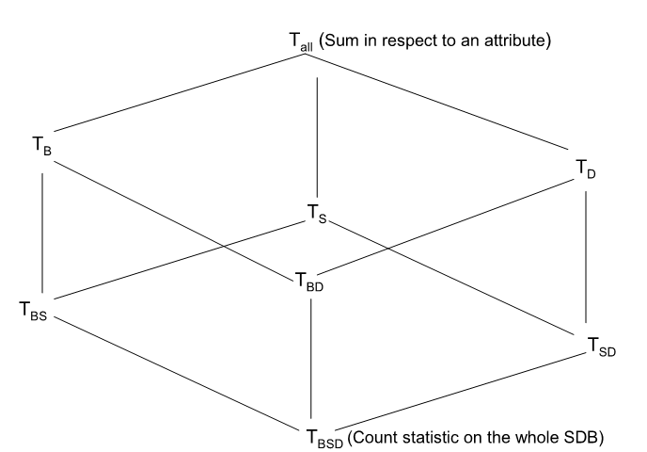
Table Lattice on Birth-Date, Sex, Dept-Code attributes

Slide 23
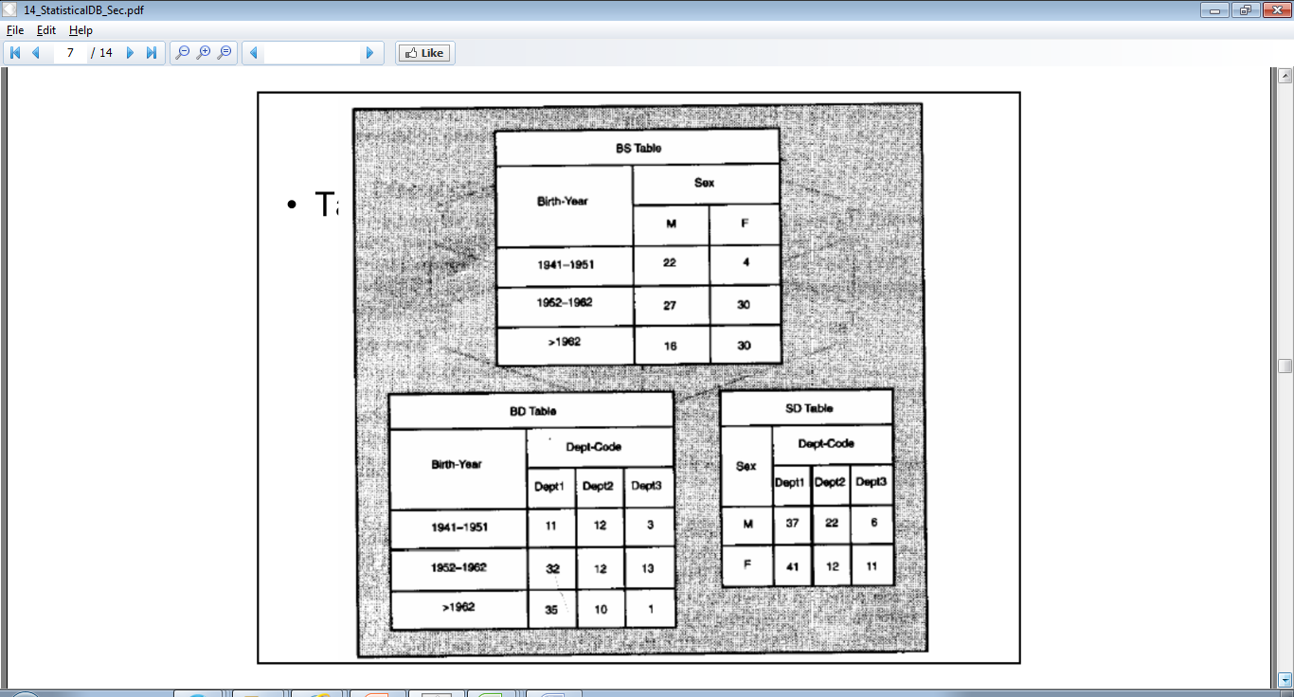

Slide 24
•Sensitive statistics: may lead to disclosure of
confidential info on single entities, even in
negative.
• The criterion: n-respondent, %k dominance
is used. It means that n or fewer records
represent more than %k of the total.
• A statistic holding a query set of size 1 is
sensitive. Sum of such nuitary cells is also sensitive

Slide 25
Conceptual Partitioning
•Used to protect inference during the conceptual design phase of the SDB.
• It is based on the definition of populations (set of entities) on which statistics can be released. And the conditions that must be verified to avoid inference.
• The Data Abstraction (D-A) model, based on the aggregation and generalization abstractions, is used to model the set of SDB entities on which statistical queries can be computed.
• Aggregation allows object relationship to be represented as aggregated objects.
• Generalization allows object classes to be represented as generic objects. The real world is represented as generalization and aggregation hierarchies.
• For statistical purposes, generalization hierarchies are of interest.
• Moving from the root to leaves in the hierarchy, population is decomposed into sub-populations, down to the atomic populations.
• Disjoint sub-populations have a common parent form a cluster.

Slide 26
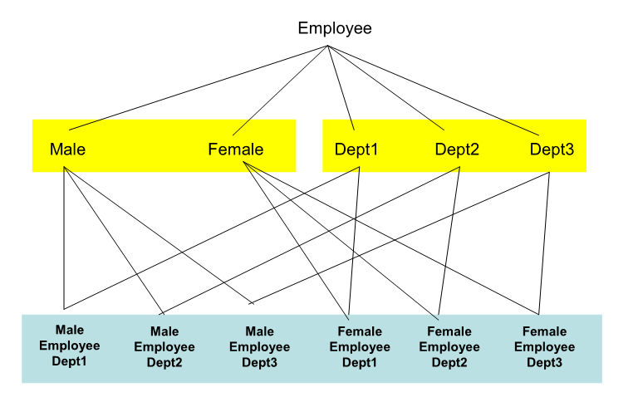
The conceptual model applied to the Employee SDB

Slide 27
•The model is used to define which statistics
(count, sum, average,…) can be released
and yet avoid inference.
• To support the definition of statistical sec
requirements, the SSMF (Statistical Sec Management Facility) proposed

Slide 28
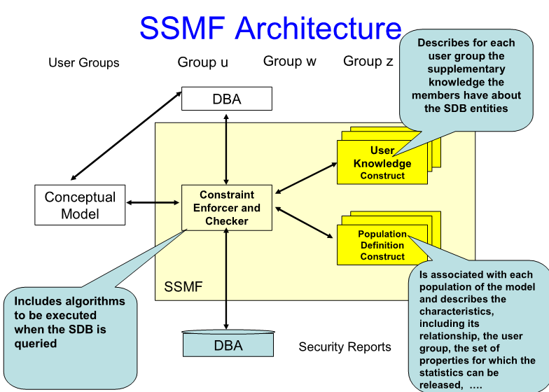

Slide 29
?

