Slide 1
What is code injection?
Code injection is the exploitation of a computer bug that is caused by processing invalid data.
Code injection can be used by an attacker to introduce (or "inject") code into a computer program to change the course of execution.
The results of a code injection attack can be disastrous

Slide 2
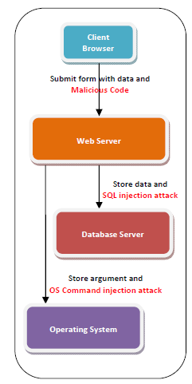
Code injection

Slide 3
Code injection can do
Arbitrarily modify values in a database through a type of code injection called SQL injection. The impact of this can range from defacement of a web site to serious compromisation of sensitive data.
Install malware on a computer by exploiting code injection vulnerabilities in a web browser or its plugins when the user visits a malicious site.

Slide 4
Code injection can do
Install malware or execute malevolent code on a server, by PHP or ASP Injection.
Privilege escalation to root permissions by exploiting Shell Injection vulnerabilities in a setuid root binary on UNIX.
Privilege escalation to Local System permissions by exploiting Shell Injection vulnerabilities in a service on Windows.
Stealing sessions/cookies from web browsers using HTML/Script Injection (Cross-site scripting).

Slide 5
Different types of Code injection
SQL injection
LDAP Injection
OS Command Injection
Cross-Site Scripting (“XSS”)

Slide 6
LDAP Injection
LDAP is Lightweight Directory Access Protocol.
LDAP injection is an attack technique of exploiting web applications that use client-supplied data in LDAP statements without first stripping potentially harmful characters from the request.

Slide 7
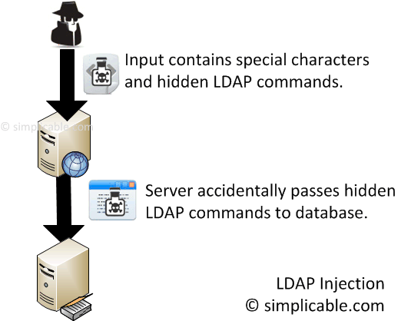
LDAP Injection

Slide 8
LDAP Injection ?
When a web application fails to properly sanitise user-supplied input, it is possible for an attacker to alter the construction of an LDAP statement.
Once an attacker is able to modify an LDAP statement, the process will run with the same permissions as the component that executed the command.(e.g. Database server, Web application server, Web server, etc.).

Slide 9
LDAP Injection?
This can cause serious security problems where the permissions grant the rights to query, modify or remove anything inside the LDAP tree.
The same advanced exploitation techniques available in SQL Injection can also be similarly applied in LDAP Injection.

Slide 10
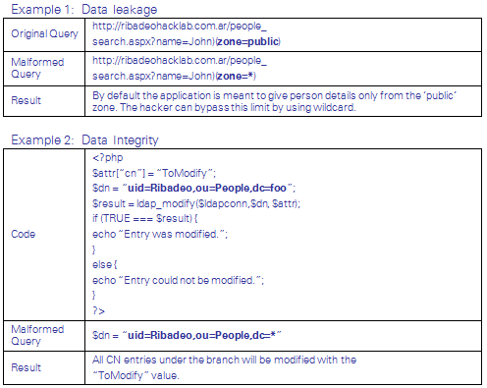
Examples of LDAP Injection

Slide 11
OS Command Injection
OS Command Injection also called as Shell Injection.
OS command injection is also known as Improper Sanitisation of Special Elements used in an OS Command and is a technique used via a web interface in order to execute OS commands on a web server.

Slide 12
OS Command Injection?
The user supplies all or part of malformed OS command through a web interface.
If the web interface that is not properly sanitised the input is vulnerable to this exploit.
With the ability to execute OS commands, the user can inject unexpected and dangerous commands, upload malicious programs or even obtain passwords directly from the operating system.

Slide 13
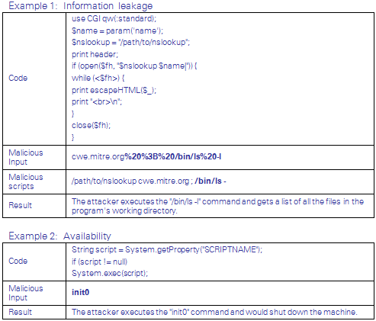
Examples of OS Command Injection

Slide 14
Cross-Site Scripting (“XSS”)
Cross-site Scripting (“XSS“) is a type of injection attack, in which malicious scripts are introduced into the trusted websites.
This exploitation would occur when a web application uses user-supplied inputs as an output without validating or encoding it.

Slide 15
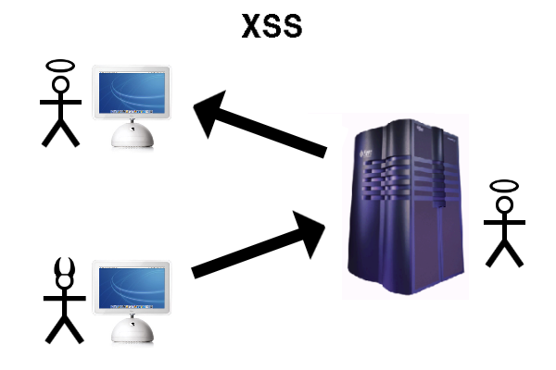
Cross-Site Scripting (“XSS”)

Slide 16
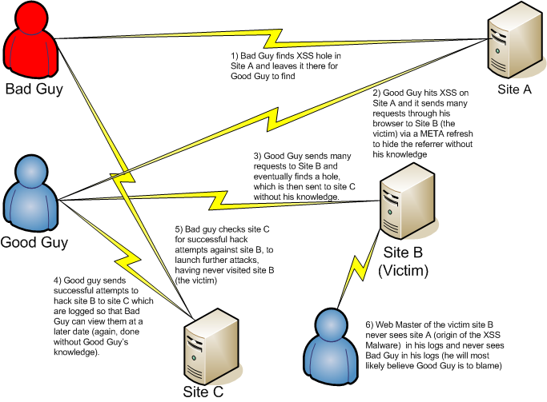
Cross-Site Scripting (“XSS”)

Slide 17
Cross-Site Scripting (“XSS”)
The malicious content sent to the web browser can take several forms including JavaScript, VBScript, ActiveX, HTML, Flash or any other type of code that the browser may execute.
XSS attacks can generally be categorised into three types:
- Stored,
- Reflected and
- Document Object Mode based (“DOM- Based”).

Slide 18
Cross-Site Scripting (“XSS”)
Stored XSS (Persistent) – Stored XSS attacks means that the injected malicious code is permanently stored on a target server such as a bulletin board, a visitor log, or a comment field, blogs, discussion boards.
When interacting with the target server, an end-user inadvertently retrieves and executes the malicious code from the server.

Slide 19
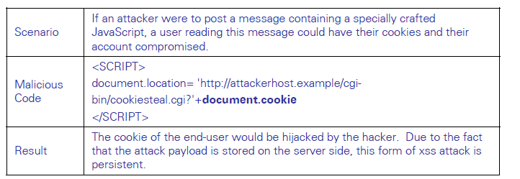
Cross-Site Scripting (“XSS”)
Sample Stored XSS

Slide 20
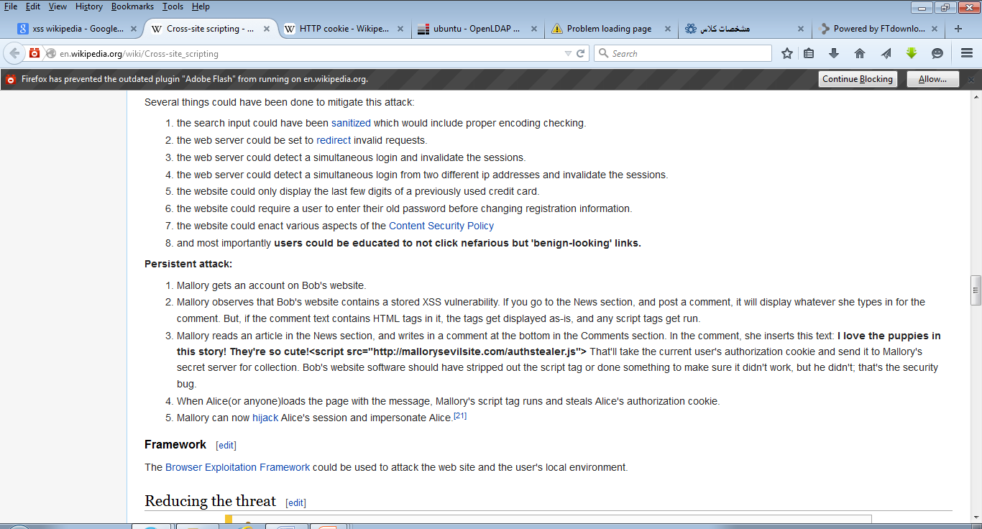
Sample: Stored XSS

Slide 21
Cross-Site Scripting (“XSS”)
Reflected XSS (Non-Persistent) – Reflected XSS attacks are those where the injected code is sent to a vulnerable web server that directs the crosssite attack back to the user’s browser.
This type of attacks aims to trick the users by clicking on a malicious link or submitting a specially crafted form.
The user’s browser then executes the malicious code, assuming it comes from a trusted server.

Slide 22
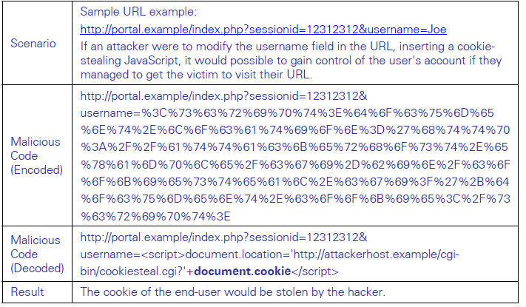
Cross-Site Scripting (“XSS”)
Sample reflected XSS

Slide 23
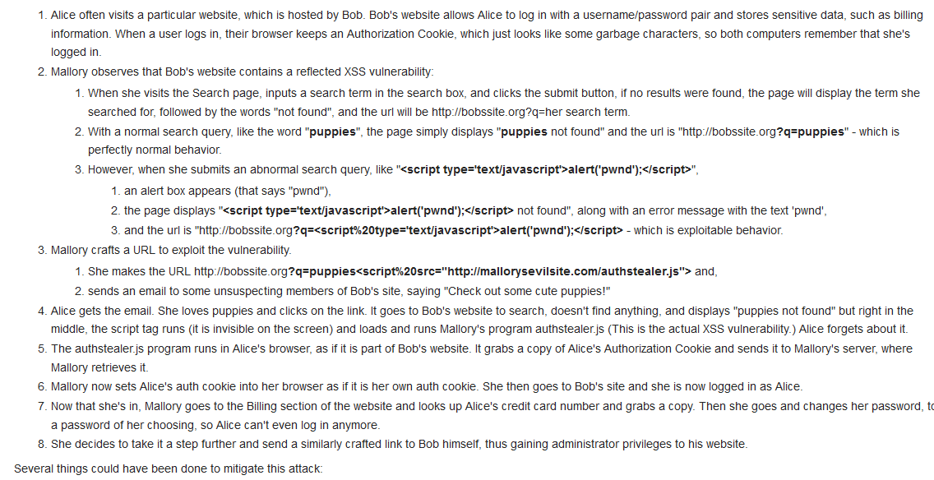
Sample: reflected XSS

Slide 24
Cross-Site Scripting (“XSS”)
DOM (Document Object Model) Based XSS – Unlike the previous two, DOM based XSS does not require the web server to receive the malicious XSS payload.
Instead, in a DOM-based XSS, the attack payload is embedded in the DOM object in the victim’s browser used by the original client side script, so that the client side code runs in an “unexpected” manner.

Slide 25
Cross-Site Scripting (“XSS”)
That means, the page itself (HTTP response) does not change, but the client side code contained in the page executes differently due to the malicious modifications that have occurred in the local DOM environment.
This attack is usually achieved by sending malicious URL to the users.

Slide 26
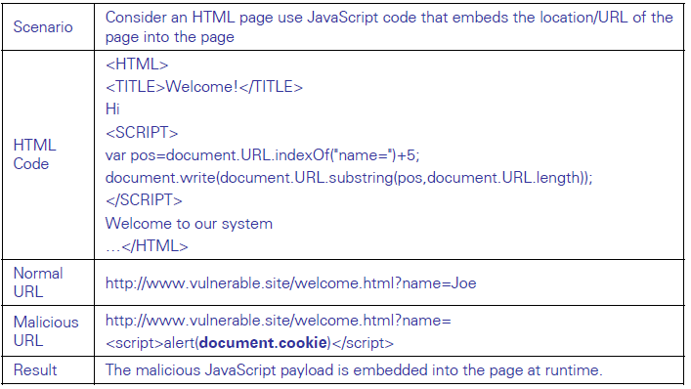
Cross-Site Scripting (“XSS”)
Sample DOM XSS

Slide 27
References:
http://geekdoctor.blogspot.com/2008_03_01_archive.html
http://simplicable.com/photo/224/LDAP-injection.html
http://www.istf.jucc.edu.hk/newsletter/IT_04/IT-4_Code_Injection.pdf

Slide 28

Questions ?

