Slide 1
Discretionary Access Control
Notes:
1
The slides for this text are organized into chapters. This lecture covers Chapter 21, and discusses database security, including SQL support for access control, and issues in allowing access to databases over a network.
The material on Mandatory Access Control and later slides can be omitted at the instructor’s discretion in an introductory course.

Slide 2
Discretionary Access Control
Based on the concept of access rights or privileges for objects (tables and views), and mechanisms for giving users privileges (and revoking privileges).
Creator of a table or a view automatically gets all privileges on it.
  DMBS keeps track of who subsequently gains and loses privileges, and ensures that only requests from users who have the necessary privileges (at the time the request is issued) are allowed.

Slide 3
System vs. Object Privileges
System Privileges
  The right to access the database and its objects – create table, create view, back up any table, etc.
  Generally granted by the DBA
Object Privileges
  The right to manipulate the content of the objects database – alter, delete, execute, index, insert, reference, select, update
  Grant by the owner of the object

Slide 4
Control of User Access
Oracle Server database security, you can do the following:
  Control database access
  Give access to specific objects in the database
  Confirm given and received privileges within the Oracle data dictionary
  Create synonyms for database objects

Slide 5
Privileges
Right to execute particular SQL statements.
DBA – high-level user with ability to grant users access
Users require system privileges to gain, access to databases/objects to manipulate content
Users can be given privilege to grant additional privileges to other users/roles
Notes:
roles, which are named groups of related privileges.

Slide 6
Database Security
Management of users
Grant and Revoke: Definition
Grant:
The GRANT statement is used to give permissions to a user or role.
By using the GRANT statement, it is possible to assign permissions to both statements as well as objects.
You can use the GRANT statement with the WITH GRANT OPTION clause to permit the user or role receiving the permission to further grant/revoke access to other accounts

Slide 7
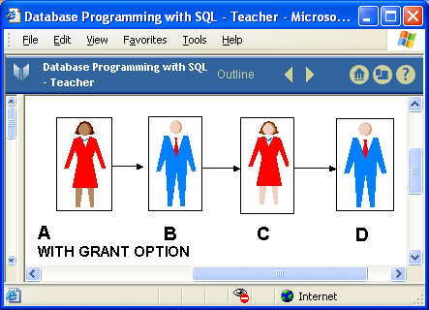

Slide 8
Database Security
Management of users
Grant and Revoke: Definition
Revoke:
The REVOKE statement is used to remove a previously granted or denied permission from a user in the current database.
You can specify the GRANT OPTION FOR clause with the REVOKE statement to remove the WITH GRANT OPTION permissions.
Specify the CASCADE clause along with the WITH GRANT OPTION clause, if the permissions being revoked were originally granted using the WITH GRANT OPTION setting.

Slide 9
Database Security
Management of users
Rights Levels
Grant and Revoke
Users or Grant and Revoke rights are created at 4 levels
Global level
Database level
Table level
Column level

Slide 10
Database Security
Management of users
Global level
Grant and Revoke
Rights Levels
Global level
Global privileges apply to all databases on a given server.
server

Slide 11
Database Security
Management of users
Database level
Grant and Revoke
Rights Levels
Database level
Database privileges apply to all tables in a given database.
server
database
database

Slide 12
Database Security
Management of users
Table level
Grant and Revoke
Rights Levels
Table level
Table privileges apply to all columns in a given table.
server
table
database
table
table
database

Slide 13
Database Security
Management of users
Column level
Grant and Revoke
Rights Levels
Column level
Column privileges apply to single columns in a given table.
server
table
database
column
column
table
column
column
table
database

Slide 14
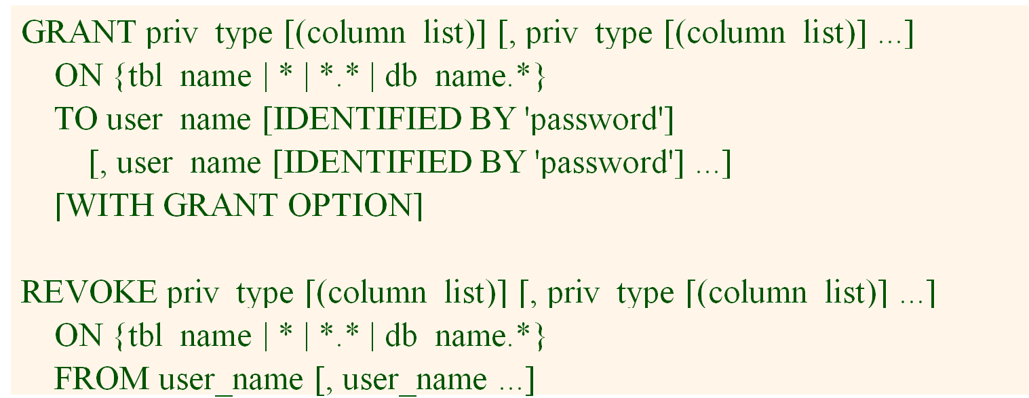
Database Security
Management of users
Syntax & Sémantic
Grant and Revoke
MySQL

Slide 15
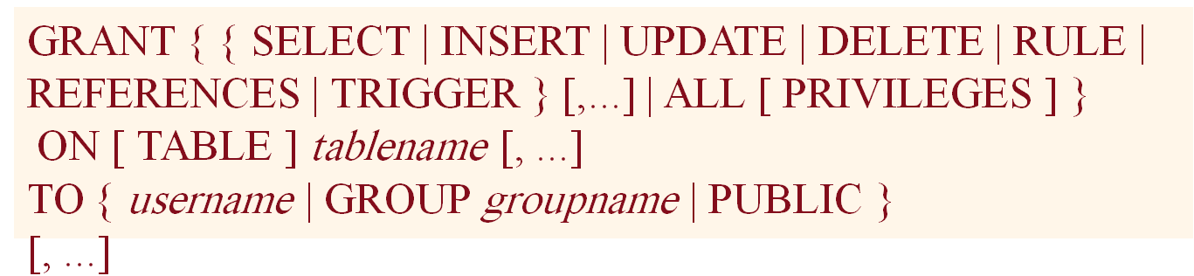
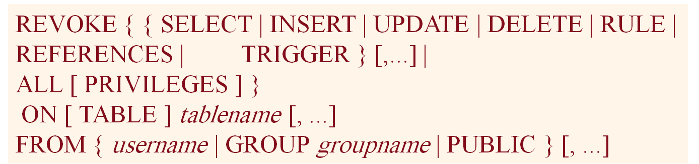
Database Security
Management of users
Syntax & Sémantic
Grant and Revoke
Postgres

Slide 16
Database Security
Management of users
Syntax & Sémantic
Grant and Revoke
Oracle
GRANT SELECT, INSERT, UPDATE, DELETE ON DEPARTMENT
TO username;
REVOKE SELECT
ON employee
FROM BOB;

Slide 17
Database Security
Management of users
Syntax & Sémantic
Grant and Revoke
Microsoft SQL
GRANT SELECT, ...
ON table
TO username
REVOKE SELECT, ...
ON table
FROM username

Slide 18
GRANT Command
GRANT privileges ON object TO users [WITH GRANT OPTION]
The following privileges can be specified:
  SELECT: Can read all columns (including those added later via ALTER TABLE command).
  INSERT(col-name): Can insert tuples with non-null or non-default values in this column.
    INSERT means same right with respect to all columns.
  DELETE: Can delete tuples.
  REFERENCES (col-name): Can define foreign keys (in other tables) that refer to this column.
If a user has a privilege with the GRANT OPTION, can pass privilege on to other users (with or without passing on the GRANT OPTION).
Only owner can execute CREATE, ALTER, and DROP.

Slide 19
GRANT and REVOKE of Privileges
GRANT INSERT, SELECT ON Sailors TO Horatio
  Horatio can query Sailors or insert tuples into it.
GRANT DELETE ON Sailors TO Yuppy WITH GRANT OPTION
  Yuppy can delete tuples, and also authorize others to do so.
GRANT UPDATE (rating) ON Sailors TO Dustin
  Dustin can update (only) the rating field of Sailors tuples.
GRANT SELECT ON ActiveSailors TO Guppy, Yuppy
  This does NOT allow the ‘uppies to query Sailors directly!
REVOKE: When a privilege is revoked from X, it is also revoked from all users who got it solely from X.
Notes:
23

Slide 20
Some examples in DB2
Authority R₁
Grant retrieve (S#, Sname, city), Delete
To John
ON Attempted Violation Reject
Or Lock_KB, etc

Slide 21
Authority R1
Grant insert , Delete , Retrieve (S # , SName , city )
ON S where S.city ≠ 'london'
To Jim, Fred
ON attempted violation Reject

Slide 22
Value dependent Authority rules
Authority R2
Grant Retrieve, Update (Sname, City)
ON S where S.city ≠ 'Paris'
To John;
Authority R3
Grant Delete, Retrieve (Sname, S#)
ON S
Value dependent
Value independent

Slide 23
Context dependent Authority rules
Grant Retrieve, Update (Sname, City )
ON S where Day ( ) IN ( 'SUN' , 'Mon' , 'Tue')
AND Time ( ) > Time '9: 00 ' AM
AND Time ( ) < Time '5: 00'PM AND Terminal ( ) = 'T4'
To Ali

Slide 24
What is a Role?
A role is a named group of related privileges that can be granted to the user.
Makes it easier to revoke and maintain privileges.
A user can have access to several roles, and several users can be assigned the same role.
Roles are typically created for a database application.
Syntax:
  CREATE ROLE role;

Slide 25
Example of a Role
CREATE ROLE manager;
  Role created.
GRANT create table TO manager;
  Grant succeeded.
GRANT manager TO User_name;
  Grant succeeded.
PRIVILEGES ARE GRANTED TO ROLES
PEOPLE ARE ASSIGNED ROLES
Notes:
Explain the graphic. Assigning privileges for a few people would not be a difficult task, but having to assign privileges for 1,000 employees would be very time consuming. The role of manager makes it easier to assign employee privileges.

Slide 26
Why Roles are easier?
Users
Manager
Privileges
Allocating privileges
without a role
Allocating privileges
with a role
Notes:
What Is a Role?
A role is a named group of related privileges that can be granted to the user. This method makes granting and revoking privileges easier to perform and maintain.
A user can have access to several roles, and several users can be assigned the same role. Roles typically are created for a database application.
Creating and Assigning a Role
First, the DBA must create the role. Then the DBA can assign privileges to the role and users to the role.
Syntax
CREATE ROLE role;
where: role is the name of the role to be created
Now that the role is created, the DBA can use the GRANT statement to assign users to the role as well as assign privileges to the role.
Class Management Note
Discuss the four following points about roles:
Are named groups of related privileges
Can be granted to users
Simplify the process of granting and revoking privileges
Are created by a DBA

Slide 27
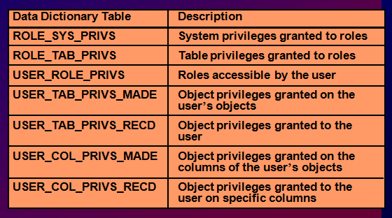
Viewing privilege in data dictionary
Types of privilege you can view

Slide 28
Example of privileges commands
SELECT *
FROM role_tab_privs
WHERE role = ‘MANAGER’;
SELECT *
FROM user_sys_privs;
SELECT *
FROM user_role_privs;

Slide 29
Displaying your privileges
To show what privileges a user has on the databases enter:
SELECT * FROM SESSION_PRIVS ;
You have a list of privileges you have displayed.
Run the command to see what you get. See next slide.

Slide 30
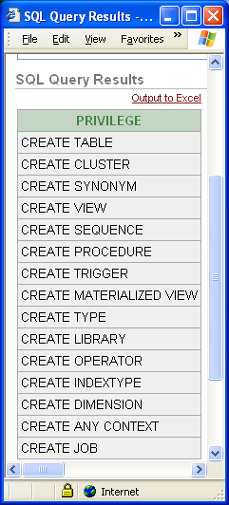
Results of previous command

Slide 31
GRANT/REVOKE on Views
If the creator of a view loses the SELECT privilege on an underlying table, the view is dropped!
If the creator of a view loses a privilege held with the grant option on an underlying table, (s)he loses the privilege on the view as well; so do users who were granted that privilege on the view!

Slide 32
Views and Security
Views can be used to present necessary information (or a summary), while hiding details in underlying relation(s).
  Given ActiveSailors, but not Sailors or Reserves, we can find sailors who have a reservation, but not the bid’s of boats that have been reserved.
Creator of view has a privilege on the view if (s)he has the privilege on all underlying tables.
Together with GRANT/REVOKE commands, views are a very powerful access control tool.
Notes:
22

Slide 33
Example:
Consider the following view defined on table S by DBA:
CREATE View V as
Select * from S where Field='Computer‘
And this authority rule has been defined:
GRANT Retrieve
ON V
TO Ali
Now, is Ali able to run the following query???
Ali: Select * from S where Field='Computer'

Slide 34
Security to the Level of a Field!
Can create a view that only returns one field of one tuple. (How?)
Then grant access to that view accordingly.
Allows for arbitrary granularity of control, but:
  Clumsy to specify, though this can be hidden under a good UI
  Performance is unacceptable if we need to define field-granularity access frequently. (Too many view creations and look-ups.)

Slide 35
Checking the authority rules
1- When a user submits a query, the DBMS considers the union of all related authority rules. He will be permitted if he has given permission in at least one authority rule.
2- If the user wants to see sth further than his privilege, there are two major methods in system’s reaction:
I- Request modification
II- Denial of access and error message

Slide 36
Checking the authority rules
Example in Quel:
Define Permit Retrieve on P To John
Where city = "London"
John: Retrieve ( p.p# , p.weight )
Where p.color = "red"
Request modification
Retrieve ( p.p# , p.weight )
Where city = "London" and p.color = "red"

Slide 37
?

