Slide 1
Business Presentation

Slide 2
Contents
In this presentation, we are going to get deep into the stock market and investing in stocks.
It is important to maintain a diversified portfolio when investing in stocks in order to maximize earnings under any market condition. Having a diversified portfolio tends to yield higher returns and face lower risk by tempering potential losses when the market is down. It is often easy to get lost in a sea of financial metrics to analyze while determining the worth of a stock and doing the same for a multitude of stocks to identify the right picks for an individual can be a tedious task. By doing a cluster analysis, one can identify stocks that exhibit similar characteristics and ones that exhibit minimum correlation. This will help investors better analyze stocks across different market segments and help protect against risks that could make the portfolio vulnerable to losses.

Slide 3
Business Problem Overview and Solution Approach
Trade & Ahead is a financial consultancy firm who provide their customers with personalized investment strategies. They have provided us with data comprising stock price and some financial indicators for a few companies listed under the New York Stock Exchange. They have asked us to analyzing the data, grouping the stocks based on the attributes provided, and sharing insights about the characteristics of each group.

Slide 4
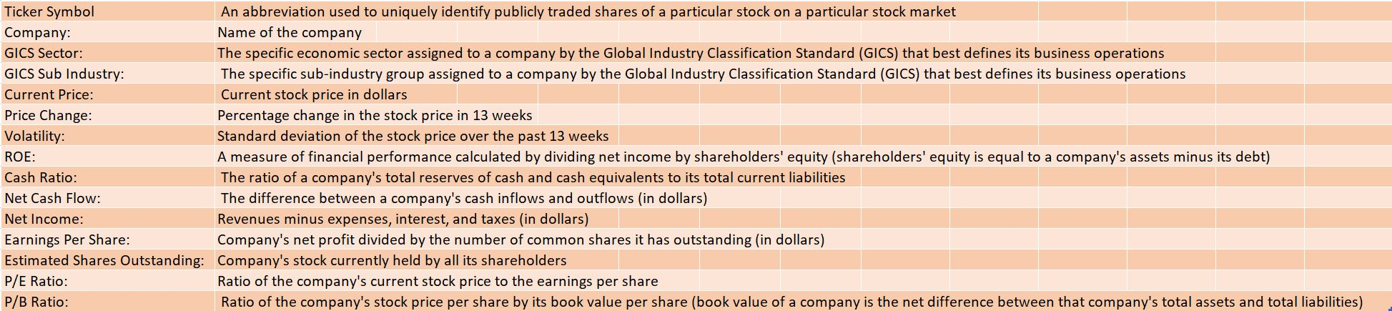
Data Overview
we have 340 rows and 15 columns
There is no missing value.
Also, we have outliers in our data
4 columns are objects 7 columns are float and others are integer
There is no duplicated values

Slide 5
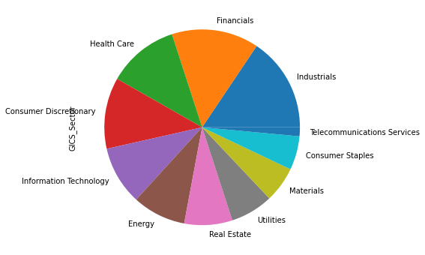
EDA
industrials and financial are on the top of The specific economic sector

Slide 6
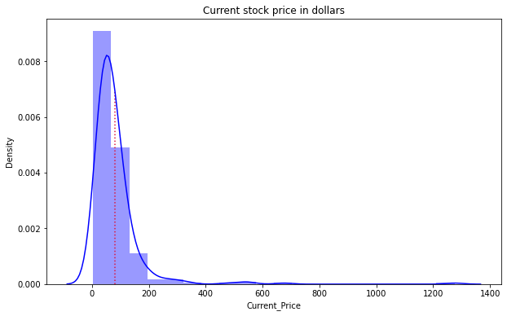
EDA
What does the distribution of stock prices look like?
Current stock price has a normal distribution but is highly skewed to the right. its mean is around 90$

Slide 7
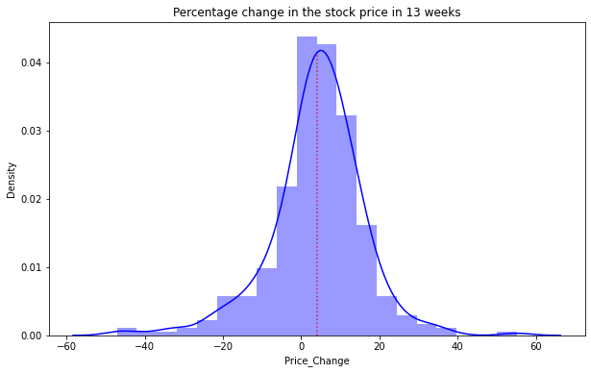
EDA
the Percentage change in the stock price in 13 weeks has a normal distribution and mean around 5

Slide 8
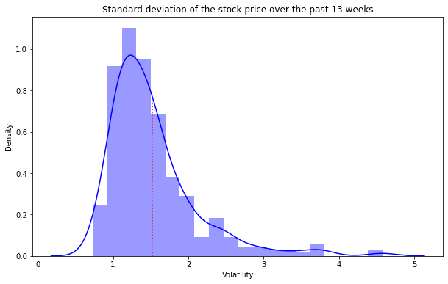
EDA
Standard deviation of the stock price over the past 13 weeks has a mean of around 1.6 and is skewed to the right.

Slide 9
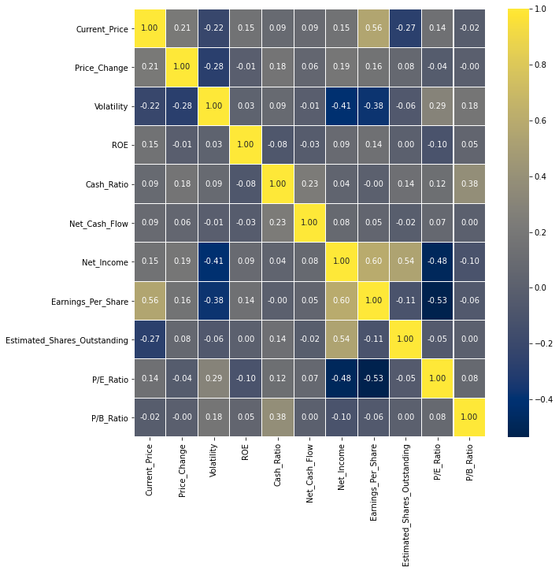
EDA
How are the different variables correlated with each other?
it seems that some variables have a correlation.
for example, between Price_Change and Volatility, there is a significant negative correlation(-0.41)
Also, Net_Income has a strong positive correlation with Estimated_Shares_Outstanding and Earnings_per_Share(0.59 & 0.56)
Earnings_per_Share has positive correlatin with Current_Price (0.48) and also has negative coorelation with REO and Volatility variables(-0.4 & -0.38).

Slide 10
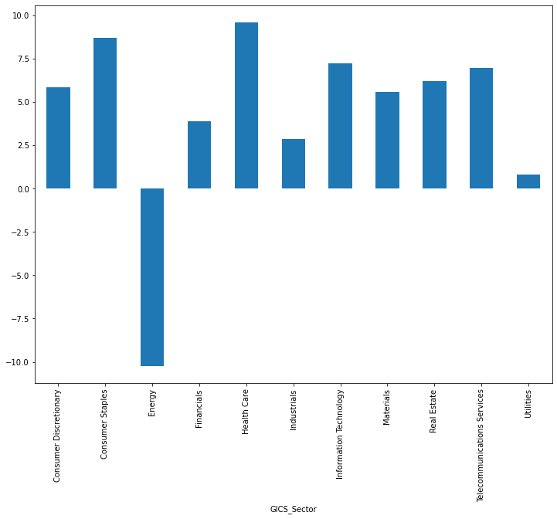
EDA
The stocks of which economic sector have seen the maximum price increase on average?
Health Care have seen the maximum price increase on average

Slide 11
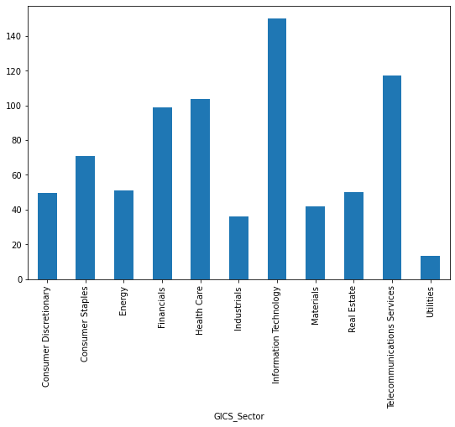
EDA
Cash ratio provides a measure of a company's ability to cover its short-term obligations using only cash and cash equivalents. How does the average cash ratio vary across economic sectors?
The average Cash ratio in economic sectors of Information Technology, Telecommunication Services, Healthcare, and Financials are higher than the others; also in Utilities section is the lowest.

Slide 12
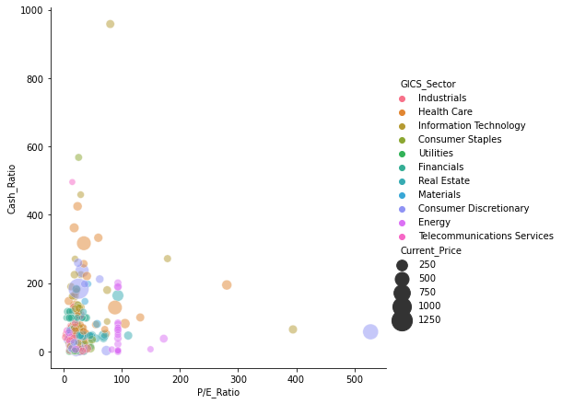
EDA
the companies with high P/E_Retio have lower Cash_Ratio also Current stock price of Consumer Discretionary and Health care sections is higher than the others.

Slide 13
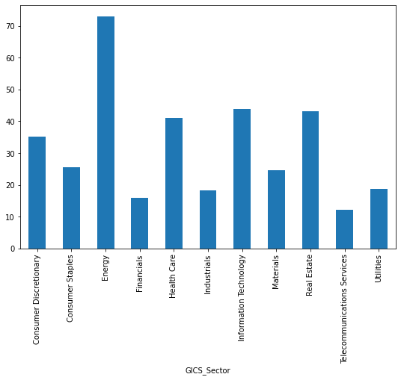
EDA
P/E ratios can help determine the relative value of a company's shares as they signify the amount of money an investor is willing to invest in a single share of a company per dollar of its earnings. How does the P/E ratio vary, on average, across economic sectors?
the relative value of company's shares in Energy, Information Technology, Real estate, and Healthcare are higher than the others

Slide 14
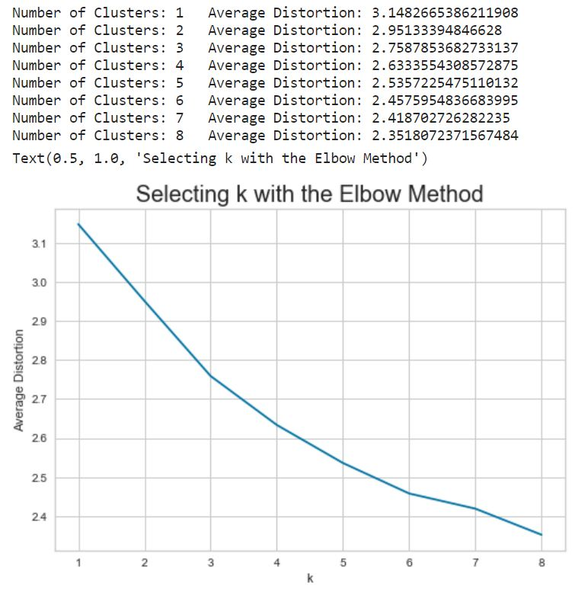
K-means Clustering
Apply K-means Clustering and Plot the Elbow curve:
The appropriate value of k from the elbow curve seems to be 6

Slide 15
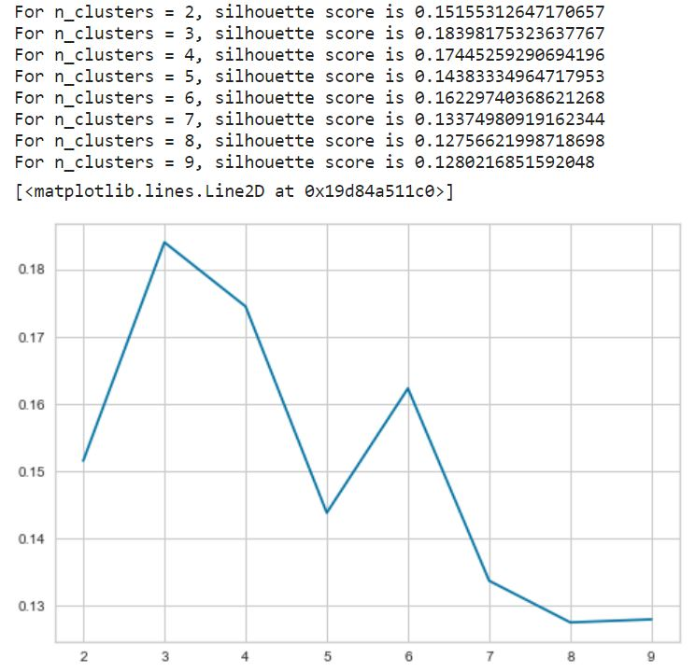
K-means Clustering
Check Silhouette Scores:
From the silhouette scores, it seems that 3 is a good value of k.

Slide 16
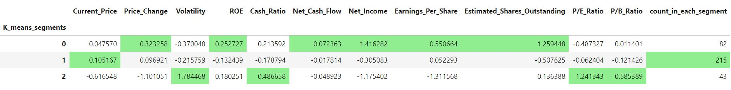
K-means Clustering
display cluster profiles
Cluster 0: There are 82 GICS_Sector in this cluster.
Current stock price is $0.04
Ratio of the company's current stock price to the earnings per share (or P/E ratio) is-0.48.
ROE or a measure of financial performance for companies of this cluster is 0.25.
Cluster 1: There are 215 GICS_Sector in this cluster.
Current stock price is $0.09
Ratio of the company's current stock price to the earnings per share (or P/E ratio) is -0.06
ROE or A measure of financial performance for companies of this cluster is 0.10
Cluster 2: There are 43 GICS_Sector in this cluster.
Current stock price is $-0.61
Ratio of the company's current stock price to the earnings per share (or P/E ratio) is 1.24
ROE or A measure of financial performance for companies of this cluster is 0.18
Cluster 2, the specific economic sector are good places to investing based on cluster profiling done.

Slide 17
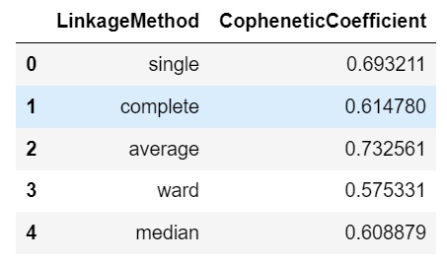
Hierarchical Clustering
Looking at the best cophenetic coefficient we get is for "Average" linkage.
But looking at dendrogram 'ward' shows the good difference between clusters.
Let's make a dendrogram for the last 25 formed clusters using complete linkage to have a better view since the above dendrograms are very populated

Slide 18
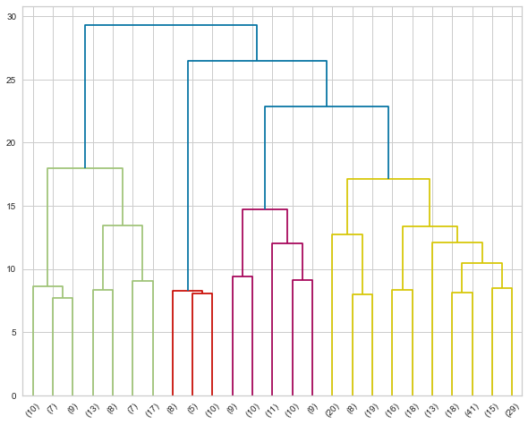
Hierarchical Clustering
Let's make a dendrogram for the last 25 formed clusters using complete linkage to have a better view since the above dendrograms are very populated
I take a maximum distance around 25 to form the different clusters as clearly visible it cuts the tallest vertical lines.

Slide 19
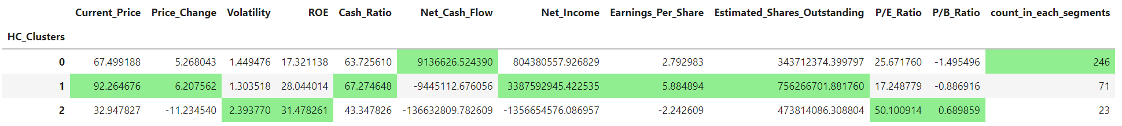
Hierarchical Clustering
display cluster profiles
Cluster 0 There are 246 GICS_Sector in this cluster.
Current stock price is $67.50
Ratio of the company's current stock price to the earnings per share (or P/E ratio) is 25.67.
ROE or A measure of financial performance for companies of this cluster is 17.32.
Cluster 1 There are 71 GICS_Sector in this cluster.
Current stock price is $92.26
Ratio of the company's current stock price to the earnings per share (or P/E ratio) is 17.24
ROE or A measure of financial performance for companies of this cluster is 28.04
Cluster 2 There are 23 GICS_Sector in this cluster.
Current stock price is $32.94
Ratio of the company's current stock price to the earnings per share (or P/E ratio) is 50.10
ROE or A measure of financial performance for companies of this cluster is 31.47

Slide 20
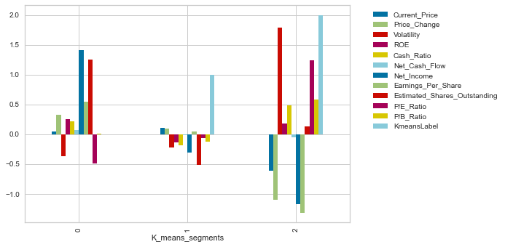
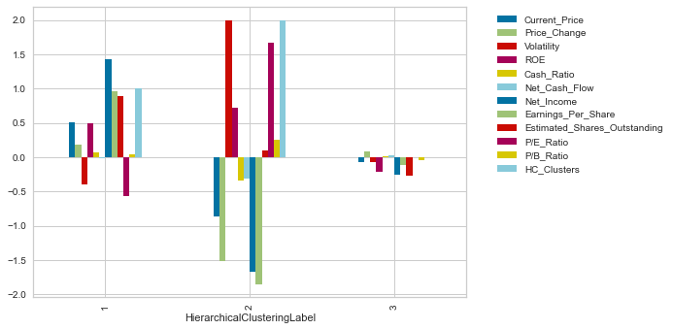
K-means vs Hierarchical Clustering
Cluster 2 of K-means appears like Cluster 2 of Hierarchical
K-means silhouette score is better than Hierarchical (0.19 vs 0.20)

Slide 21
Business Insights and Recommendations
for both clustering k-means and Hierarchical, cluster 2 have better result but, in k-means clustering ratios of (P/E Ratio, P/B Ratio, ROE and Cash Ratio) are better. this group is better for investment.
Financial performance of cluster 3 of Hierarchical and 1 of k-means clustering is very low, These companies need to concentrate more on marketing to get up their financial performance.
Performance of cluster 1 of Hierarchical and 0 of k-means are look like each other ratio of P/E is very low which means Ratio of the company's current stock price to the earnings per share are low. Also, cash ratio is very low in both so, these groups are not suggested.

