Slide 1
Data Archive (Infrastructure and GUI Access)
Narges Zarrabi

Slide 2
Data Archive - Long-term storage
Long-term storage of data
Storage medium: Tape → high latency
Powerful transfer protocols (gridfTp, rsync, scp)
Easy access from HPC services lisa and cartesius via NFS mounts → use archive as yet another directory

Slide 3
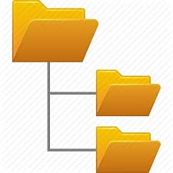


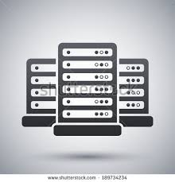
Data Archive Infrastructure
Workflow employing Archive from compute clusters at SURFsara:
User logs in to Lisa/Cartesius
Archive is mounted via NFS → User sees the archive as another folder
Copy data to HPC (with which commands?)
Do your computations on the data
Copy data back to archive (tape)
Tape
Lisa/Cartesius
Staging Data
Login
Disk
Notes:
Workflow employing Archive from compute clusters at SURFsara:
User logs in to Lisa/Cartesius
Archive is mounted via NFS → User sees the archive as another folder
Copy data to HPC with the normal system commands
→data is still on tape, but commands on HPC have been adopted to that
Do your computations on the data
Copy data back to archive (tape)

Slide 4
Archive Usage – Best practices
Try to store files of significant size (> 1 GB) as much as possible. Smaller files will always be accepted, but will lower the performance of restoring your files from tape.
If you have many small files, make sure to pack them using a file archiving tool like tar or dmftar.
Try to pack your files before uploading them to the archive, possibly by using dmftar which allows remote tarring.
Organise your files in such a way that in case the files are needed again only parts of the data set need to be restored from tape.
Avoid storing unpacked software packages, these usually contain a lot of small files. Instead pack these as well, or refer to a specific software repository.

Slide 5
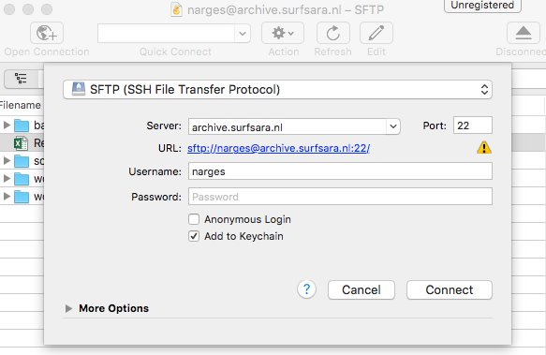
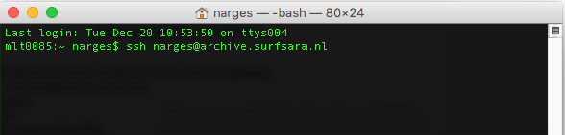
Accessing the Archive
Access via GUI (Graphical User Interface)
Access via command line Direct access
Access via NFS mounts (from compute clusters, Lisa and Cartesius)

Slide 6
Access Archive via GUI
Tools to access the Archive via GUI:
Cyberduck (Mac and Windows) →http://cyberduck.ch/
MobaXterm (Windows) → http://mobaxterm.mobatek.net/
Filezilla (Linux) → https://filezilla-project.org/

Slide 7
Access Archive via Cyberduck
Cyberduck is a standalone client that runs on Windows and Mac OSX
Download and install: http://cyberduck.ch/
To start an Archive session with Cyberduck:
Start Cyberduck
Click on 'Open connection'
You now see this screen
Choose the following options:
Connection type: SFTP (SSh File Transfer Protocol)
Server: archive.surfsara.nl
port: 22
Login with your credentials (sdemo<xxx>)

Slide 8
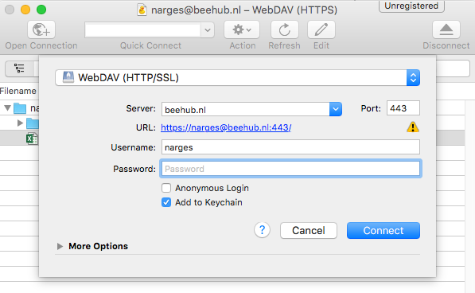
Access BeeHub via Cyberduck
To start a BeeHub session with Cyberduck:
Start Cyberduck
Click on 'Open connection'
You now see this screen
Choose the following options:
Connection type: WebDAV (HTTP/SSL)
Server: beehub.nl
port: 443
Enter your BeeHub username and password as you use them on the website (not your sdemo credentials!)

Slide 9
Transfer data between services using Cyberduck
To transfer data between services using Cyberduck:
Start Cyberduck
Establish a connection to the Archive
Establish another connection to BeeHub
Simply drag and drop files to transfer data from BeeHub to Archive

Slide 10
Access Archive via GUI
Advantages:
Easy data transfer (to the archive)
Good for dumping data to the archive, and not fetching data
Transfer data between services (Only possible for small data)
Can be accessed from Windows, Mac and Linux machines
Drawbacks
Does not support 3rd party transfer and the data flows via the user laptop. Therefore the transfer depends on your local storage and connectivity (If the connection is lost, the transfer is lost).
Only for small data files
Does not always work for fetching data (data needs to be staged first)
You can't see the status of the data (i.e. weather the data is on disk or on tape).
Server 1
( Beehub)
Server 2
(Archive)

Slide 11
Access Archive via Cyberduck

Slide 12
Access BeeHub via Cyberduck

Slide 13
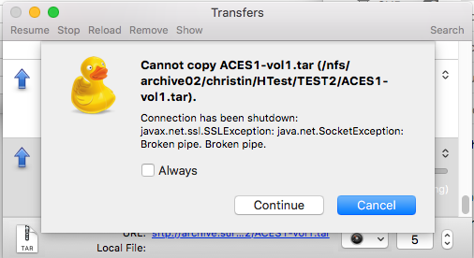
Data copied to the archive will remain on disk for a period of 4 weeks if there is enough disk space. After that the data will be removed from Disk.
Before using data on Tape, it need to first be staged on disk.
To directly transfer files from disk to a tape, a user can force a transfer by using the following commands:
dmput -r -w <filename> [..]
The following example command migrates the filename file. The process will release the disk space occupied by filename, and will wait until all offline copies are completed before terminating.
narges$ dmls -l
total 12288000
-rw-r--r-- 1 narges narges 10485760000 2016-05-26 15:33 (DUL) 2005-vol1.tar
-rw-r--r-- 1 narges narges 1048575001 2016-12-20 10:54 (DUL) bigfile
-rw-r--r-- 1 narges narges 1048575001 2016-12-20 10:54 (DUL) bigfile2
-rw-r--r-- 1 narges narges 1048575001 2016-12-20 10:54 (OFL) bigfile3
-rw-r--r-- 1 narges narges 1048575001 2016-12-20 10:55 (OFL) bigfile4
-rw-r--r-- 1 narges narges 10485760000 2016-12-20 11:09 (OFL) file1.tar
Notes:
Login to the dmf node: ssh narges@dmf.cdims.surfsara.nl
Go to this directory: cd /home/narges/workdir/BigData
Do a dmls to see the offline files: dmls -l

