Slide 1
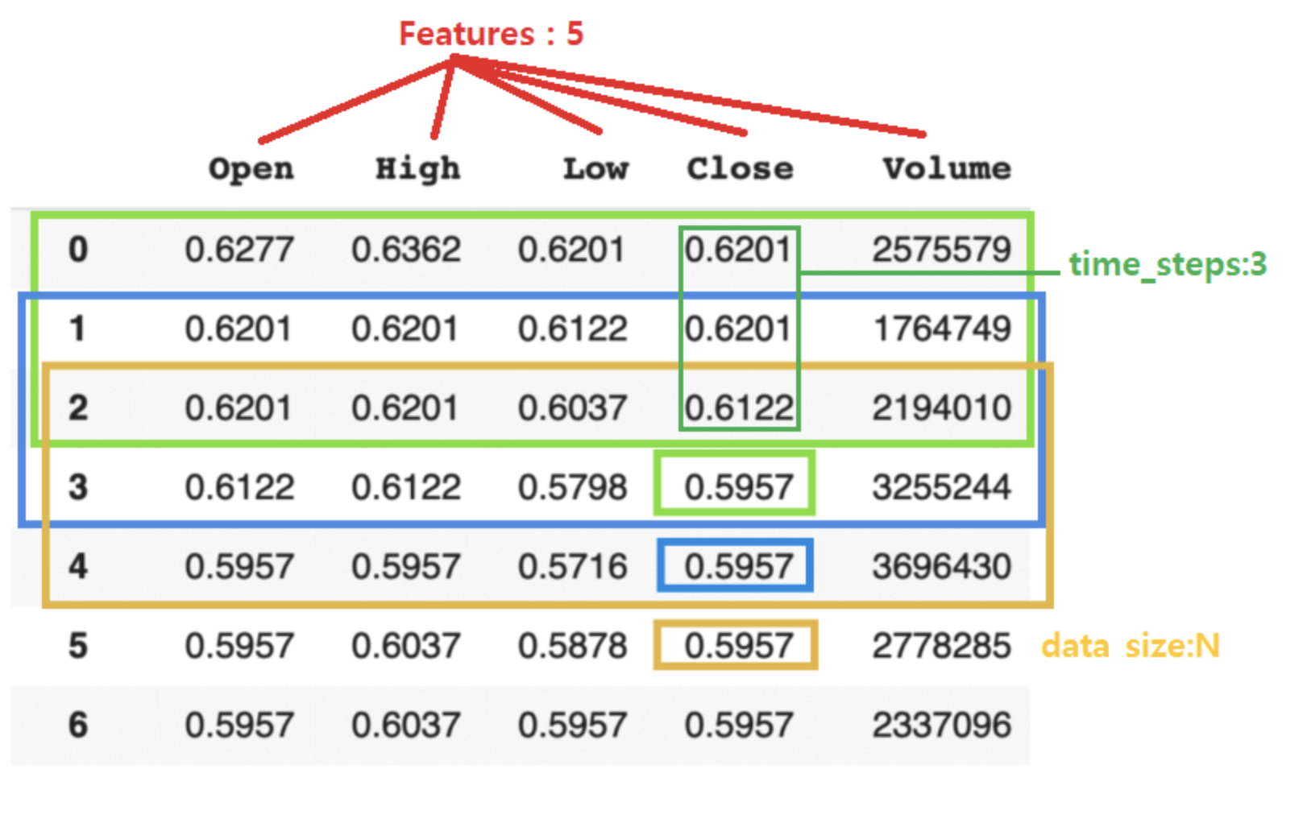
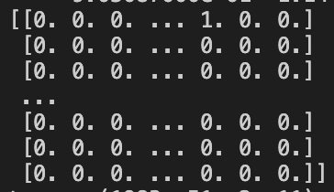
Data preparation
Data Source: https://datalab.snu.ac.kr/dtml/
Duration: 2007/01/03- 2016/12/30
tra_date = '2007-01-03'
val_date = '2015-01-02'
tes_date = '2016-01-04'
Pre-processed Input data
X = (batch size * number of stocks + 1 * time steps * features size)
Y = (batch size * number of stocks)
* number of stocks

Slide 2
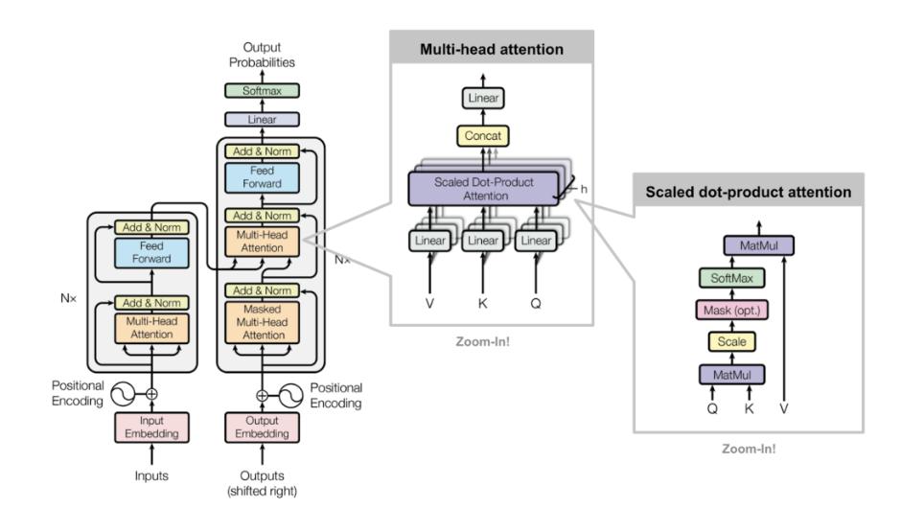
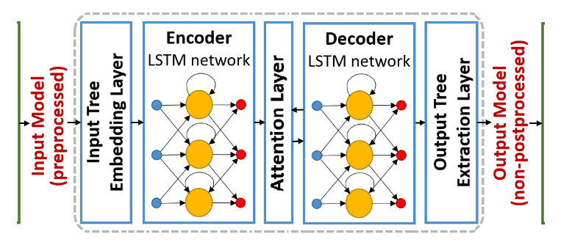
Model Background
Reference
Attention LSTM
Multi-head attention from Transformer

Slide 3
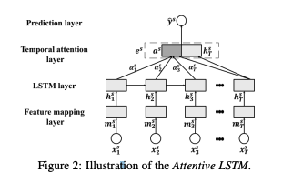
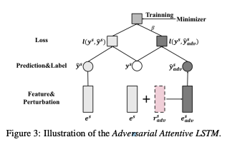
Reference Paper: Enhancing Stock Movement Prediction with Adversarial Training" IJCAI 2019

Slide 4
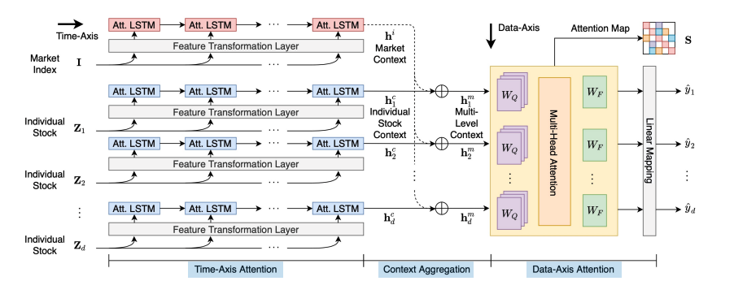
Model Architecture
기존 모델에 발전 아이디어
Context aggregation: 하이퍼파라미터 대신 weight 학습시킴
인풋데이터에 뉴스데이터 추가
인풋데이터에 퀀트베이스 피쳐 추가

Slide 5
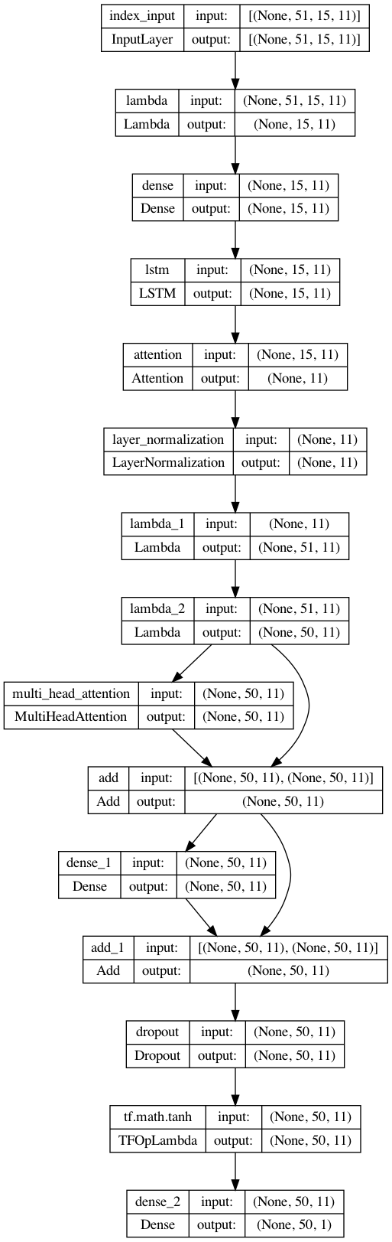

Model plot with Tensorflow
Input data
Multi head attention
Change shape 4d -> 3d for LSTM
Non-linear transformation
Feature Mapping
LSTM
Attention
Layer Normalization
Context Aggregation
Linear layer
Reshape with stock size + 1 for context Aggregation

