Slide 1

ANLY 530 FINAL PROJECT · STATEN ISLAND RAILWAY
Forecasting Staten Island Railway On-Time Performance
Explainable and uncertainty-aware machine learning for transit reliability
Chinmay Naringrekar | MTA Open Data · 2006–2026
18.7%
lower MAE than best baseline
5 folds
time-series cross-validation
79% / 90%
observed interval coverage
Notes:
Good morning. This project asks whether machine learning can turn the MTA's backward-looking on-time performance reporting for the Staten Island Railway into a forward-looking forecast. Three headline results up front: a fairly retrained XGBoost model beat the best simple baseline by about 18.7 percent on mean absolute error; that result was stress-tested with five-fold time-series cross-validation; and residual-based prediction intervals achieved almost exactly their nominal 80 and 90 percent coverage. Everything is built on twenty years of public MTA data.

Slide 2
Problem and motivation
The Staten Island Railway is the borough's only rapid-transit line and its link to the ferry.
The MTA publishes monthly on-time performance, but the reporting is retrospective:
it says how the railway performed last month, not how it will perform next month
Why forecasting could help
• Lead time for maintenance windows and staffing
• Early warning for months at risk of low OTP
• Sets rider expectations with evidence, not anecdotes
Why the series is forecastable
Momentum
Good and bad months cluster; OTP is strongly autocorrelated.
Seasonality
Recurring within-year patterns across the calendar.
History
241 monthly observations spanning 2006 to 2026.
2 / 12
Notes:
The Staten Island Railway is the only rail line on the island, and for most riders it exists to meet the ferry. The MTA already measures reliability well: monthly on-time performance, published openly. The gap is that this is entirely retrospective. The preliminary examination showed three properties that make the series a good machine-learning candidate: strong month-to-month momentum, visible seasonality, and a long history. Those three properties directly motivated the feature engineering you'll see on slide 6.

Slide 3
Research question
Can gradient-boosted tree models using lag, rolling-window, calendar, and operational features outperform statistical baselines such as SARIMA and Prophet at forecasting next-month on-time performance, while remaining interpretable through SHAP?
Accuracy
Lower error than naive, moving-average, SARIMA, and Prophet baselines?
Stability
Does the advantage hold across eras under time-aware cross-validation?
Usefulness
Can SHAP drivers and calibrated intervals support real planning decisions?
3 / 12
Notes:
The formal research question, from the project's methodology phase: can gradient-boosted trees with engineered temporal features beat traditional statistical forecasting on this problem, while staying interpretable? It decomposes into three testable sub-questions: accuracy against baselines under a fair protocol, stability across historical eras, and practical usefulness through explainability and uncertainty quantification. Each of the results slides answers one of these.

Slide 4
Data source and target variable
2006–26
monthly MTA open data
1,205
rows, 5 Day Time categories
241
7-Day monthly observations
26
columns in the model table
Target: next-month 7-Day On-Time Performance (without boat)
The On-Time Performance column filtered to the 7-Day category, shifted one month forward. The "With Boat" variant (penalizing missed ferry connections) is excluded and reserved for future comparison.
Columns: delayed trains, on-time trips, scheduled trips, OTP (with and without boat), trip completion, calendar fields.
Because the target is a one-month-forward shift, the feature table ends at 2025-12: the final raw month has no observed next month.
Excluded for now: weather, incidents, maintenance, ridership. These are future work, not part of the current model.
4 / 12
Notes:
One dataset: the MTA's public Staten Island Railway on-time performance file, 2006 through January 2026, about twelve hundred rows across five reporting categories. The headline research series is the 7-Day category, 241 monthly observations. The target definition matters: it is the without-boat OTP column, one month ahead. The dataset also carries a with-boat variant that penalizes missed ferry connections; we deliberately exclude it as a target. And a subtle point for reproducibility: shifting the target forward drops the last raw month from the supervised table, so features end at December 2025. No external data is used yet; weather and incidents are explicitly future work.

Slide 5
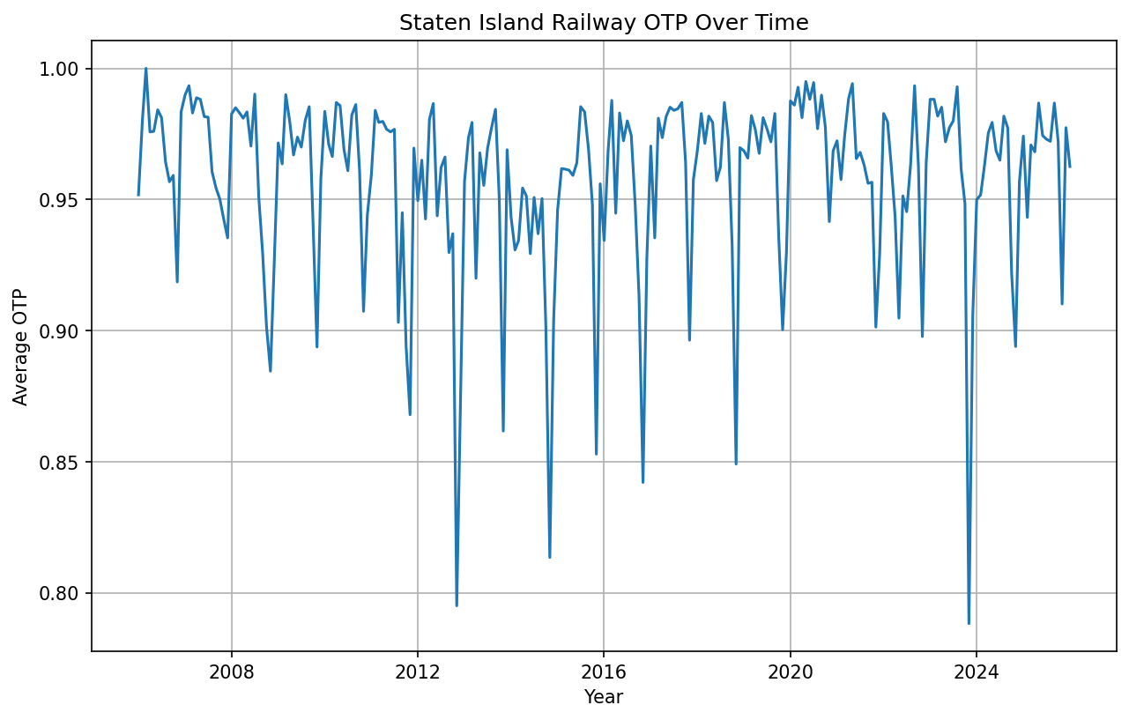
What the history shows
Three observations shaped the modeling
1. Momentum
A month's OTP sits close to recent months' OTP. Lag and rolling features will carry signal.
2. Seasonality
Systematic within-year variation. Month, quarter, and season features added; SHAP later ranks month #1.
3. Regime changes
Twenty years spans distinct eras, including the pandemic. A single train/test split can mislead, motivating time-series cross-validation.
5 / 12
Notes:
Exploratory analysis looked at the OTP trend, the delayed-trains trend, and seasonal structure. Three findings drove everything downstream. First, momentum: the series is strongly autocorrelated, which is why lag and rolling-average features work. Second, seasonality: there is recurring within-year structure, and this is not just an EDA impression, SHAP later ranks month number as the single most influential feature. Third, regime changes: the sample spans twenty years of different operating conditions including the pandemic, which is exactly why we added chronological cross-validation instead of trusting one split.

Slide 6
Feature engineering and model approach
From time series to supervised learning
Each row: this month's operational state → next month's OTP
• Lags: OTP t−1, t−2, t−3; delayed trains t−1
• Rolling means: OTP 3- and 6-month; delays 3-month
• Operational: delay rate, delayed trains, scheduled trips, completion %
• Calendar: year, month, quarter, season and Day Time dummies
Result: 1,170 rows × 26 columns, no nulls
Model selection (chronological 80/20 split)
• Linear Regression — MAE 0.0305, R² 0.12
• Random Forest — MAE 0.0311, R² 0.16
• XGBoost — best RMSE and R² (0.17), selected
XGBoost: 300 trees, depth 5, learning rate 0.05
Every reported split preserves time order. For the research comparison, XGBoost is retrained using only pre-test data, so it has no information advantage over baselines.
6 / 12
Notes:
The series becomes a supervised problem in the standard way: each row pairs the current month's operational state with next month's OTP. Feature groups mirror the EDA findings: lags for momentum, rolling means for trend, operational load, and calendar. That yields 1,170 rows by 26 features. On the modeling side, three candidates were compared on a chronological 80/20 split, on the 0-to-1 proportion scale. The three are close on MAE, but XGBoost has the best RMSE and R-squared, handles interactions, and supports fast SHAP, so it was selected. The methodological commitment: chronological honesty everywhere. In the fair comparison, XGBoost is retrained from scratch on pre-test data only.

Slide 7
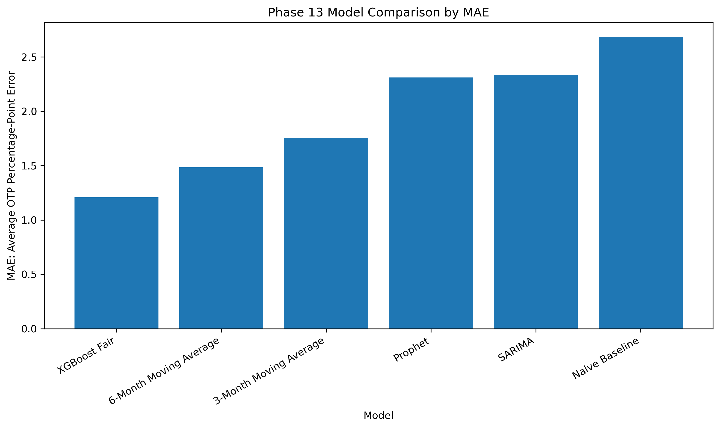
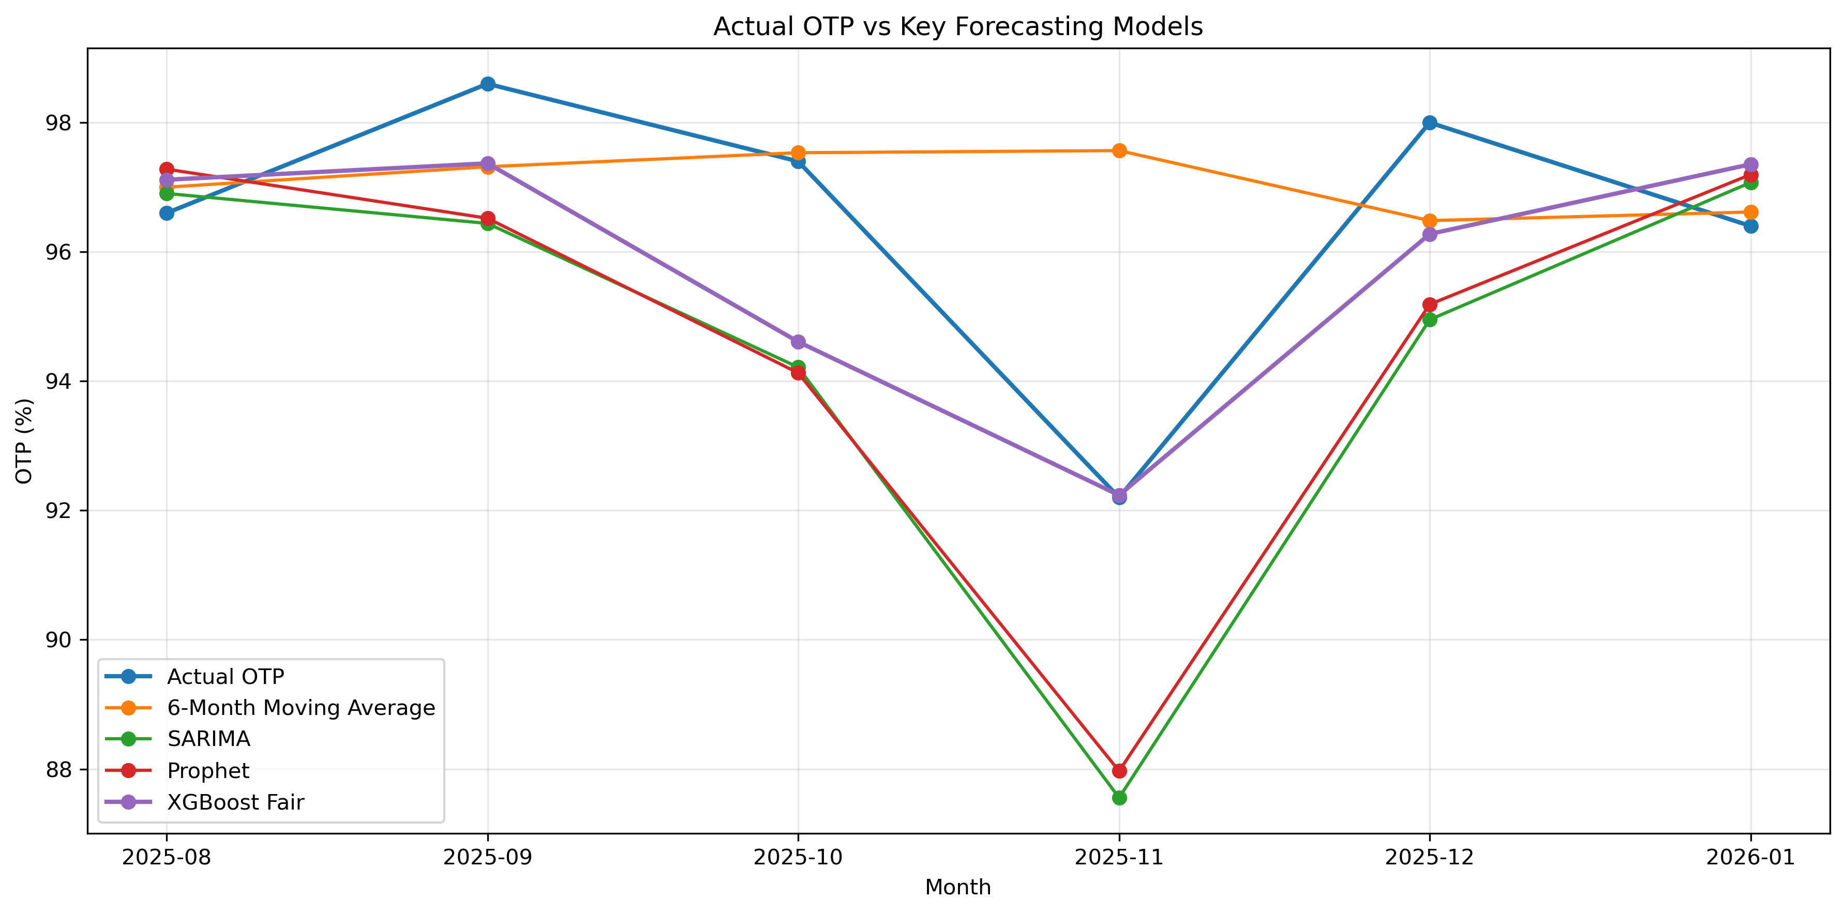
Fair baseline comparison (Phase 13)
MAE 1.21
XGBoost Fair (best baseline: 1.49)
−18.7%
error vs 6-month moving average
R² 0.48
only model above zero on test
Test window: Aug 2025 – Jan 2026, trained through Jul 2025. Full table: outputs/reports/phase13_model_comparison.csv
7 / 12
Notes:
The core accuracy result. Six forecasters, all evaluated on the same held-out window, August 2025 through January 2026, with XGBoost retrained fairly on pre-test data only. XGBoost wins with MAE 1.21 OTP percentage points against 1.49 for the best simple baseline, the 6-month moving average: an 18.7 percent reduction. It is also the only model with positive R-squared on the window. Note the ordering below it: the moving averages beat SARIMA and Prophet. On a short horizon with this much momentum, smoothing is cheap and effective, while the statistical decompositions over-model. That's part of why the gradient-boosted model's win is meaningful: it beats the hard-to-beat baseline, not just the fancy ones.

Slide 8
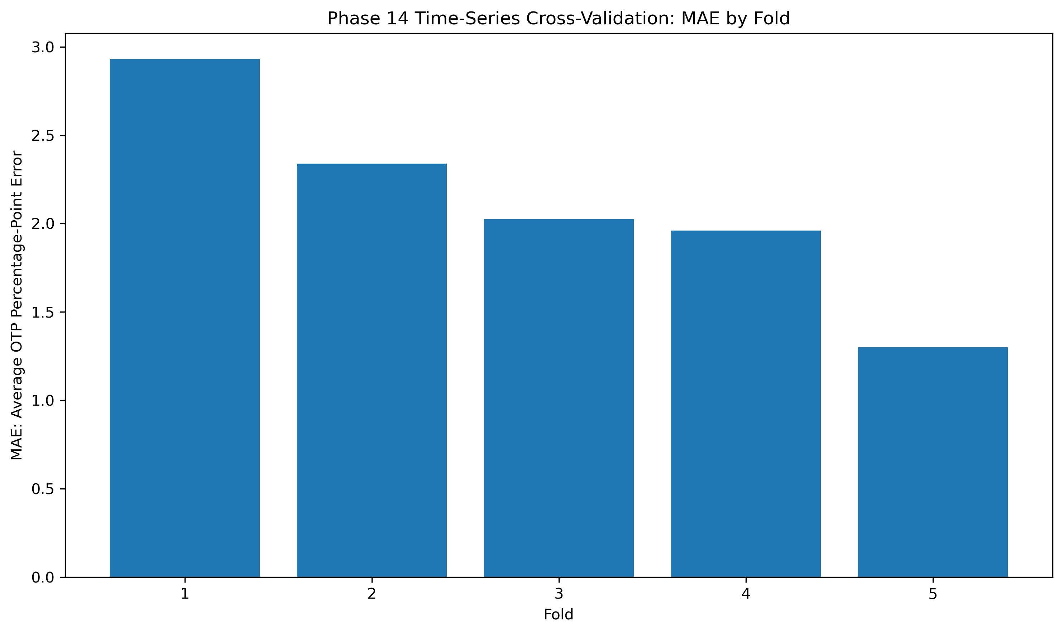
Does it hold up? Time-series cross-validation (Phase 14)
2.11 ± 0.59
average MAE across folds
2.93 → 1.30
MAE, earliest fold → latest fold
Accuracy is era-dependent and improves with training history.
5 chronological folds, 39 test rows each. Training always precedes testing.
8 / 12
Notes:
Stability check. TimeSeriesSplit with five chronological folds over the full 2006-to-2026 history. Average MAE is 2.11, clearly worse than the 1.21 from the recent-era window, and that gap is itself a finding: headline accuracy depends on the evaluation era. The fold pattern is almost monotonic. Fold 1, trained on only 39 rows from 2006 to 2009, has MAE 2.93; fold 5, trained on 195 rows through 2022, gets down to 1.30. So the honest read is: the Phase 13 number is a recent-era estimate, and the model earns its accuracy as history accumulates. Average R-squared across folds is 0.18 with high variance, which is why MAE is our primary metric.

Slide 9
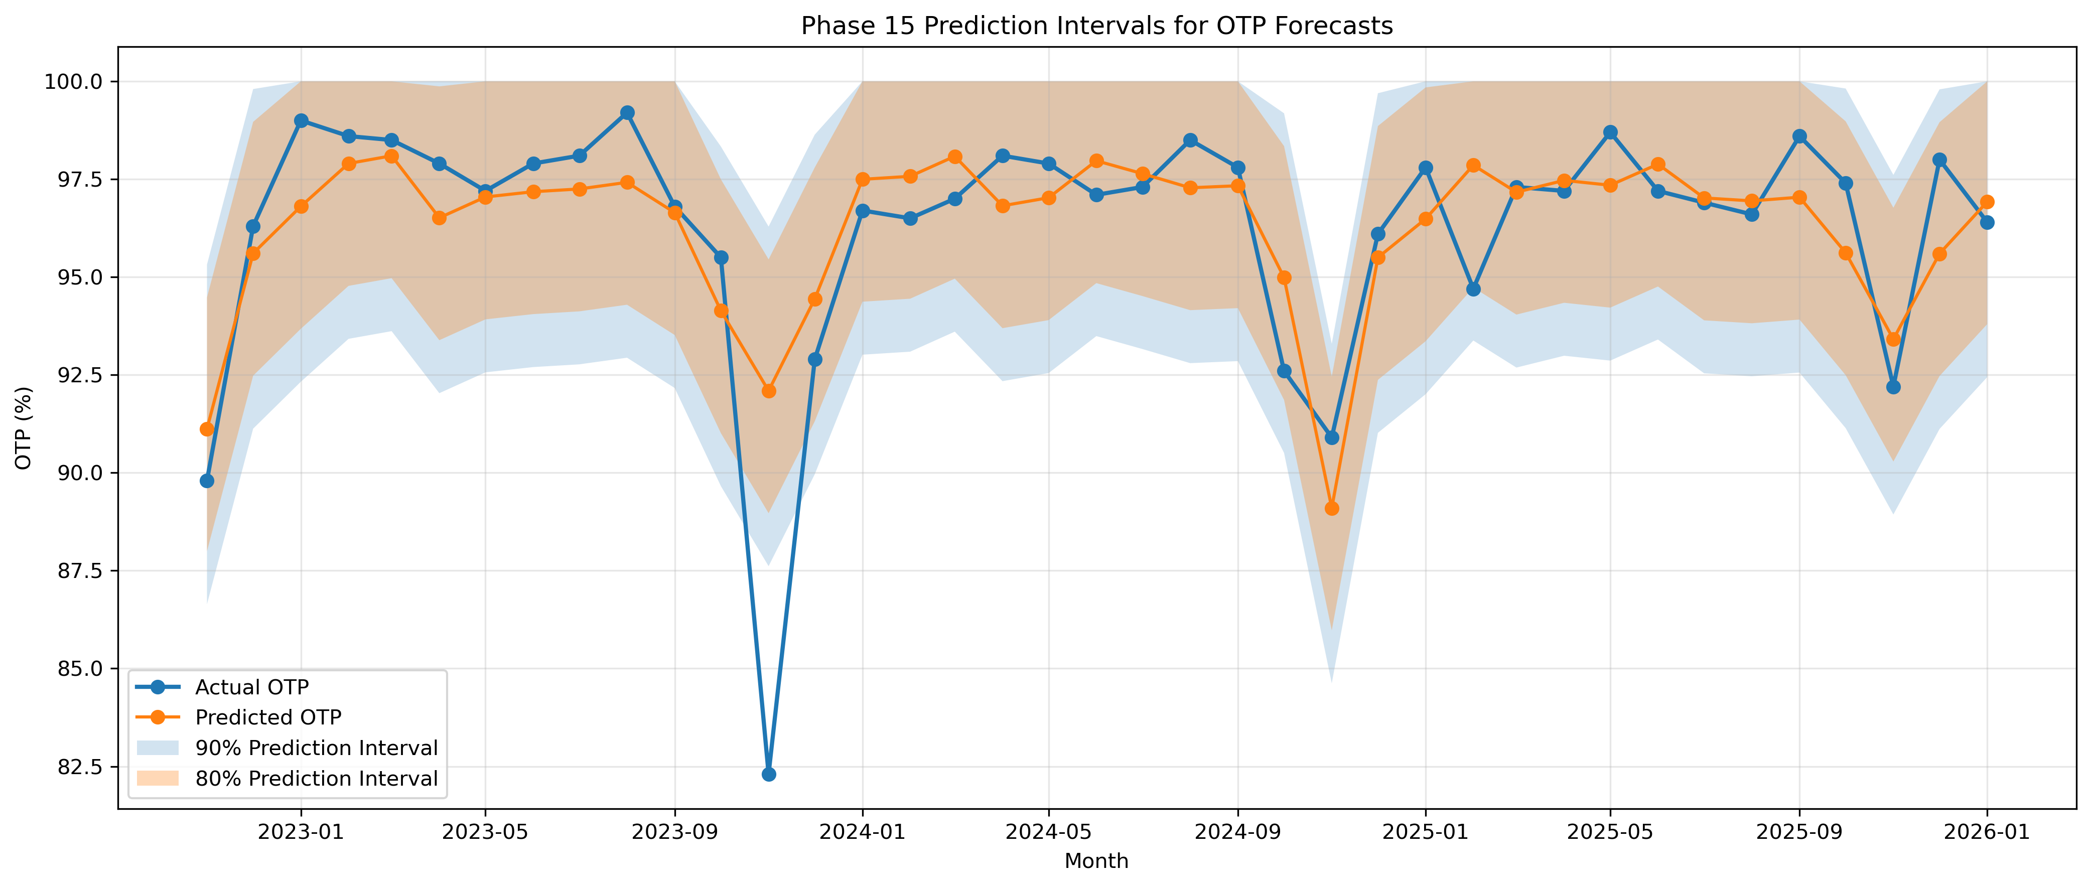
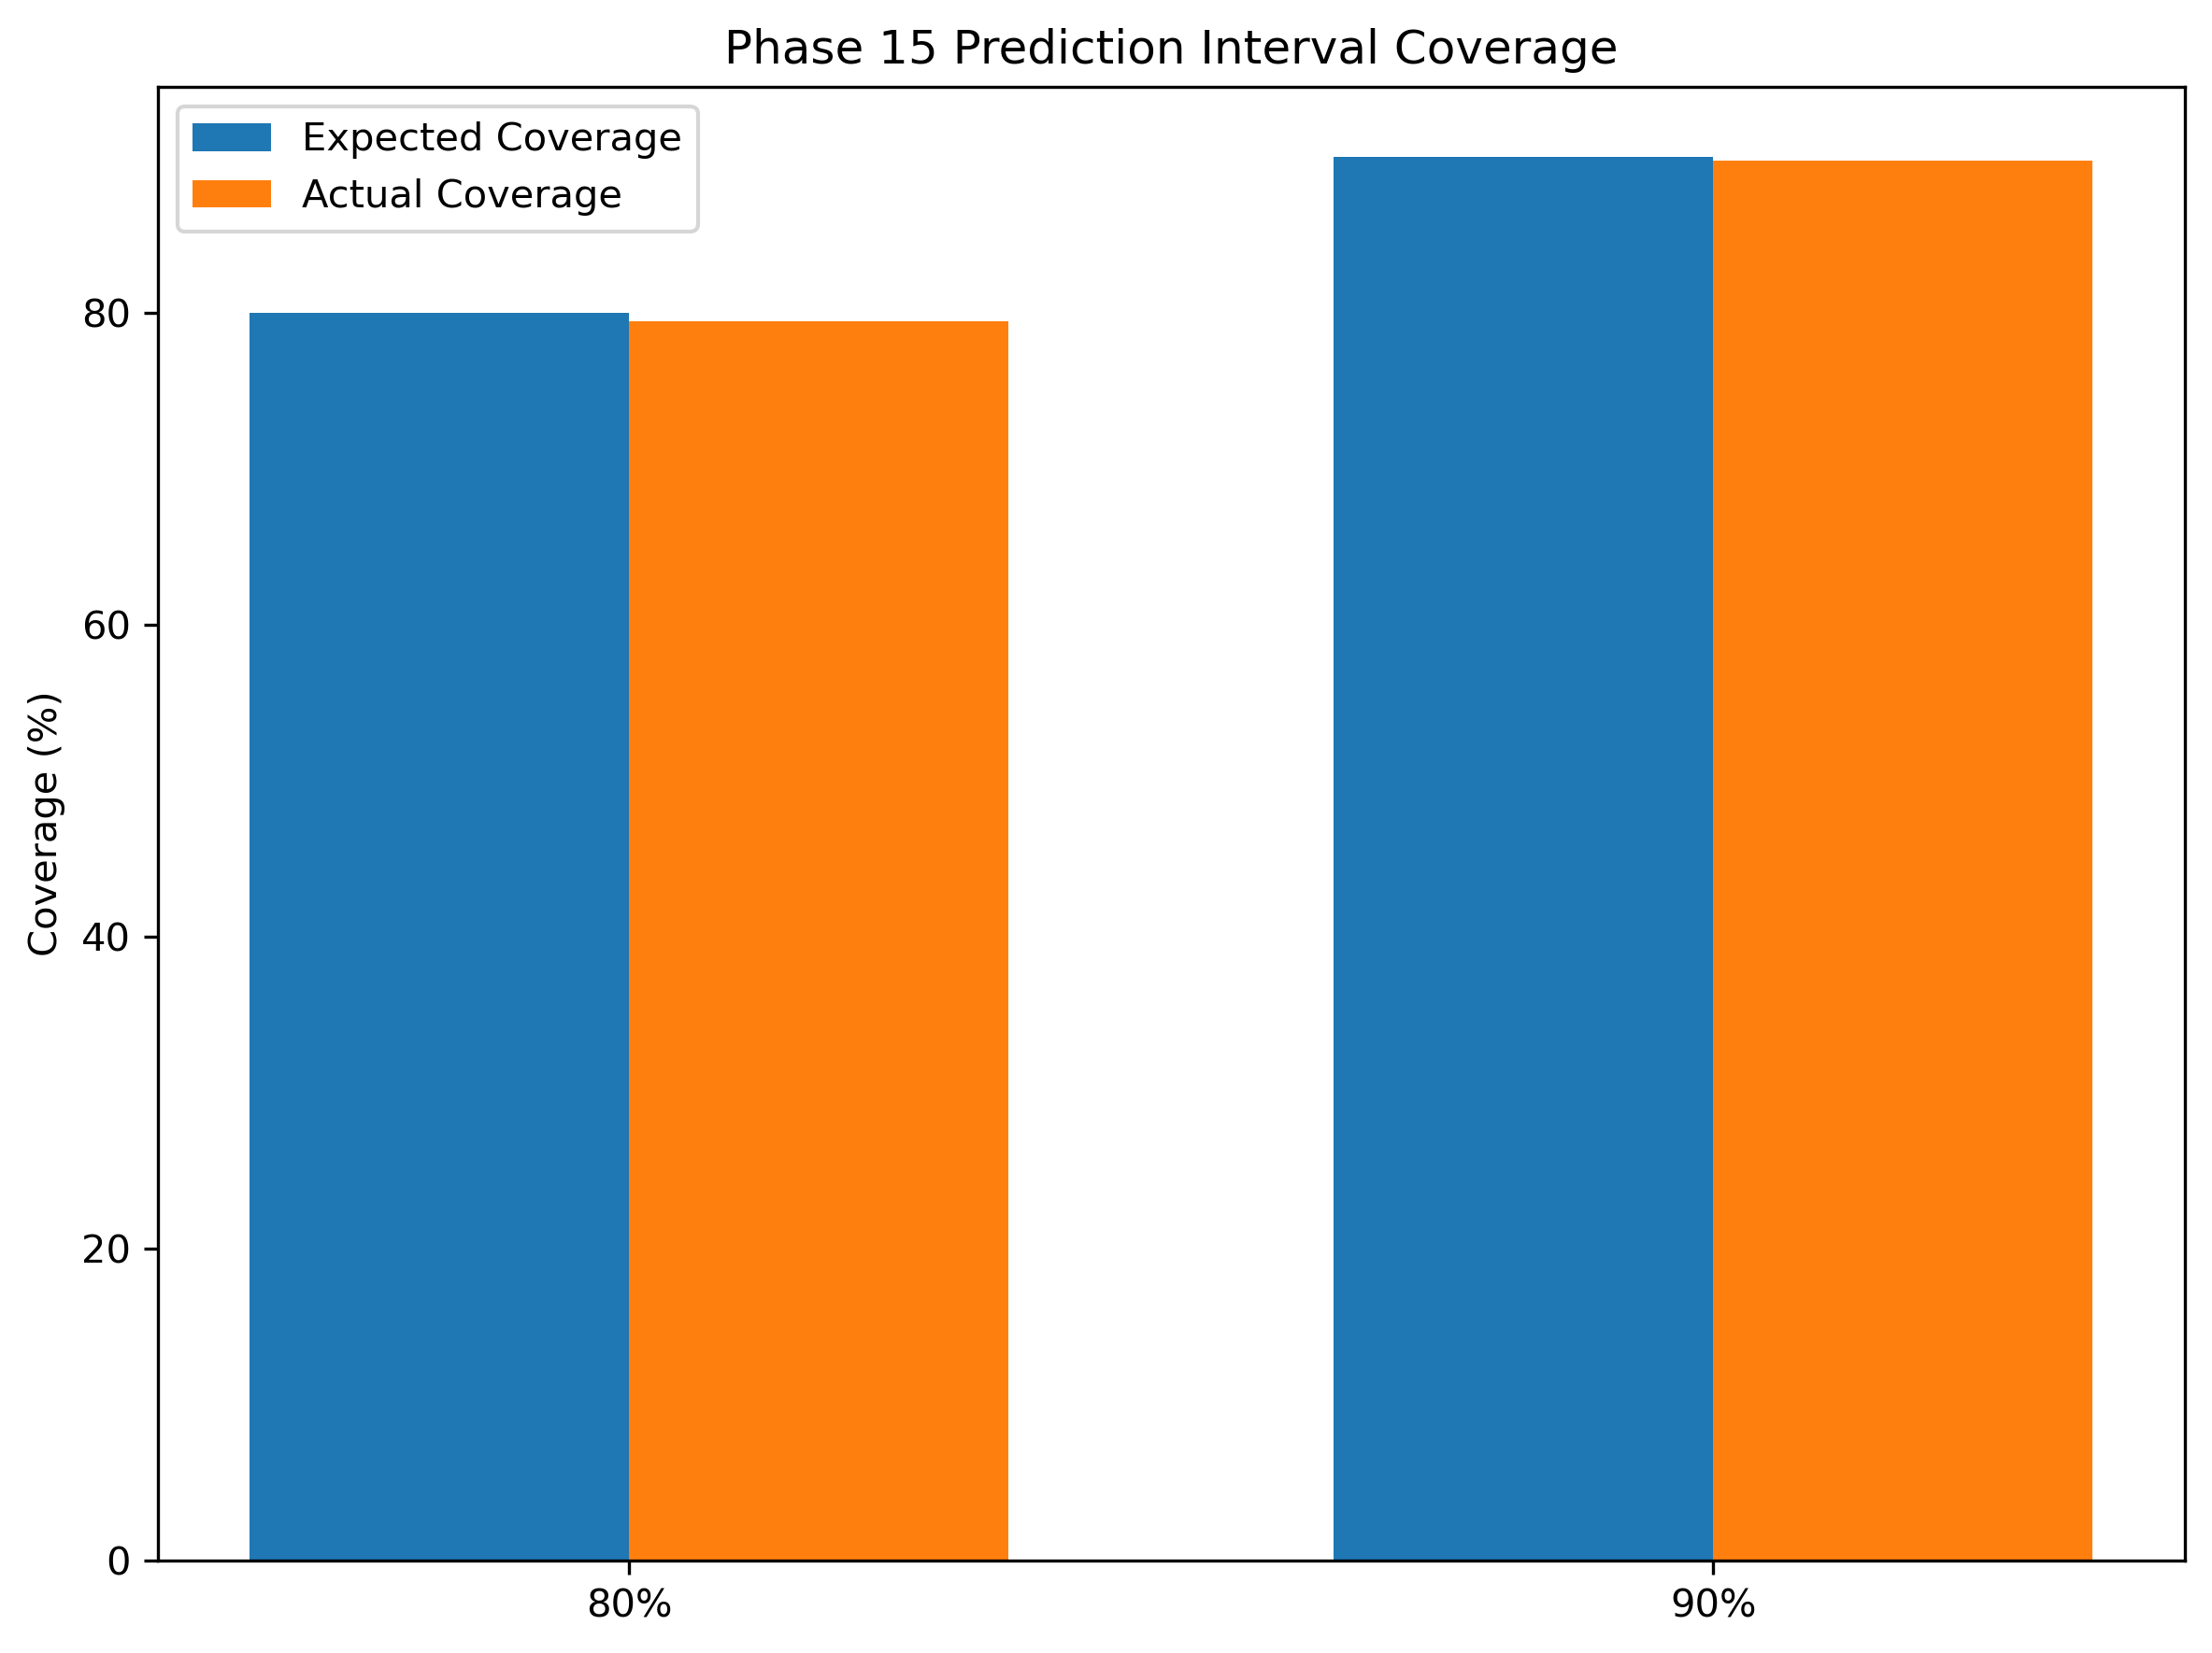
Prediction intervals and uncertainty (Phase 15)
79.5%
coverage, 80% interval
89.7%
coverage, 90% interval
Built from out-of-sample CV residuals, not in-sample fit.
80% band: −3.1 to +3.4 OTP points (width ≈ 6.3)
90% band: −4.5 to +4.2 OTP points (width ≈ 8.2)
A forecast of 96% reads as "roughly 93–99" at 80% confidence.
9 / 12
Notes:
Point forecasts overstate certainty, so Phase 15 attaches empirical intervals. Method: take the residuals from the chronologically honest cross-validation folds, and use their 10th/90th and 5th/95th percentiles as the 80 and 90 percent bands. Because these come from out-of-sample residuals, the coverage numbers are meaningful: the 80 percent interval covered 79.5 percent of actuals, the 90 percent interval covered 89.7. Both within about half a point of nominal. For a planner the translation is simple: a 96 percent OTP forecast should be read as roughly 93 to 99 at 80 percent confidence.

Slide 10
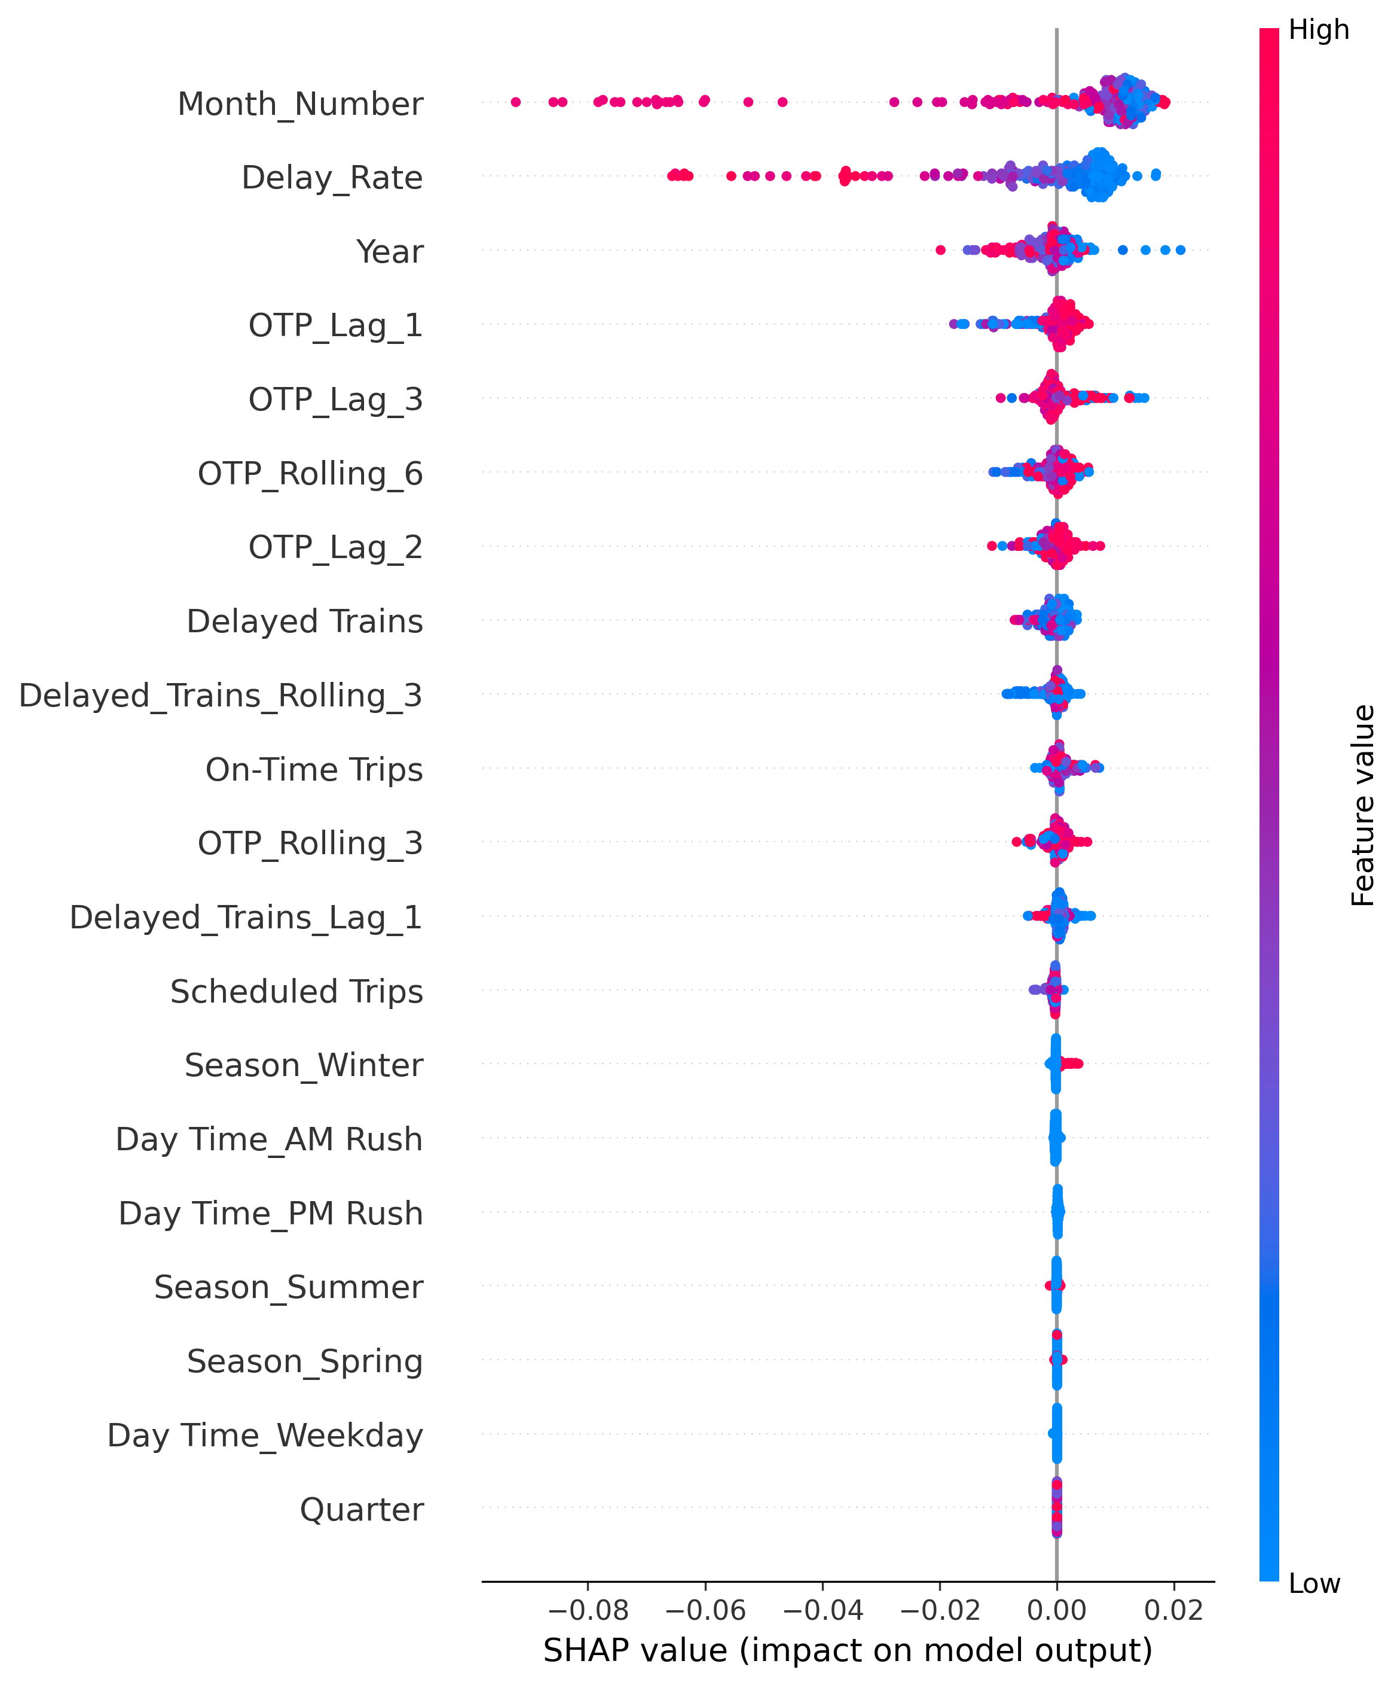
Why the model predicts what it predicts (SHAP)
Top drivers, by mean |SHAP value|
1. Month number — seasonality dominates, by a wide margin
2. Delay rate — the current delay burden carries forward
3. Year — long-run era effects
4. OTP lags and rolling means — recent momentum
5. Delayed-train counts — raw operational load
Operationally coherent: where the railway is in the calendar, how much delay it is carrying, and how it has trended recently jointly set the forecast. Not a black box: the dashboard asks why, not just what.
10 / 12
Notes:
Interpretability was part of the research question, not an afterthought. SHAP decomposes each prediction into additive feature contributions. The ranking: month number first by a wide margin, confirming the seasonality finding from EDA; then delay rate; then year, capturing era effects; then the OTP lag and rolling features, which is the momentum story; then raw delayed-train counts. The important part for the course: this list is exactly what a transit planner would name as drivers of reliability. When the model and domain intuition agree on the why, the forecast becomes something you can defend in an operations meeting.

Slide 11
Decision support: the Streamlit dashboard
1
Executive overview
KPI cards: average, best, and worst OTP; average delay rate
Operational risk levels
2
Trend and model views
Historical OTP with Day Time filtering; actual vs predicted
Low
OTP ≥ 95%
3
Future forecasting
Recursive 3–12 month horizon with forecast KPI cards
Medium
90–95%
4
Explainability
SHAP drivers surfaced next to the forecasts
High
OTP < 90%
Forecasts become risk language plus a plain-English outlook message: the vocabulary of service planning, not of machine learning.
11 / 12
Notes:
The delivery vehicle is a Streamlit dashboard aimed at non-technical users. Four capability groups: executive KPI cards; interactive trend and actual-versus-predicted views with Day Time filtering; recursive future forecasting with a user-selected 3-to-12-month horizon; and the SHAP explainability view. The piece I want to highlight is risk translation: forecasted months are classified Low, Medium, or High risk with simple OTP thresholds, plus a plain-language outlook message. That last step converts the model's output into the vocabulary planners already use. A planned upgrade will surface the Phase 13-through-15 research results directly in the app.

Slide 12
Limitations, future work, and conclusion
Limitations
• 241 monthly observations; 6-month test window
• Era-dependent accuracy (CV 2.11 vs recent 1.21)
• No weather, incident, or ridership inputs
• Recursive multi-month forecasts compound error
Future work
• Weather features, with controlled comparison
• Incident, maintenance, ridership covariates
• Uncertainty-aware risk bands
• "With Boat" and peak-period targets
Conclusion
• XGBoost beats all baselines fairly: −18.7% MAE
• Advantage is real but era-dependent
• Drivers match planner intuition (SHAP)
• Intervals calibrated near nominal coverage
A reproducible decision-support system: forecast, explanation, uncertainty, and risk framing — documented end to end.
12 / 12
Notes:
To close honestly. Limitations: this is a small monthly sample with a short test window, accuracy is era-dependent, there are no external drivers yet, and recursive forecasts compound error with horizon. Future work follows directly: weather first, with a controlled base-versus-enhanced comparison, then incident and ridership data, uncertainty-aware risk bands, and alternative targets including the with-boat series. Conclusion: under a leakage-free comparison, the gradient-boosted model beat every baseline including the hard-to-beat moving average; cross-validation tempered but did not overturn the result; SHAP showed the drivers are ones planners recognize; and the prediction intervals are calibrated. The research question is answered affirmatively, with the caveats stated. Thank you; happy to take questions.

