Slide 1






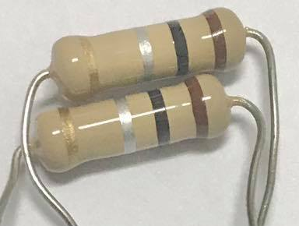
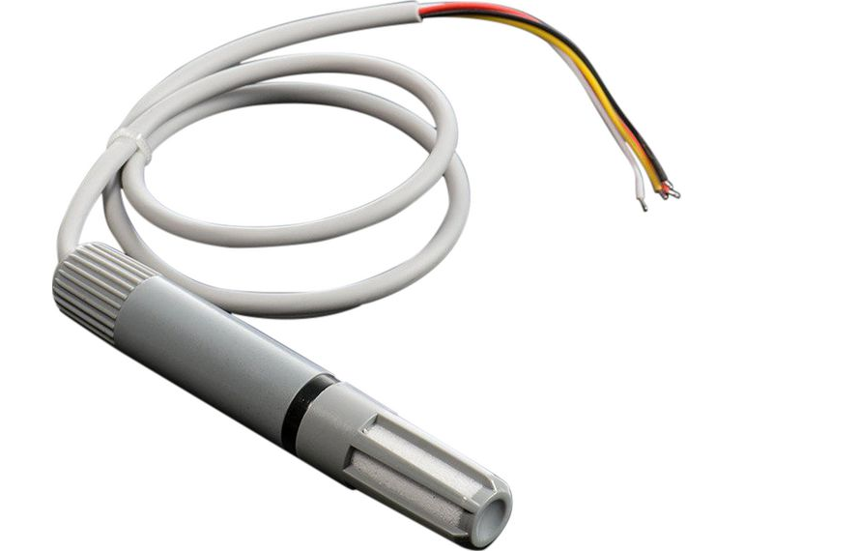
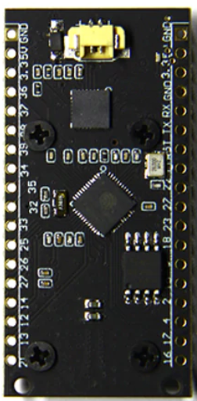
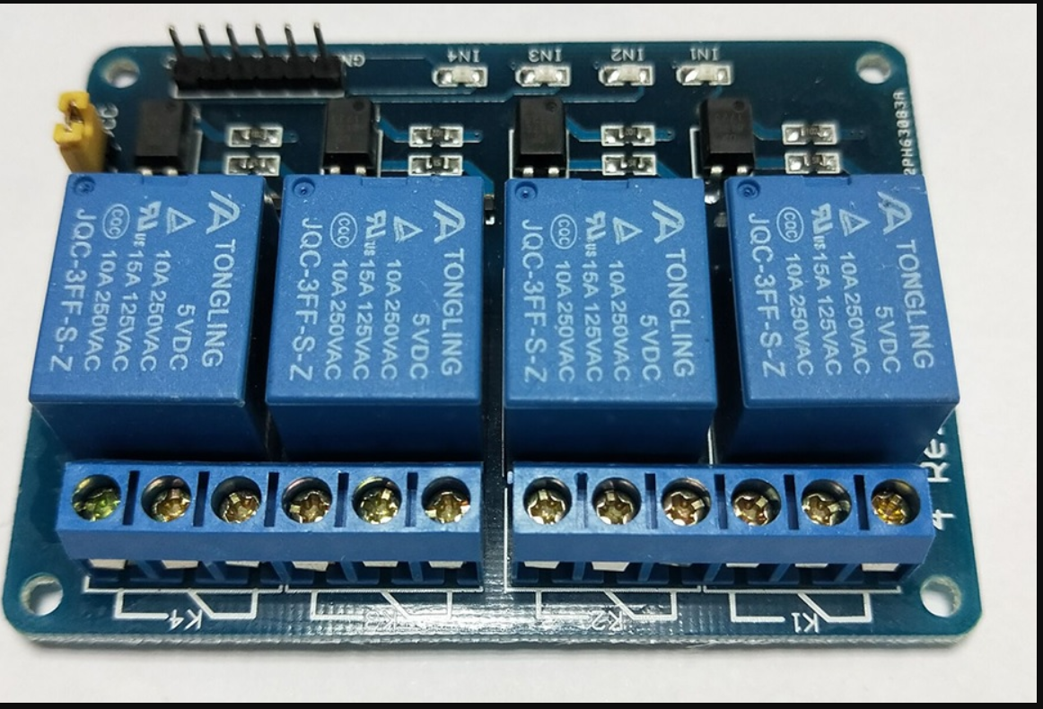
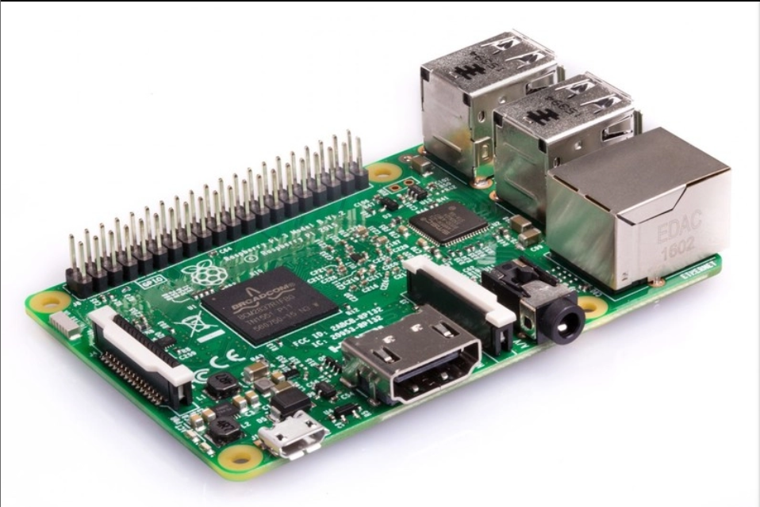

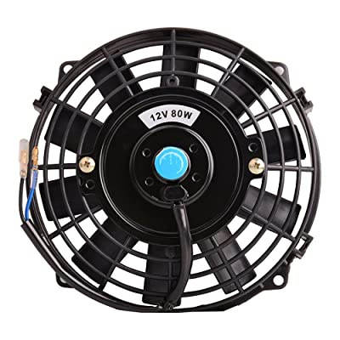
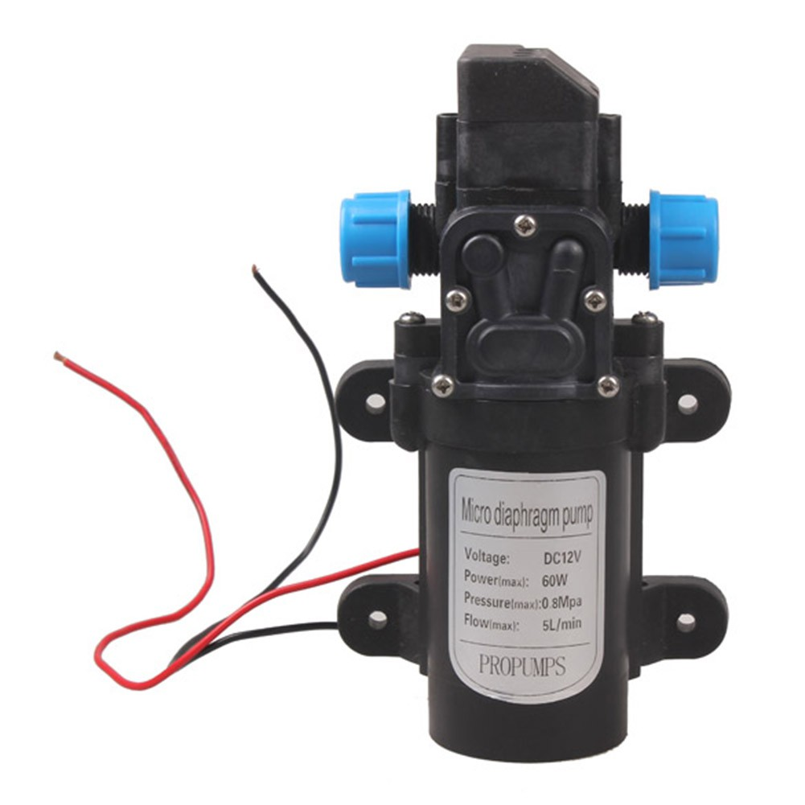



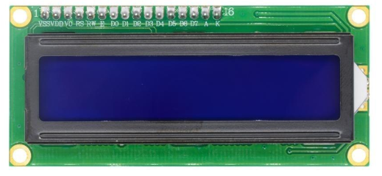

Line Application
Line Notify Service
Web Client
ngrok
Mushroom Farm
Access Point
Current Sense Resistors
AM2315
Relay
Raspberry pi 3 b
ESP32LoRa
ESP32LoRa
Fan
Pump
Windows
Application
I2C LCD
Web Server
Windows
Application
Database Server

