Slide 1
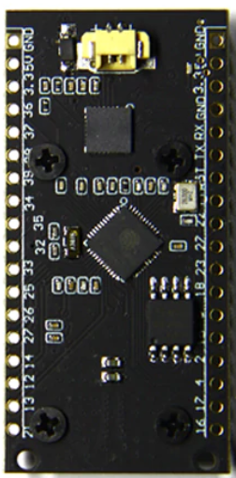





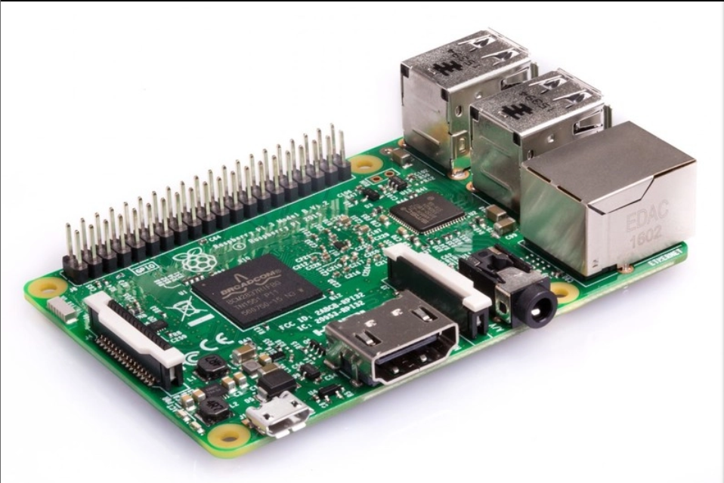

Access Point
HTTP
HTTP
HTTP
Web Server
HTTP
Internet
HTTP
Database
Client

