Slide 1






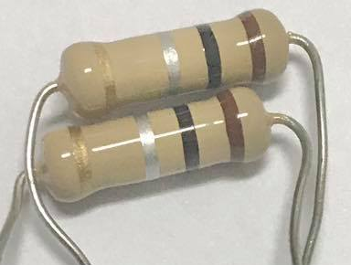
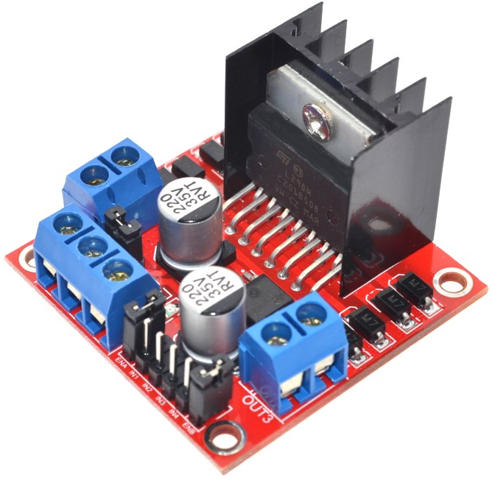
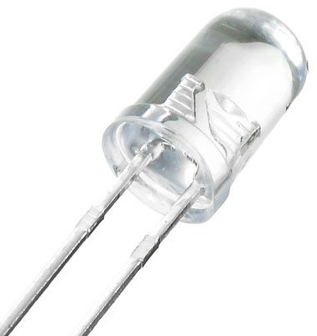
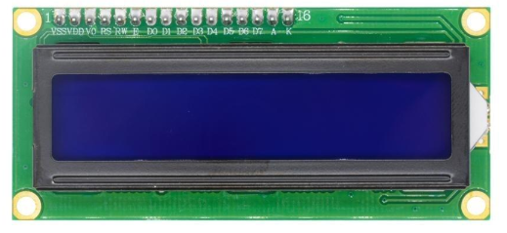
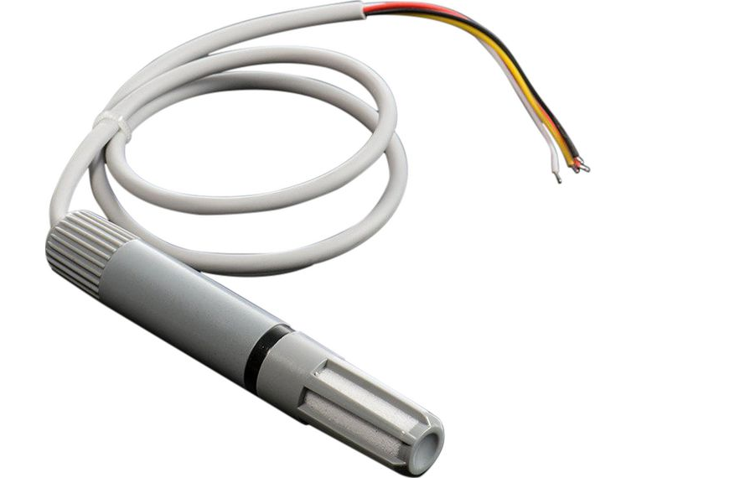
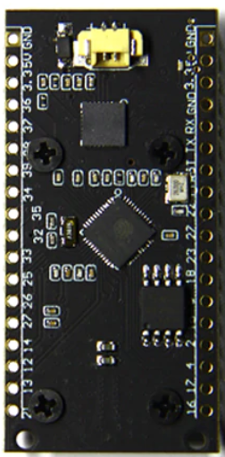
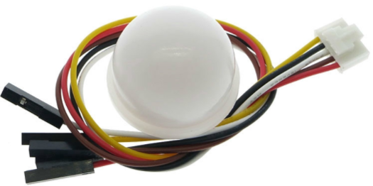
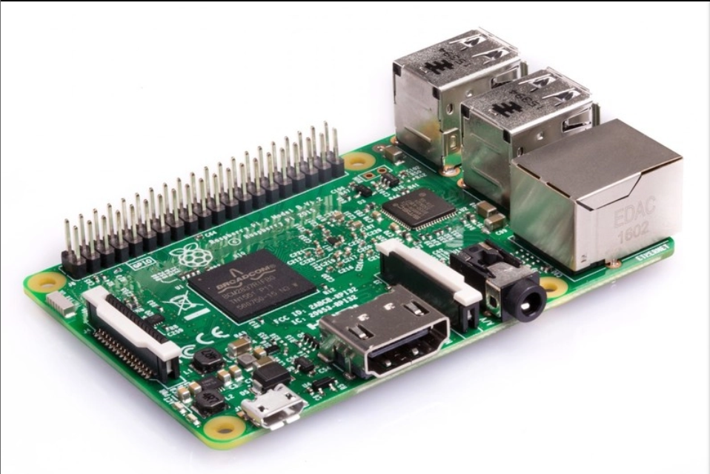
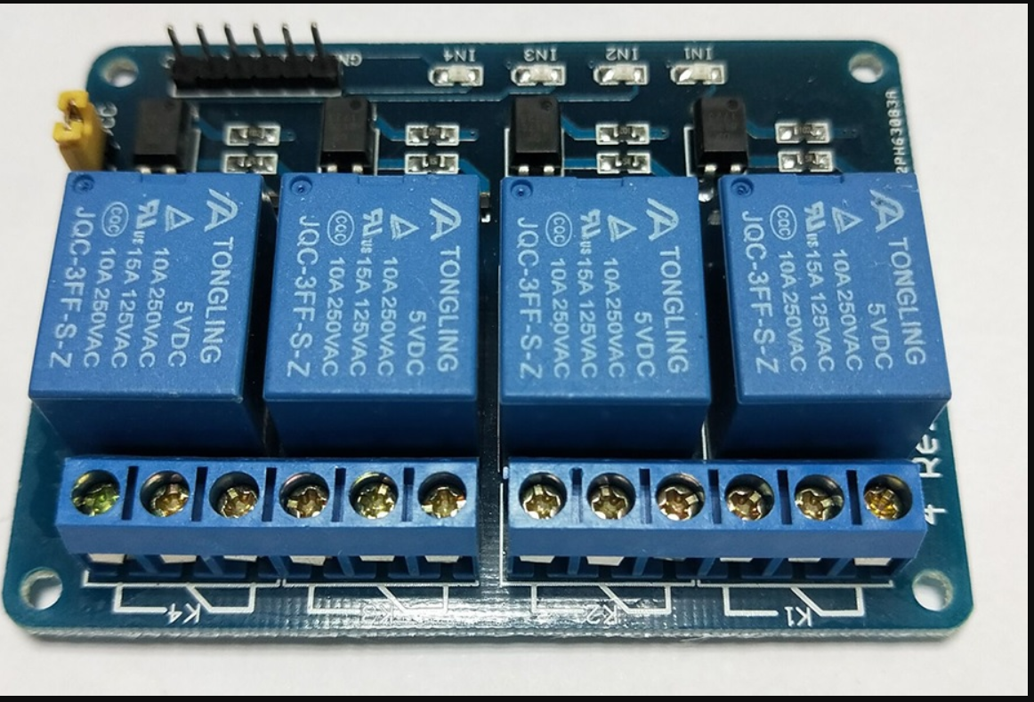




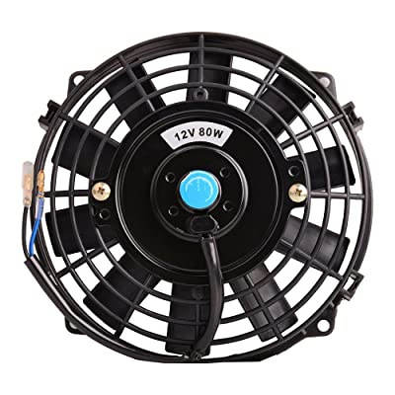

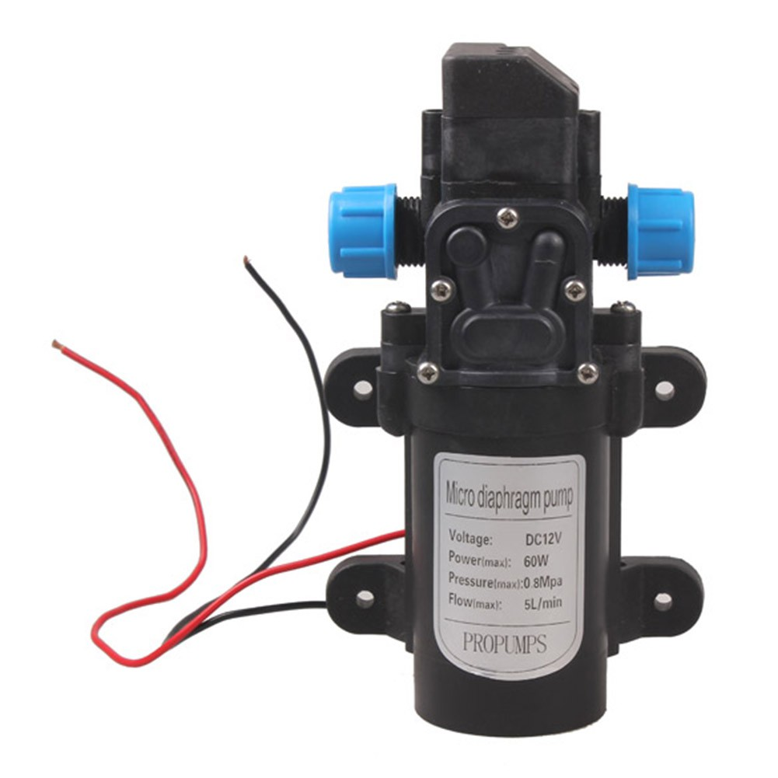
Line Application
Line Notify Service
Web Client
ngrok
Mushroom Farm
Access Point
Current Sense Resistors
LED x 112
L298N
I2C LCD
BH1750FVI
AM2315
Raspberry pi 3 b
ESP32LoRa
Relay
ESP32LoRa
Windows
Application
I2C LCD
Web Server
Windows
Application
Fan
Pump
Database Server

Slide 2

Web Application
Line Application
NGROK
Internet
Line Notify Service
Access Point
Raspberry Pi 3 b
Mushroom Farm
ESP32LoRa
Windows Application
Web Server
Windows Application
Database

