Slide 1
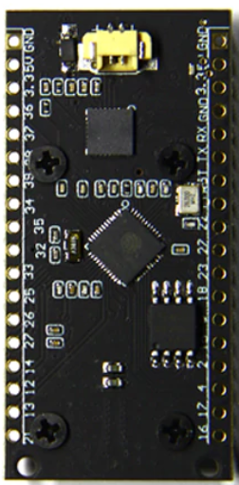




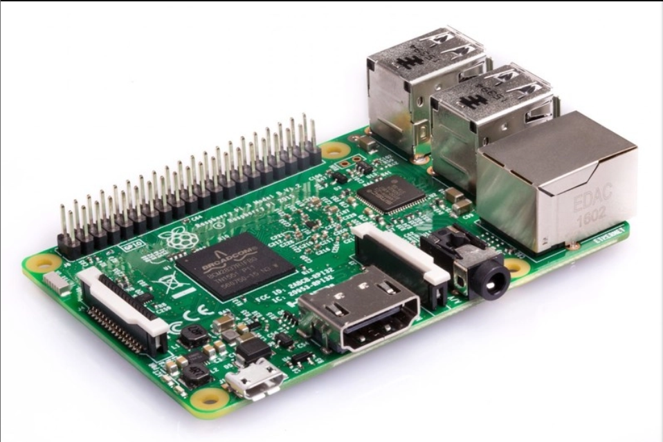

Access Point
http request
http response
Web Application
http response
http response
http request
http request
Database
Client

