Slide 1


GANESH COLLEGE OF
ENGINEERING
ENVIRONMENTAL Monitoring
IBM NAANMULATHA
M.POOJA (LEADER) S.NARMADHA S.RASHITHA

Slide 2
INTRODUCTION
▶ 1.Air monitoring
▶ 2.soil monitoring
▶ 3.IoT based environmental monitoring
▶ 4.Biodiversity environmental monitoring
▶ 5.waste fill level
▶ 6. program
▶ conclusion

Slide 3
Environmental monitoring
▶ Monitoring programs are published outlines within an organization that detail precisely which elements are being monitored, overall objectives, specific strategies, proposed sampling methods, projects within each strategy, and time frames.
▶ Environmental monitoring products and environmental monitoring software, such as Environmental Data Management Systems (EDMS), facilitate the implementation and monitoring of environmental monitoring and assessment programs, which includes a central data management hub, automated environmental monitoring alerts, compliance checking, validation, quality control, and generation of reports on dataset comparisons.

Slide 4
AIR MONITORING
▶ Environmental data gathered using specialized observation tools, such as sensor networks and Geographic Information System (GIS) models, from multiple different environmental networks and institutes is integrated into air dispersion models, which combine emissions, meteorological, and topographic data to detect and predict concentration of air pollutants.

Slide 5
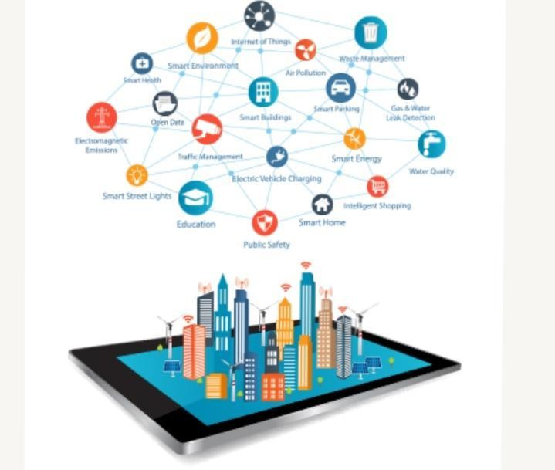

Slide 6
SOIL MONITORING
▶ Grab sampling (individual samples) and composite sampling (multiple samples) .
▶ To monitor soil, set baselines, and detect threats such as acidification, biodiversity loss, compaction, contamination, erosion, organic material loss, salinization, and slope instability.

Slide 7
IOT BASED ENVIRONMENTAL
Monitoring
▶ Environmental monitoring solutions have evolved over the years into Smart Environmental Monitoring (SEM) systems
▶ Machine Learning (ML) techniques, and the Internet of Things (IoT).
Technologies such as IoT devices and wireless sensor networks have made
advanced environmental monitoring using IoT a more streamlined and Artificial Intelligence-controlled process.

Slide 8
▶ IoT for environmental monitoring facilitates the development of wireless, remote environmental monitoring systems, which enable operations to remove much
▶ Facilitates sophisticated on-site testing, provides lower latency, and connects detection systems to response teams, ultimately resulting in higher rates of significant disaster and contamination prevention

Slide 9

STANDARDING OF ENVIRONMENTAL

Slide 10
BIODIVERSITY ENVIRONMENTAL
MONITORING
▶ Biodiversity is all the different kinds of life you’ll find in one area—the variety of animals, plants, fungi, and even microorganisms like bacteria that make up our natural world.
▶ Each of these species and organisms work together in ecosystems, like an intricate web, to maintain balance and support life.

Slide 11
Waste fill-level monitoring
▶ The solution provides real-time online access to data related to monitored bins, boxes, or containers
▶ Waste Monitoring solution combines Smart Sensors, Smart Waste Management Software System, and Citizen App.
▶ Sensor Waste Monitoring solution allows cities and businesses to uncover and understand the complex dynamics of their waste production

Slide 12
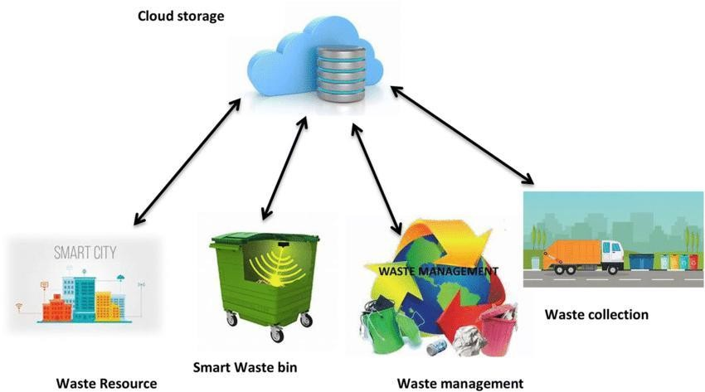

Slide 13
REMOTE SENSING
▶ Remote sensing is used in numerous fields, including geophysics, geography, land surveying and most Earth science
▶ E.g. exploration geophysics, hydrology, ecology, meteorology, oceanography, glaciology, geology); it also has military, intelligence, commercial, economic, planning, and humanitarian applications, among others.

Slide 14
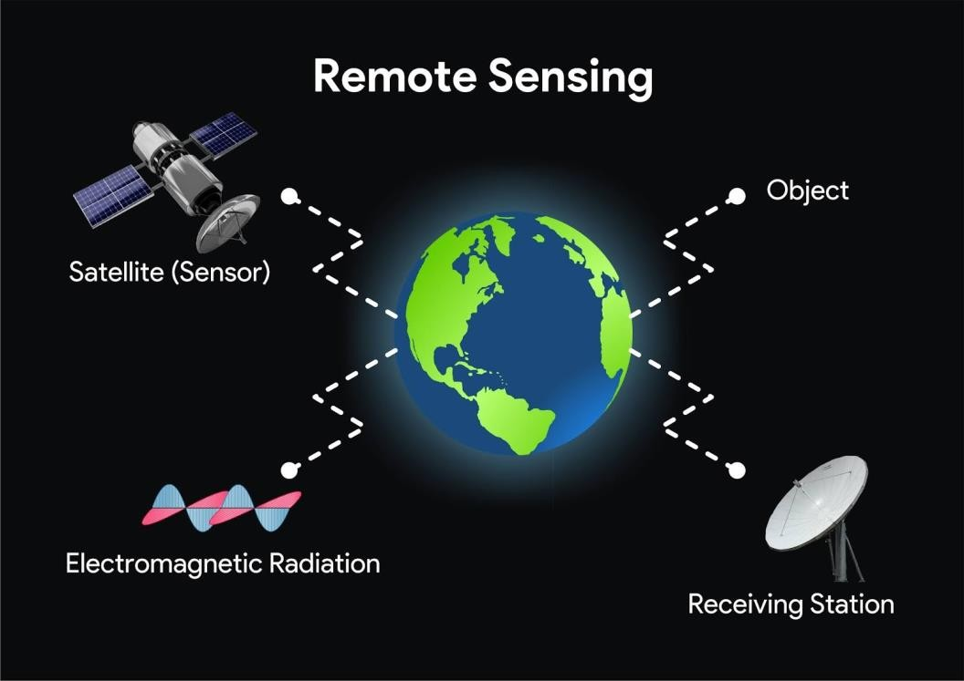

Slide 15
Program
▶ Import network
▶
▶ import time
▶
▶ From machine import Pin
▶
▶
▶
▶
▶
▶
Import dht
Import ujson
From umqtt.simple import MQTTClient

Slide 16
▶ # MQTT Server Parameters
▶
▶ MQTT_CLIENT_ID = “micropython-weather-demo”
▶
▶
▶
▶
▶
▶
▶
▶
MQTT_BROKER = “broker.mqttdashboard.com”
MQTT_USER = “”
MQTT_PASSWORD = “”
MQTT_TOPIC
= “wokwi-weather”

Slide 17
▶ Configsip: 0, SPIWP:0xee
▶
▶ clk_drv:0x00,q_drv:0x00,d_drv:0x00,cs0_drv:0x00,hd_drv:0x00,wp_drv:0x00
▶
▶
▶
▶
▶
▶
▶
▶
mode:DIO, clock div:2
load:0x3fff0030,len:4728
load:0x40078000,len:14876
ho 0 tail 12 room 4

Slide 18
▶ Umqtt/simple.py”, line 134, in publish
▶
▶ OSError: [Errno 104] ECONNRESET
▶
▶ MicroPython v1.21.0 on 2023-10-05; Generic ESP32 module with ESP32
▶
▶ Type “help ()” for more information

Slide 19
ADVANTAGES
▶ Validation and verification of cleaning and sanitation programs. …
▶ Provides data of the overall effectiveness of your sanitary program, personnel practices, and operations procedures. .
▶ Provides data about indicator organisms, spoilage organisms, and pathogens to prevent outbreaks.

Slide 20
CONCLUSION
▶ Environmental monitoring is critical to the protection of human health and the environment.
▶ As the human population continues to increase, as industrial development and energy use continues to expand, and despite advances in pollution control, the continued production of pollution remains inevitable.

Slide 21


