Slide 1



6206-Ganesh college Of Engineering
M.POOJA ( Team leader )
S. RASHITHA
S. NARMADHA

Slide 2

The Purpose of an Environmental Monitoring Program
The CGMP (current good manufacturing practise)
Provides crucial information on the quality of the aseptic processing environment during manufacturing
Prevents the release of potentially contaminated batch if appropriate standards are not fulfilled
Prevents future contaminated by detecting adverse trends

Slide 3

Microbial monitoring is a program designed to demonstrate the control of viable(living microorganisms) and non-viable particles in critical areas. These area include clean-rooms for drug fill/finish, operating rooms formulation tank rooms, laminar flow hoods, biological safety hoods, isolators, intravenous compounding areas and sterile packaging

Slide 4

Viable monitoring – Testing for the detection and enumeration of bacteria, yeast and mold. It includes the monitoring of personnel, air and area surface for microbial contamination.
Non-Viable monitoring-A reference for particle counts measured by a laser counter.

Slide 5

Environmental monitoring is a surveillance system for microbiological control of clean rooms and other controlled environments.
It is a process which provides monitoring ,testing and feedback to the microbiological quality levels in aseptic environments.

Slide 6

Sources of contamination:
Can come from air,personnal, equipment, cleaning agents, containers, water and compressed gases amongst other things.
Sound monitoring required understanding the various stringent regulatory specifications by various organizations such as the food and Drug Administration [FDMA], International Standards Organization [ISO],Parenteral Drug Associates [PDA], European Union [EU]and United States Pharmacopeia[USP].

Slide 7
Monitoring Criteria
Daily Monitoring: (Micro Area-LAF/UV Passbox /Room)
Monthly Monitoring MFG Area/Equipments/Drain Points)
Quarterly Monitoring Compressed Air)
Half Yearly Monitoring:(Operators/Personal Hygiene
monitoring)
Yearly Monitoring HVAC/AHU System Validations
Occasional Monitoring;(As and When required-During
Technical issues with filter/ on maintenance/Filter change)

Slide 8


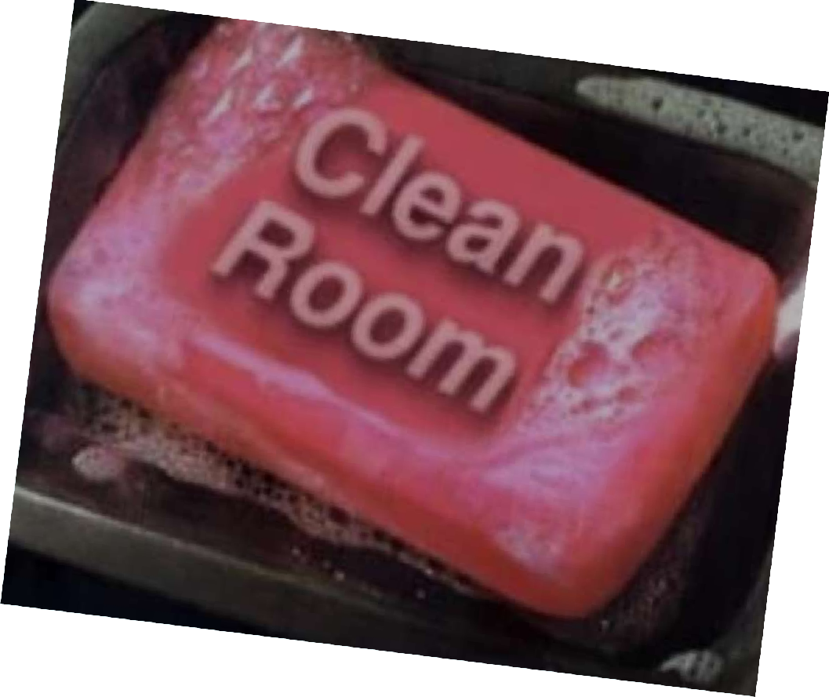



Specimens
to be covered
Air(For Both viable and Non_Variable and compressed air
Surface(Floors,Walls,Equipm
ent,etc.)
Personel (Operators/Working personel’s)
Drain(in the MFG areas

Slide 9

HVAC Validation
HVAC; Heating Ventilation and air conditioning-yearly by external party
PARAMETERS;
Temperature Air velocity Air changes Filter integrity
Non-viable air borne particles
Viable air borne particles

Slide 10
Parameters
Temperature/RH/PD
Check the temperature of the rooms with calibrated thermometer (For Temp)/Hygrometer(For RH) and record every two hours(5 readings per day)consecutively for three days
Acceptance Criteria:
The temperature should be within 23 +- 2c
The relative humidity should be within 45+-5% and the low RH should be within 20+_5%

Slide 11

Air velocity
Check the air velocity at the four corner & center of HEPA filter-using anemometer. Calculate the average velocity of filter
Air changes
Calculate the number of air changes per hour in the area using the formula
Filter integrity
For the efficiency of HEPA

Slide 12

Non-viable Airborne particle count
Derive the minimum number of sampling point location (NL) from the following equation
NL=A
A=area of clean room in square meter
Check the particle counts in the locations using a calibrated particle counter.
EX:For Secondary gowning-Nlis 02,
Where as in Blister PKg room,Nlis 05

Slide 13
Acceptance Criteria: For Class 100,000
Particles of >0.5should not be more then 3520000
Particles of >1.0 should not be more then 832000
Particles of >5.0should not be more then 29300 per cubic Meter of Air.
Acceptance Criteria: For Class 100
Particles of .0.5 should not be more then 3520
Particles of .1.0 should not be more then 832
Particles of >5.0 should not be more then 29 per Cubic Mater of Air.

Slide 14

Alert Limit:[Non Pathogen]
If microbial count exceeds the alert limit in environmental monitoring inform the same to Quality Assurance ,Production head and continue monitoring on next day.
If the contaminant levels are seen consistent or increase, advise to increase frequency of cleaning.
Monitor the area frequently till the environment count comes below alert limit During this period production activity will be continued.

Slide 15
Action limit:[Non Pathogen]
If microbial count exceeds the action limit in environmental monitoring stop all production activity of particular area and carry out the investigation.Quarantine all the products which are manufactured during that period.
Recheck the bioload of all products,which were manufactured during the last two weeks by drawing extra samples in order to evaluate the effect on product.

Slide 16
Pathogen:
If pathogen is found in monitoring ,inform the same to Quality Assurance, Production head and stop all production activity of particular area and carry out the inverstigation.Quarantine all the products which are manufactured during the period.
Recheck the bioload of all products, which were manufactured during the last two weeks by drawing extra samples in order to evaluate the effect on product.

Slide 17

Proactive action:
Clean/Sanitize the Manufacturing facilities as per Standard operating procedure.
Advantages:
The primary benefit of environmental monitoring is to check that your policy statement, plan,or condition on a resoure consent has resulted in the environment outcome you expected. It provides information to understand the current state of the environment and assess whether things are getting better or worse.

Slide 18
Disadvantage
Expensive .
Requires regular calibration
Difficult to analyze statistics and examine long-term trends.
Precludes use of data in computational tools.

Slide 19
As a basic for managing biological resources for sustainable development and resources assessment.
As aids in the management and conservation of ecosystem and population;
Usage of advanced knowledge about the dynamics of ecosystem.

Slide 20
“CONCLUSIONS”
Environment monitoring is critical to the protection of human health and the environment .

Slide 21


