Slide 1
Anomaly detection
Presented by…
V.Narmadha,
Department of artificial intelligence and data science,
Sir Issac newton college of engineering and technology.

Slide 2
AGENDA
PROJECT STATEMENT
PROJECT OERVIEW
PROJECT MODELLING
RESULTS
SOLUTION AND ITS PROPOSITIONS
WOWS IN MY SOLUTION
APPLICATION AREAS

Slide 3
PROJECT OVERVIEW
Supervised anomaly detection allows historical data to be labeled as “normal” and “abnormal,” in order to develop models to apply those labels to new data.
Anomaly detection can be applied to unlabeled data in unsupervised machine learning, using the historical data to analyze the probability distribution of values that can then determine if a new value is unlikely and therefore an anomaly.
Data Collection
Data Preprocessing
Model Architecture Design
Compile a model
Model Training
Model evaluation
Fine-tuning and Optimization
Deployment
Monitoring and Maintenance

Slide 4
PROJECT MODELING
Anomaly detection is the process of finding outlier values in a series of data.
That process assumes you have data that falls within a certain understood range (based on historical data, for example), and that occasional values outside that range happen fairly infrequently.
Basic knowledge of deep learning with Keras library, the Tkinter library for GUI building, and Python programming are required to run this amazing project.
Commands to Install the necessary libraries for this project:
pip install numpy
pip install tensorflow
pip install keras
pip install pillow

Slide 5
The MNIST dataset
Among thousands of datasets available in the market, MNIST is the most popular dataset for enthusiasts of machine learning and deep learning.
Above 60,000 plus training images rom zero to nine and more than 10,000 images for testing are present in the MNIST dataset.
So, 10 different classes are in the MNIST dataset.
Import libraries and dataset
At the project beginning, we import all the needed modules for training our model.
We can easily import the dataset and start working on that because the Keras library already contains many datasets and MNIST is one of them.
We call mnist.load_data() function to get training data with its labels and also the testing data with its labels.

Slide 6
Its time for the creation of the CNN model for this Python-based data science project.
A convolutional layer and pooling layers are the two wheels of a CNN model.
The reason behind the success of CNN for image classification problems is its feasibility with grid structured data.
We will use the Adadelta optimizer for the model compilation.
To start the training of the model we can simply call the model.fit() function of Keras.
It takes the training data, validation data, epochs, and batch size as the parameter.
The training of model takes some time.
To evaluate how accurate our model works, we have around 10,000 images in our dataset.
In the training of the data model, we do not include the testing data that’s why it is new data for our model.
Around 99% accuracy is achieved with this well-balanced MNIST dataset.

Slide 7
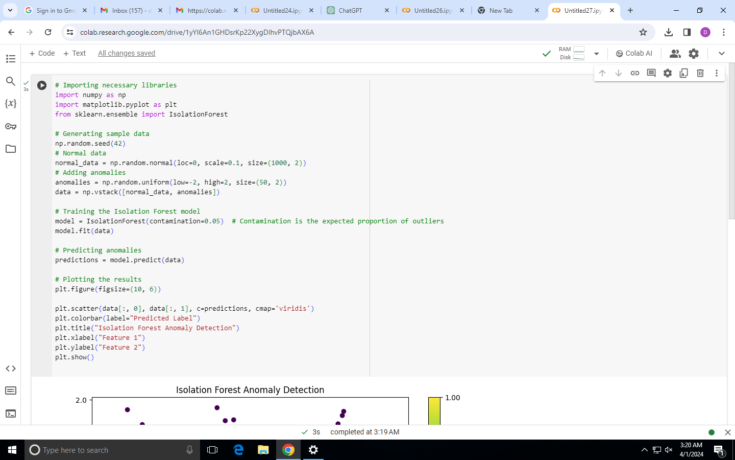
PROJECT MODELLING

Slide 8
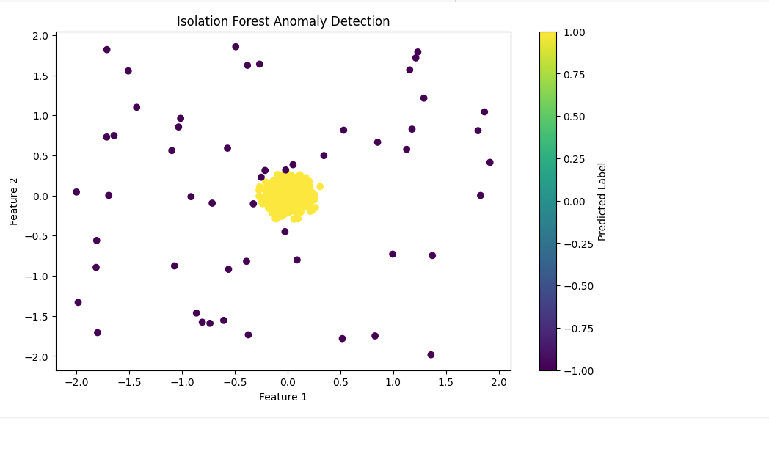
Result

Slide 9
Anomaly detection is a technique for finding an unusual point or pattern in a given set. The term anomaly is also referred to as outlier.
Earlier, the data mining researchers were focused on other techniques like classification and clustering. Outlier are found as a part of data cleansing process.
Approach:
We will approach this project by using a three-layered Neural Network.
The input layer: It distributes the features of our examples to the next layer for calculation of activations of the next layer.
The hidden layer: They are made of hidden units called activations providing nonlinear ties for the network.
A number of hidden layers can vary according to our requirements.
The output layer: The nodes here are called output units.
It provides us with the final prediction of the Neural Network on the basis of which final predictions can be made.

Slide 10
WOWS IN MY SOLUTION
Fraud detection.
Network intrusion detection.
Manufacturing quality control.
Healthcare monitoring.
Predictive maintenance.
Traffic monitoring.
Environmental monitoring.
Retail and E-commerce.

Slide 11
APPLICATIONS
What is the practical application of anomaly detection?
In the manufacturing and industrial sector, anomaly detection helps in predictive maintenance of equipment.
Sensors on machines collect data on various parameters like temperature, vibration, and sound.
Machine learning models analyze this data to identify patterns indicating potential equipment failures.
AI models can be trained and deployed to automatically analyze datasets, define “normal behavior”, and identify breaches in patterns quickly and effectively.
These models can then be used to predict future anomalies to avoid additional breaches in data.

Slide 12
THANK YOU!!

