Slide 1
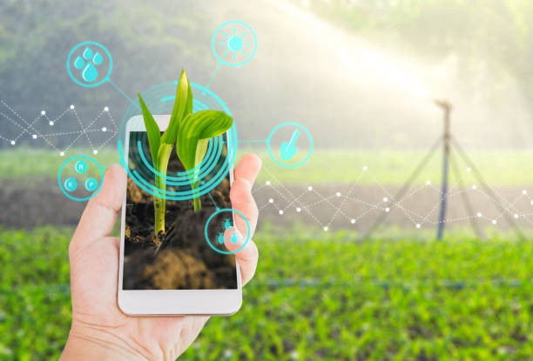
Design and Implementation of Smart Farming
IoT– Project Proposal
Group 2 - Hafsa Murtaza, Narmeen Falak
Supervisor: Prof. Dr. Chaiyod Pirak

Slide 2
Contents
Conceptual Design
Features
System Components
Hardware Connection
Software Flowchart
Task Distribution
Project Timeline

Slide 3
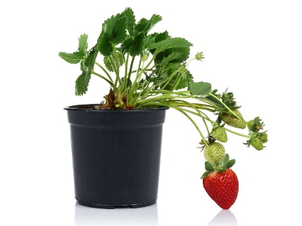
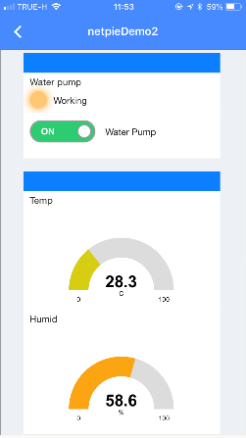
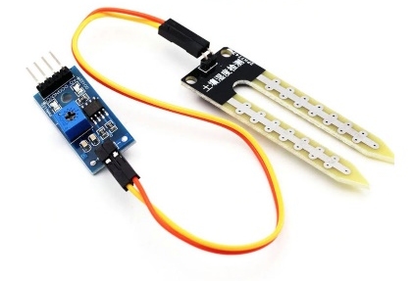

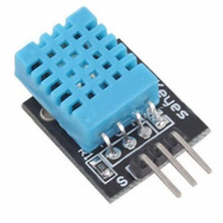
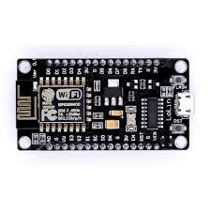
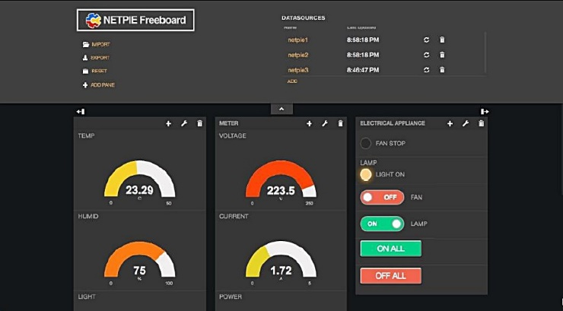
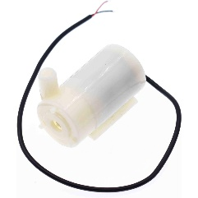
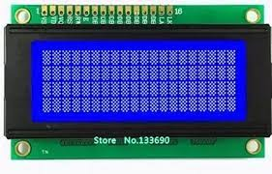
Conceptual Design
Sensor will be put inside the plant
Water pipe from pump outlet
Notify on Mobile Application
DHT11 as Temperature and Humidity Sensor
NodeMCU – ESP8266
Mini DC Water Pump
LCD Display
Display Results on Freeboard

Slide 4
Features
Real Time Measurement
Temperature of the surroundings
Humidity of the surroundings
Soil Moisture of the Plant
Real Time Display
Temperature of the surroundings
Humidity of the surroundings
Soil Moisture of the Plant
Water Pump On/Off Status
Data logging
Maximum 1000 samples
sample interval – every 60 mins

Slide 5
Features (Cont)
Water pump is controlled by a manual control and an automatic control (depending on soil moisture)
Send alert notification on mobile application if temperature, humidity or soil moisture is not in optimum limits
Send alert notification when water pump is turned on and when water pump is turned off.

Slide 6
System Components
The MCU: ESP8266
Mini Water Pump DC 3-6V 3W
Humidity sensor DHT11
Temperature sensor DHT11
Soil Moisture sensor
LCD Display (16*2 or 20*4)
Water pipe (inlet to pump; 5mm)
Water pipe (oulet from pump; outer dia 7.5mm, inner dia 4.5 mm )

Slide 7
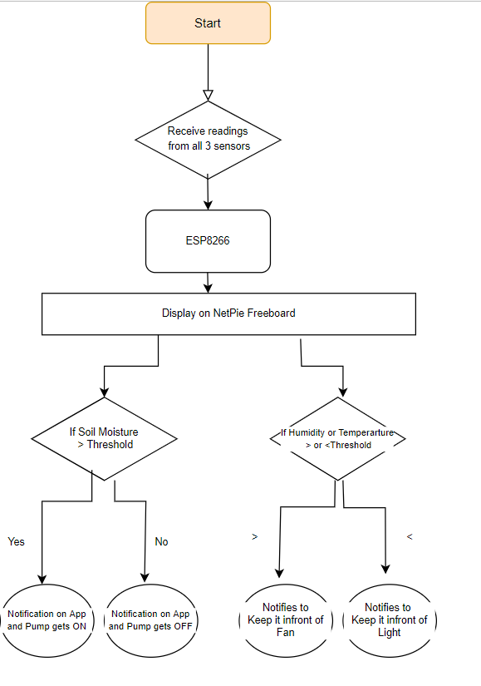
Software Flowchart

Slide 8
Software Features
Display humidity, temperature, soil moisture and pump status on mobile app
Enable user to control pump through mobile app
If temperature > upperLimitor || temp < lowerLimit send notification
If humidity > upperLimit || humidity < lowerLimit: send notification
If soil moisture < lowerLimit: turn on pump
If soil moisture >= threshold: turn off pump
If soil moisture > upperLimit: send notification

Slide 9
Software Features/Modules
Function: MeasureTemp
Input: measurement unit ( Celcius ), output: temperature value
Function: SendTempNotification:
Input: temperature value, minimum/maximum allowed temperature
Function: MeasureHumidity
Input: measurement unit ( percentage), output: humidity value
Function: SendHumidityNotification:
Input: humidity value, minimum/maximum allowed humidity
Function: MeasureSoilMoisture:
Input: measurement unit (bars), output: soil moisture value
Function: RegulateMoisture:
Input: desired moisture value
Function: SendMoistureNotification:
Input: current moisture value, maximum/minimum allowed moisture values
Function: UpdateDisplay
Input: temperature, humidity, soil moisture and water pump status

Slide 10
Task Distribution
Hafsa:
Narmeen:

Slide 11
Timeline
Task | Week
 | 1 | 2 | 3 | 4 | 5 | 6 | 7 | 8 | 9
Requirements and Design Finalization | x | x
Hardware purchase and Implementation |  | x | x | x
Software Implementation |  |  |  | x | x | x
Testing |  |  |  |  |  | x | x | x
Documentation |  | x |  | x |  | x | x | x
Delivery |  |  |  |  |  |  |  |  | x

Slide 12
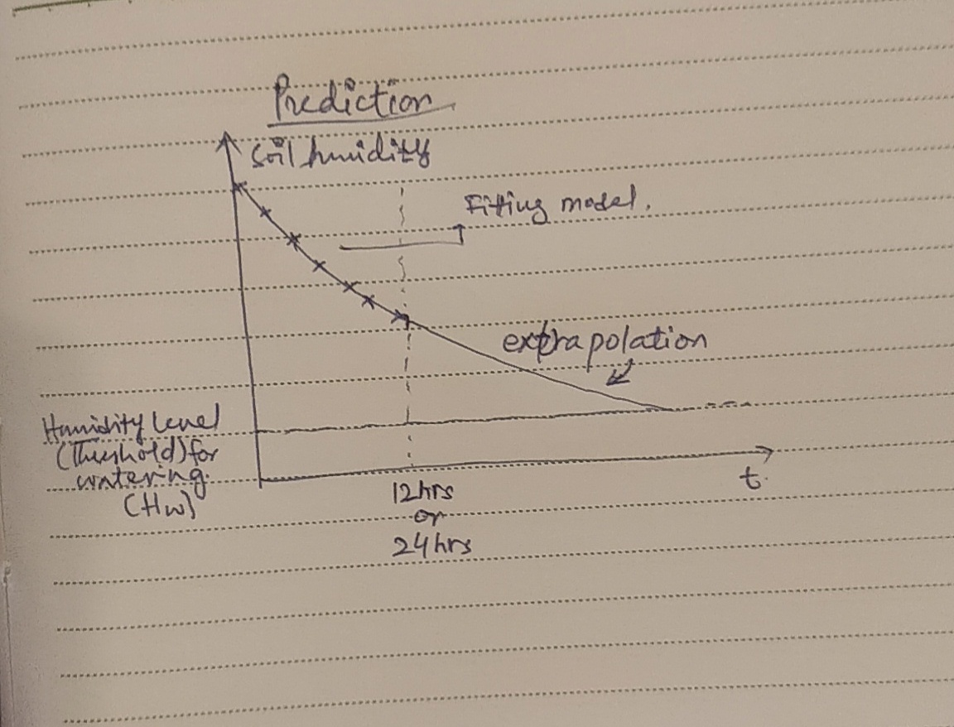
Additional (If necessary):
Using ML (regression) on the saved data
And extrapolating it further to predict the least Moisture beforehand so as to get the water for the next cycle ready.

