Slide 1
CST-411
Simulation and Complexity

Slide 2

License and References
This work is licensed under a Creative Commons Attribution-NonCommercial-ShareAlike 4.0 International License
Fore more details: https://creativecommons.org/licenses/by-nc-sa/4.0/
The author is indebted to the generosity of others who have provided example problems and datasets. Where appropriate, external sources are cited both in the slides and in Jupyter Notebooks
Images from around the Web are also used to help convey concepts
Content that is reused in these slides is either open licensed or, as I understand it, meets the Fair Use Doctrine for educational reuse.

Slide 3
License and References
My university offering of this course has an introductory Python course as a prerequisite
That course uses
Python Programming: An Introduction to Computer Science 2010, 3rd Edition, John Zelle, Franklin, Beedle & Associates Inc., ISBN 9781590282755
At times, example problems from that text will be cited

Slide 4
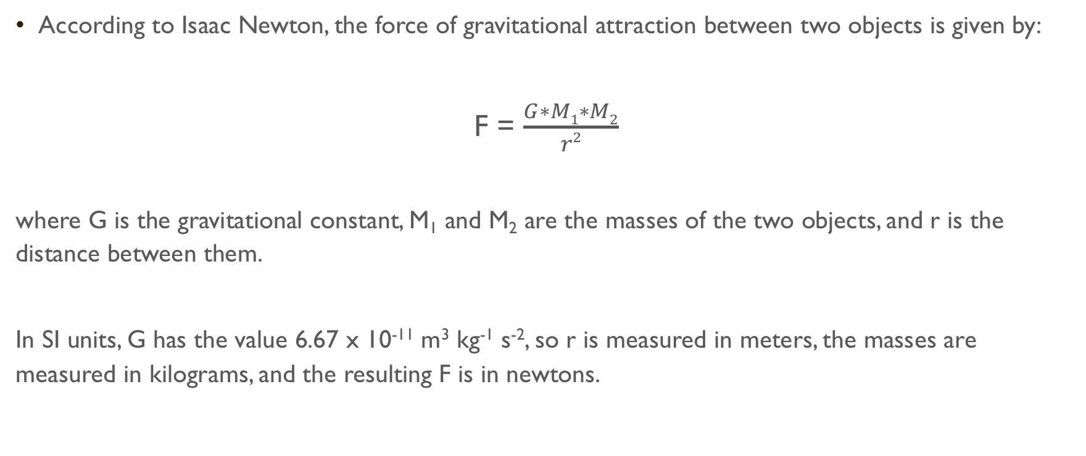
Gravitational Attraction
According to Isaac Newton, the force of gravitational attraction between two objects is given by:
F = $\frac{G∗M1∗M2}{r2}$
where G is the gravitational constant, M₁ and M₂ are the masses of the two objects, and r is the distance between them.
In SI units, G has the value 6.67 x 10⁻¹¹ m³ kg⁻¹ s⁻², so r is measured in meters, the masses are measured in kilograms, and the resulting F is in newtons.

Slide 5
Gravitational attraction
We can easily compute the force for two objects
Given a central mass (like the Sun) and an orbiting mass (like the Earth), we can even compute an orbit
However, dealing with three or more objects is difficult
Instead, such problems are tackled by numeric integration, a brute-force approach where
you take all the object positions and velocities at time T
calculate the forces they exert on each other
update the velocities, and calculate the new positions at time T+𝚫T
Then you repeat this in a loop, stepping forward through time, and output or plot the results

Slide 6
Planetary simulation
Let’s say we wanted to model the planets going around the Sun
This is extremely difficult to do by hand
We’ll create a Jupyter Notebook to do this for us, but before we get to the Python let’s look at the physics of the problem
Let’s work in two dimensions (x and y) to simplify the problem a bit
This will be similar to our cannon ball simulation
Each planet, and the Sun, will have
An x and y position
An x component and a y component of velocity
A force exerted on it from each of the other object

Slide 7
what steps are needed to simulate planets orbiting the Sun?
Create all the object – define the planets, give initial position and initial velocity
For each object, loop over all the other objects to get the total gravitational force
The total gravitational force is the sum of all the pair-wise forces, i.e. Earth-Sun, Earth-Mercury, Earth-Venus, Earth-Mars, etc., etc.
Use the total force to update our velocity and position
We’ll have a timestep like we did in our cannonball simulation
We have the relation: acceleration * timestep = velocity, Look at the units: m/s² * s = m/s
Recall that F = ma, with a little algebra we get
F/m = a,
F/m * timestep = a * timestep,
F/m * timestep = v
Loop for some desired amount of time

Slide 8
Planetary simulation
This problem is well suited for Classes and Objects
Recall that Classes and Objects are a means of
Creating reusable software
Modeling real-world entities in software
That what we have!
We can create a planetary object with attributes
Name
Mass
X position
Y position
X component of the velocity
Y component of the velocity

