Slide 1
CST-411
Simulation and Complexity

Slide 2

License and References
This work is licensed under a Creative Commons Attribution-NonCommercial-ShareAlike 4.0 International License
Fore more details: https://creativecommons.org/licenses/by-nc-sa/4.0/
The author is indebted to the generosity of others who have provided example problems and datasets. Where appropriate, external sources are cited both in the slides and in Jupyter Notebooks
Images from around the Web are also used to help convey concepts
Content that is reused in these slides is either open licensed or, as I understand it, meets the Fair Use Doctrine for educational reuse.

Slide 3
License and References
My university offering of this course has an introductory Python course as a prerequisite
That course uses
Python Programming: An Introduction to Computer Science 2010, 3rd Edition, John Zelle, Franklin, Beedle & Associates Inc., ISBN 9781590282755
At times, example problems from that text will be cited

Slide 4
Modeling and simulation
Some problems (e.g. our cannon ball) can also be solved analytically
Some problems have no analytical solution (or it’s too difficult) so we have to use computation
Some problems are not even solvable via computation
Problems that can be solved both analytically and computationally (cannon ball)
Problems were there exists no analytical solution or it’s too difficult
Problems that are too complex for a computer to solve in a reasonable amount of time
Important points to keep in mind:
Computers are executing algorithms (set of instructions) that we define
Sometimes, the same outcome can be achieved with a different set of of instructions, making the solution easier and less complex

Slide 5
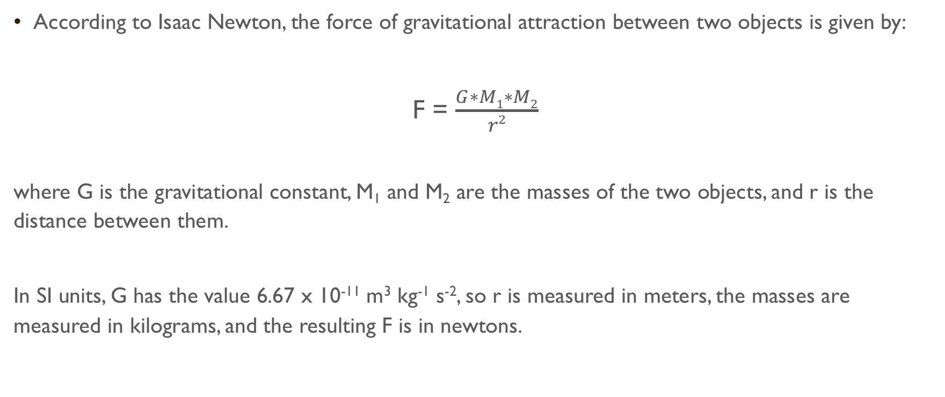
Gravitational Attraction
According to Isaac Newton, the force of gravitational attraction between two objects is given by:
F = $\frac{G∗M1∗M2}{r2}$
where G is the gravitational constant, M₁ and M₂ are the masses of the two objects, and r is the distance between them.
In SI units, G has the value 6.67 x 10⁻¹¹ m³ kg⁻¹ s⁻², so r is measured in meters, the masses are measured in kilograms, and the resulting F is in newtons.

Slide 6
Gravitational attraction
We can easily compute the force for two objects
Given a central mass (like the Sun) and an orbiting mass (like the Earth), we can even compute an orbit
However, dealing with three or more objects is difficult
Instead, such problems are tackled by numeric integration, a brute-force approach where
you take all the object positions and velocities at time T
calculate the forces they exert on each other
update the velocities, and calculate the new positions at time T+𝚫T
Then you repeat this in a loop, stepping forward through time, and output or plot the results

Slide 7
Planetary simulation
Let’s say we wanted to model the planets going around the Sun
This is extremely difficult to do by hand
We’ll create a Jupyter Notebook to do this for us, but before we get to the Python let’s look at the physics of the problem
Let’s work in two dimensions (x and y) to simplify the problem a bit
This will be similar to our cannon ball simulation
Each planet, and the Sun, will have
An x and y position
An x component and a y component of velocity
A force exerted on it from each of the other object

Slide 8
what steps are needed to simulate planets orbiting the Sun?
Create all the object – define the planets, give initial position and initial velocity
For each object, loop over all the other objects to get the total gravitational force
The total gravitational force is the sum of all the pair-wise forces, i.e. Earth-Sun, Earth-Mercury, Earth-Venus, Earth-Mars, etc., etc.
Use the total force to update our velocity and position
We’ll have a timestep like we did in our cannonball simulation
We have the relation: acceleration * timestep = velocity, Look at the units: m/s² * s = m/s
Recall that F = ma, with a little algebra we get
F/m = a,
F/m * timestep = a * timestep,
F/m * timestep = v
Loop for some desired amount of time

Slide 9
Planetary simulation
This problem is well suited for Classes and Objects
Recall that Classes and Objects are a means of
Creating reusable software
Modeling real-world entities in software
That what we have!
We can create a planetary object with attributes
Name
Mass
X position
Y position
X component of the velocity
Y component of the velocity

Slide 10
Classes and object review
A class is a template/blueprint/recipe for how a real-world entity should be represented in software
Classes are not exact representations of the real-world entities.
We choose which properties we’d like to represent depending on what we need to do
For example, a Student object might contain
GPA
Courses taken
Year of study (Freshman, Sophomore, Junior, Senior)
We may leave other attributes of a student out because they are not relevant to our program
Extracurricular activities such as sports and student groups may not be needed

Slide 11
Classes and object review
A class is just a template/blueprint/recipe for a real-world entity
A student class simply says that a student has properties like
GPA
Courses taken
Year of study (Freshman, Sophomore, Junior, Senior)
A class defines what all students inside our program will have in common.
A class does not define a particular student
A Object is what we get when we create representations of real-world entities from Classes
For example, representing Susan, a Senior, using our Student class

Slide 12
Classes and object review
A class has three important components
An initialization function to define any initial values, calculations, or setup
Data values, which Python calls attributes
Functions to operate on the data, which Python calls methods

Slide 13
class Student:
def __init__ (self, name, year):
self.name = name
self.year = year
def computeAverageGrade(self, grades):
sum = 0
for grade in grades:
sum += grade ## same as: sum = sum + grade
avg = sum / len(grades)
return avg

Slide 14
Planetary simulation
Returning to our planetary simulation
What would our class syntax look like if we wanted
Name
Mass
X position
Y position
X component of the velocity
Y component of the velocity
A method for computing the gravitational attraction to all the other planets and the Sun

Slide 15
class Celestial_Object:
def __init__(self, mass, px, py, vx, vy):
# vx, vy: x, y velocities in m/s
# px, py: x, y positions in m
# mass in kg
self.mass = mass
self.vx = vx
self.vy = vy
self.px = px
self.py = py

Slide 16
def attraction(self, other):
# Returns the force exerted upon this body by the other object.
# We don't compute the force of gravity from our self
assert self is not other
# Compute the distance to the other object.
dx = (other.px-self.px) # distance in the x-direction
dy = (other.py-self.py) # distance in the y-direction
d = math.sqrt(dx**2 + dy**2) # magnitude of the distance vector
# Report an error if the distance is zero
assert d > 0

Slide 17
continued…
# Compute the force of attraction
f = G * self.mass * other.mass / (d**2)
# Compute the direction of the force.
theta = math.atan2(dy, dx)
fx = math.cos(theta) * f
fy = math.sin(theta) * f
return fx, fy

Slide 18
What do we have?
A class that will allow us to represent celestial objects
A method in that class that allows us to compute the gravitational force between that object and another
What do we still need?
A timestep – how long between each update
Let’s go with one day
The ability to loop over all the objects and compute all the gravitational attractions
Let’s create a reusable function that we can pass a list of celestial objects and it will
Loop over all the celestial objects in the list
Make sure we’re not computing the gravitational attraction between and object and itself
Compute the gravitational attraction and use it to update the velocity and position

Slide 19
def loop(bodies):
# loops through the simulation, updating the positions and velocities of all the provided bodies.
timestep = 24.0*60.0*60.0 # One day in seconds
force = {}
for body in bodies:
# Add up all of the forces exerted on this 'body'.
total_fx = 0.0 # total force in the x-direction
total_fy = 0.0 # total force in the y-direction
for other in bodies:
# Don't calculate the body's attraction to itself
# continue skips the remaining steps and goes back to the start of the loop
if body is other:
continue
fx, fy = body.attraction(other)
total_fx += fx # update the total x force with the value from this body
total_fy += fy # update the total y force with the value from this body

Slide 20
Continued…
# Record the total force exerted.
# force is a dictionary with a multi-valued key
force[body] = (total_fx, total_fy)
# Update velocities based upon on the force.
for body in bodies:
fx, fy = force[body]
body.vx += fx / body.mass * timestep
body.vy += fy / body.mass * timestep
# Update positions
body.px += body.vx * timestep
body.py += body.vy * timestep

Slide 21
Planetary simulation
There is a Jupyter Notebook called planets.ipynb
It has the class and function already defined
Using the data on the next slide
Visualize the initial positions of the planets and the Sun
Simulate one year of all 8 planets orbiting the Sun
Visualize the final position of each planet and the Sun
Bonus:
Can you give each planet a different color in the visualization?
Can you label each planet in the visualization?
Hint: you can place text using plt.text( x-position, y-position, text )

Slide 22
Celestial Object | Mass (kg) | Px (m) | Py (m) | Vx (m/s) | Vy (m/s)
Sun | 1.9891 x 10³⁰ | 0 | 0 | 0 | 0
Mercury | 3.3022 x 10²³ | -4.60x10¹⁰ | 0 | 0 | -58980
Venus | 4.8685 x 10²⁴ | -1.07x10¹¹ | 0 | 0 | -35260
Earth | 5.9736 x 10²⁴ | -1.47x10¹¹ | 0 | 0 | -30300
Mars | 6.4185 x 10²³ | -2.07x10¹¹ | 0 | 0 | -26500
Jupiter | 1.8986 x 10²⁷ | -7.41x10¹¹ | 0 | 0 | -13720
Saturn | 5.6846 x 10²⁶ | -1.35x10¹² | 0 | 0 | -10180
Uranus | 8.6810 x 10²⁵ | -2.74x10¹² | 0 | 0 | -7110
Neptune | 10.243 x 10²⁵ | -4.44x10¹² | 0 | 0 | -5500

Slide 23
Planetary simulation
Run the simulation for another year, keeping track of the x and y positions of the Sun and planets as you step through each day
You could use list appending such as: x.append(value)
Or you can add all the elements of another list at once by using extend
Example:
x = [7, 8]
y = [1, 2, 3, 4]
x.extend(y)
This time, plot the orbits of the inner planets (Mercury, Venus, Earth, and Mars)
Can you plot each planet’s orbit in a different color?
Does the Sun move? Zoom in on your plot to find out.

Slide 24
Time complexity
If we want to know how complex an algorithm is we just time it, right?
Complex algorithms take a long time and non-complex algorithms run quickly, right?
Not exactly
This approach isn’t very generalizable. It depends very much on the computer used. An algorithm may run quickly on a high-end desktop, but slow on my old laptop. How do we classify it then?
Computer scientists and mathematicians have developed a more general means of classifying the time complexity of an algorithm that is independent of where it’s executed

Slide 25
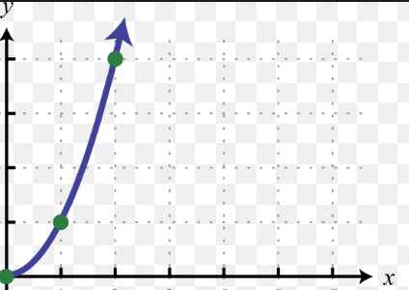
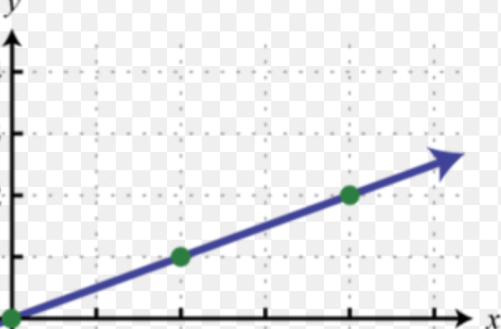
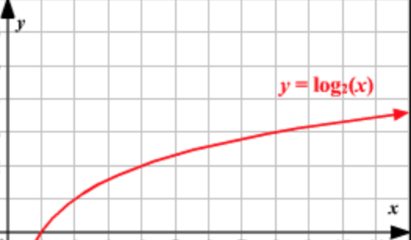
Time complexity
A more general approach is to look at how the execution time depends on the size of the data
We’re not worried about exact numbers, just the overall trend
?
Execution time
Size of the data

Slide 26
Time complexity
1.
There’s an entire branch of computer science devoted to study algorithm complexity
Most algorithms will fall into one of four categories
From best performing to worst performing
Constant time complexity – as the input data increases in size the algorithm execution time doesn’t change
Log time complexity – the execution time mimics the log function. As input data increases the execution time increases, but starts to flatten out
Linear time complexity – the execution time mimics a straight line. Doubling the input data doubles the execution time, tripling the input data triples the execution time, etc.
Quadratic time complexity – the execution time mimics a quadratic function. Doubling the input data leads to a 4x increase in execution time, etc.
2.
3.
4.

Slide 27
Time complexity
Certain statements and ordering will lead to one complexity over the other
print(“Hello World”)
Is constant in time execution. The running time of the statement will not change in relation to the number of inputs.
for ( i = 0; i < n; i++ )
statement;
Is linear. The running time of the loop is directly proportional to n. When n doubles, so does the running time. When n triples, so does the running time, etc.
for ( i = 0; i < n; i++ )
for ( j = 0; j < n; j++ )
statement;
Is quadratic. The running time of the two loops is proportional to the square of n. When n doubles, the running time increases by n * n.

Slide 28
Time complexity
In general,
doing something that doesn’t depend on the inputs is constant
doing something with every input is linear
doing something with every item in two dimensions (loop inside loop) is quadratic
and dividing the working area in half is logarithmic
there are other cases such as cubic, exponential, and square root, but they're not nearly as common
The time complexity is expressed using a capital O notation meaning ”on the order of”
For example,
O( 1 ) the algorithm has constant time complexity, changing the inputs has no affect
O( n ) the algorithm has linear time complexity, the running time is proportional to the inputs
O( n² ) the algorithm has quadratic time complexity, running time is proportional to inputs squared
O( log n ) the algorithm has logarithmic time complexity

Slide 29
Time complexity
O( 1 ) the algorithm has constant time complexity, changing the inputs has no affect
O( n ) the algorithm has linear time complexity, the running time is proportional to the inputs
O( n² ) the algorithm has quadratic time complexity, running time is proportional to inputs squared
O( log n ) the algorithm has logarithmic time complexity
Things to note
Time complexity is independent of hardware – we’re not concerned with the best, worst, or average time we can get on any specific hardware
Time complexity isn’t exact. A search algorithm that is O( n ) won’t always take time proportional to the number of inputs. Maybe we get lucky and the first item we look at is the one we’re looking for. Rather, time complexity is more of “at most” this is the time

Slide 30
Computing Time complexity
You add up how many statements will execute as a function of the size of its input, and then simplify the expression to the largest term
For example, if we count 2n + 2 statements, we can describe this as just O(n).
We are interested in the performance of the algorithm as N becomes large.
Consider the two terms 2n and 2.
What is the relative influence of these two terms as N becomes large? Suppose N is a million.
Then the first term is 2 million and the second term is only 2.
For this reason, we drop all but the largest terms for large n
So, now we have gone from 2n + 2 to 2n
We don’t need an exact solution, just the overall trend as n increases
2n and n have the same trend, so 2n becomes just n

Slide 31
What about our planet sim?
We have a loop inside of a loop.
Each simulation step requires calculating n * n distances and attractions
Technically, it’s n * (n-1) calculations since we ignored Sun-Sun, Mercury-Mercury, etc.
But, as we saw: n² – n would just simply to n²
So the time complexity of our planet simulation is O(n²)
Again, this is relative to the computer we’re running on
If you determine how long it takes to simulate one planet, you can determine how adding more planets will impact the simulation

Slide 32
What about our planet sim?
Why should you care?
Time complexity helps us
Determine if our particular problem is solvable – and how best to solve it
Compare multiple algorithms that do the same thing
Computers can only handle so many computations before the simulation is not feasible
For a laptop or desktop simulation this occurs at a few thousand objects.
There are tens of millions of stars in a very small galaxy. Our own galaxy has billions of stars.
A galaxy simulation has too much complexity. Entirely different approaches need to be used for that problem
the attraction of distant stars is approximated and only nearby stars are calculated exactly
if objects are far apart, a larger timestep is used, and timestep could be shortened when objects are interacting more closely

Slide 33
What about our planet sim?
Compare multiple algorithms that do the same thing
Searching is a common problem in scientific computing – we’ll see examples in the homework
Brute force searching – trying every possible value – is O( n )
Binary search is O( log n )
For small n (searching over a few values) there isn’t much difference
For large n (lots of input data) you’ll see a noticeable improvement in execution time by choosing the binary search approach when writing your algorithm

Slide 34
Time complexity
Understanding, and computing, time complexity helps us understand if a problem is easily solvable using the system we have or if we need to try other approaches
If time complexity is larger than we’d like, we could
Move to another programming language optimized for speed (C for instance)
Parallelize the code to divide the work in each step among multiple CPUs
Think about revising the algorithm. Maybe there is a different way to implement what we want to do that will involve fewer calculation

