Slide 1
CST-411
Gradient Descent

Slide 2

License and References
This work is licensed under a Creative Commons Attribution-NonCommercial-ShareAlike 4.0 International License
Fore more details: https://creativecommons.org/licenses/by-nc-sa/4.0/
The author is indebted to the generosity of others who have provided example problems and datasets. Where appropriate, external sources are cited both in the slides and in Jupyter Notebooks
Images from around the Web are also used to help convey concepts
Content that is reused in these slides is either open licensed or, as I understand it, meets the Fair Use Doctrine for educational reuse.

Slide 3
License and References
My university offering of this course has an introductory Python course as a prerequisite
That course uses
Python Programming: An Introduction to Computer Science 2010, 3rd Edition, John Zelle, Franklin, Beedle & Associates Inc., ISBN 9781590282755
At times, example problems from that text will be cited

Slide 4
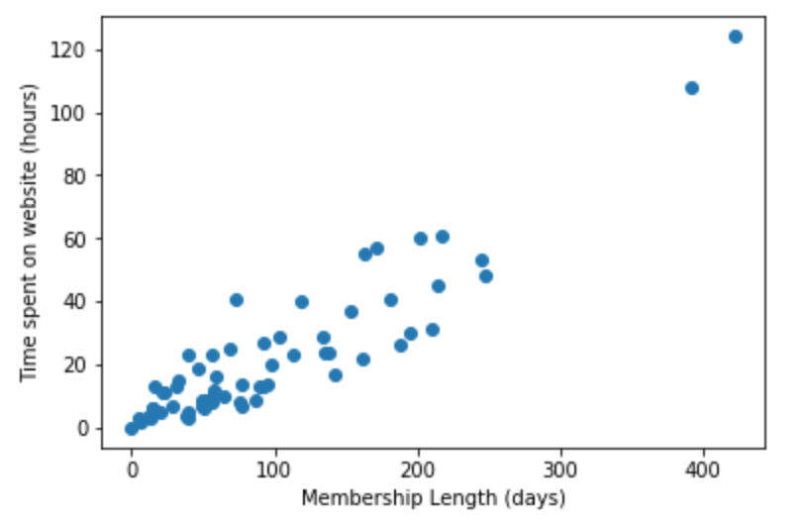
Finding the best fit to the data
We’ve looked at what we can do when we need to fit a model (function) to data
But, what about how?
How does Python find the “best” line to go through our data?

Slide 5
Finding the best fit to the data
For a straight line, Python has two parameters to work with
Slope (m), steepness of the line
Y-intercept (b), moves the line up and down
By changing these two values Python can try many different lines against our data
But, how do it know which parameter to change when and by how much?
How does it know if it’s getting completely off track?
How do Python know when to stop comparing lines to data?

Slide 6
Finding the best fit to the data
Answering these questions will give us insight into what scipy functions are doing when they fit a model (function) to our data
These questions also form the basis of the field called Machine Learning
For a straight line we can use some Calculus and directly solve for estimates of the best m and b
Beyond straight lines things get a little more complicated, but the result is the basis of many Machine Learning algorithms

Slide 7
Gradient descent
Here’s our starting point
Pick values for m (slope) and b (y-intercept)
Randomly? Not if we can help it!
Use m and b to create a line
Compare the line to our data (observations)
Pick a new m and a new b
Repeat until we’ve found the “best” line for our data (observations)
The first thing we notice is that we’re going to need a way to measure how well we’re doing?
Are the new m and b values creating a better or worse fit?
The function that tells us how well we’re doing goes by several different names:
cost function, loss function, optimization function
There are also several choices one could use here

Slide 8
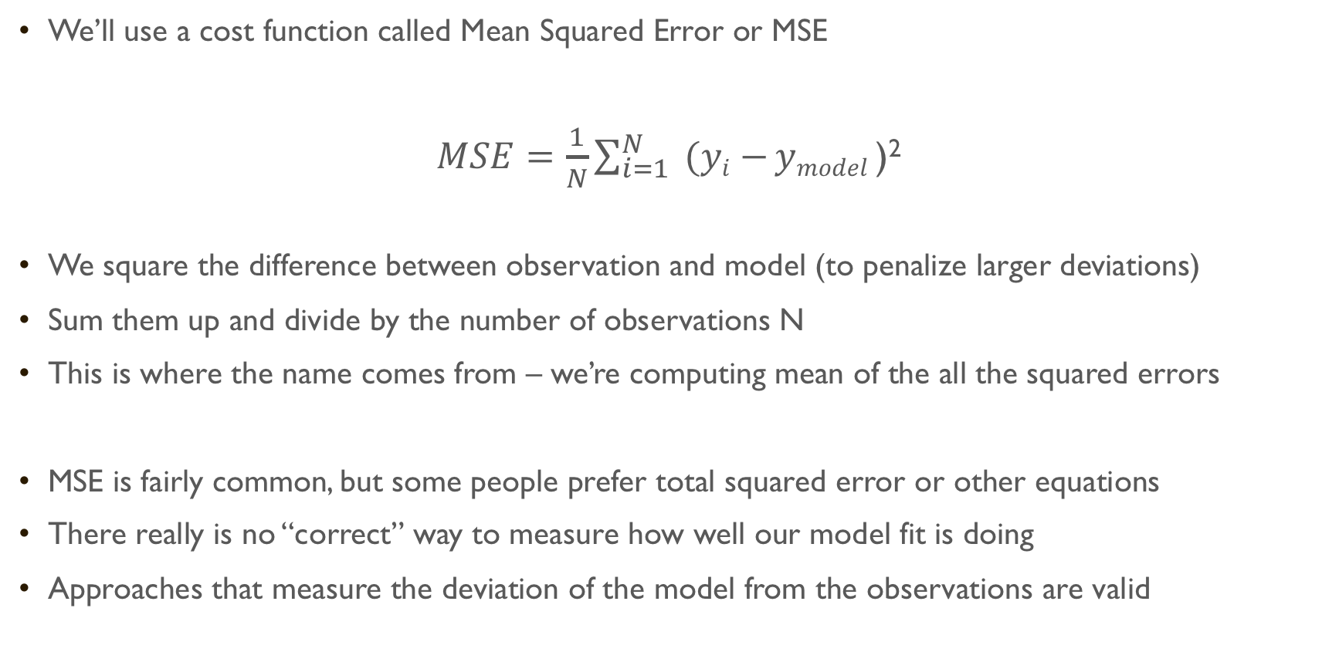
Gradient descent
We’ll use a cost function called Mean Squared Error or MSE
$MSE=\frac{1}{N}\sum_{i=1}^{N}{ (yi−}ymodel$ )²
We square the difference between observation and model (to penalize larger deviations)
Sum them up and divide by the number of observations N
This is where the name comes from – we’re computing mean of the all the squared errors
MSE is fairly common, but some people prefer total squared error or other equations
There really is no “correct” way to measure how well our model fit is doing
Approaches that measure the deviation of the model from the observations are valid

Slide 9
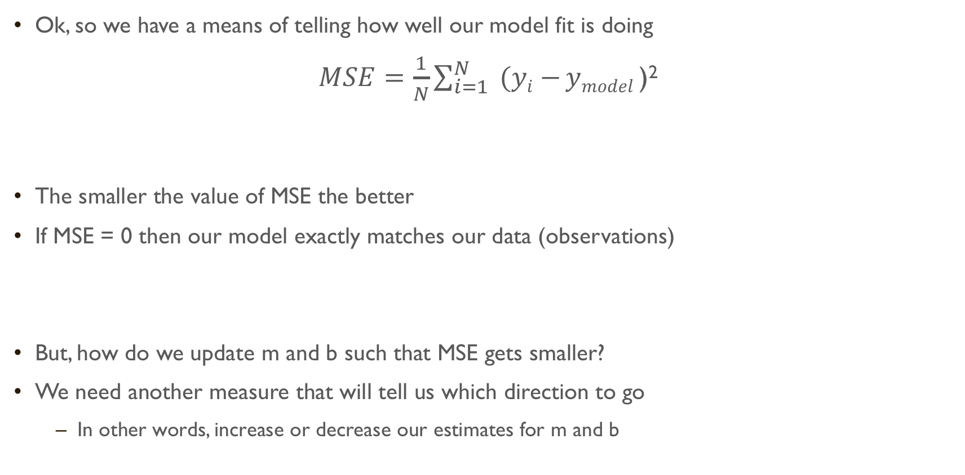
Gradient descent
Ok, so we have a means of telling how well our model fit is doing
$MSE=\frac{1}{N}\sum_{i=1}^{N}{ (yi−}ymodel$ )²
The smaller the value of MSE the better
If MSE = 0 then our model exactly matches our data (observations)
But, how do we update m and b such that MSE gets smaller?
We need another measure that will tell us which direction to go
In other words, increase or decrease our estimates for m and b

Slide 10
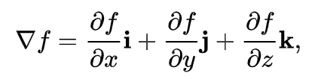
Gradient descent
This is where the gradient can help us
The gradient tells us the rate of change of a function
That’s exactly what we’re looking for
We can take the gradient of our cost function (MSE) and look for the direction in which it decreases
We then update m and b so that we move in the direction of decreasing MSE
Image Credit: https://medium.com/@lachlanmiller_52885/machine-learning-week-1-cost-function-gradient-descent-and-univariate-linear-regression-8f5fe69815fd

Slide 11
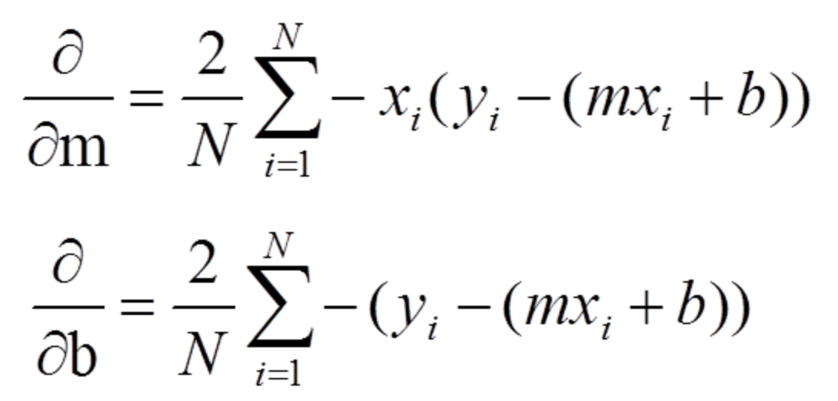
Gradient descent
y_{model} )
y_{model} )
Computing the gradient of MSE involves some Calculus and a lot of algebra
Once we work it all out, we get the equations above that tell us how m and b are changing
A derivative of zero means we are at either a local minima or maxima – the closer we get to zero, the better
We want to move away from large derivatives (places with steep rate of change) and towards zero derivatives (places where b and m have created the lowest value of MSE and we’d increase MSE if we moved in either direction)

Slide 12
Gradient descent
The Gradient Descent algorithm is thus defined as
Pick starting m and b values
Create a line from m and b using y=mx+b
Compute MSE for this line and observations to see how well we did
Use the two partial derivative equations (previous slide) to determine if we’re in a place with steep rate of change or we’ve reached a minimum
Update m and b using the partial derivative results
If we’re at a place with steep rate of change, move in the direction that will decrease MSE
If we’re at a minimum (increasing or decreasing b and m increases MSE) then stop
Repeat until we’ve found the minimum and call this the ”best” m and b
However, there are some practical things we need to consider…

Slide 13
Gradient descent
How big of a step do we take?
If we change m or b significantly, we risk missing the minimum
If we change m or b very slowly, the algorithm will take a long time to find the “best” values
When do we stop?
Do we go for a set number of moves?
How many?
Do we stop early if we don’t improve?
We can’t guarantee we’ve found the global minimum

Slide 14
Gradient descent
Let’s take a look at this in code
Jupyter Notebook 07_Gradient_Descent.ipynb has an implementation of Gradient Decent

Slide 15
Gradient descent
Congratulations!
Gradient Descent is the first step toward understanding machine learning and artificial intelligence
Many machine learning approaches use Gradient Descent, or its main ideas, to find the “best” fit to data/observations
Many of the AI/Machine Learning advances you read about rely on the basic principles of Gradient Descent

