Slide 1
CST-411
Waves and FFT

Slide 2

License and References
This work is licensed under a Creative Commons Attribution-NonCommercial-ShareAlike 4.0 International License
Fore more details: https://creativecommons.org/licenses/by-nc-sa/4.0/
The author is indebted to the generosity of others who have provided example problems and datasets. Where appropriate, external sources are cited both in the slides and in Jupyter Notebooks
Images from around the Web are also used to help convey concepts
Content that is reused in these slides is either open licensed or, as I understand it, meets the Fair Use Doctrine for educational reuse.

Slide 3
License and References
My university offering of this course has an introductory Python course as a prerequisite
That course uses
Python Programming: An Introduction to Computer Science 2010, 3rd Edition, John Zelle, Franklin, Beedle & Associates Inc., ISBN 9781590282755
At times, example problems from that text will be cited

Slide 4
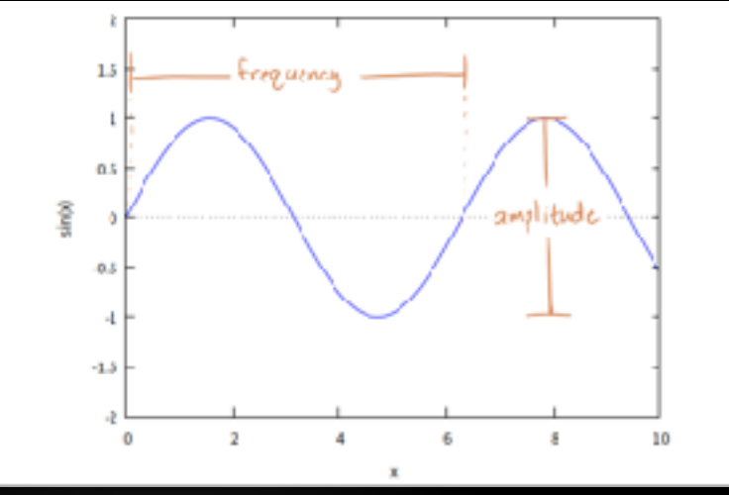
waves
A wave is a disturbance that travels through a medium
Some common examples are
Sound waves (air molecules are disturbed)
Ocean waves (water molecules are disturbed)
Waves have properties such as
Frequency - the number of waves that pass a fixed point in a given amount of time.
The SI unit for is the hertz (Hz), where 1 hertz equals 1 wave passing a fixed point in 1 second
Amplitude – the height of the wave

Slide 5
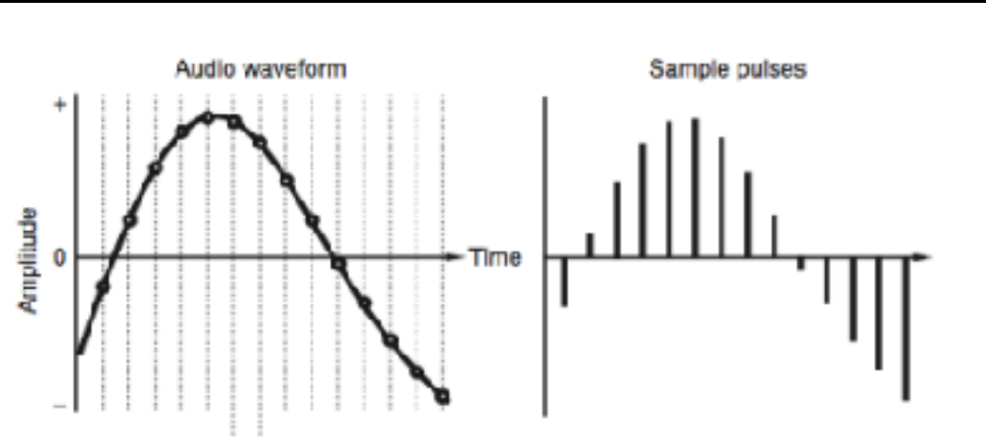
waves
For sound waves the frequency determines the pitch (note) we here and the amplitude determines volume
Sound in the real-world is continuous, but computers are discrete
We need to sample…
Music is just array of wave heights
sampled at regular intervals

Slide 6
waves
Music is typically sampled at 44kHz
Why 44kHz?
It’s a tradeoff between sound quality and storage space
44kHz = 44,000Hz = 44,000 times per second
A typical song is ~3 minutes, that’s
= 180 seconds * 44,000
= 7.9 million samples
This provides a good representation
of the sound wave and can be stored
in a few Megabytes.

Slide 7
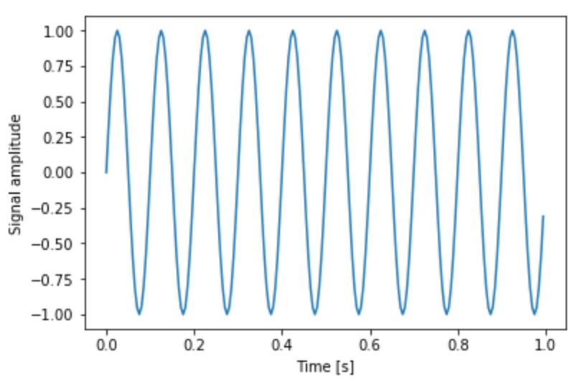
Sample wave
Let’s look at a sample wave
Frequency is 10 Hz

Slide 8
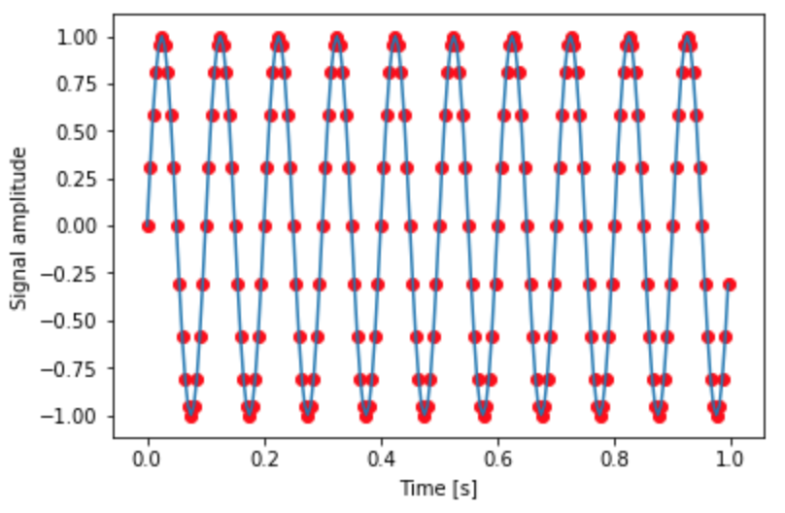
Sample wave
Let’s look at a sample wave
Frequency is 10 Hz
And a sampling rate of 100 measurements/s

Slide 9
Sample wave
A common need with waves is to transform between a temporal representation - what the wave looks like over time – and a frequency representation
For a simple wave like this we can count the peaks to get the frequency, but that won’t always be the case
The Fourier Transform provides a mathematical means of moving from a temporal representation to a frequency representation

Slide 10
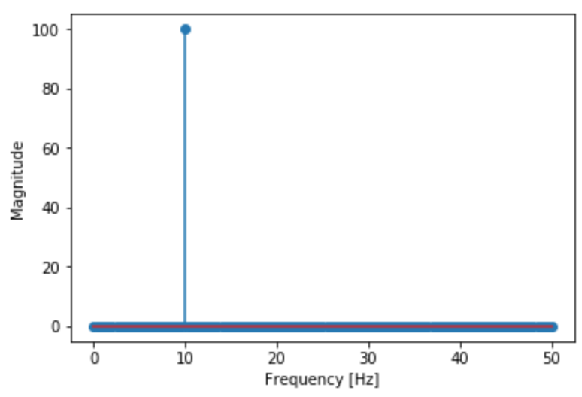
FFT
These figures show what we mean by temporal and frequency representation
The top figure shows a temporal representation of our sample wave – how the amplitude of the wave changes over time
The bottom figure shows a frequency representation of the same wave
Two ways of looking at the same wave
The notebook Waves_and_FFT.ipynb has an example if you’d like to follow along

Slide 11
FFT
import scipy.fftpack
# y is a list containing the amplitudes of the wave
fft = scipy.fftpack.rfft(y)
# the frequencies on the x-axis
# depend on the sampling rate
freqs = scipy.fftpack.rfftfreq(len(fft)) * sampleRate
# a stem plot is a fancy scatter plot
plt.stem(freqs, np.abs(fft))
plt.xlabel('Frequency [Hz]')
plt.ylabel(’Magnitude')

Slide 12
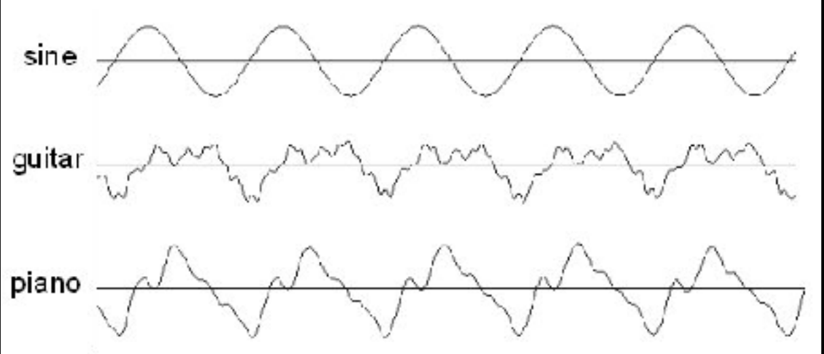
Real vs Synthetic Waves
Our artificial wave is nice for demonstration purposes
However, ‘real’ waves are more complicated
We rarely, if ever, see a pure sine wave
For example, musical instruments produce waves at other frequencies due to the properties of strings, tubes, etc.
This is the same A note played by a guitar and a piano

Slide 13
Real vs Synthetic Waves
A common use of the FFT is to transform a wave like this from a temporal representation to a frequency representation
This allows us to see what frequencies – other waves – are present along with the main one
Given a wave comprised of other waves, we can use FFT to see which frequencies are present
As we’ll see, this has several practical applications in physics and engineering

Slide 14
Piano hands-on problem
The file piano.txt is a digital recording of a note played on a piano
Your task is to determine which note it is
Given
The sampling rate of the recording is 44 kHz
Piano note frequencies are defined as: https://en.wikipedia.org/wiki/Piano_key_frequencies
Which key on the piano was played?
Suggestion – uploading the file to Jupyter Hub and using numpy’s loadtxt function is efficient here
y = np.loadtxt("piano.txt", float)

Slide 15
Trumpet hands-on problem
The file trumpet.txt is a digital recording of a note played on a trumpet
The sampling rate of this digital recording was also 44 kHz
Which note was played?
Suggestion – try comparing the FFT plot of the trumpet to the FFT plot of the piano

Slide 16
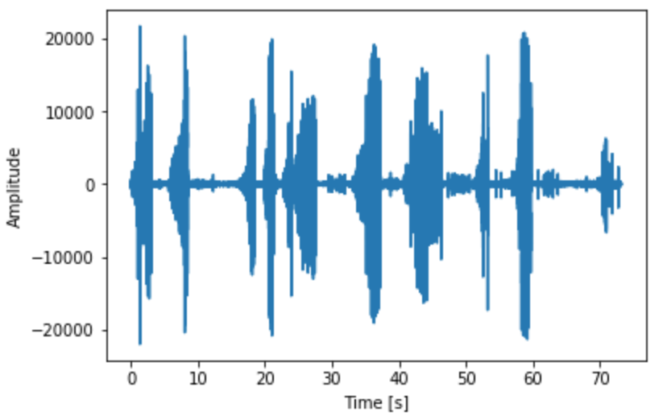
Bird songs
Let’s try a more complicated piece of music
This is a nightingale.
Nightingales like to sing.
What frequencies are their songs comprised of?
Let’s find out
bird image: https://www.independent.co.uk/environment/nature/male-nightingales-sing-complex-songs-to-show-females-they-will-be-good-fathers-say-scientists-10327130.html

Slide 17
Nightingale recording is taken from FreeSound and is available via Creative Commons license
https://freesound.org/people/genghis%20attenborough/sounds/34707/
It’s a wav file, which we haven’t looked at yet
import scipy.io.wavfile
rate, audio = scipy.io.wavfile.read('nightingale.wav')
audio = np.mean(audio, axis=1) # convert from stereo to mono
N = audio.shape[0] # how many data points do we have
L = N / rate # the length of the recording is num points / sampling rate
print(f'Audio length: {L:.2f} seconds')
plt.plot(np.arange(N) / rate, audio)
plt.xlabel('Time [s]')
plt.ylabel('Amplitude')

Slide 18
FFT is a rather slow operation
To get results quickly, let’s look at a sample of the nightingale song
# subset the audio
a=audio[40000:50000]
# what is our new size and duration
N = a.shape[0]
L = N / rate
print(f'Audio length: {L:.2f} seconds’)
What does it look like if we visualize it?
What frequencies are present in the nightingale’s song?

Slide 19
spectrograms
For the nightingale, the FFT is helpful, but not ideal
It shows us which frequencies are present; however, there are few limitations
We know that the frequencies present change throughout the song
Think of a pop song, the instruments being played change throughout the song
We don’t get any information about when these frequencies were present and how they compared to other frequencies at that time
This is where something called the spectrogram is useful

Slide 20
spectrograms
Spectrograms are created by taking the wave data and
Breaking it up into chunks, which usually overlap
Perform a Fourier Transformed on each chunk
Each chunk then corresponds to a vertical line in the spectrogram image - a measurement of magnitude versus frequency for a specific moment in time
These spectrogram images are then laid side by side to form the complete image

Slide 21
Spectrograms – in code
import scipy.signal
freqs, times, Sx = scipy.signal.spectrogram(a, fs=rate, window='hanning’, nperseg=1024, noverlap=924, detrend=False, scaling='spectrum')
plt.pcolormesh(times, freqs/1000, 10 * np.log10(Sx), cmap='viridis')
plt.ylabel('Frequency [kHz]')
plt.xlabel('Time [s]’)
Outputs of scipy.signal.spectrogram are: frequencies, times, and spectrogram value

Slide 22
A physics example
Looking at music is fun
But, can we also use FFT to in astrophysics? Let’s look at our Sun
The file http://narock.github.io/teaching/CST-411/sunspots.txt as two columns separated by spaces
It’s the number of sunspots (column 2) observed each month (column 1)
Start by visualizing the data

Slide 23
Sunspot cycle
The number of sunspots is increasing and decreasing over time – looks a lot like a wave
We can use FFT to find the dominant frequency – in other words, the frequency at which the sunspots rise and fall
What is it?
A relationship from physics may be useful here: period = 1 / frequency
Try plotting period on the x-axis instead of frequency
Keep in mind that our data is in months – not years

Slide 24
summary
We can view waves in either a temporal view or a frequency view
The temporal view works with amplitude over time and shows how the wave changes
The frequency view shows us which frequencies are present and how they compare in magnitude
The Fourier Transform is a mathematical technique for transforming back and forth between these two views
There is a collection of Fourier Transform routines in scipy under scipy.fftpack
fft(), computes FFT and returns both real and complex solutions
ifft(), inverse of fft()
fftn(), FFT for multi-dimensional data, returns real and complex solutions
ifftn(), invers of fftn()
rfft(), computes FFT and returns only real part
irfft(), inverse of rfft()

Slide 25
Fourier Transform
A mathematical technique to transform between temporal and frequency views
Based on infinite waves
Discreate Fourier Transform (DFT)
An implementation for non-infinite waves
Fast Fourier Transform (FFT)
A fast efficient computational implementation of DFT
Executes on a computer much faster than DFT

