Slide 1
CST-411
Integration and Differentiation

Slide 2

License and References
This work is licensed under a Creative Commons Attribution-NonCommercial-ShareAlike 4.0 International License
Fore more details: https://creativecommons.org/licenses/by-nc-sa/4.0/
The author is indebted to the generosity of others who have provided example problems and datasets. Where appropriate, external sources are cited both in the slides and in Jupyter Notebooks
Images from around the Web are also used to help convey concepts
Content that is reused in these slides is either open licensed or, as I understand it, meets the Fair Use Doctrine for educational reuse.

Slide 3
License and References
My university offering of this course has an introductory Python course as a prerequisite
That course uses
Python Programming: An Introduction to Computer Science 2010, 3rd Edition, John Zelle, Franklin, Beedle & Associates Inc., ISBN 9781590282755
At times, example problems from that text will be cited

Slide 4
Derivatives and Integrals
Derivatives and Integrals are common in scientific computing
Scipy has a set of routines for each
A few things to note up front
These routines use numerical techniques that are approximate solutions. The solutions are very precise, but not exact
Scipy does not do symbolic integration or symbolic differentiation. In other words, we can’t ask it to integrate 2x and get back x². Rather, it evaluates the integral (derivative) over specified values. It always returns a number – not a function
There are libraries – like SymPy – which will do symbolic computing. But, it’s not part of the standard scientific computing collection of scipy, numpy, pandas, and matplotlib

Slide 5
Derivatives
Let’s say we wanted to take the derivative of x² and evaluate it at 0, 1, and 2
What would be the result if we did this by hand?

Slide 6
import numpy as np
import scipy.misc # this is where derivative functions are
# define the function we want to differentiate
def f(x):
return x**2
# the values we want to evaluate in our derivative
x = np.arange(0,3, 1) # a list of values from [0, 3), steps of 1
# inputs are (function to differentiate, values to evaluate,
# and which derivative) n=1 is saying the first derivative
f1 = scipy.misc.derivative(f, x, n=1)
print("We are taking the derivative of x squared at", x)
print("The derivative at", x, "is", f1)

Slide 7
Derivatives
What about the second derivative?
Let’s say we wanted to now take the second derivative of x² and evaluate it at 0, 1, and 2
What would be the result if we did this by hand?

Slide 8
import numpy as np
import scipy.misc # this is where derivative functions are
# define the function we want to differentiate
def f(x):
return x**2
# the values we want to evaluate in our derivative
x = np.arange(0,3, 1) # a list of values from [0, 3), steps of 1
# inputs are (function to differentiate, values to evaluate,
# and which derivative) n=1 is saying the first derivative
f2 = scipy.misc.derivative(f, x, n=2)
print("We are taking the second derivative of x squared at", x)
print("The second derivative at", x, "is", f2)

Slide 9
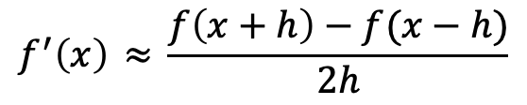
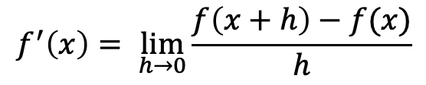
How does Scipy do this?
You may recall from Calculus that the derivative can be written as
$$f^{′}\left(x\right)= \lim_{h→0}{\frac{f\left(x+h\right)−f(x)}{h}}$$
Similarly, if the function f(x) can be evaluated at values that lie to the left and right of x,
then the derivative can be show to be approximately equal to
$$f^{′}\left(x\right) ≈{\frac{f\left(x+h\right)−f(x−h)}{2h}}$$
This is how Scipy approximates the derivative given a function we provide

Slide 10
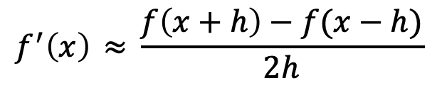
How does Scipy do this?
There are practical considerations we need to consider
$$f^{′}\left(x\right) ≈{\frac{f\left(x+h\right)−f(x−h)}{2h}}$$
If h is too big, we get a poor approximation of the derivative
If h is too small, rounding errors will produce errors in the result

Slide 11
How does Scipy do this?
Let’s look at an example
Let’s say we wanted to take the derivative of x³ and evaluate it at 1
What do you expect the answer to be?
Is this what Scipy gives us?

Slide 12
If we let Scipy choose h then our answer isn’t very good
Fortunately, we can add another input to integrate and choose our own h
def f3(x):
return x**3
f = scipy.misc.derivative(f3, 1, n=1, dx = 0.001)
Scipy calls the parameter dx, but it’s the same as what we had as h
Try integrating with dx = 0.001 and dx = 1e-6

Slide 13
So, what value do we choose?
An exact answer depends on the function we are differentiating and the computer we are working on (how precisely it stores numbers internally also factors in)
A good rule of thumb, applicable for most computers today is around 1x10⁻⁶
Our usage of integrate now becomes
f1 = scipy.misc.derivative(f, x, n=1, dx=1e-6)

Slide 14
Derivatives
What about partial derivatives?
Let’s say we have f(x,y) = x² + y³
The derivative with respect to x is: 2x
Evaluated at x=1 would give us 2

Slide 15
Derivatives
Let’s say we have f(x,y) = x² + y³
def f(x, y):
return (x**2 + y**3)
y = [10]
f1 = scipy.misc.derivative(f, 1, n=1, dx=1e-16, args = y)
We must supply a value for y to be used in the evaluation
In this case it has no effect, but in others it might

Slide 16
Derivatives
Let’s say we have f(x,y) = x² + y³
What if we wanted the partial derivative with respect to y?
def f(y, x):
return (x**2 + y**3)
x = [10]
f1 = scipy.misc.derivative(f, 1, n=1, dx=1e-16, args = x)
We must supply a value for y to be used in the evaluation
In this case it has no effect, but in others it might

Slide 17
Integration
Scipy has several functions for integration
Personally, I prefer scipy.integrate.quad() and scipy.integrate.nquad()
Both are in scipy.integrate
scipy.integrate.quad() for integration of one variable scipy.integrate.nquad() for n-dimensional integration

Slide 18
Integration
Why quad?
In math, quadrature is a historical term which means a process of determining area.
An integral is the area under the curve
scipy.integrate.quad() for integration of one variable scipy.integrate.nquad() for n-dimensional integration
The specific quadrature being used is the Clenshaw–Curtis quadrature, which approximates an integral by rewriting it as a sum

Slide 19
Integration
Let’s say we want to integrate 2x from 0 to 2
We’d expect to get x² and
I = 2² – 0² = 4
import scipy.integrate
def f(x):
return 2.*x
I = scipy.integrate.quad(f, 0, 2)
print(I)
(4.0, 4.440892098500626e-14)
The first result is the answer, the second an estimate of the error

Slide 20
Integration
Nquad is for integration in higher dimensions
The usage looks like this
def f(x,y):
return x**2 + y**2
I = scipy.integrate.nquad(f, [[0, 10],[1, 25]])
This is saying, integrate the function f over the range [0,10] for x and [1,25] for y
Output of nquad is the same as quad: the answer, and an estimate of error

Slide 21
Integration
import scipy.integrate
def f(x):
return 2.*x
I = scipy.integrate.quad(f, 0, 2)
print(I)
(4.0, 4.440892098500626e-14)
Like derivative, quad and nquad have additional options for error tolerance
epsrel specifies the largest absolute relative error we are willing to tolerate and the functions will operate accordingly:
I = scipy.integrate.quad(f, 0, 2, epsrel=1e-6)
This value is already set to 1.49e-8, which is fine for all of our cases so I don’t include it here

Slide 22
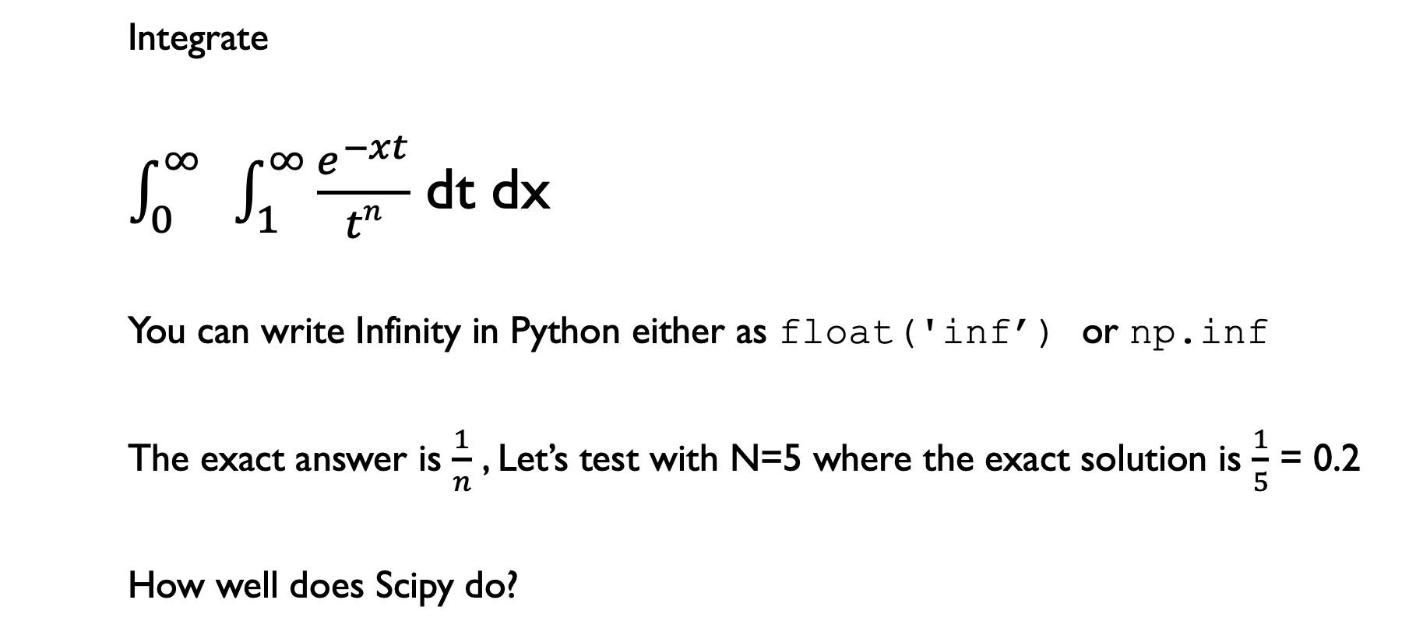
Integration practice problem
Integrate
$\int_{0}^{∞}{ }\int_{1}^{∞}{\frac{e^{−xt}}{tn}}$ dt dx
You can write Infinity in Python either as float('inf’) or np.inf
The exact answer is $\frac{1}{n}$ , Let’s test with N=5 where the exact solution is $\frac{1}{5}$ = 0.2
How well does Scipy do?

Slide 23
Application Problem
A particle is moving along the x-axis. It’s velocity is given by v(t) = -t³ + 6t² + 2t
At what value time (value of t) does the particle obtain its maximum acceleration?

Slide 24
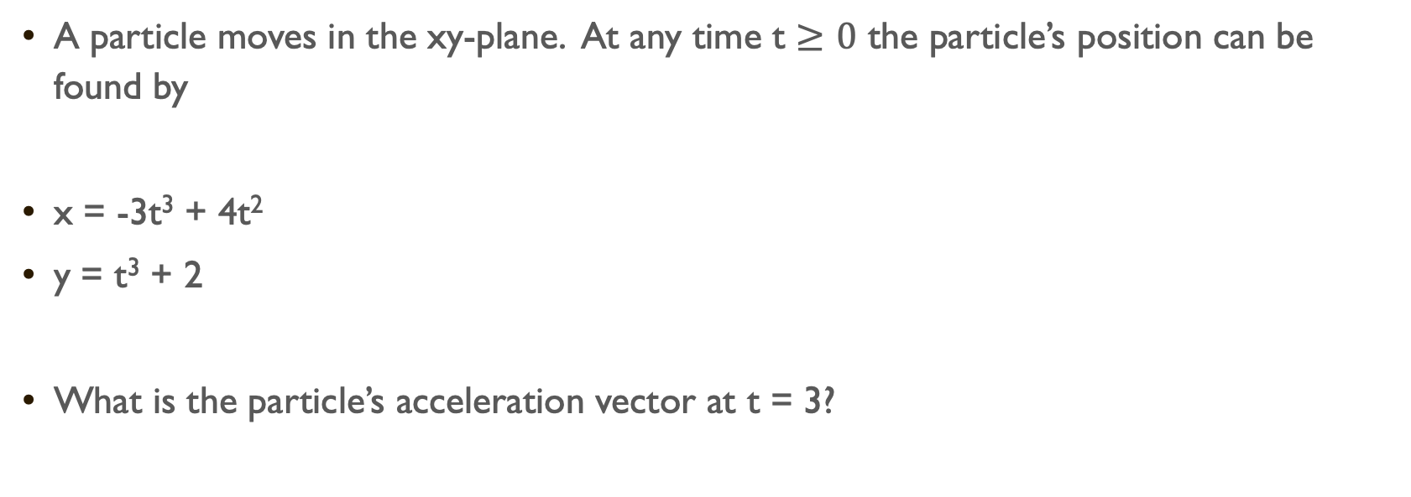
Application problem
A particle moves in the xy-plane. At any time t $≥0$ the particle’s position can be found by
x = -3t³ + 4t²
y = t³ + 2
What is the particle’s acceleration vector at t = 3?

Slide 25
Application problem
Our factory is producing Wonderful Widgets
Our revenue (in thousands of dollars) is given by: r(x) = 10x
For example, selling one widget = r(1) = 10*1 = 10 = $10,000
But, we have to pay electricity bills, and our employees, and take care of other costs
Our costs are: c(x) = x³ – 6x² + 15x, also in thousands of dollars
Selling one widget cost c(1) = 1³ – 6*1² + 15 = -5 + 15 = 10 = $10,000
Selling just one widget, we break even
How many widgets do we need to sell to maximize our profit?

Slide 26
Application problem
Approximate through visualization and analysis
Define a function that describes our profits as a function of x (widgets made)
Visualize the profit function
Find the maximum
Confirm and find more precise answer by
Thinking about critical points
Recall, c is a critical point if f’(c) = 0
A critical point c is a maximum when f’’(c) < 0

