Slide 1
BICYCLE THEFT CLASSIFIER
TEAM 3
Diwakar Singh - 301185459
Hitesh Dharmadhikari - 301150694
Jefil Tasna John Moran - 301149710
Shrikant Kale - 301150258
Nestor Romero Leon - 301133331

Slide 2
Dataset General Information
The dataset comprises data from Toronto Police Department regarding bicycle theft in the GTA Area
The dataset consists of 35 columns and 25569 records
The columns included in the data set are:
Primary_Offence, Occurrence_Year, Occurrence_Month, Occurrence_DayOfWeek, Occurrence_DayOfMonth, Occurrence_DayOfYear, Occurrence_Hour, Report_Date, Report_Year, Report_Month, Report_DayOfWeek, Report_DayOfMonth, Report_DayOfYear, Report_Hour, Division, City, Hood_ID, NeighbourhoodName,
Location_Type, Premises_Type, Bike_Make, Bike_Model, Bike_Type, Bike_Speed, Bike_Colour, Cost_of_Bike, Status, Longitude, Latitude

Slide 3
Dataset General Information
The main goal for the project is to build a predictive service that based on certain features would provide a classification of either a bike is likely to be returned or not

Slide 4
Dataset General Information
<class 'pandas.core.frame.DataFrame'>
RangeIndex: 25569 entries, 0 to 25568
Data columns (total 35 columns):
# Column Non-Null Count Dtype
--- ------ -------------- -----
0 X 25569 non-null float64
1 Y 25569 non-null float64
2 OBJECTID 25569 non-null int64
3 event_unique_id 25569 non-null object
4 Primary_Offence 25569 non-null object
5 Occurrence_Date 25569 non-null object
6 Occurrence_Year 25569 non-null int64
7 Occurrence_Month 25569 non-null object
8 Occurrence_DayOfWeek 25569 non-null object
9 Occurrence_DayOfMonth 25569 non-null int64
10 Occurrence_DayOfYear 25569 non-null int64
11 Occurrence_Hour 25569 non-null int64
12 Report_Date 25569 non-null object
13 Report_Year 25569 non-null int64
14 Report_Month 25569 non-null object
15 Report_DayOfWeek 25569 non-null object
16 Report_DayOfMonth 25569 non-null int64
17 Report_DayOfYear 25569 non-null int64
18 Report_Hour 25569 non-null int64
19 Division 25569 non-null object
20 City 25569 non-null object
21 Hood_ID 25569 non-null object
22 NeighbourhoodName 25569 non-null object
23 Location_Type 25569 non-null object
24 Premises_Type 25569 non-null object
25 Bike_Make 25448 non-null object
26 Bike_Model 15923 non-null object
27 Bike_Type 25569 non-null object
28 Bike_Speed 25569 non-null int64
29 Bike_Colour 23508 non-null object
30 Cost_of_Bike 23825 non-null float64
31 Status 25569 non-null object
32 Longitude 25569 non-null float64
33 Latitude 25569 non-null float64
34 ObjectId2 25569 non-null int64
dtypes: float64(5), int64(11), object(19)
memory usage: 6.8+ MB
None
For columns datatype composition we have:
Float64 5 (14%)
Int64 11 (31%)
Object(mixed) 19 (55%)

Slide 5
Dataset General Information
Missing / Null values found in columns:
Bike_Make 121 (0.47%) (categorical)
Bike_Model 9646 (37.72%) (categorical)
Bike_Colour 2061 (8.06%) (categorical)
Cost_of_Bike 1744 (6.82%) (numerical)

Slide 6
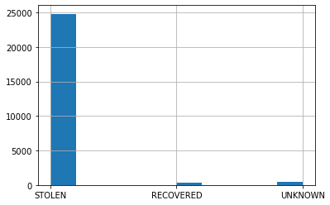
Status
count 25569
unique 3
top STOLEN
freq 24807
Name: Status, dtype: object
This column was selected as the label used for determine if a bike was returned after being stolen
The positive class will be RECOVERED and the rest of the classes would be the negative class turning the problem into a binary classification problem
STOLEN 24807
UNKNOWN 454
RECOVERED 308
Name: Status, dtype: int64

Slide 7
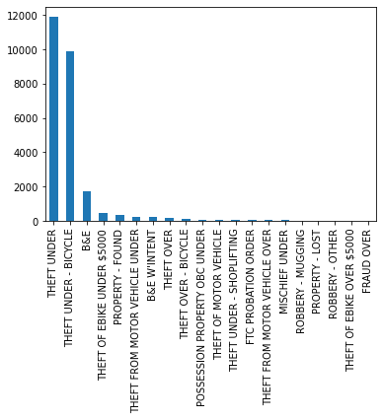
Primary Offence
TOP 20 – Primary Offence
count 25569
unique 66
top THEFT UNDER
freq 11904
Name: Primary_Offence, dtype: object
The top 3 values account for 92.03% of primary offence classification (23533)

Slide 8
Primary Offence
THEFT UNDER 11904
THEFT UNDER - BICYCLE 9891
B&E 1738
THEFT OF EBIKE UNDER $5000 462
PROPERTY - FOUND 320
THEFT FROM MOTOR VEHICLE UNDER 224
B&E WINTENT 214
THEFT OVER 150
THEFT OVER - BICYCLE 119
POSSESSION PROPERTY OBC UNDER 51
THEFT OF MOTOR VEHICLE 50
THEFT UNDER - SHOPLIFTING 50
FTC PROBATION ORDER 44
THEFT FROM MOTOR VEHICLE OVER 37
MISCHIEF UNDER 34
ROBBERY - MUGGING 28
PROPERTY - LOST 26
ROBBERY - OTHER 26
THEFT OF EBIKE OVER $5000 25
FRAUD OVER 21
…
count 25569
unique 66
top THEFT UNDER
freq 11904
Name: Primary_Offence, dtype: object

Slide 9
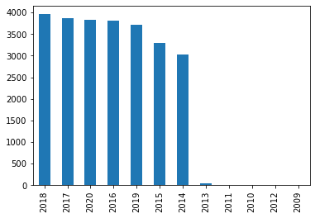
Occurrence Year
count 25569.000000
mean 2017.124174
std 1.960127
min 2009.000000
25% 2016.000000
50% 2017.000000
75% 2019.000000
max 2020.000000
Name: Occurrence_Year, dtype: float64
The occurrence of thefts seem to follow an uniform distribution with low values between 2009 and 2013 most likely due for lack of proper records
2018 3960
2017 3872
2020 3833
2016 3813
2019 3717
2015 3289
2014 3031
2013 46
2011 3
2010 2
2012 2
2009 1
Occurrences by Year

Slide 10
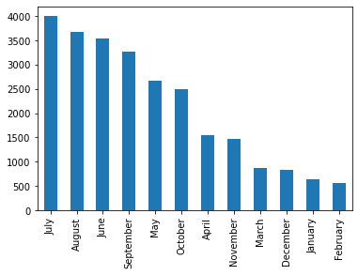
Occurrence Month
July 4002
August 3680
June 3532
September 3265
May 2659
October 2492
April 1553
November 1467
March 876
December 834
January 640
February 569
count 25569
unique 12
top July
freq 4002
Name: Occurrence_Month, dtype: object
The occurrence of thefts seem to follow an uniform distribution with low values between 2009 and 2013 most likely due for lack of proper records
Data distribution suggest a higher number of theft during the warmer months and higher values during summer (June, July, August)

Slide 11
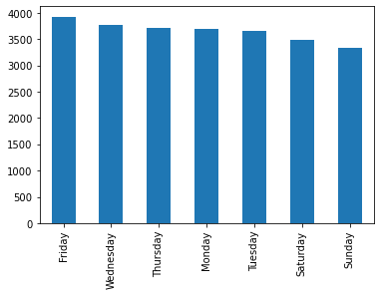
Occurrence Day of Week
count 25569
unique 7
top Friday
freq 3924
Name: Occurrence_DayOfWeek, dtype: object
Friday 3924
Wednesday 3768
Thursday 3719
Monday 3689
Tuesday 3658
Saturday 3483
Sunday 3328
Data seem to follow a fairly uniform distribution

Slide 12
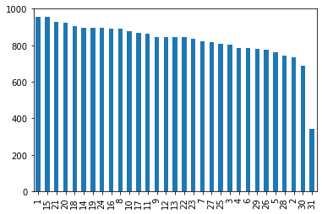
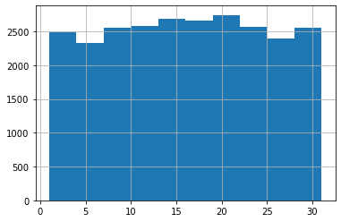
Occurrence Day of Month
count 25569.000000
mean 15.616684
std 8.592886
min 1.000000
25% 8.000000
50% 16.000000
75% 23.000000
max 31.000000
Name: Occurrence_DayOfMonth, dtype: float64
Data seem to follow a fairly uniform distribution

Slide 13
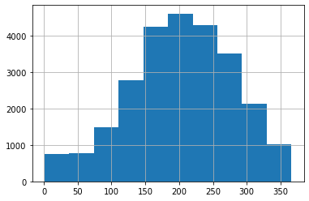
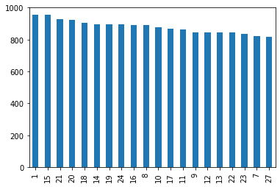
Occurrence Day of Year
count 25569.000000
mean 202.227698
std 76.821431
min 1.000000
25% 153.000000
50% 205.000000
75% 259.000000
max 366.000000
Name: Occurrence_DayOfYear, dtype: float64
Data distribution suggest a higher number of theft during the warmer months and higher values during summer (June, July, August)
Distribution consistent with the findings in distribution of thefts by month

Slide 14
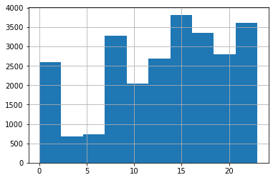
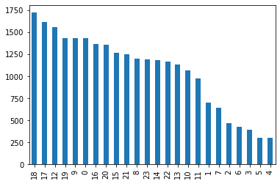
Occurrence Hour
count 25569.000000
mean 13.274395
std 6.530181
min 0.000000
25% 9.000000
50% 14.000000
75% 19.000000
max 23.000000
Name: Occurrence_Hour, dtype: float64

Slide 15
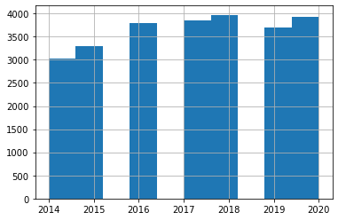
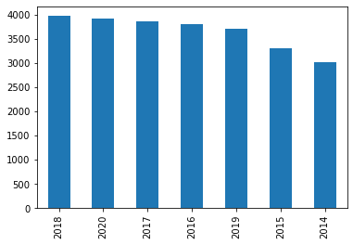
Report Year
count 25569.000000
mean 2017.143572
std 1.955024
min 2014.000000
25% 2016.000000
50% 2017.000000
75% 2019.000000
max 2020.000000
Name: Report_Year, dtype: float6
2018 3971
2020 3919
2017 3856
2016 3801
2019 3703
2015 3295
2014 3024

Slide 16
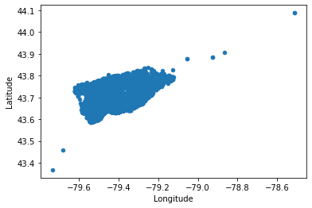
Longitude / Latitude
count 25569.000000
mean -79.395399
std 0.060373
min -79.734080
25% -79.420564
50% -79.392251
75% -79.374373
max -78.511428
Name: Longitude, dtype: float64
count 25569.000000
mean 43.673526
std 0.038471
min 43.367790
25% 43.650240
50% 43.662282
75% 43.681868
max 44.087501
Name: Latitude, dtype: float64

Slide 17
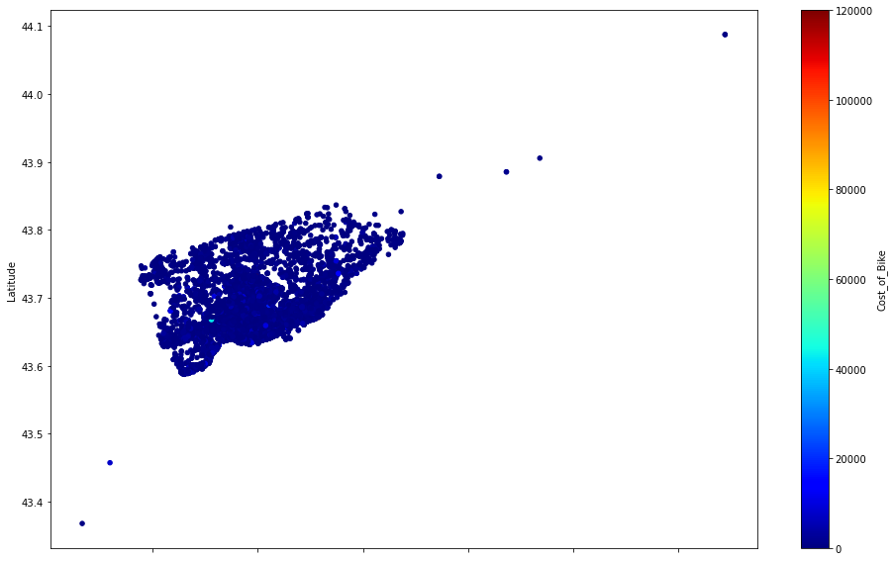
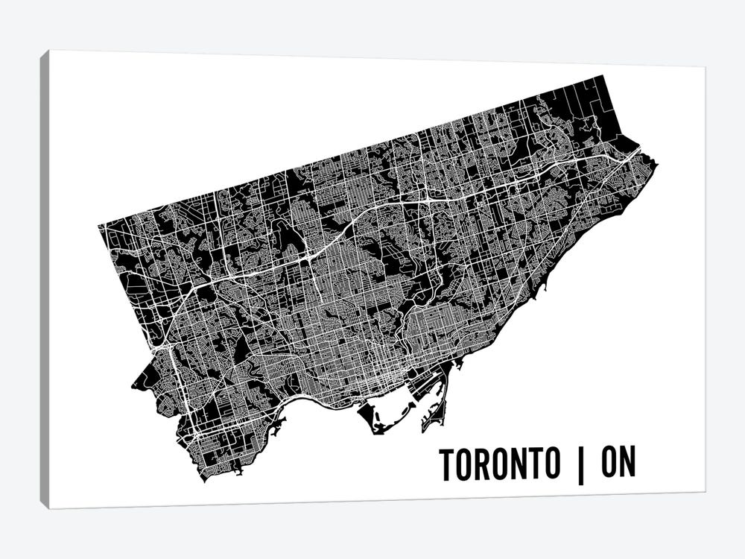
Longitude / Latitude
Clear patches showcase clusters of high cost bicycles been stolen in particular areas

Slide 18
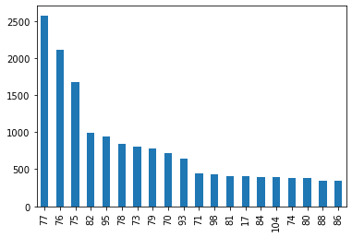
Hood_ID
77 2576
76 2112
75 1676
82 992
95 947
78 840
73 801
79 780
70 716
93 645
71 448
98 435
81 408
17 403
84 395
104 388
74 382
80 380
88 340
86 339
…
count 25569
unique 141
top 77
freq 2576
Name: Hood_ID, dtype: object

Slide 19
NeighbourhoodName
Waterfront Communities-The Island (77) 2576
Bay Street Corridor (76) 2112
Church-Yonge Corridor (75) 1676
Niagara (82) 992
Annex (95) 947
Kensington-Chinatown (78) 840
Moss Park (73) 801
University (79) 780
South Riverdale (70) 716
Dovercourt-Wallace Emerson-Junction (93) 645
Cabbagetown-South St.James Town (71) 448
Rosedale-Moore Park (98) 435
Trinity-Bellwoods (81) 408
Mimico (includes Humber Bay Shores) (17) 403
Little Portugal (84) 395
Mount Pleasant West (104) 388
North St.James Town (74) 382
Palmerston-Little Italy (80) 380
High Park North (88) 340
Roncesvalles (86) 339
Name: NeighbourhoodName, dtype: int64
count 25569
unique 141
top Waterfront Communities-The Island (77)
freq 2576
Name: NeighbourhoodName, dtype: object
This column provides the label for the Hood_ID field
There are some identifiable “hot zones” corresponding with the scatter plot of the geographic distribution of thefts

Slide 20
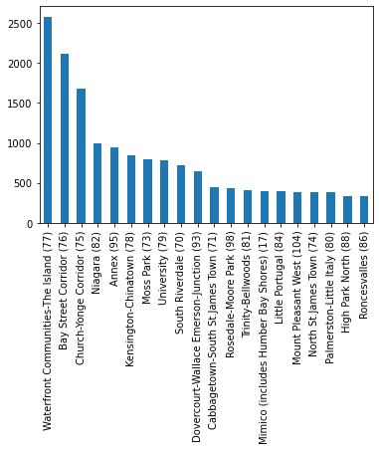
NeighbourhoodName
count 25569
unique 141
top Waterfront Communities-The Island (77)
freq 2576
Name: NeighbourhoodName, dtype: object

Slide 21
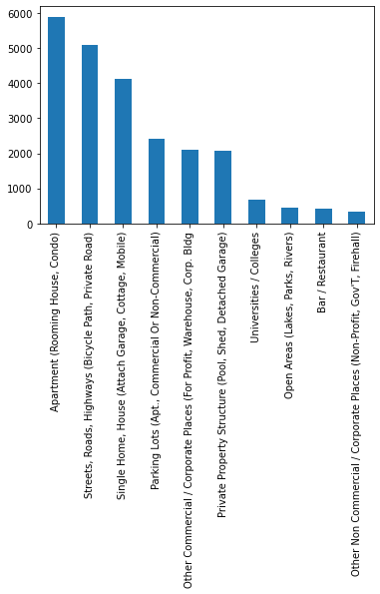
Location_Type
count 25569
unique 42
top Apartment (Rooming House, Condo)
freq 5887
Name: Location_Type, dtype: object
Apartment (Rooming House, Condo) 5887
Streets, Roads, Highways (Bicycle Path, Private Road) 5088
Single Home, House (Attach Garage, Cottage, Mobile) 4118
Parking Lots (Apt., Commercial Or Non-Commercial) 2421
Other Commercial / Corporate Places (For Profit, Warehouse, Corp. Bldg 2094
Private Property Structure (Pool, Shed, Detached Garage) 2074
Universities / Colleges 668
Open Areas (Lakes, Parks, Rivers) 442
Bar / Restaurant 411
Other Non Commercial / Corporate Places (Non-Profit, Gov'T, Firehall) 347

Slide 22
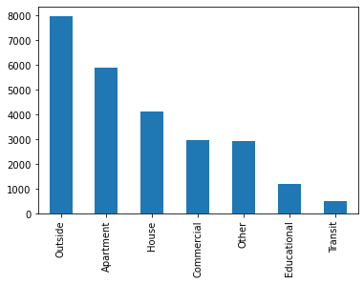
Premises_Type
count 25569
unique 7
top Outside
freq 7960
Name: Premises_Type, dtype: object
Outside 7960
Apartment 5887
House 4118
Commercial 2953
Other 2937
Educational 1193
Transit 521

Slide 23
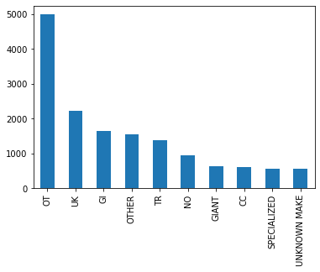
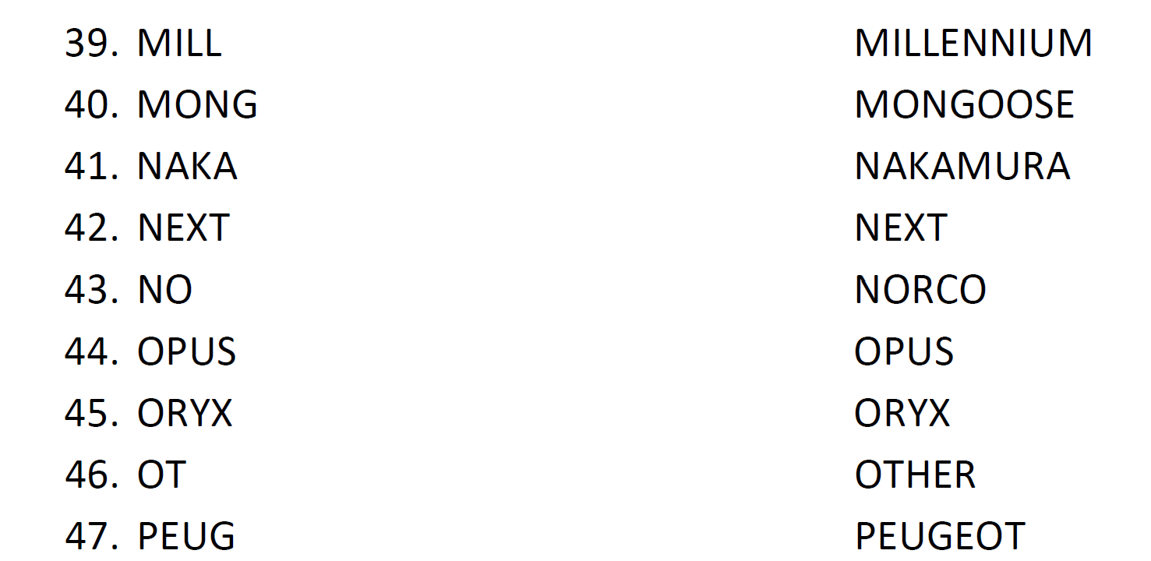
Bike_Make
count 25448
unique 820
top OT
freq 4991
Name: Bike_Make, dtype: object
OT 4991
UK 2230
GI 1648
OTHER 1550
TR 1375
NO 960
GIANT 631
CC 612
SPECIALIZED 566
UNKNOWN MAKE 564
* Bicycle_Data_Code_Sheet.pdf

Slide 24
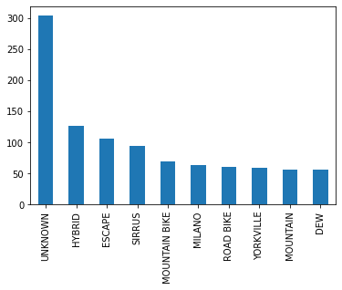
Bike_Model
count 15923
unique 8097
top UNKNOWN
freq 304
Name: Bike_Model, dtype: object
UNKNOWN 304
HYBRID 127
ESCAPE 106
SIRRUS 94
MOUNTAIN BIKE 69
MILANO 64
ROAD BIKE 61
YORKVILLE 59
MOUNTAIN 57
DEW 57

Slide 25
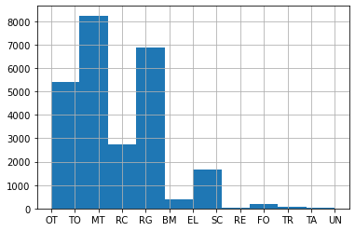
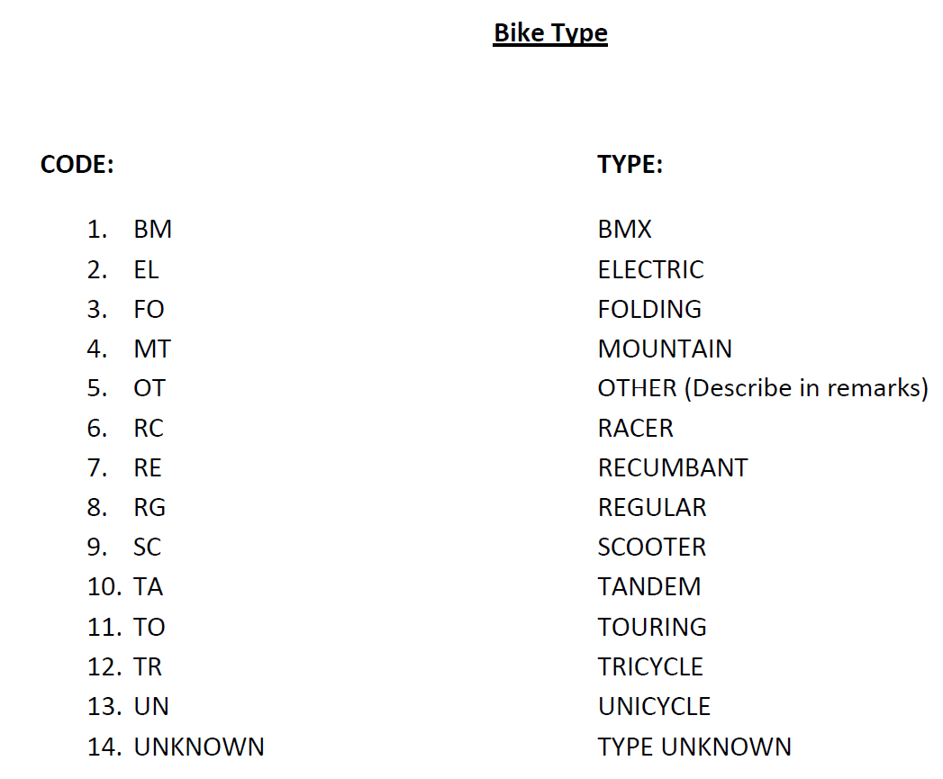
Bike_Type
count 25569
unique 13
top MT
freq 8245
Name: Bike_Type, dtype: object
MT 8245
RG 6889
OT 4067
RC 2729
EL 1358
TO 1325
BM 376
SC 295
FO 184
TR 58
TA 22
RE 13
UN 8
* Bicycle_Data_Code_Sheet.pdf

Slide 26
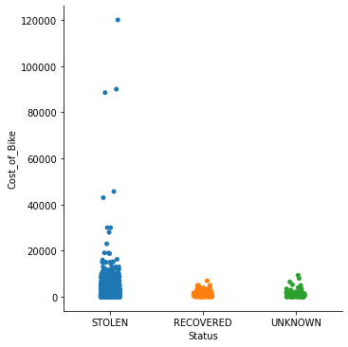
Cost_of_Bike
count 23825.000000
mean 949.542371
std 1675.880345
min 0.000000
25% 350.000000
50% 600.000000
75% 1000.000000
max 120000.000000
Bikes stolen are mostly under CAD 1000
STOLEN bikes contain some data values that seem to be outlier as they relate to very high values

Slide 27
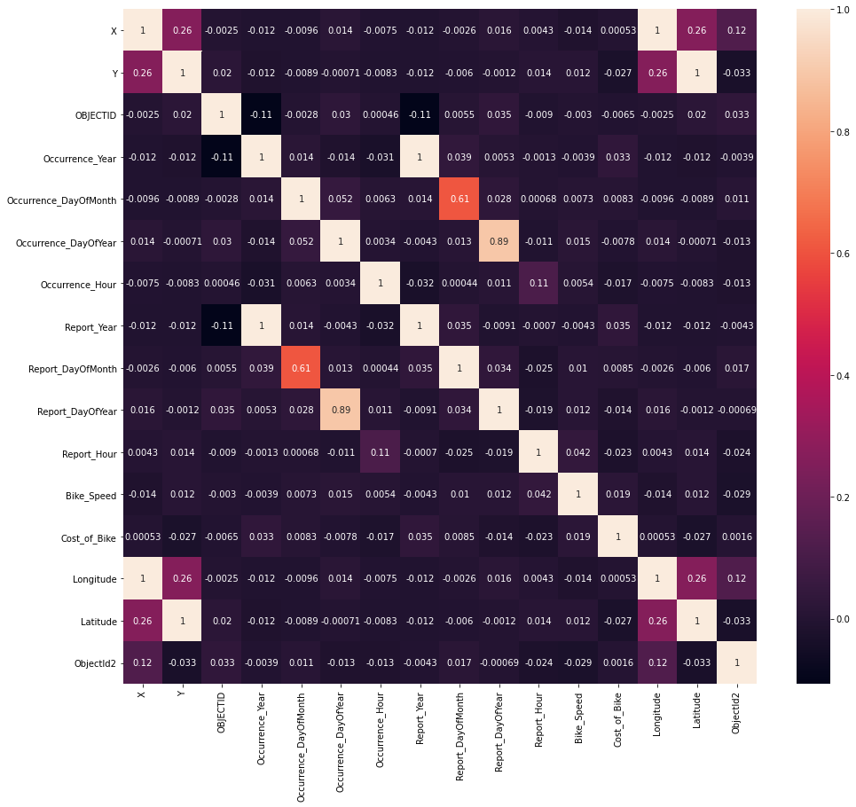
Data Correlation
Initial correlation analysis does not reveal anything particularly useful besides correlation between Occurrence and Report variables, and between Geolocation variables
Additional codification of some variables is required

Slide 28
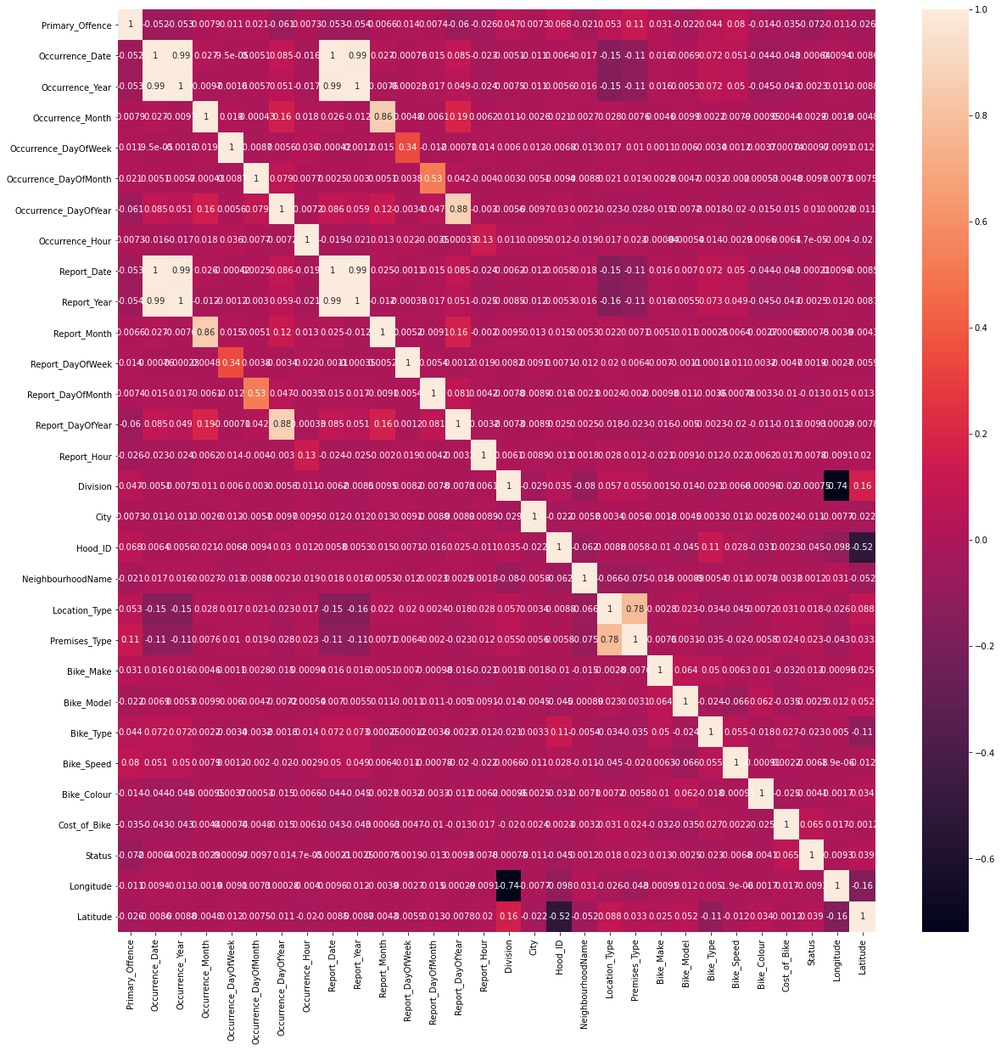
Data Correlation
With complete codification and scaling the correlation matrix shows additional information and confirms some of the previous findings
Variables of Interest:
Cost of bike
Latitude
Premises Type
Location Type
Bike Make
Occurrence Day Year
City
Report Day of Month
Bike Type
Hood_ID
Primary Offence
Status 1.000000
Cost_of_Bike 0.064606
Latitude 0.038855
Premises_Type 0.023273
Location_Type 0.018295
Bike_Make 0.012649
Occurrence_DayOfYear 0.010124
Report_DayOfYear 0.009334
Report_Hour 0.007835
Occurrence_Month 0.002926
Report_DayOfWeek 0.001885
NeighbourhoodName 0.001204
Occurrence_DayOfWeek 0.000967
Report_Month 0.000752
Occurrence_Hour 0.000047
Report_Date -0.000212
Occurrence_Date -0.000642
Division -0.000746
Occurrence_Year -0.002328
Bike_Model -0.002459
Report_Year -0.002546
Bike_Colour -0.004052
Bike_Speed -0.006802
Longitude -0.009336
Occurrence_DayOfMonth -0.009744
City -0.011463
Report_DayOfMonth -0.013285
Bike_Type -0.022566
Hood_ID -0.045421
Primary_Offence -0.071681
Name: Status, dtype: float64

Slide 29
Feature Selection
After the initial data exploration of the data, the group determined that the columns:
X, Y, OBJECTID, event_unique_id, ObjectId2, Occurrence_Date, Report_Date
would be candidates to be removed.
After feature selection with Decision Tree, the best features were identified as:
'Primary_Offence', 'Occurrence_Date', 'Occurrence_DayOfMonth',
'Report_Date', 'Report_DayOfMonth', 'Report_DayOfYear', 'Report_Hour',
'NeighbourhoodName', 'Location_Type', 'Bike_Model', 'Bike_Speed',
'Cost_of_Bike', 'Longitude', 'Latitude'

