Slide 1
Narong Sungkhamalai
ณรงค์ สังขมาลัย

Slide 2
Overview
Current Position : Tech lead/Back office team
Experience :
  Bualuang Securities pcl. : 2010 – Current (13 year)
  Krungthai Asset management: 2003 – 2010 (7 year)
  Siam Computer Institute : 2000 – 2002 (3 year)
Education : BS Industrial Education/Computer KMITL (2nd Honor)

Slide 3
Experience Siam Computer
Computer Instructor 2000-2002
  MS Office word/excel/PowerPoint
  Basic programming ms access
  Advance programming vb

Slide 4
Experience KTAM
Krungthai Asset management
Programmer 2003-2005
  Requirement gathering
  Development software In house
  Convert FoxPro to Visual Basic
Senior Programmer 2005-2009
  Team lead support/programmer
  IT Budget plaining
  System Engineer
    Implement MS Exchange convert form Lotus notes
    Server/Network/Storage Admin
    Database administrator

Slide 5
Experience Bualuang Securities
System Analyst 5 year 2010-2015
  Hiport
  HiBLS
  SharePoint Bualuang Intranet
Senior System Analyst 5 year 2016-2020
  K2 deposit/withdrawal
  iPoint System
  SharePoint Structure Notes
  Customer info
Tech lead/Backoffice 4 year 2020-Now
  Manage My's team for Fund Business
    2 B/A
    2 SA/Support
    2 Dev
  Project planning/Prioritizing
  Mentor Team/Knowledge sharing
  System Resource Planning
  Problem solving

Slide 6
Why find new career?
Why find new career
Why apply this position
Find way to growth up
Exit from Comfort Zone
Challenge job
Top tier of sector
Firm/growth company

Slide 7
Strong/Weak
Strong
weak
Solution-oriented
Analytical skills
Continual improvement
Talk in public

Slide 8







Hiportfolio HiBLS
HIBLS
Data Management
SQL
Report Designer
Export Data
Data Interface
Reporting

Slide 9


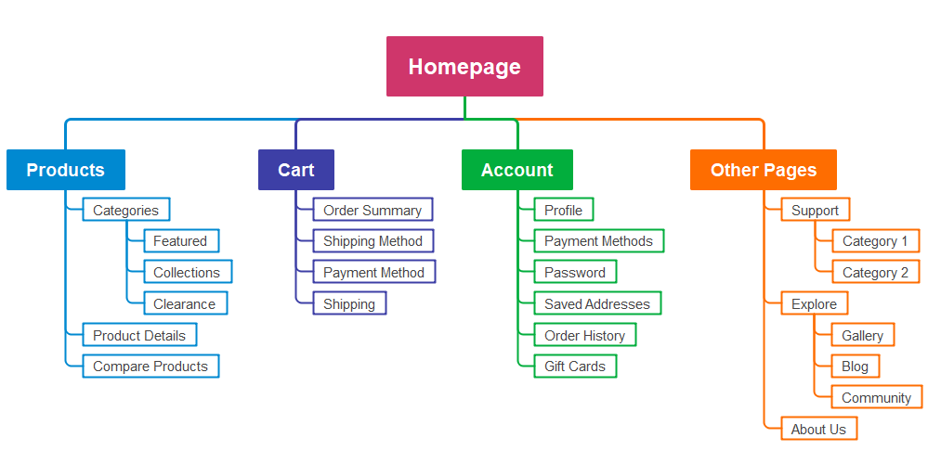
Bualuang Intranet
Setup and Install
Join Intranet working group
Site map

Slide 10
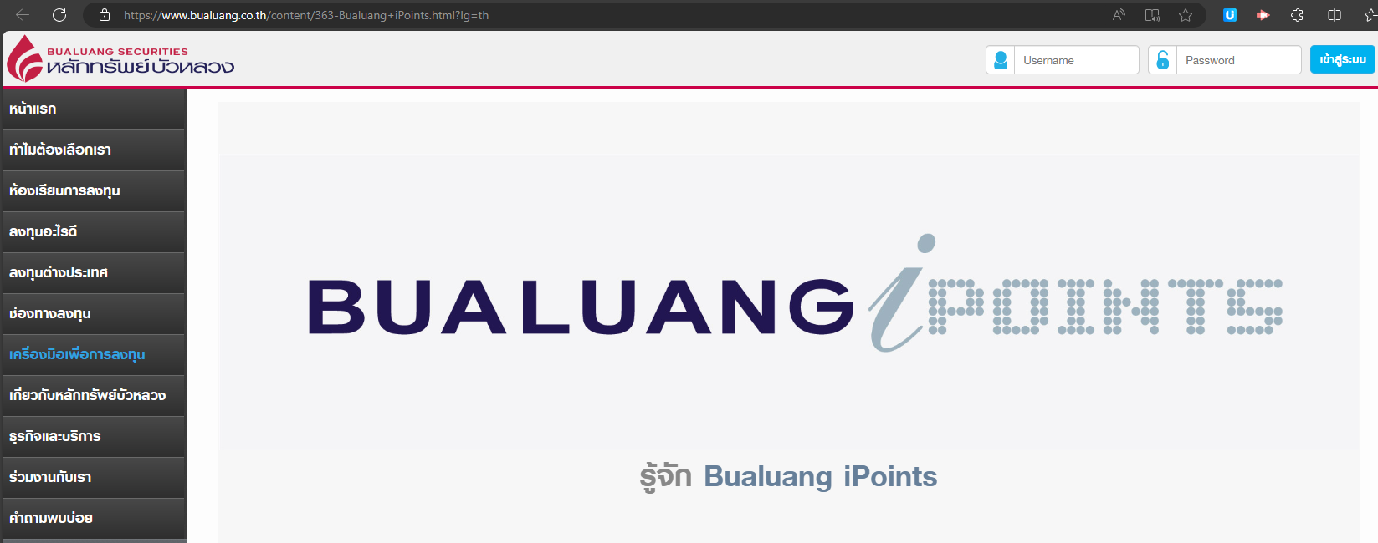



iPoint
Application
Back End Trading
Point Redemption
Point Creation
ETL
CALC
iPoint
Point email notification
Point Query API
Trading File

Slide 11






K2 workflow Deposit/Withdraw
Deposit
Trading
Form
Withdraw
Check and
Manual Entry
Deposit
Form
Trading
Withdraw
Q
Async Service Model and Business logic and API
Monitor/Reporting

Slide 12

Structure Notes
Application
Contract
Document workflow
Design Solution
Coding
Filing Contract

Slide 13


Customer Info
Call center
Back End Trading
Web form
Consolidate
Data
ETL
Customer File
Web Service

Slide 14
Current position Fund Company
Fund
Registrar
Fund Investment
Fund
Accounting
Broker
Insurance
Bank
Fund Manager
Dealer
Account
Fund Connext
Registrar
Rest API
In-house
CRD
Bloomberg
Hiportfolio
In-house
Data Feed
DB
Data Feed
DB
ETL
ETL

Slide 15
Stack
Microservice Architect
Container Base application
Rest/Api
API Gateway
Message broker
SQL, NoSQL
Logging and monitoring

