Slide 1


Slide 2
Version control systems
Version control (or revision control, or source control) is all about managing multiple versions of documents, programs, web sites, etc.
  Almost all “real” projects use some kind of version control
  Essential for team projects, but also very useful for individual projects
Some well-known version control systems are CVS, Subversion, Mercurial, and Git
  CVS and Subversion use a “central” repository; users “check out” files, work on them, and “check them in”
  Mercurial and Git treat all repositories as equal
Distributed systems like Mercurial and Git are newer and are gradually replacing centralized systems like CVS and Subversion

Slide 3
Why version control?
For working by yourself:
  Gives you a “time machine” for going back to earlier versions
  Gives you great support for different versions (standalone, web app, etc.) of the same basic project
For working with others:
  Greatly simplifies concurrent work, merging changes
For getting an internship or job :P

Slide 4
Why Git?
Git has many advantages over earlier systems such as CVS and Subversion
  More efficient, better workflow, etc.
  See the literature for an extensive list of reasons
  Of course, there are always those who disagree
Best competitor: Mercurial
  Same concepts, slightly simpler to use
  Much less popular than Git

Slide 5
Download and install Git
Download “Git” from
http://git-scm.com/downloads
Note: Git is primarily a command-line tool
GUIs are preferred over command-line tools, but…
The GIT GUIs are more trouble than they are worth (YMMV)

Slide 6
Introduce yourself to Git
Enter these lines (with appropriate changes):
  git config --global user.name "Nikhil Arora"
  git config --global user.email narora200@gmail.com
You only need to do this once
If you want to use a different name/email address for a particular project, you can change it for just that project
  cd to the project directory
  Use the above commands, but leave out the --global

Slide 7

Checking your settings
To list all the settings at once:
  git config --list
To list the settings according to the key name:
  git config user.name
  git config user.email

Slide 8
Create and fill a repository
cd to the project directory you want to use
Type in git init
  This creates the repository (a directory named .git)
  You seldom (if ever) need to look inside this directory
Type in git add .
  The period at the end is part of this command!
    Period means “this directory”
  This adds all your current files to the repository
Type in git commit –m "Initial commit"
  You can use a different commit message, if you like

Slide 9
Clone a repository from elsewhere
git clone URL
git clone URL mypath
  These make an exact copy of the repository at the given URL
git clone git://github.com/rest_of_path/file.git
  Github is the most popular (free) public repository
All repositories are equal
  But you can treat some particular repository (such as one on Github) as the “master” directory
Typically, each team member works in his/her own repository, and “merges” with other repositories as appropriate

Slide 10
The repository
Your top-level working directory contains everything about your project
  The working directory probably contains many subdirectories—source code, binaries, documentation, data files, etc.
  One of these subdirectories, named .git, is your repository
At any time, you can take a “snapshot” of everything (or selected things) in your project directory, and put it in your repository
  This “snapshot” is called a commit object
  The commit object contains (1) a set of files, (2) references to the “parents” of the commit object, and (3) a unique “SHA1” name
  Commit objects do not require huge amounts of memory
You can work as much as you like in your working directory, but the repository isn’t updated until you commit something

Slide 11
init and the .git repository
When you said git init in your project directory, or when you cloned an existing project, you created a repository
  The repository is a subdirectory named .git containing various files
  The dot indicates a “hidden” directory
  You do not work directly with the contents of that directory; various git commands do that for you
  You do need a basic understanding of what is in the repository

Slide 12
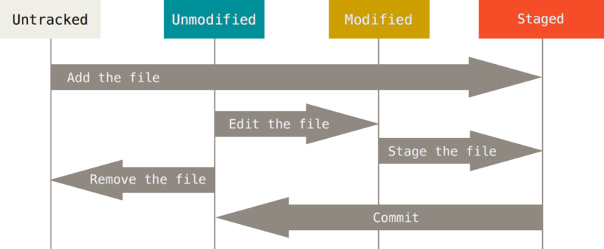

Lifecycle of status of Git files
Type in “git status” to check the status.

Slide 13
Making commits
You do your work in your project directory, as usual
If you create new files and/or folders, they are not tracked by Git unless you ask it to do so
  git add newFile1 newFolder1 newFolder2 newFile2
Committing makes a “snapshot” of everything being tracked into your repository
  A message telling what you have done is required
  git commit –m “Any relevant message”
  git commit
    This version opens an editor for you to enter the message
    To finish, save and quit the editor
Format of the commit message
  One line containing the complete summary
  If more than one line, the second line must be blank

Slide 14
Commits and graphs
A commit is when you tell git that a change (or addition) you have made is ready to be included in the project
When you commit your change to git, it creates a commit object
  A commit object represents the complete state of the project, including all the files in the project
  The very first commit object has no “parents”
  Usually, you take some commit object, make some changes, and create a new commit object; the original commit object is the parent of the new commit object
    Hence, most commit objects have a single parent
  You can also merge two commit objects to form a new one
    The new commit object has two parents
Hence, commit objects form a directed graph
  Git is all about using and manipulating this graph

Slide 15
Working with your own repository
A head is a reference to a commit object
The “current head” is called HEAD (all caps)
Usually, you will take HEAD (the current commit object), make some changes to it, and commit the changes, creating a new current commit object
  This results in a linear graph: A → B → C → …→ HEAD
You can also take any previous commit object, make changes to it, and commit those changes
  This creates a branch in the graph of commit objects
You can merge any previous commit objects
  This joins branches in the commit graph

Slide 16
Commit messages
In git, “Commits are cheap.” Do them often.
When you commit, you must provide a one-line message stating what you have done
  Terrible message: “Fixed a bunch of things”
  Better message: “Corrected the calculation of median scores”
Commit messages can be very helpful, to yourself as well as to your team members
You can’t say much in one line, so commit often

Slide 17

Ignoring Files
Often, you’ll have a class of files that you don’t want Git to automatically add or even show you as being untracked.
In such cases, you can create a file listing patterns to match them named .gitignore. Here is an example .gitignore file:
# ignore all files in the build/ directory
build/
# ignore doc/notes.txt, but not doc/server/arch.txt
doc/*.txt
# ignore all .pdf files in the doc/ directory
doc/**/*.pdf

Slide 18
Choose an editor
When you “commit,” git will require you to type in a commit message
For longer commit messages, you will use an editor
The default editor is probably vim
To change the default editor:
  git config --global core.editor /path/to/editor
You may also want to turn on colors:
  git config --global color.ui auto

Slide 19
Working with others
All repositories are equal, but it is convenient to have one central repository in the cloud.
Here’s what you normally do:
  Download the current head (HEAD) from the central repository
  Make your changes
  Commit your changes to your local repository
  Check to make sure someone else on your team hasn’t updated the central repository since you got it
  Upload your changes to the central repository
If the central repository has changed since you got it:
  It is your responsibility to merge your two versions
    This is a strong incentive to commit and upload often!
  Git can often do this for you, if there aren’t incompatible changes

Slide 20
git diff command
When you want to know exactly what you changed, not just which files were changed – you can use the git diff command.
If you want to see what you’ve staged that will go into your next commit, you can use git diff --staged. This command compares your staged changes to your last commit.

Slide 21
Removing files
To remove a file from Git, you have to remove it from your tracked files (more accurately, remove it from your staging area) and then commit.
The git rm command does that, and also removes the file from your working directory so you don’t see it as an untracked file the next time around.

Slide 22
Viewing the commit history
The most basic and powerful tool to do this is the git log command.
One of the more helpful options is -p, which shows the difference introduced in each commit. You can also use -2, which limits the output to only the last two entries.
$ git log -p -2

Slide 23
Undoing Things
$ git commit --amend
This command takes your staging area and uses it for the commit.
$ git reset HEAD <file>...
Used for Unstaging a Staged File.
$ git checkout -- <file>
Used for Unmodifying a Modified File.

Slide 24
Undoing Things (Cont...)
Rollback to an old git commit
$ git checkout [revision] . //revision is the commit hash
The dot at the end is very important. It will apply changes to the whole tree.
Then commit.
Note: Check commit hash from $ git log
Undo the above thing by
$ git reset --hard;

Slide 25
Working with Remotes
Remote repositories are versions of your project that are hosted on the Internet or network somewhere.
Showing Your Remotes
$ git remote
It lists the shortnames of each remote handle you’ve specified.
-v, shows you the URLs as well.
$ git remote -v

Slide 26
Working with Remotes (Cont...)
Adding Remote Repositories
$ git remote add <shortname> <url>
Fetching the latest commit from remote repo.
$ git fetch <shortname>
It’s important to note that the git fetch command only downloads the data to your local repository.
Use the $ git pull command to automatically fetch and then merge that remote branch into your current branch
$ git pull <shortname>

Slide 27
Working with Remotes (Cont...)
Pushing to Your Remotes
When you have your project at a point that you want to share, you have to push it upstream.
$ git push [remote-name] [branch-name]
Inspecting a Remote
$ git remote show [remote-name]
Removing and Renaming Remotes
$ git remote rename <oldName> <newName>
$ git remote rm <name>

Slide 28
Tagging
Like most VCSs, Git has the ability to tag specific points in history as being important.
Listing Your Tags
$ git tag
Creating Tags
$ git tag -a v1.4 -m "my version 1.4"
-a for creating annotated tags

Slide 29
Working with branches in Git
A branch represents an independent line of development. You can think of them as a way to request a brand new working directory, staging area, and project history.
List all of the branches in your repository.
$ git branch
Create a new branch
$ git branch <branch>
Delete the specified branch
$ git branch -d <branch>
Rename the current branch
$ git branch -m <oldName> <newName>

Slide 30
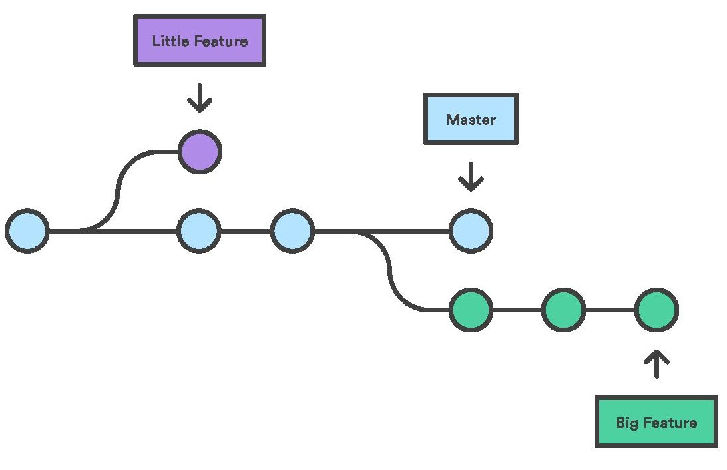
Why do we create branches?
In Git, branches are a part of your everyday development process. No matter how big or small the change, you spawn a new branch to encapsulate your changes. This makes sure that unstable code is never committed to the main code base.

Slide 31
Branches (Cont...)
Git Checkout
  The git checkout command lets you navigate between the branches created by git branch. Checking out a branch updates the files in the working directory to match the version stored in that branch
  $ git checkout <existing-branch>
  $ git checkout -b <new-branch>
Git Merge
The git merge command lets you take the independent lines of development created by git branch and integrate them into a single branch. The current branch will be updated to reflect the merge, but the target branch will be completely unaffected.
$ git merge <branch>

Slide 32
Merge / Diff Tools
Many a times while trying to merge two different branches, merge conflicts come into the picture. These can be due to:
DiffMerge is one such type of tool.
Here's how to install it:
https://sourcegear.com/diffmerge/downloads.php

Slide 33
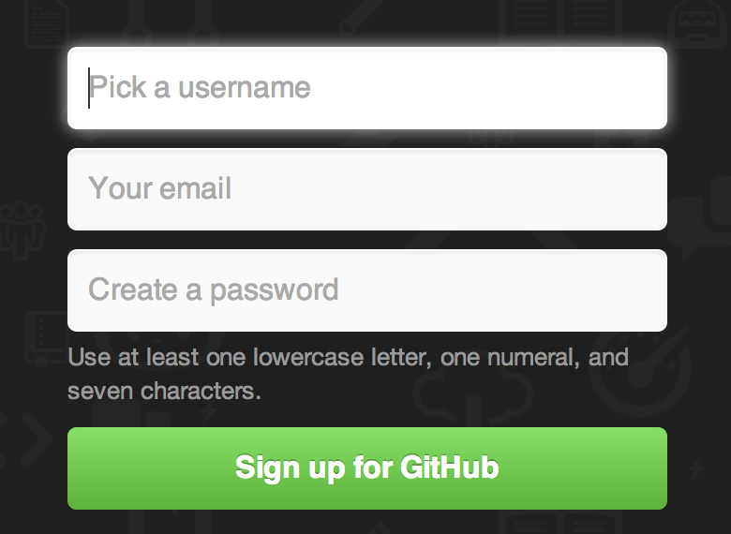
github.com
Account Setup and Configuration
Simply visit https://github.com

Slide 34
Collaborating on github
GitHub is web-based Git repository hosting service. It provides access control and several collaboration features. Other examples of Git repository services are Bitbucket, SourceForge, GitLab etc.
GitHub has been adopted by many large open-source projects as their primary home for collaboration and contribution
  Find a suitable project for yourself
  Fork the repository into your own account
  Study the code carefully and try to find any discrepancies in the code.
  Start small, once you’re used to it, start resolving issues posted in the original repository
  If you’ve solved any issue or corrected any discrepancy, submit a Pull Request to the collaborators of the repository to merge your changes into their master branch.

Slide 35


Collaborating on github (Cont...)
Forking Projects
If you want to contribute to an existing project to which you don’t have push access, you can “fork” the project.
What this means is that GitHub will make a copy of the project that is entirely yours; it lives in your user’s namespace, and you can push to it.
People can fork a project, push to it, and contribute their changes back to the original repository by creating what’s called a Pull Request

Slide 36
Collaborating on github (Cont...)
The GitHub Flow
Here’s how it generally works:
Create a topic branch from master.
Make some commits to improve the project.
Push this branch to your GitHub project.
Open a Pull Request on GitHub.
Discuss, and optionally continue committing.
The project owner merges or closes the Pull Request.

Slide 37
Collaborating on github (Cont...)
Creating a Pull Request
Here’s how it generally works:
Clone our fork of the project locally
Create a descriptive topic branch
Make our change to the code
Check that the change is good
Commit our change to the topic branch
Push our new topic branch back up to our GitHub fork
Now, if we go back to our fork on GitHub, we can see that GitHub present us with an option to create a pull request.

Slide 38
education.github.com
Get the Student Developer Pack loaded with dozens of free-resources to help students learn.
Go to http://education.github.com
Click on “Request a discount”
Fill the information.
Note: As we don't have a school-issued email address, therefore we have to upload an image of our id-card for verification.
To make sure that your application gets accepted, it is recommended that you click both sides of the id-card and then make a collage of them.

Slide 39
Some cool open-source projects
By the Tech Team of BVP-CSI
-> Ujjwal (Web-Administrator) https://github.com/imujjwal96/prelimQuiz
-> Nikhil (Technical-Head) https://github.com/narora200/bvuliveweb
-> Saad (Technical-Head) https://github.com/syedsaadh/PurpleWall
-> Arpit (Technical-Head) https://github.com/arpitn30/PocketLibrary
-> Dalip (Web-Executive) https://github.com/dalip123/events
-> Ashish (Technical-Executive) https://github.com/ashish411/Book_Listing

Slide 40


What are you waiting for?
Start now!

