Slide 1

MathSolver

Slide 2

MathSolver
The Math solver app is an Android application that provides a one-stop solution for various mathematical problems. The app includes features such as permutation and combination, logical operations, number conversion, unit conversion, and a simple calculator

Slide 3
What is android studio
Android Studio is an Integrated Development Environment (IDE) for developing Android applications.

Slide 4
Feature
Simple Calculator
Unit Conversion
Number Conversion

Slide 5
Feature
Logical Operation
Permutation and Combination
News

Slide 6
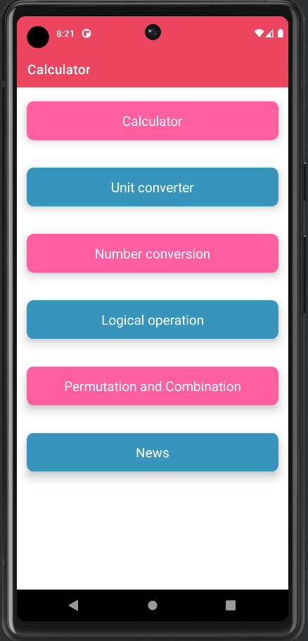
Math Solver

Slide 7
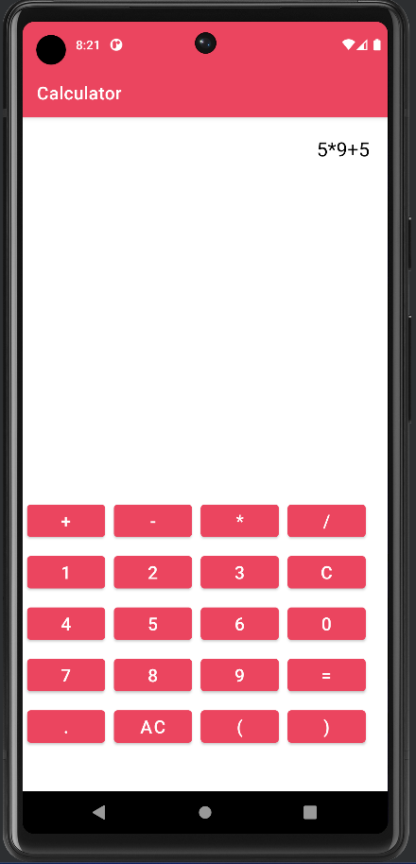
Simple Calculator
This module provides an intuitive and easy-to-use interface for performing basic mathematical operations such as addition, subtraction, multiplication, and division.

Slide 8
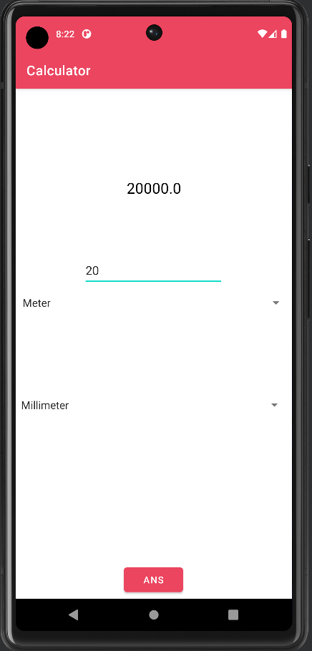
Unit conversion
The Unit Conversion module allows users to convert units of measurement, such as length.

Slide 9
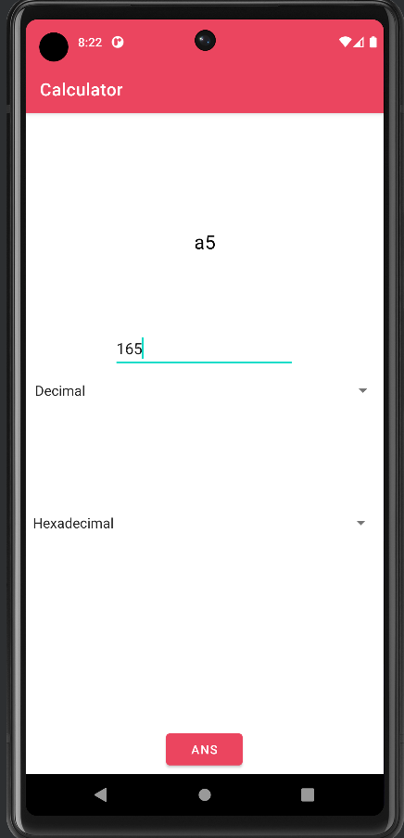
Number conversion
The Number Conversion module is designed to convert numbers from one system to another, such as decimal to binary, octal, or hexadecimal.

Slide 10
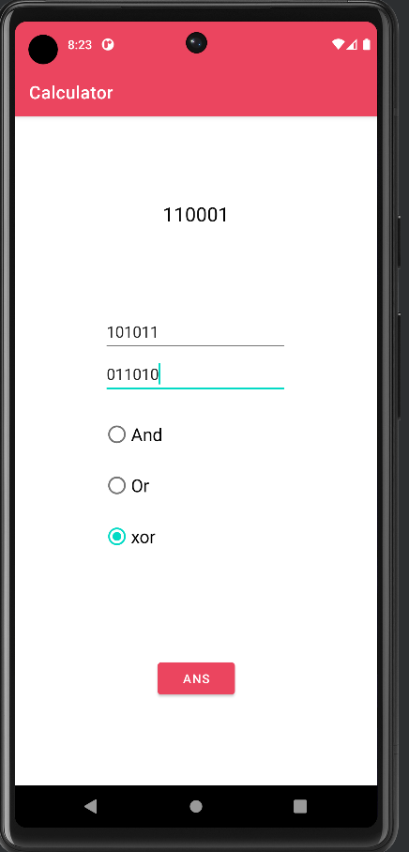
Logical Operation
The Logical Operation module allows users to perform logical operations such as AND, OR, and XOR.

Slide 11
Permutation and Combination
The Permutation and Combination module is designed to solve problems related to probability and statistics.

Slide 12


News
this module showcases a range of news articles with their respective titles and descriptions and allows you to read the full article by simply clicking on the "Read More" button.

Slide 13
Upcoming features
Matrix Operations
Fibonacci series
Equation Solver
Complex Numbers Calculator

Slide 14

Github Link
https://github.com/narottamandeep2003/Calculator

Slide 15

Thank You
Thank the audience for their attention and provide any additional information or resources

