Slide 1

SKETCHBOOK / RAVE COFFEE 01 / CREATIVE PROPOSITION
SERIOUS
COFFEE.
ZERO
SNOBBERY.
Excellent coffee, explained like a knowledgeable friend — so a better morning never feels like joining a club.
INTERNAL / NOT CLIENT APPROVED
CAMPAIGN WORLD V3 / CREATIVE NORTH STAR
01 / 05
Notes:
Source: NOS-CAMPAIGNWORLD-RAVE-v3, Creative North Star and emotional job.
The proposition is source creative, not current client approval or a verified market claim.
Photography is internal AI-generated creative illustration; it does not depict Rave products or customers.

Slide 2

SKETCHBOOK / RAVE COFFEE 02 / AUDIENCE PROFILE
THE UPGRADER
A better morning, not a coffee credential.
WANTS
Café-quality coffee at home — without turning it into a hobby.
HESITATES
Too much choice, jargon, price doubt and fear of buying the wrong thing.
MOVES WHEN
A human voice makes the first choice obvious and the next step low-risk.
SOURCE HYPOTHESIS
VALIDATE WITH REAL CUSTOMERS
INTERNAL / NOT CLIENT APPROVED
SOURCE HYPOTHESIS / VALIDATION REQUIRED
02 / 05
Notes:
Source: NOS-CAMPAIGNWORLD-RAVE-v3 audience section.
The Upgrader is a source hypothesis, not a verified Rave customer segment. Age, behaviours and barriers require first-party validation.
Portrait is internal AI-generated creative illustration and does not depict a real Rave customer.

Slide 3
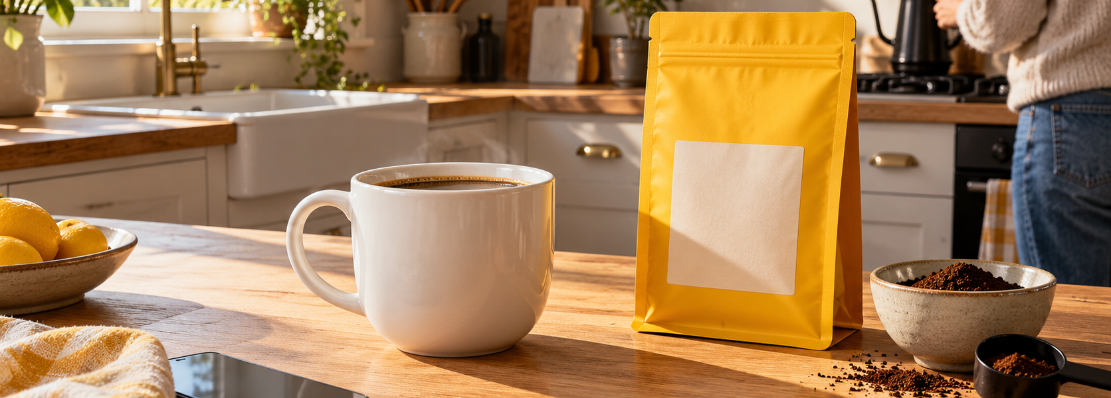
SKETCHBOOK / RAVE COFFEE 03 / VISUAL WORLD + ART DIRECTION
MORNING, NOT THEATRE.
LIVED-IN
LEGIBLE
NEVER
Domestic kitchens. Natural light. A real morning already in progress.
One hero element. Product clear. Yellow present in every asset.
Hessian. Coffee cherries. Latte art. Moody roastery. Barista theatre.
INTERNAL / NOT CLIENT APPROVED
CAMPAIGN WORLD V3 / CREATIVE ILLUSTRATION
03 / 05
Notes:
Source: NOS-CAMPAIGNWORLD-RAVE-v3 visual world, colour, composition and anti-reference guidance.
The image is an internal AI-generated art-direction reference, not client photography or a representation of current Rave packaging.
Rave Yellow #FFC700 is preserved as the recurring brand signal.

Slide 4
SKETCHBOOK / RAVE COFFEE 04 / CAMPAIGN TERRITORY
THE ANTI-SNOB
Make category theatre visible — then make Rave's directness feel like relief.
THE REPEATABLE CONSTRUCTION
TASTING NOTES:
THEATRE.
1. Name the convention.
2. Cut through it.
3. Replace it with one useful truth.
ROAST DATE:
EVERYTHING.
Distinctive by voice. Useful by design.
INTERNAL / NOT CLIENT APPROVED
SOURCE CREATIVE / CREATIVE ILLUSTRATION
04 / 05
Notes:
Source: NOS-CAMPAIGNWORLD-RAVE-v3, Territory 1: The Anti-Snob and Asset 05 type-card direction.
Campaign language is an internal creative proposition, not a substantiated comparative product claim.
Before external use, copy requires product, legal and brand review against current Rave evidence.

Slide 5
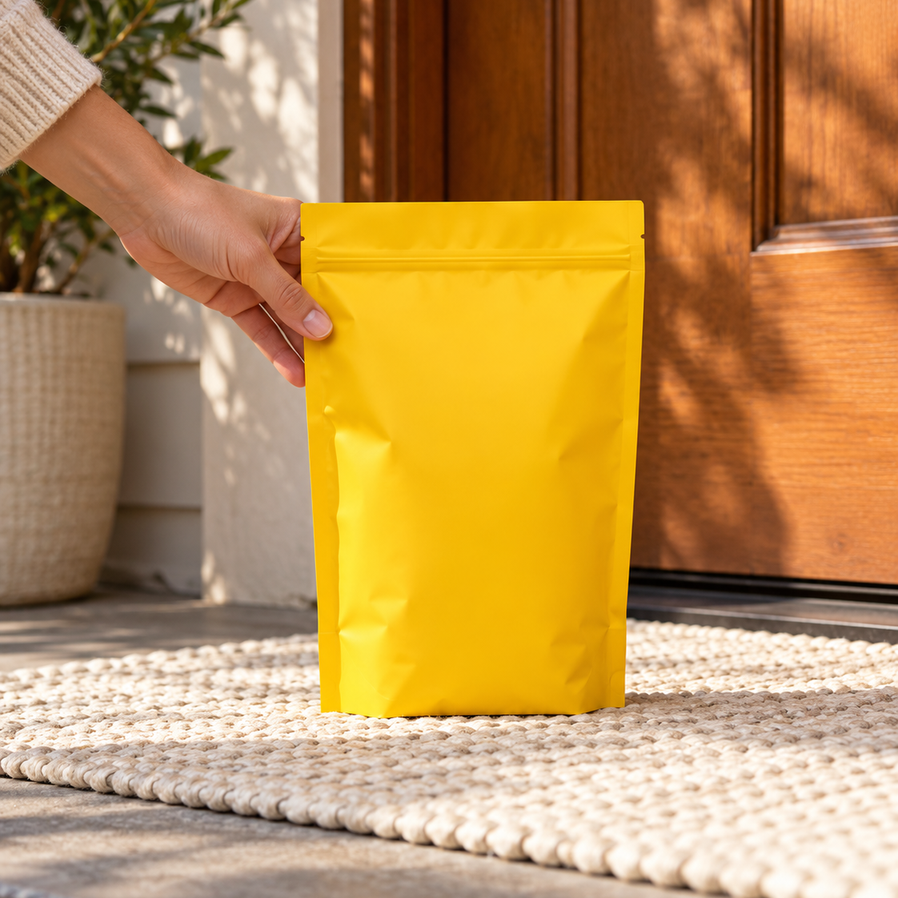
SKETCHBOOK / RAVE COFFEE 05 / EXECUTIONS + APPLICATIONS
ONE WORLD. THREE WAYS IN.
Type creates recognition. Delivery makes freshness tangible. Guidance removes the first-choice barrier.
ORGANIC SOCIAL
PAID SOCIAL
QUIZ ENTRY
NO TASTING
NOTES.
JUST GREAT
COFFEE.
NOT SURE
WHERE TO
START?
TAKE THE QUIZ.
A low-pressure first step into better coffee.
ROASTED TUESDAY 7AM.
AT YOUR DOOR THURSDAY.
FIND MY COFFEE →
Illustrative timestamp — replace only with verified operations data.
Prototype interaction — verify current quiz journey before use.
INTERNAL / NOT CLIENT APPROVED
CREATIVE ILLUSTRATION / NOT LIVE MEDIA
05 / 05
Notes:
Source: NOS-CAMPAIGNWORLD-RAVE-v3, Assets 03, 05 and 12 plus channel applications.
All three executions are internal creative illustrations. They are not published, activated, approved or performance-tested.
The delivery timestamp is illustrative and must be replaced with verified operational data. The quiz CTA must be checked against Rave's current live journey before external use.

