Slide 1
HTML & CSS
Narendran.S, 5250, 93405

Slide 2
Html – Hypertext Markup Language
Lays down the foundation and forms the basic structure for your webpage.
Css – Cascading Style Sheets
Helps in making the webpage attractive and interactive.

Slide 3
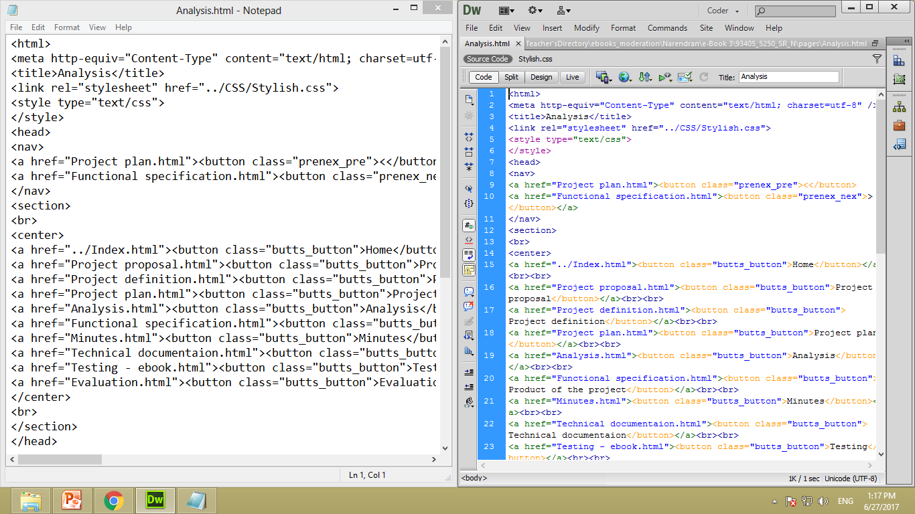
Two ways of creating - using a notepad or a web authoring software

Slide 4
class= “~”
id = “~:”
A
A
B
C
B
C

Slide 5
div class= “~”
div class= “~”
class= “~”
id = “~:”
B
C
B
C
A
A
1
2
3
1
2
3

Slide 6
<style>
#~: {
property: specifics;
};
.~{
property: specifics;
};
</style>

Slide 7
<link rel="stylesheet“ href=“name.css">
B
C
B
C
A
A
1
2
3
1
2
3

Slide 8

Few of the things possible by hover properties
A
A
C
C
AS.html

