Slide 1
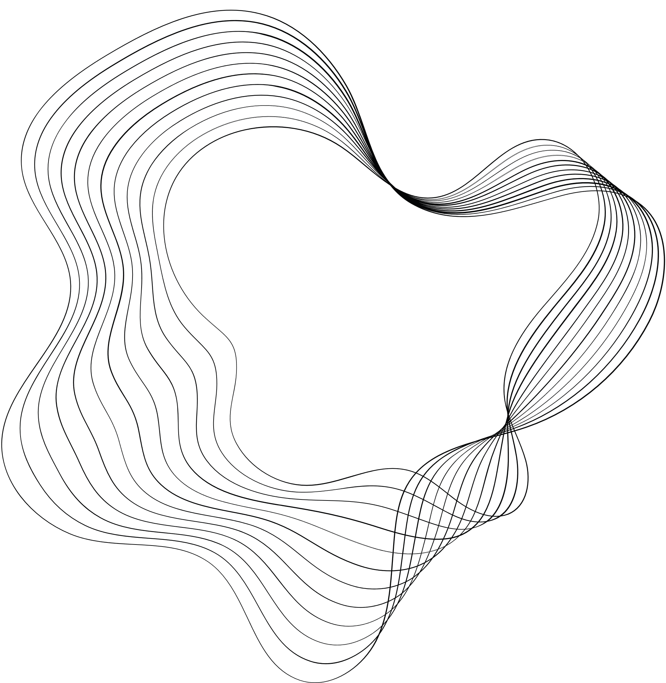

VISHWAKARMA INSTITUTE OF TECHNOLOGY
ENGINEERING DESIGN AND INNOVATION PROJECT
ROBUST ENCRYPTION AND ACCESS CONTROL MECHANISMS FOR ENSURING CONFIDENTIALITY IN CLOUD-BASED DATA STORAGE
GUIDED BY:PROF SMT SWATI JADHAV
Group: TY-60
1 - ELTON LOBO - 12210032
2 - LALROPUIA SAILO- 1221
3 - ADITYA NARSALE- 12211502
5 - PALAASH PADMAN- 12211235

Slide 2
CONTENTS
INTRODUCTION
PROBLEM STATEMENT
OBJECTIVE
SYSTEM ARCHITECTURE
METHODOLOGY
GCP IMPLEMENTATION
DOMAIN KNOWLEDGE
TOOLS USED
LITERATURE SURVEY

Slide 3
INTRODUCTION
Dependence on Cloud Storage: Cloud servers reduce local storage needs but pose new risks.
Loss of Privacy: Users risk unauthorized access and misuse of their personal images.
Security Risks: Cloud servers are vulnerable to cyberattacks and data breaches.
Insider Threats: Employees with access can misuse data, causing potential leaks.
Encryption Challenges: Managing secure encryption can be difficult for users.
Legal Concerns: Storing images on foreign servers raises privacy and jurisdiction issues.

Slide 4
Problem Statement
Addressing Privacy and Security Concerns: With the growing use of cloud storage, protecting image privacy and ensuring security is crucial.
Privacy-Preserving Retrieval: Develop a JPEG image retrieval scheme that safeguards user data from unauthorized access.
Minimized File Size Expansion: Ensure that the retrieval process does not significantly increase the file size, optimizing storage.
Reduced Computational Overhead: Design the system to be efficient and resource-light, avoiding heavy processing requirements.
Practical Implementation: Balance robust security, minimal file expansion, and low computational demands for real-world usability.
Notes:
CBlR while maintaining the privacy of the images.
compatible with JPEG compression-images remain encrypted and secure during retrieval.
The encrypted image should not be significantly larger than the original image. The process of encrypting and decrypting images should require as little additional computing power and time as possible. As on the cloud now, this makes it efficient.
5

Slide 5
Objective
Maintain Privacy and Confidentiality of Images:
Develop an encryption scheme that secures JPEG images before uploading to the cloud, protecting them from unauthorized access.
Enable Efficient Image Retrieval:
Implement a method that allows the cloud server to perform Content-Based Image Retrieval (CBIR) on encrypted images without needing decryption.
Preserve Local Features of Images:
Design the encryption process to retain local image features necessary for accurate image similarity analysis.
Support Scalable Retrieval:
Ensure the retrieval process can handle large datasets efficiently, using techniques like feature vector generation, clustering, and vocabulary creation.

Slide 6
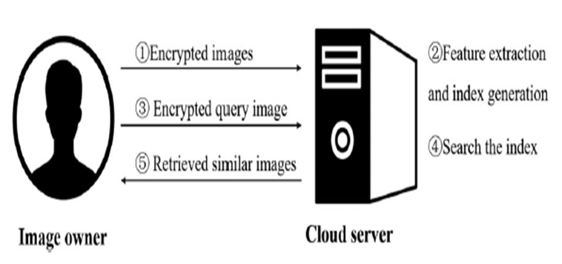
System Architecture
Two entities: the image owner and cloud server
The image owner encrypts the images and uploads them to the cloud server
Cloud calculates features from the ciphertext images to provide the similar image retrieval service
If the owner needs to retrieve the similar images to a query, he encrypts the query image and sends it
The cloud extracts features from it and search the similar ones by comparing the distances between the feature vector of query image and that of database images
Similar images are return to the owner for decryption

Slide 7
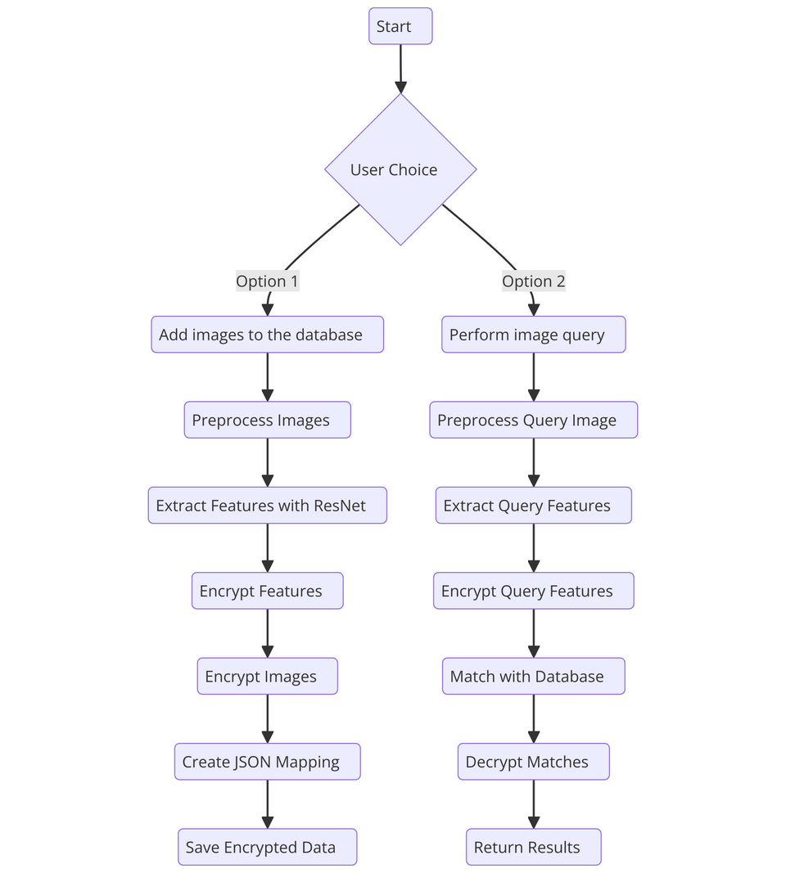
METHODOLOGY

Slide 8
Methodology
1. Data Preprocessing
Input images are collected and preprocessed to standardize size, scale, and format.
Pretrained ResNet model is used (excluding the classification layer) to extract feature vectors that represent the image’s unique characteristics.
2. Secure Encryption Mechanisms
AES (Advanced Encryption Standard):
Used to encrypt raw image data for secure storage.
Ensures images are protected against unauthorized access.
CKKS (Cheon-Kim-Kim-Song):
A homomorphic encryption scheme designed for computations on encrypted data.
Feature vectors extracted from ResNet are encrypted using CKKS with a public key.
Encrypted vectors are stored in .pkl format for privacy-preserving retrieval.

Slide 9
Methodology
3. Privacy-Preserving Feature Matching
Query images undergo the same ResNet feature extraction process.
The query feature vector is encrypted using the same CKKS key.
Cosine Similarity is computed between the encrypted query vector and stored vectors to identify matches.
4. Decryption for Similarity Validation
Matching feature vectors are decrypted using the CKKS secret key.
Cosine similarity scores are compared against a defined threshold (e.g., 80%) to confirm a match.
Key Benefits
AES protects sensitive image data.
CKKS ensures feature vectors remain encrypted during storage and matching operations.
ResNet’s deep learning capabilities enable accurate feature representation, while cosine similarity ensures reliable comparison.

Slide 10
GCP IMPLEMENTATION
Start
Set Up Project: Create a GCP project, enable billing and APIs (Cloud Storage, Functions, Run)
Design Storage: Use GCS for encrypted images and feature vectors, organize by user/project
Backend Logic:
Image Upload: Encrypt and store images in GCS
Query Processing: Encrypt query and match features
Similarity Matching: Compare vectors and rank results
Compute Resources:
Cloud Functions: Preprocessing and feature extraction
Cloud Run: Host similarity matching
Vertex AI (Optional): Train ML models

Slide 11
GCP IMPLEMENTATION
Database:
Use Firestore for storing metadata (user IDs, image paths) in a flexible NoSQL format.
Use Cloud SQL for structured, relational data storage if needed.
Security:
Use Cloud KMS to manage AES and CKKS encryption keys for secure data handling.
Implement IAM roles with least-privilege access for controlling service permissions.
Deploy App:
Host the frontend on Firebase Hosting for fast content delivery.
Deploy the backend to Cloud Run for scalability and Cloud Functions for event-driven tasks like preprocessing.
Monitoring:
Enable Cloud Logging to track logs and troubleshoot.
Use Cloud Monitoring to monitor performance, set resource usage alerts, and track system health.

Slide 12
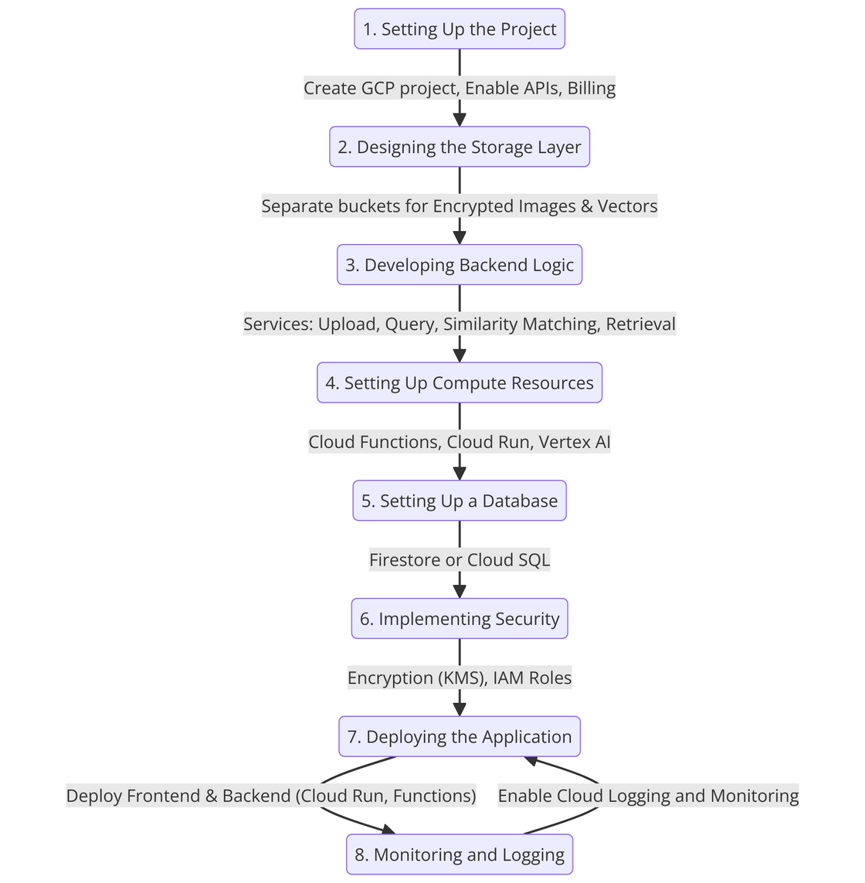
GCP IMPLEMENTATION

Slide 13
Domain Knowledge
Image Processing:
involves the manipulation and analysis of digital images to enhance their quality, extract valuable information, or prepare them for further analysis.
Cryptography:
practice of securing information by converting it into an unreadable format through encryption, ensuring that only authorized parties can access the data
Content-Based Image Retrieval (CBIR):
technique that enables the retrieval of images from a database based on visual content such as color, texture, and shape rather than textual metadata
Machine Learning:
branch of artificial intelligence that focuses on developing algorithms that allow computers to learn from and make decisions based on data.
Cloud Computing:
provides on-demand access to computing resources such as servers, storage, and applications over the internet

Slide 14
Tools used
Google Cloud Platform (GCP)
Compute Engine, Cloud Storage, Cloud Functions, Vertex AI
Python
Matplotlib
OpenCV
Replit, TensorFlow

Slide 15
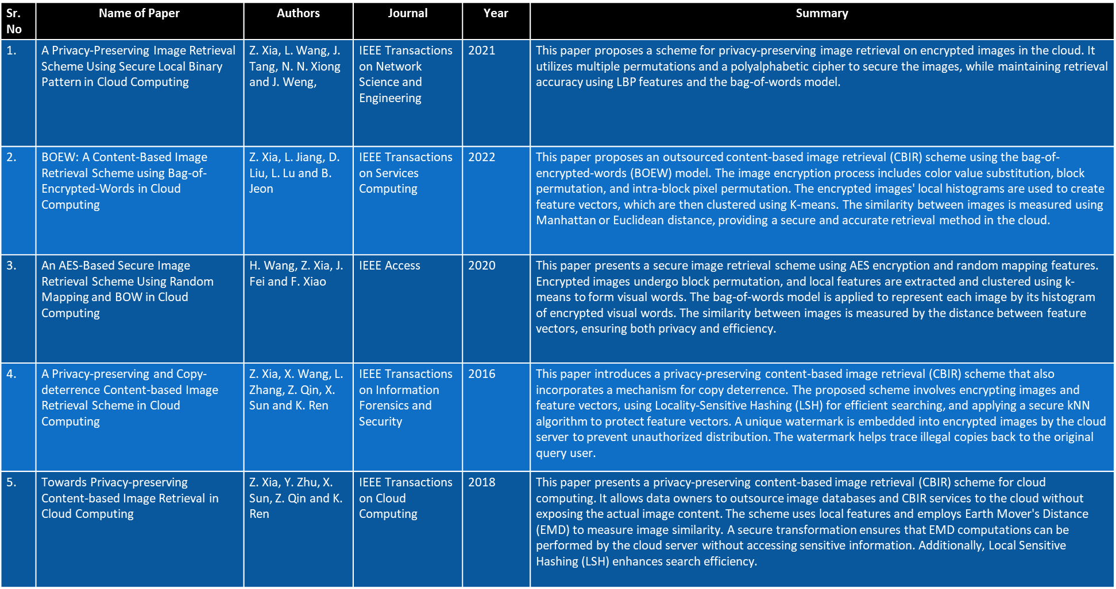
Literature survey

Slide 16
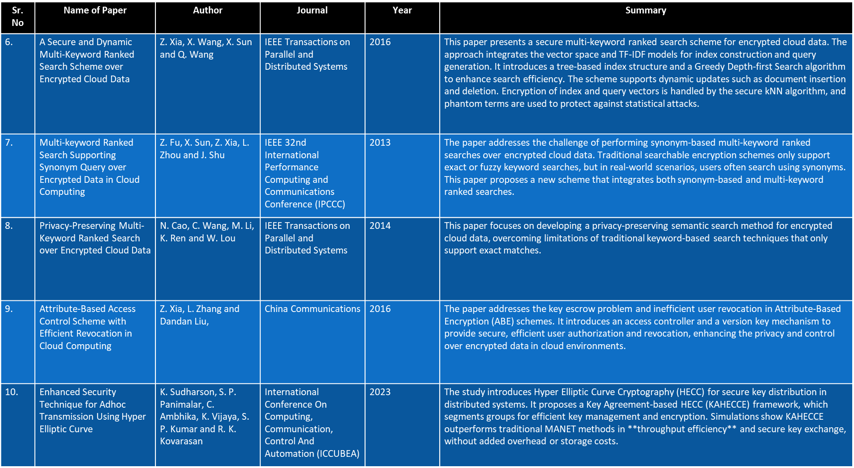
Literature survey

Slide 17
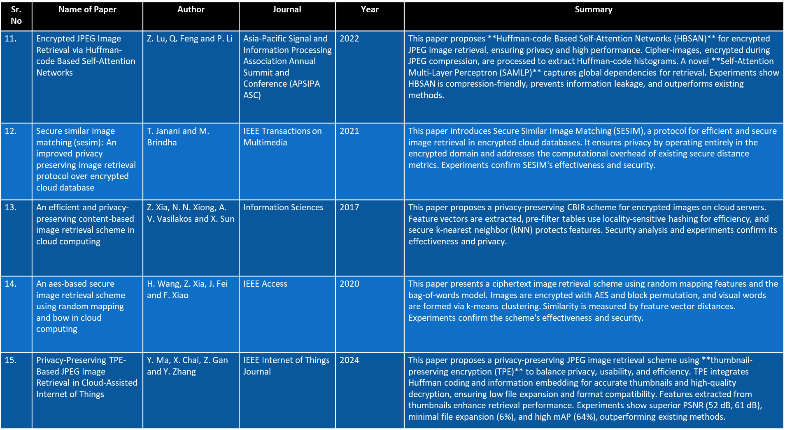
Literature survey

Slide 18
References
• C. Liu, Z. Liu, M. Li, and J. Han, “Towards Privacy-Preserving Content-Based Image Retrieval in Cloud Computing,” IEEE Transactions on Cloud Computing, vol. 8, no. 4, pp. 1361–1373, Oct.-Dec. 2020. doi: 10.1109/TCC.2017.2750198.
• Z. Fu, X. Sun, Q. Liu, L. Zhou, and J. Shu, “Achieving Efficient Cloud Search Services: Multi-Keyword Ranked Search Over Encrypted Cloud Data Supporting Synonym Query,” IEEE Transactions on Consumer Electronics, vol. 60, no. 1, pp. 164–172, Feb. 2014. doi: 10.1109/TCE.2014.6780930.
• M. Li, Y. Zhu, X. Sun, and T. Zhang, “Privacy-Preserving Keyword-Based Semantic Search Over Encrypted Cloud Data,” IEEE Transactions on Cloud Computing, vol. 5, no. 3, pp. 546–558, July-Sept. 2017. doi: 10.1109/TCC.2016.2555811.
• J. Hur and K. Kang, “Attribute-Based Access Control with Efficient Revocation in Data Outsourcing Systems,” IEEE Transactions on Parallel and Distributed Systems, vol. 25, no. 8, pp. 1907–1916, Aug. 2014. doi: 10.1109/TPDS.2013.252.

Slide 19
References
• W. Zhang, S. Wang, W. Liu, and J. Yang, “A Privacy-Preserving Image Retrieval Scheme Using Secure Local Binary Pattern in Cloud Computing,” IEEE Transactions on Cloud Computing, vol. 7, no. 4, pp. 968–978, Dec. 2019. doi: 10.1109/TCC.2018.2877780.
• Z. Xia, Y. Zhu, X. Sun, Z. Qin, and K. Ren, “BOEW: A Content-Based Image Retrieval Scheme Using Bag-of-Encrypted-Words in Cloud Computing,” IEEE Transactions on Services Computing, vol. 10, no. 5, pp. 796–808, Sept.-Oct. 2017. doi: 10.1109/TSC.2016.2515589.
• Q. Liu, C. C. Chang, and L. Chen, “An AES-Based Secure Image Retrieval Scheme Using Random Mapping and BOW in Cloud Computing,” Multimedia Tools and Applications, vol. 76, no. 15, pp. 16033–16050, Aug. 2017. doi: 10.1007/s11042-016-3976-4.
• C. Liu, Z. Liu, M. Li, and J. Han, “Towards Privacy-Preserving Content-Based Image Retrieval in Cloud Computing,” IEEE Transactions on Cloud Computing, vol. 8, no. 4, pp. 1361–1373, Oct.-Dec. 2020. doi: 10.1109/TCC.2017.2750198.

Slide 20
Thank you

