Slide 1
mHealth NLP Project Update
Narshion Ngao, 27th May 2019

Slide 2
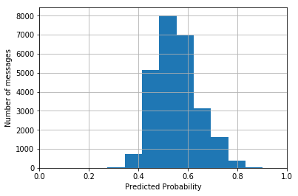
Logistic Regression
Features: edd, language, chars, words
Test | Results
Accuracy_score | 57.95
Roc_auc | 55.76
K-fold CV (accuracy) | 57.95

Slide 3
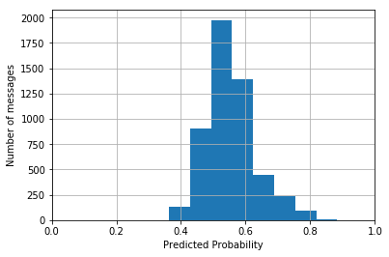
Edd and Language only
Test | Results
Accuracy_score | 57.71
Roc_auc_score | 57.95
K-fold CV (average accuracy) | -

Slide 4
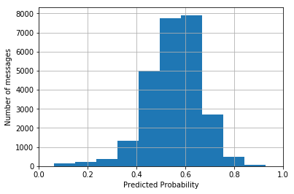
Logistic Regression with GB
Test | Results
Accuracy_score | 62.63
Roc_auc_score | 60.37
K-fold CV (accuracy) | -

Slide 5
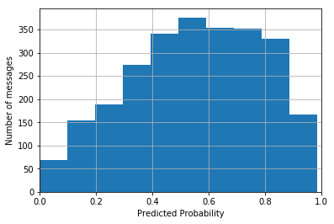
BoW Only
Test | Results
Accuracy_score | 69.45
Roc_auc_score | 68.60
K-fold CV (average accuracy) with GB | -

Slide 6
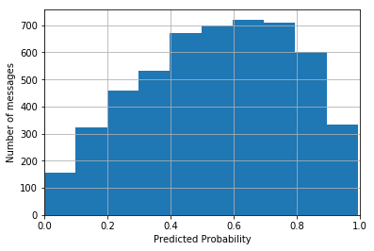
BoW With edd, language, chars, words
Test | Results
Accuracy_score | 69.22
Roc_auc_score | 76.50
K-fold CV (average accuracy) with GB | -

Slide 7
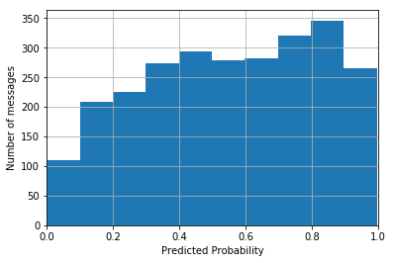
Bi-gram Only
Test | Results
Accuracy_score | 73.07
Roc_auc_score | 80.59
K-fold CV (average accuracy) with GB | -

Slide 8
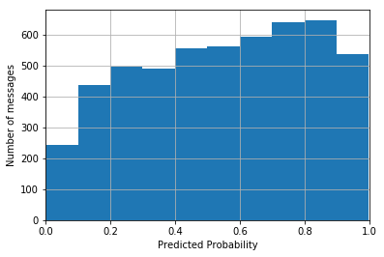
Bi-gram with edd, language, chars, words
Test | Results
Accuracy_score | 72.07
Roc_auc_score | 79.80
K-fold CV (average accuracy) with GB | -

Slide 9
Word2Vec

Slide 10
Doc2Vec

