Slide 1
CCNA 1 v7 Modules 4 – 7: Ethernet Concepts Exam

Slide 2
What is the purpose of the OSI physical layer?
controlling access to media
transmitting bits across the local media
performing error detection on received frames
exchanging frames between nodes over physical network media

Slide 3
Why are two strands of fiber used for a single fiber optic connection
The two strands allow the data to travel for longer distances without degrading.
They prevent crosstalk from causing interference on the connection.
They increase the speed at which the data can travel.
They allow for full-duplex connectivity.

Slide 4
Which characteristic describes crosstalk?
the distortion of the network signal from fluorescent lighting
the distortion of the transmitted messages from signals carried in adjacent wires
the weakening of the network signal over long cable lengths
the loss of wireless signal over excessive distance from the access point

Slide 5
Which procedure is used to reduce the effect of crosstalk in copper cables?
requiring proper grounding connections
twisting opposing circuit wire pairs together
wrapping the bundle of wires with metallic shielding
designing a cable infrastructure to avoid crosstalk interference
avoiding sharp bends during installation

Slide 6
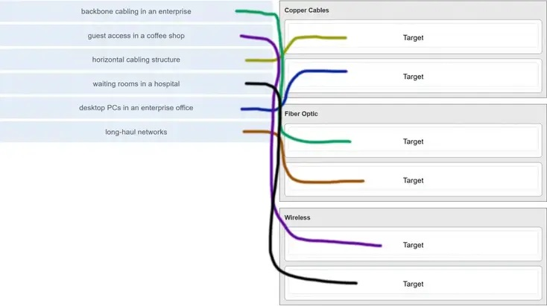
Match the situation with the appropriate use of network media.

Slide 7
A network administrator is measuring the transfer of bits across the company backbone for a mission critical financial application. The administrator notices that the network throughput appears lower than the bandwidth expected. Which three factors could influence the differences in throughput? (Choose three.)
the amount of traffic that is currently crossing the network
the sophistication of the encapsulation method applied to the data
the type of traffic that is crossing the network
the latency that is created by the number of network devices that the data is crossing
the bandwidth of the WAN connection to the Internet
the reliability of the gigabit Ethernet infrastructure of the backbone
Explanation: Throughput usually does not match the specified bandwidth of physical links due to multiple factors. These factors include, the amount of traffic, type of traffic, and latency created by the network devices the data has to cross.

Slide 8
What are two characteristics of fiber-optic cable? (Choose two.)
It is not affected by EMI or RFI.
Each pair of cables is wrapped in metallic foil.
It combines the technique of cancellation, shielding, and twisting to protect data.
It typically contains 4 pairs of fiber-optic wires.
It is more expensive than UTP cabling is.
Explanation: Fiber-optic cabling supports higher bandwidth than UTP for longer distances. Fiber is immune to EMI and RFI, but costs more, requires more skill to install, and requires more safety precautions.

Slide 9
What is a primary role of the Physical layer in transmitting data on the network?
create the signals that represent the bits in each frame on to the media
provide physical addressing to the devices
determine the path packets take through the network
control data access to the media
Explanation: The OSI physical layer provides the means to transport the bits that make up a frame across the network media. This layer accepts a complete frame from the data link layer and encodes it as a series of signals that are transmitted to the local media.

Slide 10
With the use of unshielded twisted-pair copper wire in a network, what causes crosstalk within the cable pairs?
he magnetic field around the adjacent pairs of wire
the use of braided wire to shield the adjacent wire pairs
the reflection of the electrical wave back from the far end of the cable
the collision caused by two nodes trying to use the media simultaneousl
Explanation: Crosstalk is a type of noise, or interference that occurs when signal transmission on one wire interferes with another wire. When current flows through a wire a magnetic field is produced. The produced magnetic field will interface the signal carried in the adjacent wire.

