Slide 1
Permutations and Combinations
CS/APMA 202
Rosen section 4.3
Aaron Bloomfield

Slide 2
Permutations vs. Combinations
Both are ways to count the possibilities
The difference between them is whether order matters or not
Consider a poker hand:
  A♦, 5♥, 7♣, 10♠, K♠
Is that the same hand as:
  K♠, 10♠, 7♣, 5♥, A♦
Does the order the cards are handed out matter?
  If yes, then we are dealing with permutations
  If no, then we are dealing with combinations

Slide 3
Permutations
A permutation is an ordered arrangement of the elements of some set S
  Let S = {a, b, c}
  c, b, a is a permutation of S
  b, c, a is a different permutation of S
An r-permutation is an ordered arrangement of r elements of the set
  A♦, 5♥, 7♣, 10♠, K♠ is a 5-permutation of the set of cards
The notation for the number of r-permutations: P(n,r)
  The poker hand is one of P(52,5) permutations

Slide 4
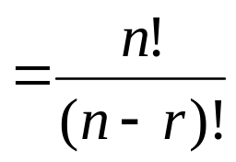
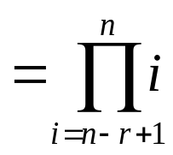
Permutations
Number of poker hands (5 cards):
  P(52,5) = 52*51*50*49*48 = 311,875,200
Number of (initial) blackjack hands (2 cards):
  P(52,2) = 52*51 = 2,652
r-permutation notation: P(n,r)
  The poker hand is one of P(52,5) permutations

Slide 5
r-permutations example
How many ways are there for 5 people in this class to give presentations?
There are 27 students in the class
  P(27,5) = 27*26*25*24*23 = 9,687,600
  Note that the order they go in does matter in this example!

Slide 6
Permutation formula proof
There are n ways to choose the first element
  n-1 ways to choose the second
  n-2 ways to choose the third
  …
  n-r+1 ways to choose the r^{th} element
By the product rule, that gives us:
P(n,r) = n(n-1)(n-2)…(n-r+1)

Slide 7
Permutations vs. r-permutations
r-permutations: Choosing an ordered 5 card hand is P(52,5)
  When people say “permutations”, they almost always mean r-permutations
    But the name can refer to both
Permutations: Choosing an order for all 52 cards is P(52,52) = 52!
  Thus, P(n,n) = n!

Slide 8
Rosen, section 4.3, question 3
How many permutations of {a, b, c, d, e, f, g} end with a?
  Note that the set has 7 elements
The last character must be a
  The rest can be in any order
Thus, we want a 6-permutation on the set {b, c, d, e, f, g}
P(6,6) = 6! = 720
Why is it not P(7,6)?

Slide 9
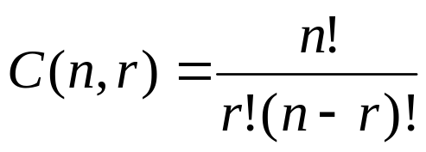
Combinations
What if order doesn’t matter?
In poker, the following two hands are equivalent:
  A♦, 5♥, 7♣, 10♠, K♠
  K♠, 10♠, 7♣, 5♥, A♦
The number of r-combinations of a set with n elements, where n is non-negative and 0≤r≤n is:

Slide 10
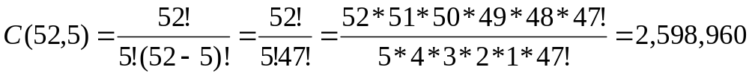
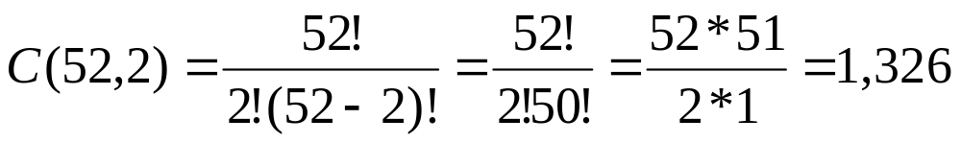
Combinations example
How many different poker hands are there (5 cards)?
How many different (initial) blackjack hands are there?

Slide 11
Combination formula proof
Let C(52,5) be the number of ways to generate unordered poker hands
The number of ordered poker hands is P(52,5) = 311,875,200
The number of ways to order a single poker hand is P(5,5) = 5! = 120
The total number of unordered poker hands is the total number of ordered hands divided by the number of ways to order each hand
Thus, C(52,5) = P(52,5)/P(5,5)

Slide 12
Combination formula proof
Let C(n,r) be the number of ways to generate unordered combinations
The number of ordered combinations (i.e. r-permutations) is P(n,r)
The number of ways to order a single one of those r-permutations P(r,r)
The total number of unordered combinations is the total number of ordered combinations (i.e. r-permutations) divided by the number of ways to order each combination
Thus, C(n,r) = P(n,r)/P(r,r)

Slide 13
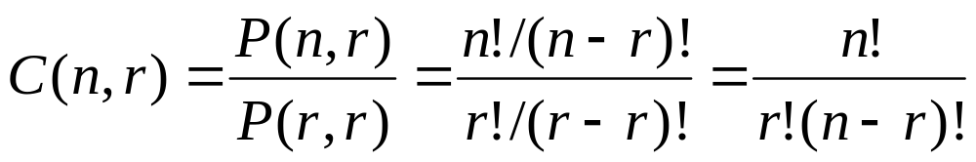
Combination formula proof
Note that the textbook explains it slightly differently, but it is same proof

Slide 14
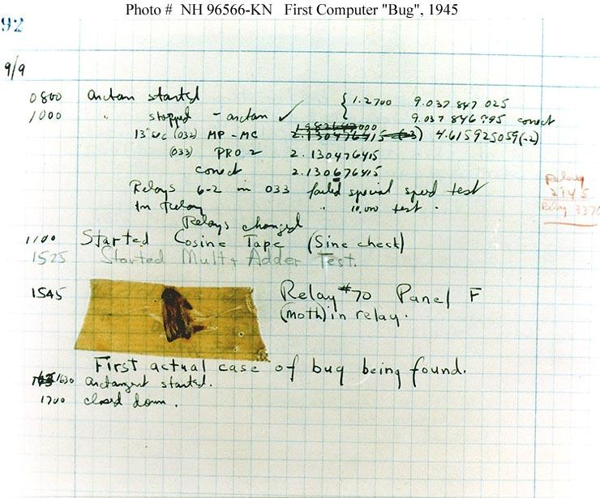
Computer bugs

Slide 15

Rosen, section 4.3, question 11
How many bit strings of length 10 contain:
exactly four 1’s?
  Find the positions of the four 1’s
  Does the order of these positions matter?
    Nope!
    Positions 2, 3, 5, 7 is the same as positions 7, 5, 3, 2
  Thus, the answer is C(10,4) = 210
at most four 1’s?
  There can be 0, 1, 2, 3, or 4 occurrences of 1
  Thus, the answer is:
    C(10,0) + C(10,1) + C(10,2) + C(10,3) + C(10,4)
    = 1+10+45+120+210
    = 386

Slide 16
End of lecture on 30 March 2005

Slide 17
Rosen, section 4.3, question 11
How many bit strings of length 10 contain:
at least four 1’s?
  There can be 4, 5, 6, 7, 8, 9, or 10 occurrences of 1
  Thus, the answer is:
    C(10,4) + C(10,5) + C(10,6) + C(10,7) + C(10,8) + C(10,9) + C(10,10)
    = 210+252+210+120+45+10+1
    = 848
  Alternative answer: subtract from 2¹⁰ the number of strings with 0, 1, 2, or 3 occurrences of 1
an equal number of 1’s and 0’s?
  Thus, there must be five 0’s and five 1’s
  Find the positions of the five 1’s
  Thus, the answer is C(10,5) = 252

Slide 18
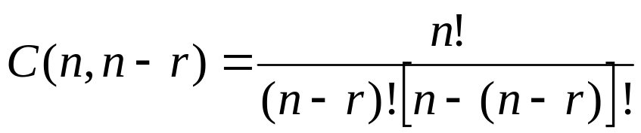
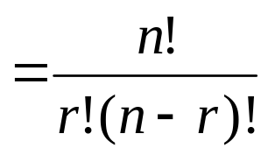
Corollary 1
Let n and r be non-negative integers with
r ≤ n. Then C(n,r) = C(n,n-r)
Proof:

Slide 19
Corollary example
There are C(52,5) ways to pick a 5-card poker hand
There are C(52,47) ways to pick a 47-card hand
P(52,5) = 2,598,960 = P(52,47)
When dealing 47 cards, you are picking 5 cards to not deal
  As opposed to picking 5 card to deal
  Again, the order the cards are dealt in does matter

Slide 20
Combinatorial proof
A combinatorial proof is a proof that uses counting arguments to prove a theorem
  Rather than some other method such as algebraic techniques
Essentially, show that both sides of the proof manage to count the same objects
In a typical Rosen example, he does not do much with this proof method in this section
  We will see more in the next sections
Most of the questions in this section are phrased as, “find out how many possibilities there are if …”
  Instead, we could phrase each question as a theorem:
  “Prove there are x possibilities if …”
  The same answer could be modified to be a combinatorial proof to the theorem

Slide 21
Rosen, section 4.3, question 40
How many ways are there to sit 6 people around a circular table, where seatings are considered to be the same if they can be obtained from each other by rotating the table?
First, place the first person in the north-most chair
  Only one possibility
Then place the other 5 people
  There are P(5,5) = 5! = 120 ways to do that
By the product rule, we get 1*120 =120
Alternative means to answer this:
There are P(6,6)=720 ways to seat the 6 people around the table
For each seating, there are 6 “rotations” of the seating
Thus, the final answer is 720/6 = 120

Slide 22
Rosen, section 4.3, question 42
How many ways are there for 4 horses to finish if ties are allowed?
  Note that order does matter!
Solution by cases
  No ties
    The number of permutations is P(4,4) = 4! = 24
  Two horses tie
    There are C(4,2) = 6 ways to choose the two horses that tie
    There are P(3,3) = 6 ways for the “groups” to finish
      A “group” is either a single horse or the two tying horses
    By the product rule, there are 6*6 = 36 possibilities for this case
  Two groups of two horses tie
    There are C(4,2) = 6 ways to choose the two winning horses
    The other two horses tie for second place
  Three horses tie with each other
    There are C(4,3) = 4 ways to choose the two horses that tie
    There are P(2,2) = 2 ways for the “groups” to finish
    By the product rule, there are 4*2 = 8 possibilities for this case
  All four horses tie
    There is only one combination for this
  By the sum rule, the total is 24+36+6+8+1 = 75

Slide 23
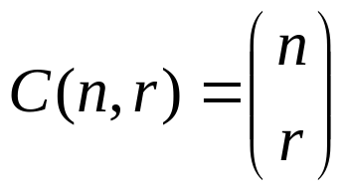
A last note on combinations
An alternative (and more common) way to denote an r-combination:
I’ll use C(n,r) whenever possible, as it is easier to write in PowerPoint

Slide 24
Quick survey
I felt I understood the material in this slide set…
Very well
With some review, I’ll be good
Not really
Not at all

Slide 25
Quick survey
The pace of the lecture for this slide set was…
Fast
About right
A little slow
Too slow

Slide 26
Quick survey
How interesting was the material in this slide set? Be honest!
Wow! That was SOOOOOO cool!
Somewhat interesting
Rather borting
Zzzzzzzzzzz

Slide 27
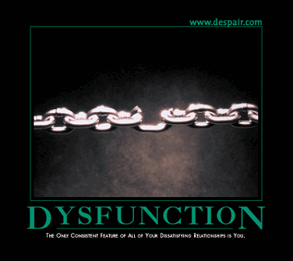

Demotivators

