Slide 1

Combinatorics
Rosen 6th ed., §5.1-5.3, § 5.5

Slide 2
Combinatorics
Count the number of ways to put things together into various combinations.
  e.g. If a password is 6-8 letters and/or digits, how many passwords can there be?
Two main rules:
  Sum rule
  Product rule

Slide 3
Sum Rule
Let us consider two tasks:
  m is the number of ways to do task 1
  n is the number of ways to do task 2
  Tasks are independent of each other, i.e.,
    Performing task 1 does not accomplish task 2 and vice versa.
Sum rule: the number of ways that “either task 1 or task 2 can be done, but not both”, is m+n.
Generalizes to multiple tasks ...

Slide 4
Example
A student can choose a computer project from one of three lists. The three lists contain 23, 15, and 19 possible projects respectively. How many possible projects are there to choose from?

Slide 5
Set Theoretic Version
If A is the set of ways to do task 1, and B the set of ways to do task 2, and if A and B are disjoint, then:
“the ways to do either task 1 or 2 are
A∪B, and |A∪B|=|A|+|B|”

Slide 6
Product Rule
Let us consider two tasks:
  m is the number of ways to do task 1
  n is the number of ways to do task 2
  Tasks are independent of each other, i.e.,
    Performing task 1does not accomplish task 2 and vice versa.
Product rule: the number of ways that “both tasks 1 and 2 can be done” in mn.
Generalizes to multiple tasks ...

Slide 7
Example
The chairs of an auditorium are to be labeled with a letter and a positive integer not to exceed 100. What is the largest number of chairs that can be labeled differently?

Slide 8
Set Theoretic Version
If A is the set of ways to do task 1, and B the set of ways to do task 2, and if A and B are disjoint, then:
The ways to do both task 1 and 2 can be represented as A×B, and |A×B|=|A|·|B|

Slide 9
More Examples
How many different bit strings are there of length seven?

Slide 10
More Examples
Suppose that either a member of the CS faculty or a student who is a CS major can be on a university committee. How many different choices are there if there are 37 CS faculty and 83 CS majors ?

Slide 11
More Examples
How many different license plates are available if each plate contains a sequence of three letters followed by three digits?

Slide 12
More Examples
What is the number of different subsets of a finite set S ?

Slide 13
Example Using Both Rules
Each user on a computer system has a password, which is six to eight characters long where each character is an uppercase letter or a digit. Each password must contain at least one digit. How many possible passwords are there?

Slide 14
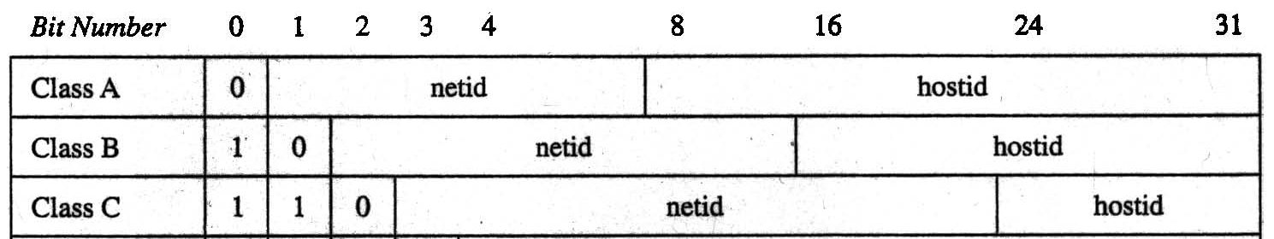
IP Address Example
(Internet Protocol vers. 4)
Main computer addresses are in one of 3 types:
  Class A: address contains a 7-bit “netid” ≠ 1⁷, and a 24-bit “hostid”
  Class B: address has a 14-bit netid and a 16-bit hostid.
  Class C: address has 21-bit netid and an 8-bit hostid.
  Hostids that are all 0s or all 1s are not allowed.
How many valid computer addresses are there?

Slide 15
Example Using Both Rules:
IP address solution
(# addrs)
= (# class A) + (# class B) + (# class C)
  (by sum rule)
# class A = (# valid netids)·(# valid hostids)
  (by product rule)
(# valid class A netids) = 2⁷ − 1 = 127.
(# valid class A hostids) = 2²⁴ − 2 = 16,777,214.
Continuing in this fashion we find the answer is:
3,737,091,842 (3.7 billion IP addresses)

Slide 16
Inclusion-Exclusion Principle
(relates to the “sum rule”)
Suppose that k≤m of the ways of doing task 1 also simultaneously accomplishes task 2. (And thus are also ways of doing task 2.)
Then the number of ways to accomplish “Do either task 1 or task 2” is m+n−k.
Set theory: If A and B are not disjoint, then |A∪B|=|A|+|B|−|A∩B|.

Slide 17
Example
How many strings of length eight either start with a 1 bit or end with the two bit string 00?

Slide 18
More Examples
Hypothetical rules for passwords:
  Passwords must be 2 characters long.
  Each password must be a letter a-z, a digit 0-9, or one of the 10 punctuation characters !@#$%^&*().
  Each password must contain at least 1 digit or punctuation character.

Slide 19
Sol. Cont’d
A legal password has a digit or puctuation character in position 1 or position 2.
  These cases overlap, so the principle applies.
(# of passwords w. OK symbol in
position #1) = (10+10)·(10+10+26)
(# w. OK sym. in pos. #2): also 20·46
(# w. OK sym both places): 20·20
Answer: 920+920−400 = 1,440

Slide 20
Pigeonhole Principle
If k+1 objects are assigned to k places, then at least 1 place must be assigned ≥2 objects.
In terms of the assignment function:
  If f:A→B and |A|≥|B|+1, then some element of B has ≥2 pre-images under f.
  i.e., f is not one-to-one.

Slide 21
Example
How many students must be in class to guarantee that at least two students receive the same score on the final exam, if the exam is graded on a scale from 0 to 100 points?

Slide 22
Generalized Pigeonhole Principle
If N≥k+1 objects are assigned to k places, then at least one place must be assigned at least ⎡N/k⎤ objects.
e.g., there are N=280 students in this class. There are k=52 weeks in the year.
  Therefore, there must be at least 1 week during which at least ⎡280/52⎤= ⎡5.38⎤=6 students in the class have a birthday.

Slide 23
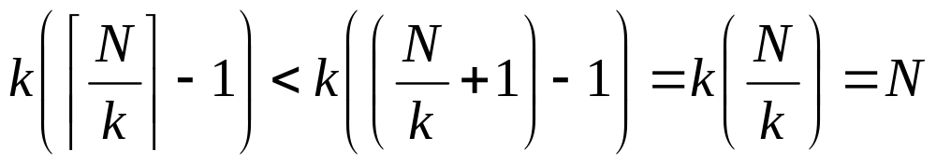
Proof of G.P.P.
By contradiction. Suppose every place has < ⎡N/k⎤ objects, thus ≤ ⎡N/k⎤−1.
Then the total number of objects is at most
So, there are less than N objects, which contradicts our assumption of N objects! □

Slide 24
G.P.P. Example
Given: There are 280 students in the class. Without knowing anybody’s birthday, what is the largest value of n for which we can prove that at least n students must have been born in the same month?
Answer:
⎡280/12⎤ = ⎡23.3⎤ = 24

Slide 25
More Examples
What is the minimum number of students required in a discrete math class to be sure that at least six will receive the same grade, if there are five possible grades, A, B, C, D, and F?

Slide 26
Permutations
A permutation of a set S of objects is an ordered arrangement of the elements of S where each element appears only once:
e.g., 1 2 3, 2 1 3, 3 1 2
An ordered arrangement of r distinct elements of S is called an r-permutation.
The number of r-permutations of a set S with n=|S| elements is
P(n,r) = n(n−1)…(n−r+1) = n!/(n−r)!

Slide 27
Example
How many ways are there to select a third-prize winner from 100 different people who have entered a contest?

Slide 28
More Examples
A terrorist has planted an armed nuclear bomb in your city, and it is your job to disable it by cutting wires to the trigger device.
There are 10 wires to the device.
If you cut exactly the right three wires, in exactly the right order, you will disable the bomb, otherwise it will explode!
If the wires all look the same, what are your chances of survival?
P(10,3) = 10·9·8 = 720,
so there is a 1 in 720 chance that you’ll survive!

Slide 29
More Examples
How many permutations of the letters ABCDEFG contain the string ABC?

Slide 30
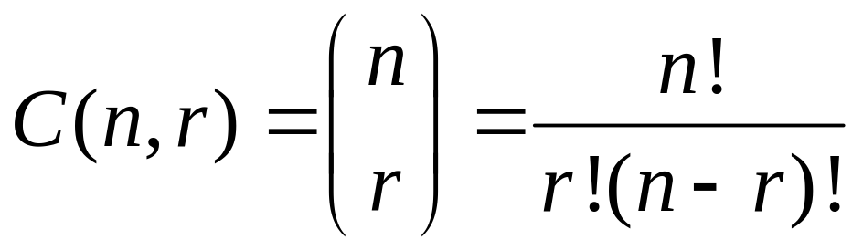
Combinations
The number of ways of choosing r elements from S (order does not matter).
S={1,2,3}
e.g., 1 2 , 1 3, 2 3
The number of r-combinations C(n,r) of a set with n=|S| elements is

Slide 31
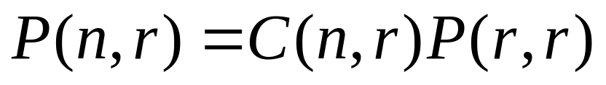
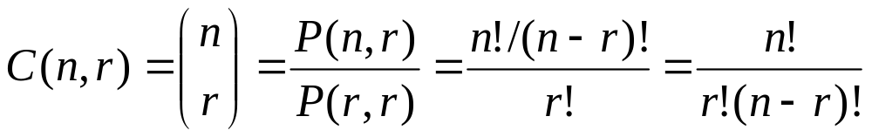
Combinations vs Permutations
Essentially unordered permutations …
Note that C(n,r) = C(n, n−r)

Slide 32
Combination Example
How many distinct 7-card hands can be drawn from a standard 52-card deck?
  The order of cards in a hand doesn’t matter.
Answer C(52,7) = P(52,7)/P(7,7)
= 52·51·50·49·48·47·46 / 7·6·5·4·3·2·1
17
10
7
8
2
52·17·10·7·47·46 = 133,784,560

Slide 33
More Examples
How many ways are there to select a committee to develop a discrete mathematics course if the committee is to consist of 3 faculty members from the Math department and 4 from the CS department, if there are 9 faculty members from Math and 11 from CS?

Slide 34
Generalized
Permutations and Combinations
How to solve counting problems where elements may be used more than once?
How to solve counting problems in which some elements are not distinguishable?
How to solve problems involving counting the ways we to place distinguishable elements in distinguishable boxes?

Slide 35

Permutations with Repetition
The number of r-permutations of a set of n objects with repetition allowed is
Example: How many strings of length n can be formed from the English alphabet?

Slide 36
Combinations with Repetition
The number of r-combinations from a set with n elements when repetition of elements is allowed are C(n+r-1,r)

Slide 37
Combinations with Repetition
Example: How many ways are there to select 5 bills from a cash box containing $1 bills, $2 bills, $5 bills, $10 bills, $20 bills, $50 bills, and $100 bills? Assume that the order in which bills are chosen does not matter and there are at least 5 bills of each type.

Slide 38
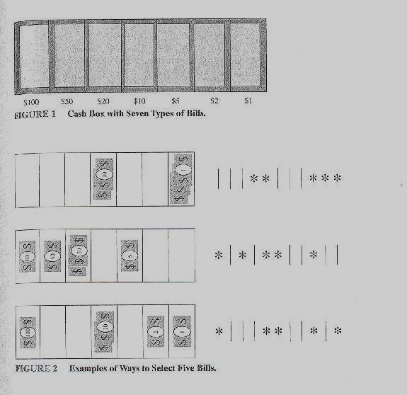
Combinations with Repetition
Approach: Place five markers in the compartments
i.e., # ways to arrange five stars and six bars ...
Solution: Select the positions of the 5 stars from 11 possible positions !
C(n+r-1,5)= C(7+5-1,5)=C(11,5)
n=7
r=5
compartments
and
dividers
markers

Slide 39
Combinations with Repetition
Example: How many ways are there to place 10 non-distinguishable balls into 8 distinguishable bins?

Slide 40
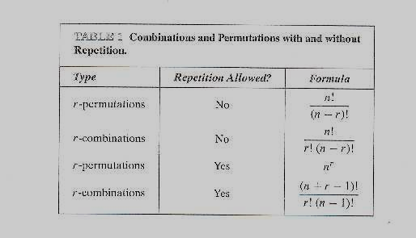
Permutations and Combinations with and without Repetition

Slide 41



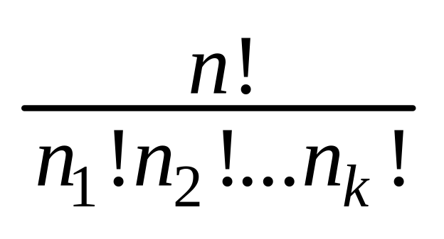



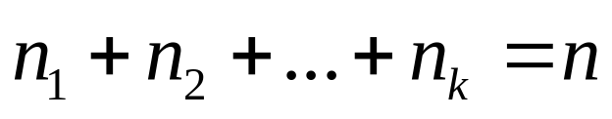
Permutations with non-distinguishable objects
The number of different permutations of n objects, where there are non-distinguishable objects of type 1, non-distinguishable objects of type 2, …, and non-distinguishable objects of type k, is
i.e., C(n, )C(n- , )…C(n- - -…- , )

Slide 42
Permutations with non-distinguishable objects
Example: How many different strings can be made by reordering the letters of the word
SUCCESS

Slide 43

Distributing Distinguishable
Objects into Distinguishable Boxes
The number of ways to distribute n distinguishable objects into k distinguishable boxes so that objects are placed into box i, i=1,2,…,k, equals

Slide 44
Distributing Distinguishable
Objects into Distinguishable Boxes
Example: How many ways are there to distribute hands of 5 cards to each of 4 players from the standard deck of 52 cards?

