Slide 1
ITN ( Version 7.00) Practice PT Skills Assessment (PTSA) Exam Answers

Slide 2
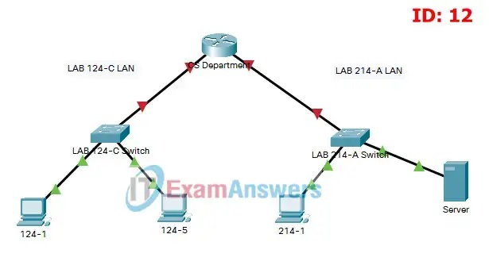
Topology

Slide 3
Requirements by device:
CS Department router:
Configuration of initial router settings
Interface configuration and IPv4 and IPv6 addressing
Device security enhancement, or device hardening
Secure transport for remote configuration connections as covered in the labs and Packet Tracers in the course.
LAB 214-A Switch: - Enabling basic remote management by Telnet - PC and Server hosts:
IPv4 full addressing
IPv6 addressing

Slide 4
Addressing Table

