Slide 1
Discrete Mathematics R204GA05401
Narasimhulu M_{M. Tech.}
Assistant Professor
Department of Computer Science & Engineering

Slide 2
Objectives
Narasimhulu M_{M. Tech.}
Assistant Professor
Department of Computer Science & Engineering

Slide 3
Objectives
This course will introduce and illustrate in the elementary discrete mathematics for computer science and engineering students.
To equip the students with standard concepts like formal logic notation, methods of proof, induction, sets, relations, graph theory, permutations and combinations, counting principles.

Slide 4
Course Outcomes
Narasimhulu M_{M. Tech.}
Assistant Professor
Department of Computer Science & Engineering

Slide 5
Course Outcomes
Illustrate discrete mathematic components like statements, logic, sets, structures, numbers and combinatorics.
Evaluate and simplify propositional and predicate calculus using inference theory.
Perform the operations on Sets, Relations and functions and their properties.
Identify algebraic systems and use general properties on number theory.
Use combinatorics solving the counting problems.
Use graph algorithms for representing, identifying, generating and evaluating the Graphs.

Slide 6
Unit II Set Theory
Narasimhulu M_{M. Tech.}
Assistant Professor
Department of Computer Science & Engineering

Slide 7
Unit II Set Theory
Introduction, Operations on Binary Sets, Principle of Inclusion and Exclusion,
Relations: Properties of Binary Relations, Relation Matrix and Digraph, Operations on Relations, Partition and Covering, Transitive Closure, Equivalence, Compatibility and Partial Ordering Relations, Hasse Diagrams,
Functions: Bijective Functions, Composition of Functions, Inverse Functions, Permutation Functions, Recursive Functions, Lattice and its Properties.

Slide 8
Introduction on Sets
Narasimhulu M_{M. Tech.}
Assistant Professor
Department of Computer Science & Engineering

Slide 9
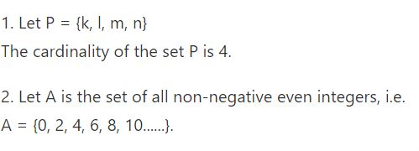
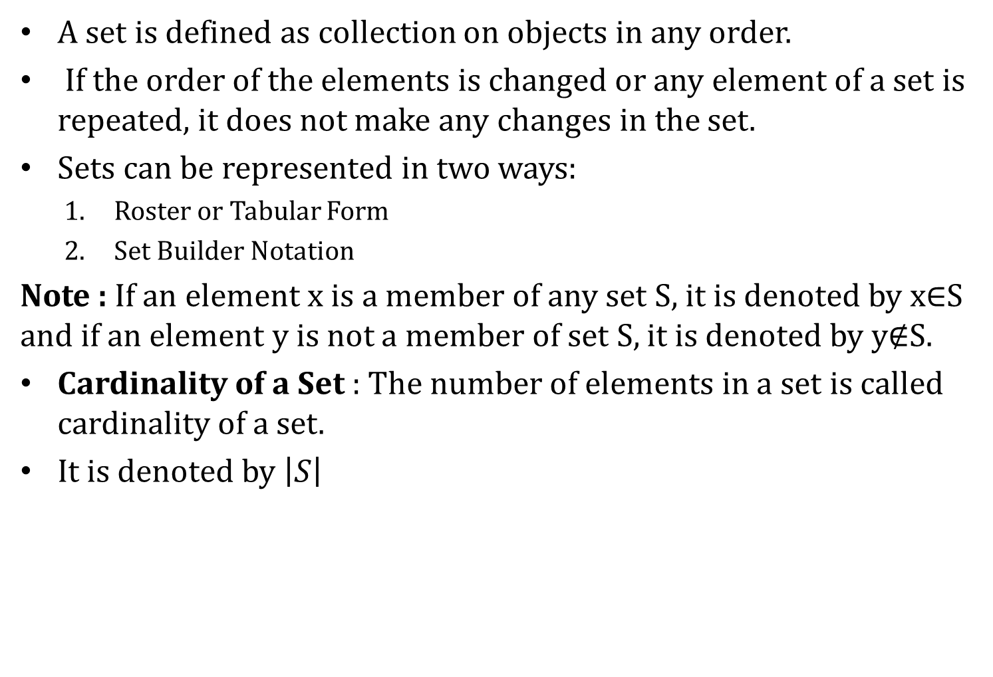
Introduction on Sets
A set is defined as collection on objects in any order.
If the order of the elements is changed or any element of a set is repeated, it does not make any changes in the set.
Sets can be represented in two ways:
Roster or Tabular Form
Set Builder Notation
Note : If an element x is a member of any set S, it is denoted by x$∈$S and if an element y is not a member of set S, it is denoted by y$∉$S.
Cardinality of a Set : The number of elements in a set is called cardinality of a set.
It is denoted by $\left|S\right|$

Slide 10
Introduction on Sets
Types of Sets:
Finite Set
Infinite Set
Subset
Proper Subset
Universal set
Empty or null set
Singleton or Unit set
Equal set
Equivalent set
Overlapping set

Slide 11
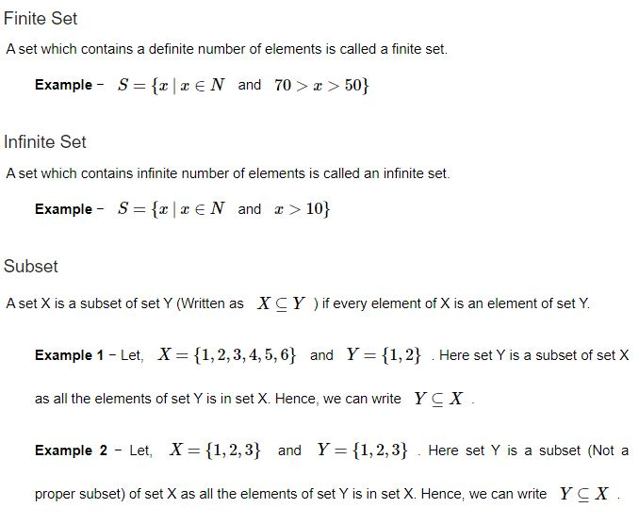
Introduction on Sets
Types of Sets:

Slide 12
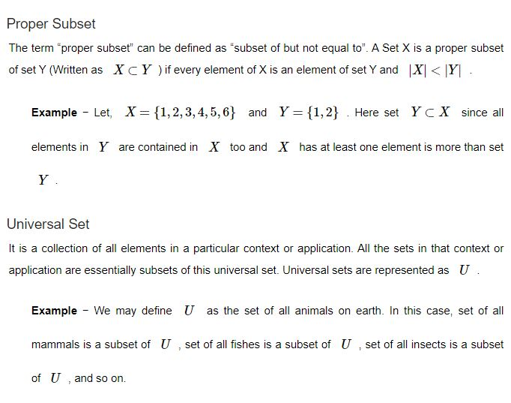
Introduction on Sets
Types of Sets:

Slide 13
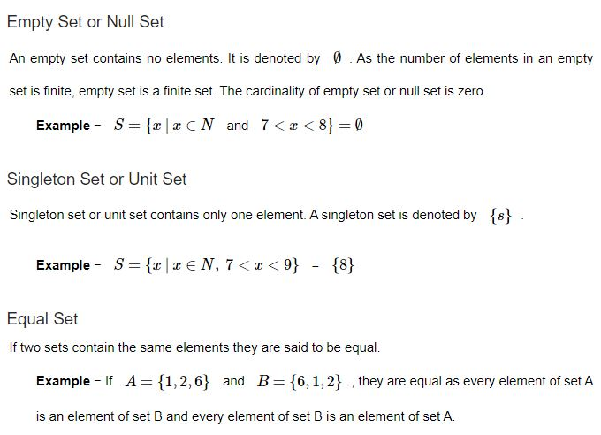
Introduction on Sets
Types of Sets:

Slide 14
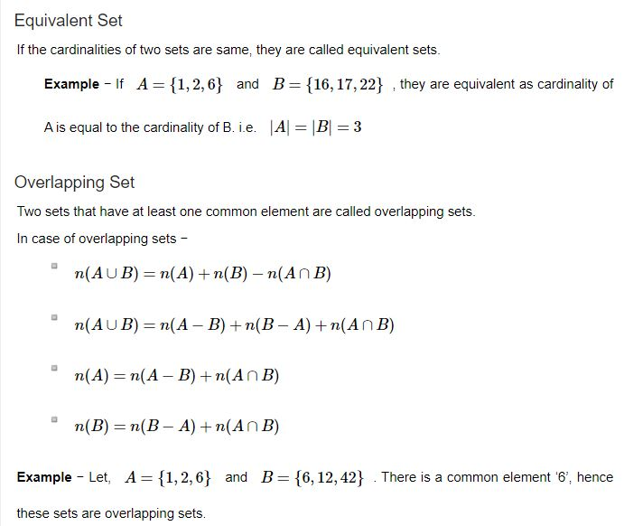
Introduction on Sets
Types of Sets:

Slide 15
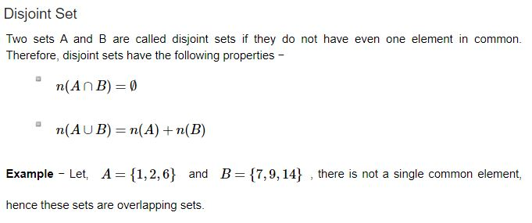
Introduction on Sets
Types of Sets:

Slide 16
Introduction on Sets
Operations on Binary sets:
Union
Intersection
Difference
Complement
Cartesian product

Slide 17
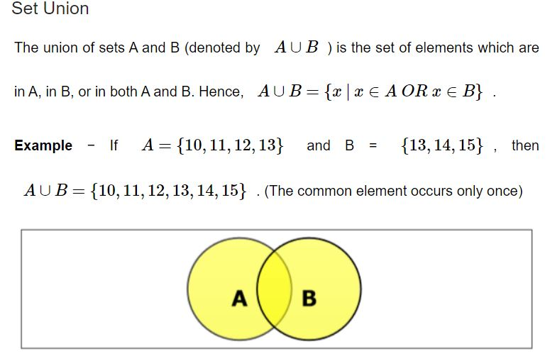
Introduction on Sets
Operations on Binary sets:

Slide 18
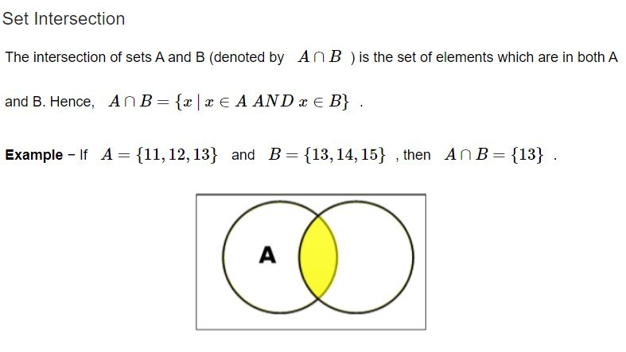
Introduction on Sets
Operations on Binary sets:

Slide 19
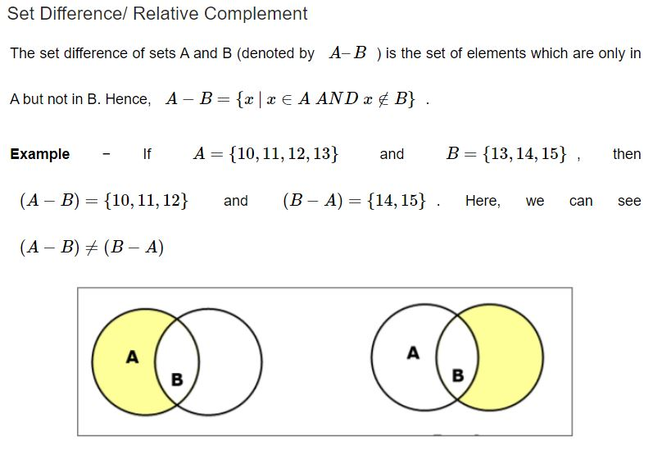
Introduction on Sets
Operations on Binary sets:

Slide 20
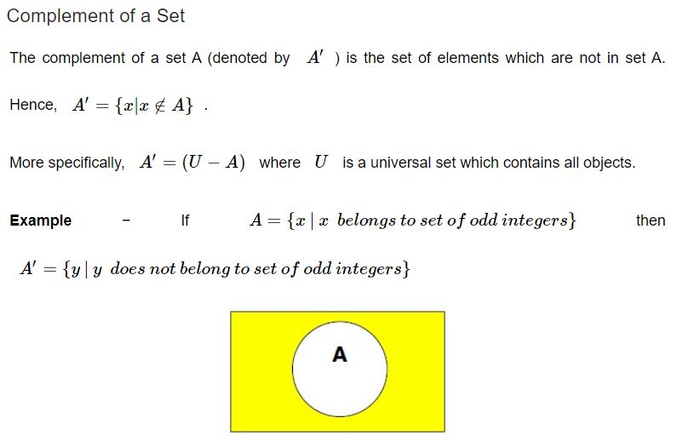
Introduction on Sets
Operations on Binary sets:

Slide 21
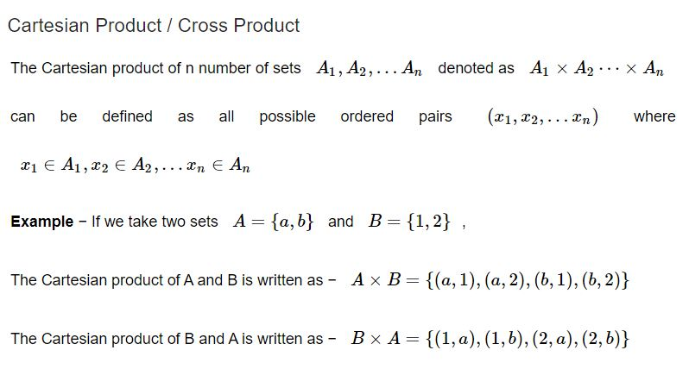
Introduction on Sets
Operations on Binary sets:

Slide 22
Introduction on Sets
Principle of Inclusion and Exclusion:

Slide 23
Introduction on Sets
Principle of Inclusion and Exclusion:

Slide 24
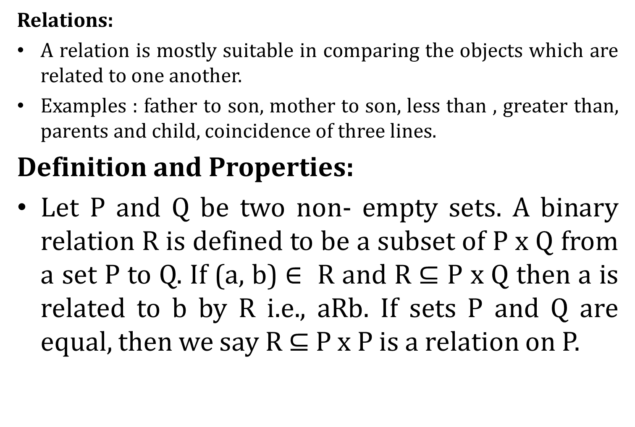
Introduction on Sets
Relations:
A relation is mostly suitable in comparing the objects which are related to one another.
Examples : father to son, mother to son, less than , greater than, parents and child, coincidence of three lines.
Definition and Properties:
Let P and Q be two non- empty sets. A binary relation R is defined to be a subset of P x Q from a set P to Q. If (a, b) $∈$ R and R $⊆$ P x Q then a is related to b by R i.e., aRb. If sets P and Q are equal, then we say R ⊆ P x P is a relation on P.

Slide 25
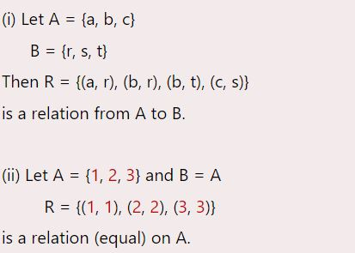
Introduction on Sets
Examples:

Slide 26
Introduction on Sets
Domain and Range of Relation:
The Domain of relation R is the set of elements in P which are related to some elements in Q, or it is the set of all first entries of the ordered pairs in R. It is denoted by DOM (R).
The range of relation R is the set of elements in Q which are related to some element in P, or it is the set of all second entries of the ordered pairs in R. It is denoted by RAN (R).

Slide 27
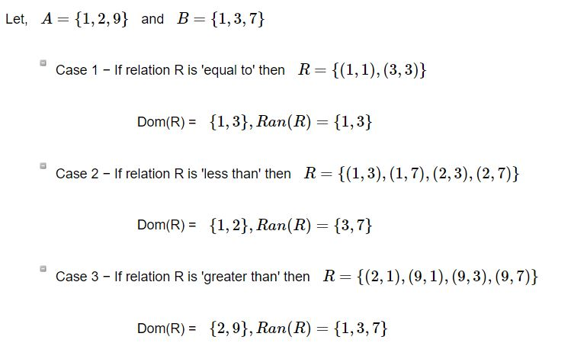
Introduction on Sets
Domain and Range of Relation:

Slide 28


Introduction on Sets
Properties of a binary Relation:
A relation R on set A is called Reflexive if $∀$a $∈$A is related to a (aRa holds).
A relation R on set A is called Irreflexive if no a∈A is related to a (aRa does not hold).
A relation R on set A is called Symmetric if xRy implies yRx, ∀ x ∈ A and ∀y ∈ A.

Slide 29
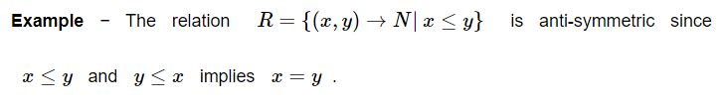
Introduction on Sets
Properties of a binary Relation:
A relation R on set A is called Anti-Symmetric if xRy and yRx implies x=y ∀ x∈ A and ∀y ∈ A.
An asymmetric binary relation is similar to antisymmetric relation. The difference is that an asymmetric relation never has both elements aRb and bRa even if a=b.
Every asymmetric relation is also antisymmetric. The converse is not true. If an antisymmetric relation contains an element of kind (a,a), it cannot be asymmetric. Thus, a binary relation R is asymmetric if and only if it is both antisymmetric and irreflexive.

Slide 30
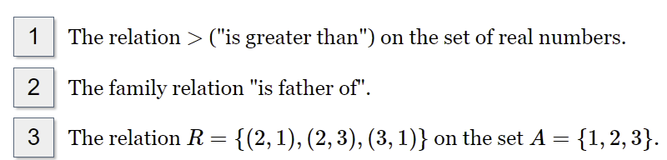

Introduction on Sets
Properties of a binary Relation:
Examples of asymmetric relations:
A relation R on set A is called Transitive if xRy and yRz implies xRz, ∀ x, y, z ∈ A.

Slide 31
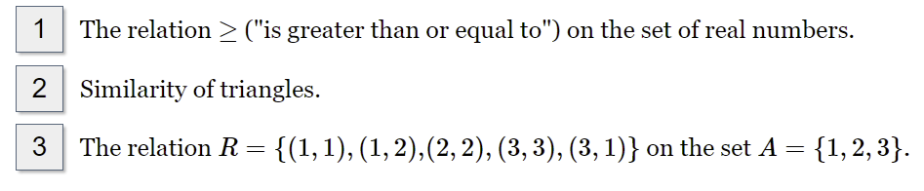
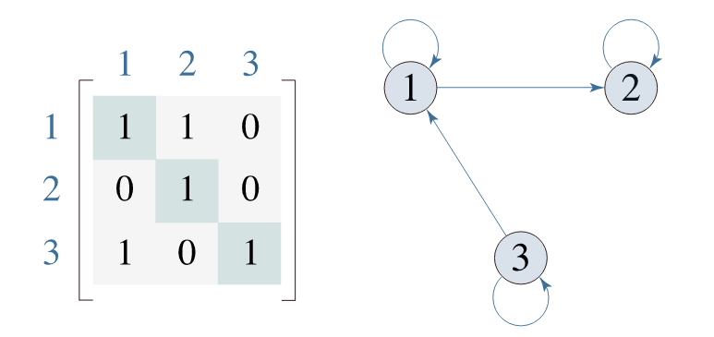
Introduction on Sets
Examples of reflexive relations:

Slide 32
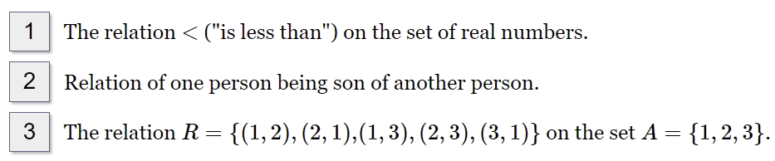
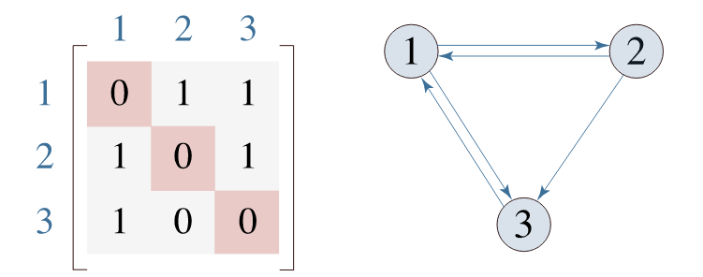
Introduction on Sets
Examples of irreflexive relations:

Slide 33
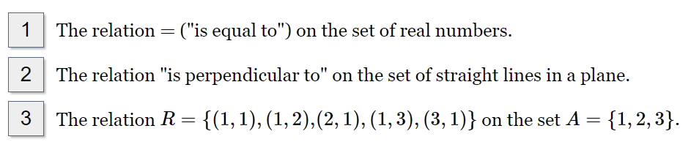
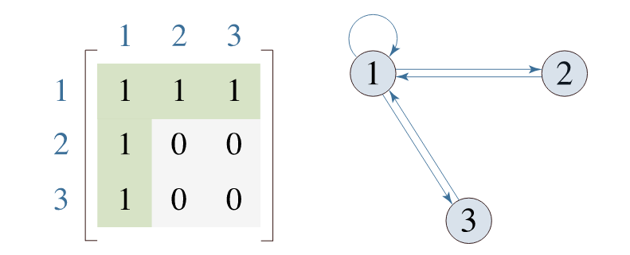
Introduction on Sets
Examples of symmetric relations:

Slide 34
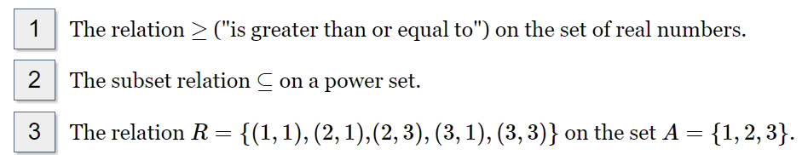
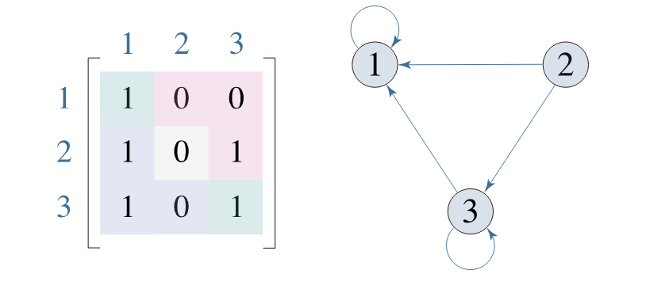
Introduction on Sets
Examples of antisymmetric relations:

Slide 35
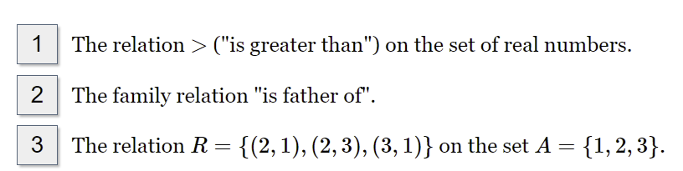
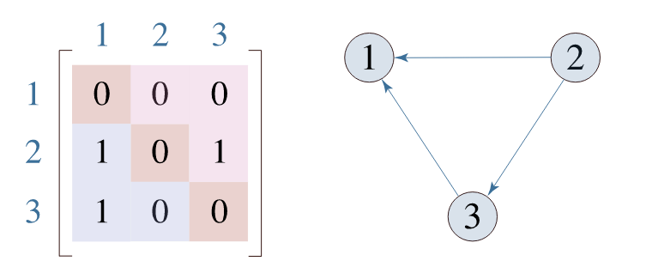
Introduction on Sets
Examples of asymmetric relations:

Slide 36
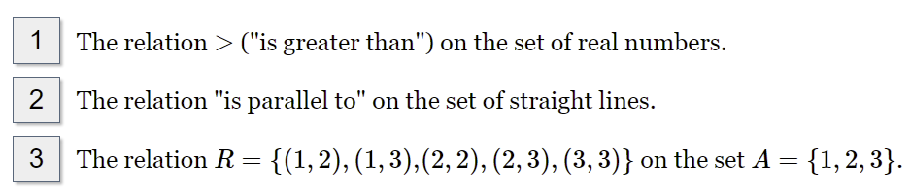
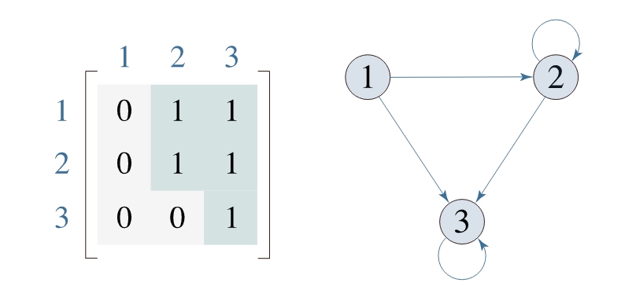
Introduction on Sets
Examples of transitive relations:

Slide 37
Introduction on Sets
Relation matrix and Digraph:
Let P = [a₁,a₂,a₃, . . . a_{m}] and Q = [b₁,b₂,b_{3,} . . . b_{n}] are finite sets, containing m and n number of elements respectively. R is a relation from P to Q. The relation R can be represented by m x n matrix M = [M_{ij}], defined as
M_{ij} = 0 if (a_{i},b_{j}) ∉ R
1 if (a_{i},b_{j} )∈ R
Let P = {1, 2, 3, 4}, Q = {a, b, c, d}
and R = {(1, a), (1, b), (1, c), (2, b), (2, c), (2, d)}.

Slide 38
Introduction on Sets
Relation matrix and Digraph:
The Relation matrix reflects some properties of a relation in a set.
Reflexive = if all diagonal entries is ‘1’.
Irreflexive = if all diagonal entries is ‘0’.
Symmetric = M_{ij} = 1 and M_{ji} = 1 for all i, j i is not equal to j.
Anti-Symmetric = M_{ij} = 1 and M_{ji} = 0 for all i, j i is not equal to j.

Slide 39
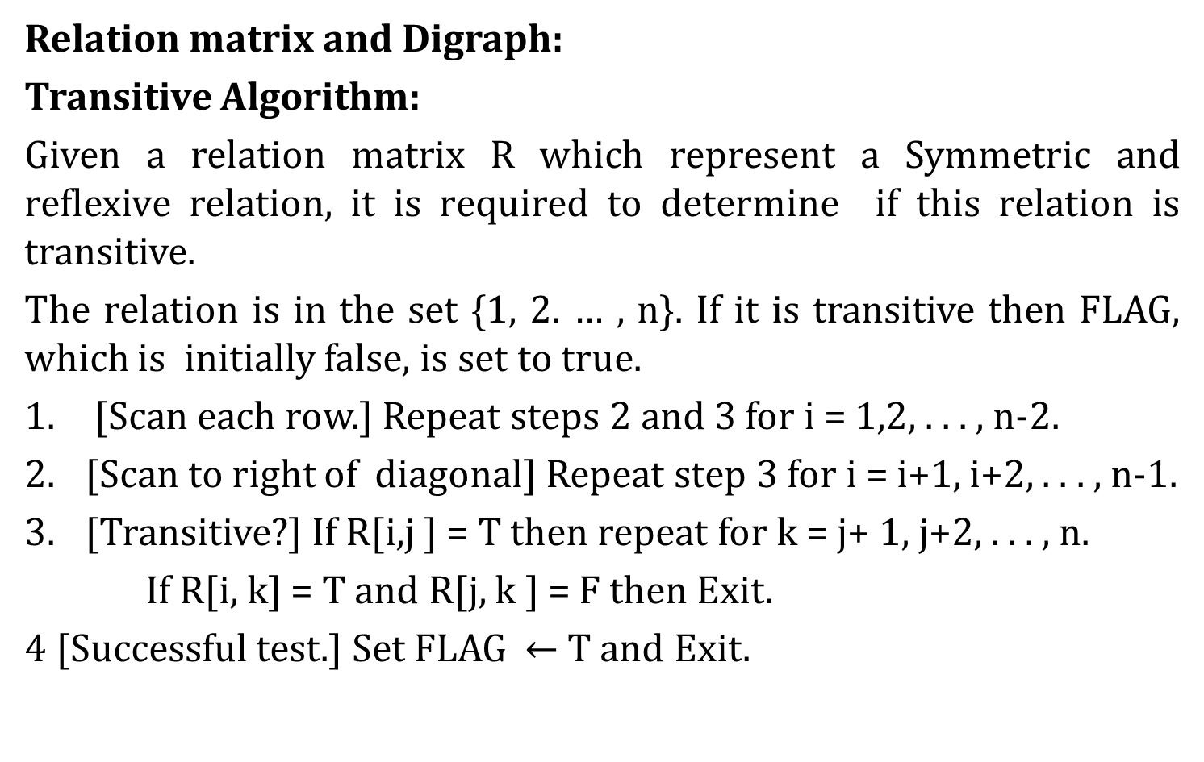
Introduction on Sets
Relation matrix and Digraph:
Transitive Algorithm:
Given a relation matrix R which represent a Symmetric and reflexive relation, it is required to determine if this relation is transitive.
The relation is in the set {1, 2. … , n}. If it is transitive then FLAG, which is initially false, is set to true.
[Scan each row.] Repeat steps 2 and 3 for i = 1,2, . . . , n-2.
[Scan to right of diagonal] Repeat step 3 for i = i+1, i+2, . . . , n-1.
[Transitive?] If R[i,j ] = T then repeat for k = j+ 1, j+2, . . . , n.
If R[i, k] = T and R[j, k ] = F then Exit.
4 [Successful test.] Set FLAG $←$T and Exit.

Slide 40
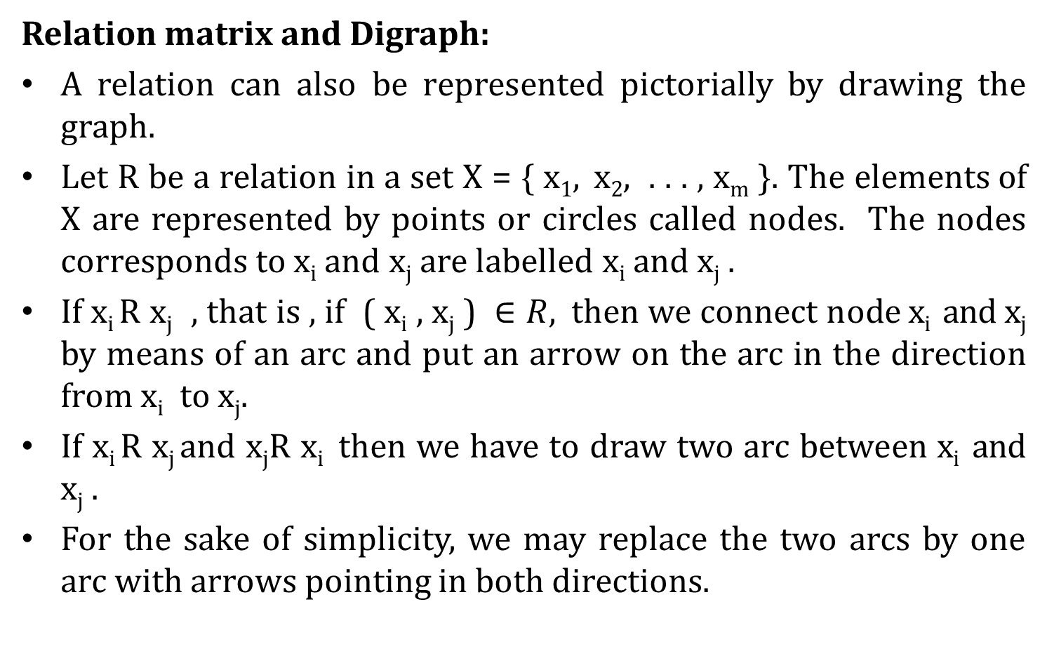
Introduction on Sets
Relation matrix and Digraph:
A relation can also be represented pictorially by drawing the graph.
Let R be a relation in a set X = { x₁, x₂, . . . , x_{m} }. The elements of X are represented by points or circles called nodes. The nodes corresponds to x_{i} and x_{j} are labelled x_{i} and x_{j} .
If x_{i} R x_{j} , that is , if ( x_{i} , x_{j} ) $∈R,$then we connect node x_{i} and x_{j} by means of an arc and put an arrow on the arc in the direction from x_{i} to x_{j}.
If x_{i} R x_{j} and x_{j}R x_{i} then we have to draw two arc between x_{i} and x_{j} .
For the sake of simplicity, we may replace the two arcs by one arc with arrows pointing in both directions.

Slide 41
Introduction on Sets
Relation matrix and Digraph:
From the graph, It is possible to observe some of its properties.
Reflexive: a loop at each node.
Irreflexive: no loop at any node.
Symmetric: if one node is connected to another, then there is return arc from second node to first node.
Transitive: the graph contain loops of the following

Slide 42
Introduction on Sets
Relation matrix and Digraph:
Anti-Symmetric: No direct path exist from one node to another node. Refer the following diagram.
Anti-Symmetric

Slide 43
Introduction on Sets
Relation matrix and Digraph:
Transitive: the graph contain loops of the following
Transitive Relations

Slide 44
Introduction on Sets
Relation matrix and Digraph:
Example 1: Let X = { 1, 2, 3, 4 } and R = { (x, y) | x > y }. Draw the graph of R and also give its matrix. Also specify the type of relation.
Example 2: Determine the properties of the relation given by the following graphs and also write the corresponding relation matrices.

Slide 45
Introduction on Sets
Relation matrix and Digraph:
Example 2: Determine the properties of the relation given by the following graphs and also write the corresponding relation matrices.

Slide 46
Introduction on Sets
Operations on Relations:
Intersection of Relations
Union of Relations
Difference of Relations
Symmetric Difference of Relations
Complement of a Binary Relation
Converse of a Binary Relation

Slide 47
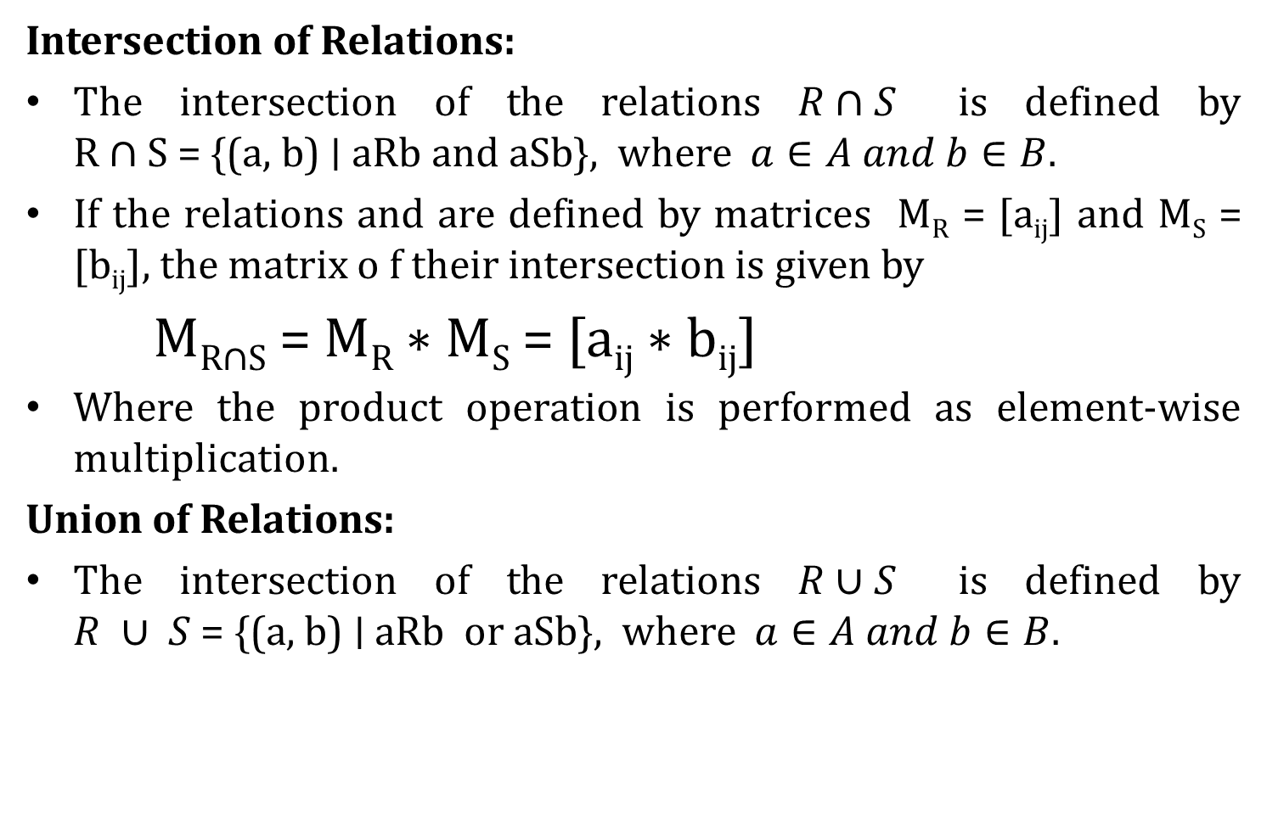
Introduction on Sets
Intersection of Relations:
The intersection of the relations $R∩S$ is defined by R ∩ S = {(a, b) ∣ aRb and aSb}, where $a∈A and b∈B.$
If the relations and are defined by matrices M_{R} = [a_{ij}] and M_{S} = [b_{ij}], the matrix o f their intersection is given by
M_{R∩S} = M_{R} ∗ M_{S} = [a_{ij} ∗ b_{ij}]
Where the product operation is performed as element-wise multiplication.
Union of Relations:
The intersection of the relations $R∪S$ is defined by $R ∪ S$= {(a, b) ∣ aRb or aSb}, where $a∈A and b∈B.$

Slide 48

Introduction on Sets
Union of Relations:
The intersection of the relations $R∪S$ is defined by $R ∪ S$= {(a, b) ∣ aRb or aSb}, where $a∈A and b∈B.$
If the relations R and S are defined by matrices M_{R} = [a_{ij}] and M_{S} = [b_{ij}] the union of the relations is given by the following matrix:

Slide 49
Introduction on Sets
Difference of Relations:

Slide 50
Introduction on Sets
Symmetric Difference of Relations

Slide 51
Introduction on Sets
Complement of a Binary Relation

Slide 52
Introduction on Sets
Converse of a Binary Relation

Slide 53
Introduction on Sets
Other Types of Relations :
Empty, Universal and Identity Relations:

Slide 54
Introduction on Sets
Properties of Combined Relations:

Slide 55

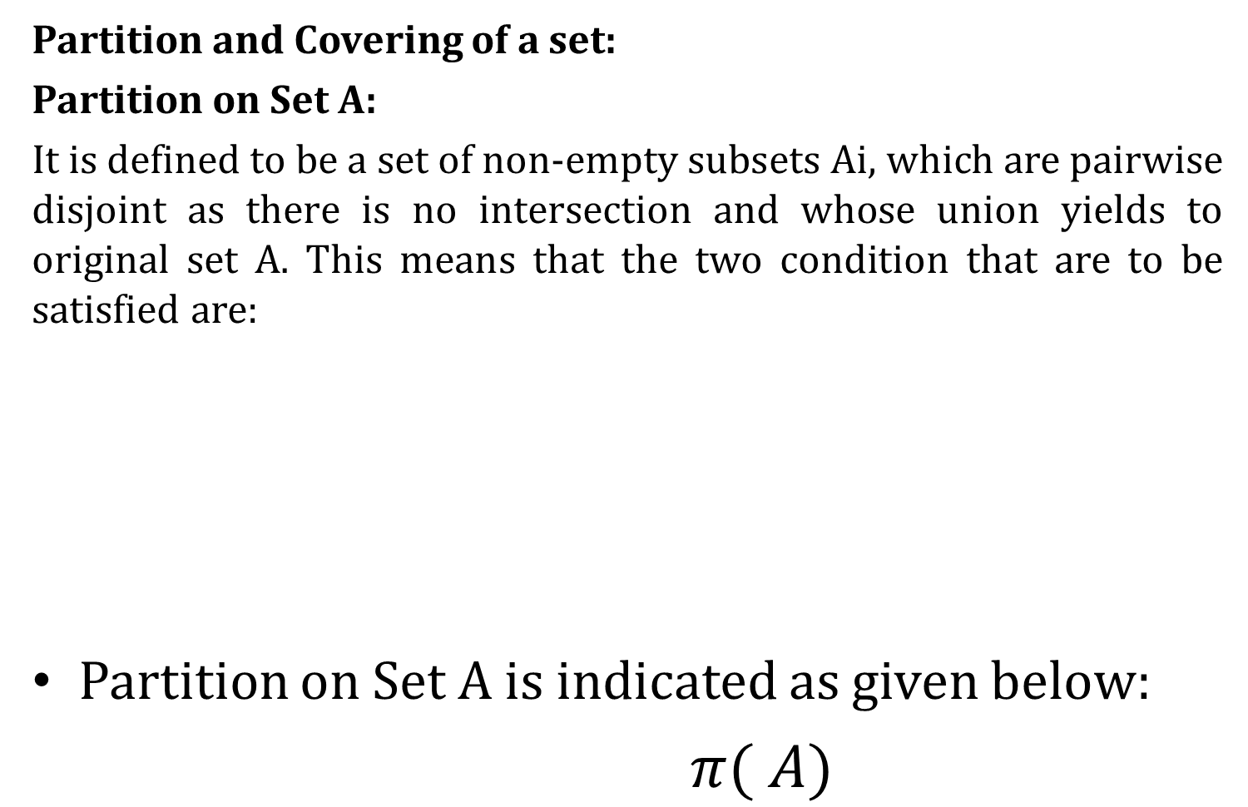
Introduction on Sets
Partition and Covering of a set:
Partition on Set A:
It is defined to be a set of non-empty subsets Ai, which are pairwise disjoint as there is no intersection and whose union yields to original set A. This means that the two condition that are to be satisfied are:
Partition on Set A is indicated as given below:
$π( A)$

Slide 56

Introduction on Sets
Partition and Covering of a set:
Covering on Set A:
It is defined as a set on non-empty subsets A_{i}, whose union leads to the original set A and which are need not be pairwise disjoint. Here are the two conditions that are to be satisfied:

Slide 57
Introduction on Sets
Transitive Closure:
Before to discuss about Transitive closure. Let we discuss first what is closure of a relation.
The closure of a relation R with respect to property P is the relation obtained by adding the minimum number of ordered pairs to R to obtain property P.
In terms of the digraph representation of R:
To find the reflexive closure - add loops
To find the symmetric closure - add arcs in the opposite direction.
To find the transitive closure - if there is a path from a to b, add an arc from a to b.

Slide 58
Introduction on Sets
Transitive Closure:
To find the transitive closure of a relation is equivalent to determining which pairs of vertices in the associated directed graph are connected by a path.
Let R be a relation on a set A. The connectivity relation R∗ consists of the pairs (a, b) such that there is a path of length at least one from a to b in R. Therefore the transitive closure of a relation R equals the connectivity relation R*.

Slide 59
Introduction on Sets
Transitive Closure:

Slide 60
Introduction on Sets
Transitive Closure:
Calculate Transitive Closure of the following digraph.

Slide 61
Introduction on Sets
Transitive Closure:
find the transitive closures of these relations on {1, 2, 3, 4}.

Slide 62
Introduction on Sets
Transitive Closure:
find the transitive closures of these relations on {a, b, c, d, e}.

Slide 63
Introduction on Sets
Equivalence Relation:
A Relation R in a set X is called an equivalence relation if it is reflexive, symmetric and transitive.
Examples:
Equality of numbers on a set of real numbers.
Equality of subsets of a universal set.
Similarity of lines being parallel on a set of lines in a plane.
Similarity of triangles on the set of triangles.
Example 1:
Let X = { 1, 2, 3, 4 } and R = { (1,1), (1,4), (4,1), (4,4), (2,2), (2,3), (3,2), (3,3) } find the relation is equivalence or not.
Example 2:
Let X = { 1, 2, … , 7} and R = { (x, y) | x – y is divisible by 3 } find the relation is equivalence or not.

Slide 64
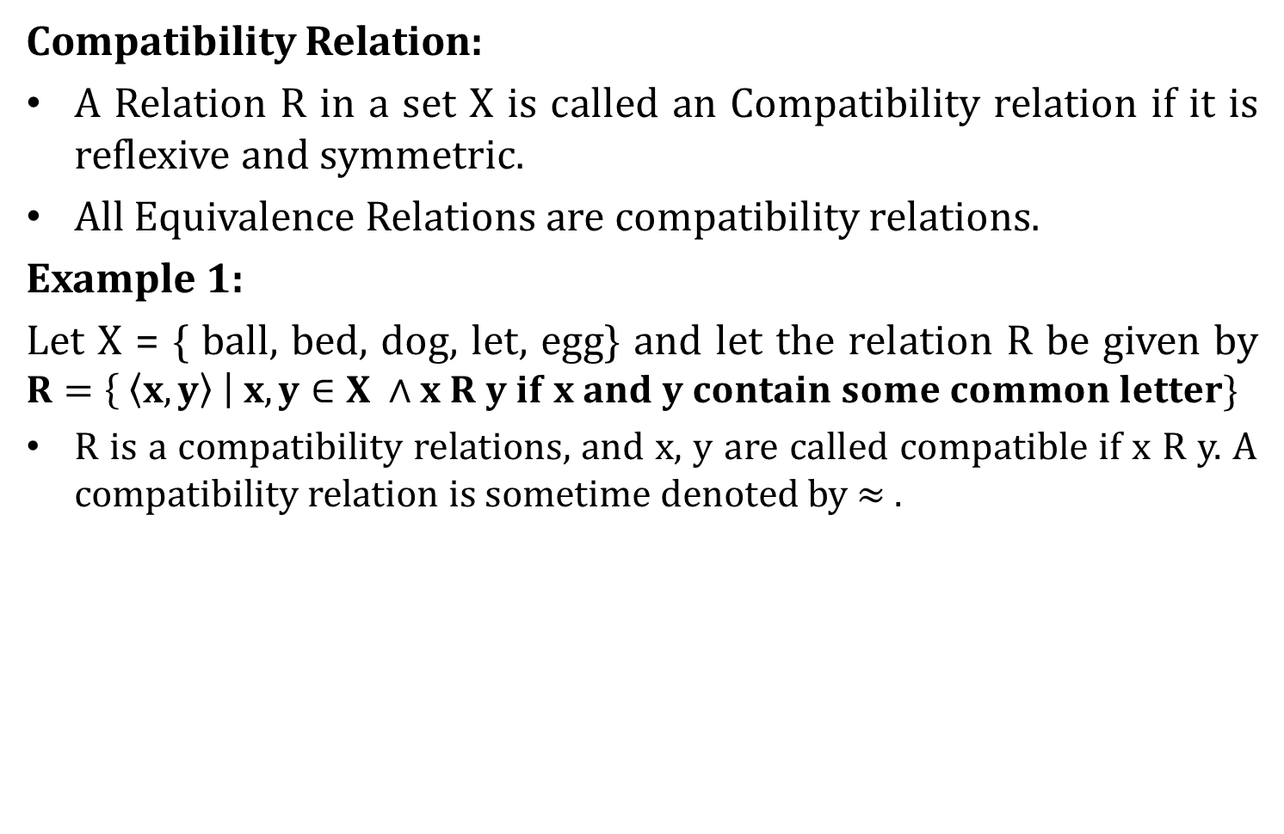
Introduction on Sets
Compatibility Relation:
A Relation R in a set X is called an Compatibility relation if it is reflexive and symmetric.
All Equivalence Relations are compatibility relations.
Example 1:
Let X = { ball, bed, dog, let, egg} and let the relation R be given by $R=\left\{ \left\langle x, y\right\rangle \right| x, y∈X ∧x R y if x and y contain some common letter\}$
R is a compatibility relations, and x, y are called compatible if x R y. A compatibility relation is sometime denoted by $≈ .$

Slide 65
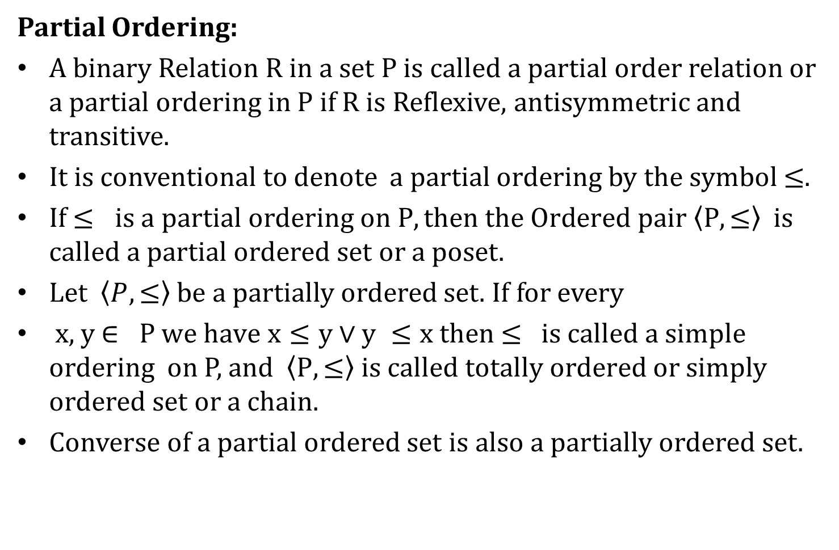
Introduction on Sets
Partial Ordering:
A binary Relation R in a set P is called a partial order relation or a partial ordering in P if R is Reflexive, antisymmetric and transitive.
It is conventional to denote a partial ordering by the symbol $≤.$
If $≤ is a partial ordering on P, then the Ordered pair \left\langle P, ≤\right\rangle$ is called a partial ordered set or a poset.
Let $\left\langle P, ≤\right\rangle$ be a partially ordered set. If for every
x, y $∈ P we have$ $x≤y∨y ≤x then$ ≤ is called a simple ordering on P, and $\left\langle P, ≤\right\rangle is called totally ordered$ or simply ordered set or a chain.
Converse of a partial ordered set is also a partially ordered set.

Slide 66
Introduction on Sets
Partial Ordering:
Examples:
Less than or Equal to, Greater than or equal to
Inclusion
Divides and Integral multiple.
Lexicographic Odering

Slide 67
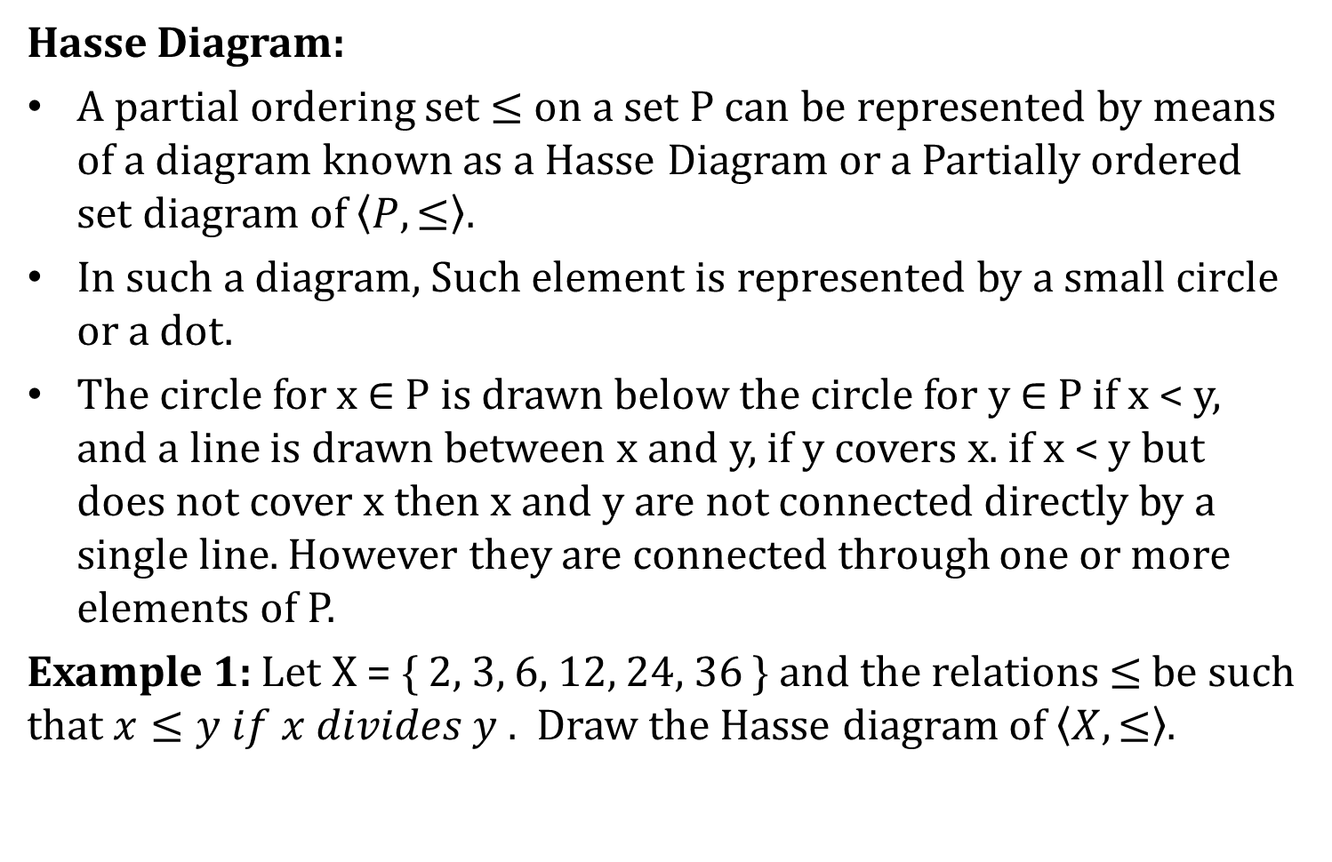
Introduction on Sets
Hasse Diagram:
A partial ordering set $≤$ on a set P can be represented by means of a diagram known as a Hasse Diagram or a Partially ordered set diagram of $\left\langle P, ≤\right\rangle$.
In such a diagram, Such element is represented by a small circle or a dot.
The circle for x $∈$ P is drawn below the circle for y $∈$ P if x < y, and a line is drawn between x and y, if y covers x. if x < y but does not cover x then x and y are not connected directly by a single line. However they are connected through one or more elements of P.
Example 1: Let X = { 2, 3, 6, 12, 24, 36 } and the relations $≤$be such that $x≤y if x divides y .$ Draw the Hasse diagram of $\left\langle X, ≤\right\rangle$.

Slide 68
Introduction on Sets
Hasse Diagram:
Draw the Hasse diagram of the following sets under the partial ordering relation “divides” and indicate those which are totally ordered.
{2, 6, 24} { 3, 5, 15} {1,2,3,6, 12} {2, 4, 8, 16} {3, 9, 27, 54}

Slide 69
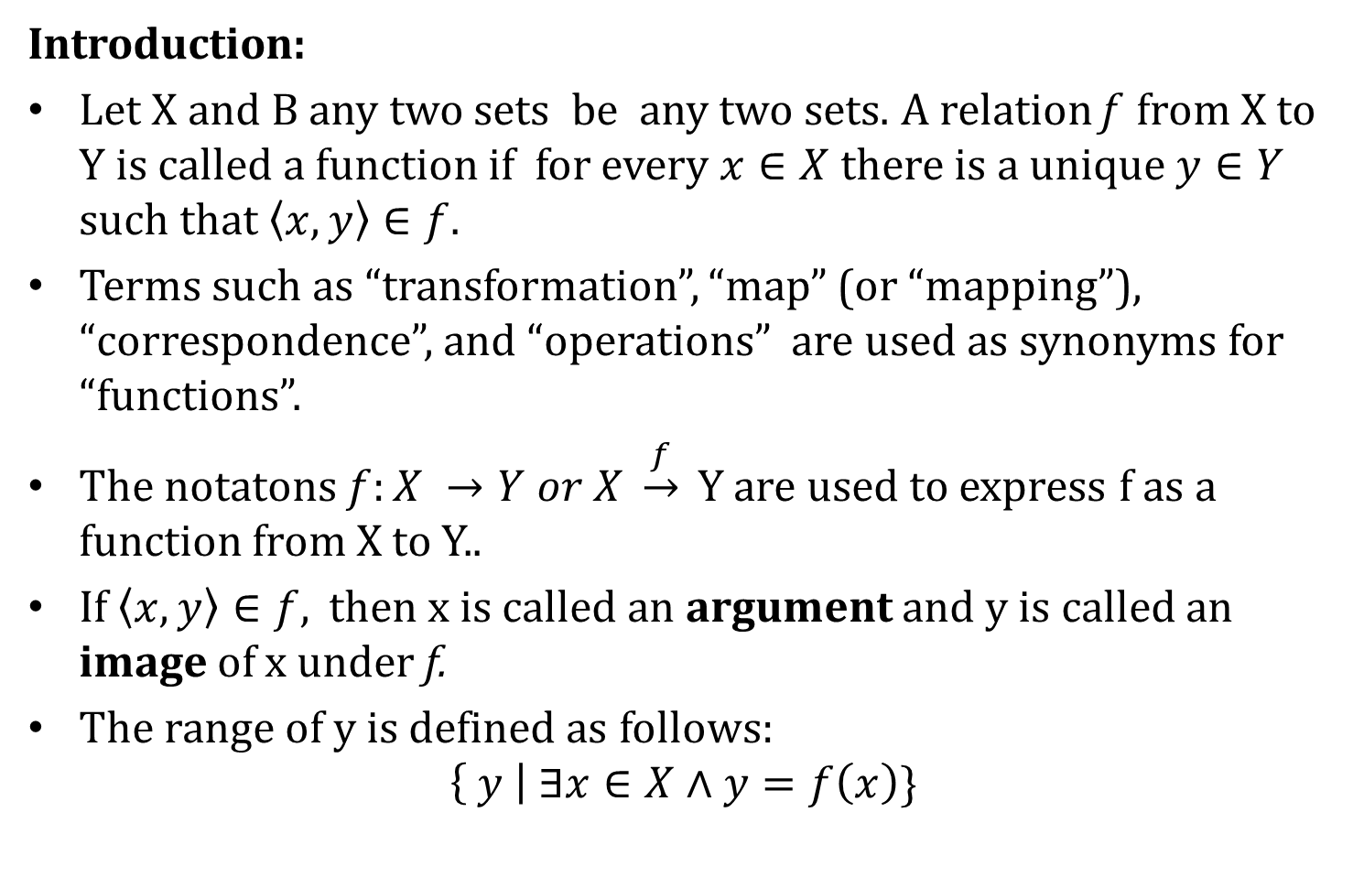
Functions
Introduction:
Let X and B any two sets be any two sets. A relation f from X to Y is called a function if for every $x∈X$ there is a unique $y∈Y$ such that $\left\langle x,y\right\rangle ∈f.$
Terms such as “transformation”, “map” (or “mapping”), “correspondence”, and “operations” are used as synonyms for “functions”.
The notatons $f:X →Y or X \underset{→}{f} Y$are used to express f as a function from X to Y..
If $\left\langle x,y\right\rangle ∈f,$ then x is called an argument and y is called an image of x under f.
The range of y is defined as follows:
$$\left\{ y \right| ∃x∈X∧y=f\left(x\right)\}$$

Slide 70
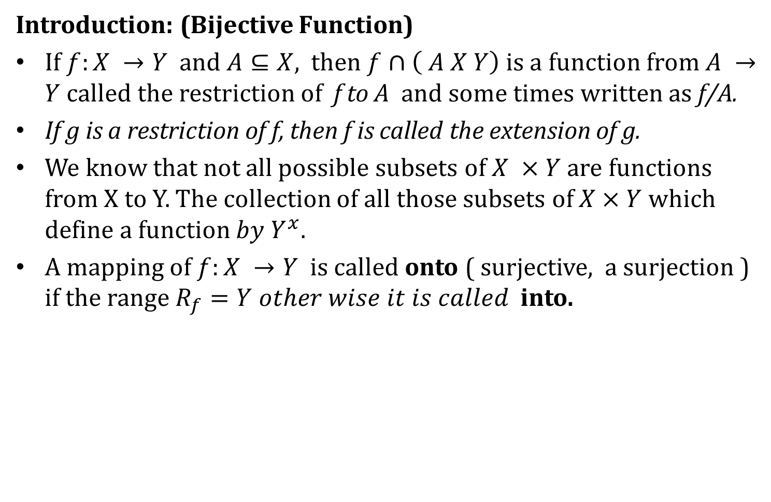
Functions
Introduction: (Bijective Function)
If $f:X →Y$ and $A⊆X,$ then $f∩\left( A X Y\right)$ is a function from $A →Y$called the restriction of f to A and some times written as f/A.
If g is a restriction of f, then f is called the extension of g.
We know that not all possible subsets of $X ×Y$are functions from X to Y. The collection of all those subsets of $X×Y$which define a function $by Y^{x}$.
A mapping of $f:X →Y$ is called onto ( surjective, a surjection ) if the range $R_{f}=Y other wise it is called$ into.

Slide 71

Functions
Introduction:
A mapping $of f:X →Y$is called one-to-one function ( injective , 1-1) if distinct elements of X are mapped into distinct elements of Y.
A mapping $of f:X →Y$is called one-to-one onto function ( bijective) if it is both one-to-one and onto. Such a mapping is also called one-to-one correspondence between X and Y.

Slide 72
Functions
Introduction: Bijective

Slide 73
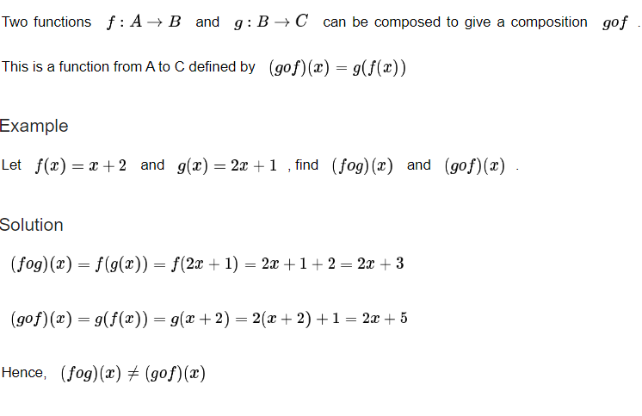
Functions
Composition of functions:

Slide 74
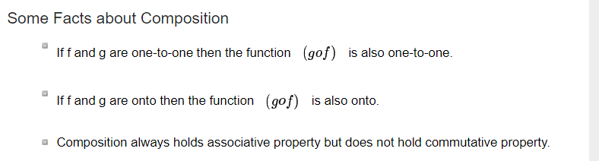
Functions
Composition of functions:

Slide 75
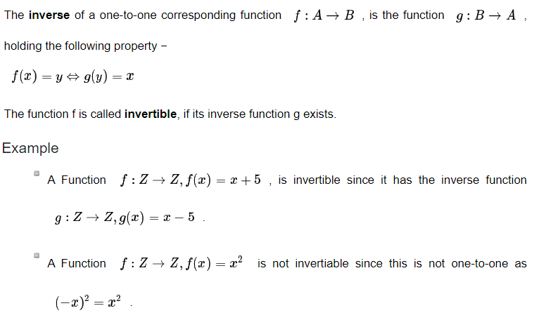
Functions
Inverse Function:

Slide 76
Functions
Recursive functions:
A function is said to be recursively defined if the function definition refers to itself. In order for the definition not to be circular, the function definition must have the following two properties.
There must be certain arguments, called base values, for which the function does not refer to itself.
Each time the function does refer to itself, the argument of the function must be closer to a base value.

Slide 77
Functions
Recursive functions:
Factorial Function

Slide 78
Functions
Permutation Function:
A Bijection from a Set A to itself is called a permutation of A

Slide 79
Functions
Permutation Function:
A Bijection from a Set A to itself is called a permutation of A

Slide 80
Functions
Permutation Function:
A Bijection from a Set A to itself is called a permutation of A

Slide 81
Functions
Permutation Function:
Cycle Permutation

Slide 82
Functions
Permutation Function:
Cycle Permutation

Slide 83
Functions
Permutation Function:
Cycle Permutation

Slide 84
Functions
Permutation Function:
Note: Two cycles of a set A are said to be disjoint if no element of A appears in both cycles.

Slide 85
Functions
Permutation Function:

Slide 86
Functions
Permutation Function:

Slide 87
Functions
Permutation Function:

Slide 88
Functions
Permutation Function:

Slide 89
Functions
Permutation Function:

Slide 90
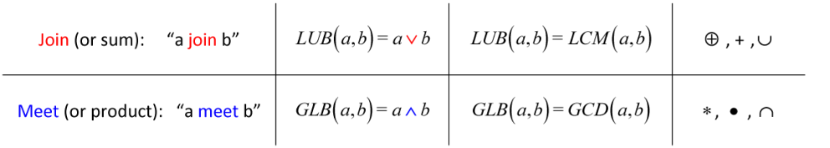
Functions
Lattice and its properties:
Formally, a lattice is a poset, a partially ordered set, in which every pair of elements has both a least upper bound and a greatest lower bound. In other words, it is a structure with two binary operations: Join, Meet

Slide 91
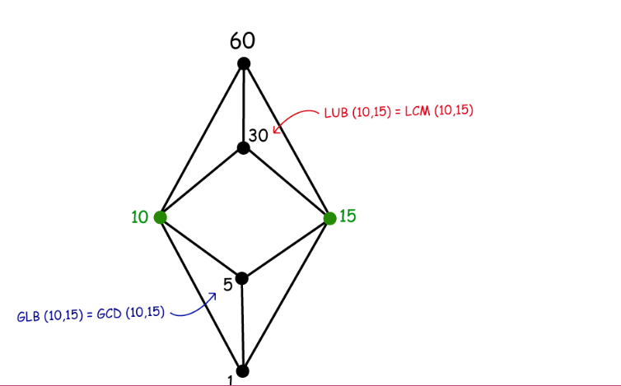
Functions
Lattice and its properties:

Slide 92
Functions
Lattice and its properties:
It is important to note that not all partially ordered sets are lattices. So, how do we determine whether or not a poset is a lattice?
There are three ways we can show that a poset is or is not a lattice:
Construct a table for each pair of elements and confirm that each pair has a LUB and GLB.
Use the “join and “meet method for each pair of elements.
Draw a Hasse diagram and look for comparability.

Slide 93
Functions
Lattice and its properties:
Moreover, several types of lattices are worth noting:
Complete Lattice – all subsets of a poset have a join and meet, such as the divisibility relation for the natural numbers or the power set with the subset relation.
Bounded Lattice – if the lattice has a least and greatest element, denoted 0 and 1 respectively.
Complemented Lattice – a bounded lattice in which every element is complemented. Namely, the complement of 1 is 0, and the complement of 0 is 1.
Distributive Lattice – if for all elements in the poset the distributive property holds.
Boolean Lattice – a complemented distributive lattice, such as the power set with the subset relation.

Slide 94
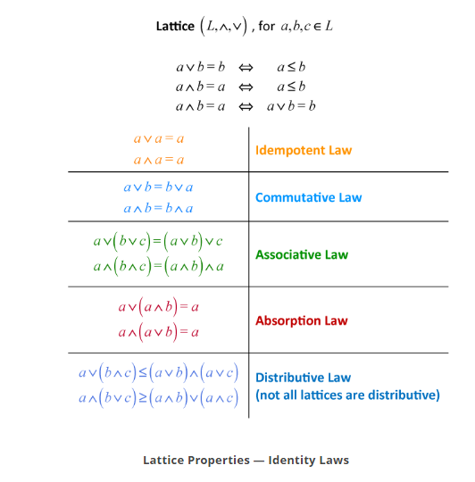
Functions
Lattice and its properties:

